Slide 1
“Brotherly Kindness, Too.”
John Staiger
For Morningside Church of Christ
Sunday 29 March 2020
PM Sermon
Broadcast live at 6pm on Facebook from 16 McClintock Road, Massey, Auckland.

Slide 2
Brotherly Kindness, Too

Slide 3
Add
Brotherly Kindness
2 Peter 1:5-7

Slide 4

‘Brotherly Love’ in Bible Greek: “Philadelpheia”
‘Phileo’—Love & ‘Adelphos’—Brother

Slide 5
Philadelpheia Never Sleeps...
Hebrews 13:1
“Let love of the brethren continue.” (NASB)
Brotherly love must be kept alive and active—
Fuelled to continue:
  Takes time spent
  Takes needs met
  Takes patience invested
  Takes a desire IN YOU that everyone do well in the Lord—This is a given!

Slide 6
Philadelpheia Never Sleeps...
Hebrews 13:1
“Let love of the brethren continue.” (NASB)
Brotherly love must be kept alive and active—
Fuelled to continue:
  Takes time spent
  Takes needs met
  Takes patience invested
  Takes a desire IN YOU that everyone do well in the Lord—This is a given!

Slide 7
Philadelpheia Never Sleeps...
Hebrews 13:1
“Let love of the brethren continue.” (NASB)
Brotherly love must be kept alive and active—
Fuelled to continue:
  Takes time spent
  Takes needs met
  Takes patience invested
  Takes a desire IN YOU that everyone do well in the Lord—This is a given!

Slide 8
Philadelpheia Never Sleeps...
Hebrews 13:1
“Let love of the brethren continue.” (NASB)
Brotherly love must be kept alive and active—
Fuelled to continue:
  Takes time spent
  Takes needs met
  Takes patience invested
  Takes a desire IN YOU that everyone do well in the Lord—This is a given!

Slide 9
Philadelpheia Never Sleeps...
Hebrews 13:1
“Let love of the brethren continue.” (NASB)
Brotherly love must be kept alive and active—
Fuelled to continue:
  Takes time spent
  Takes needs met
  Takes patience invested
  Takes a desire IN YOU that everyone do well in the Lord—This is a given!

Slide 10
Philadelpheia Never Sleeps...
Hebrews 13:1
“Let love of the brethren continue.” (NASB)
Brotherly love must be kept alive and active—
Fuelled to continue:
  Takes time spent
  Takes needs met
  Takes patience invested
  Takes a desire IN YOU that everyone do well in the Lord—This is a given!

Slide 11

Philadelpheia goes with you everywhere.
Romans 12:10—¹⁰Be devoted to one another in brotherly love; give preference to one another in honour; (NASB)
It’s easy to be dismissive—
A shrug of the shoulders
This is the stuff of people who want to be liked by everyone.
How much love did Jesus show his enemies by destroying their businesses at the temple?

Slide 12
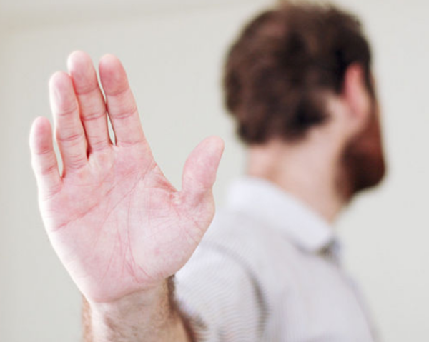
Philadelpheia goes with you everywhere.
Romans 12:10—¹⁰Be devoted to one another in brotherly love; give preference to one another in honour; (NASB)
It’s easy to be dismissive—
A shrug of the shoulders or waving you off.
They say…

Slide 13
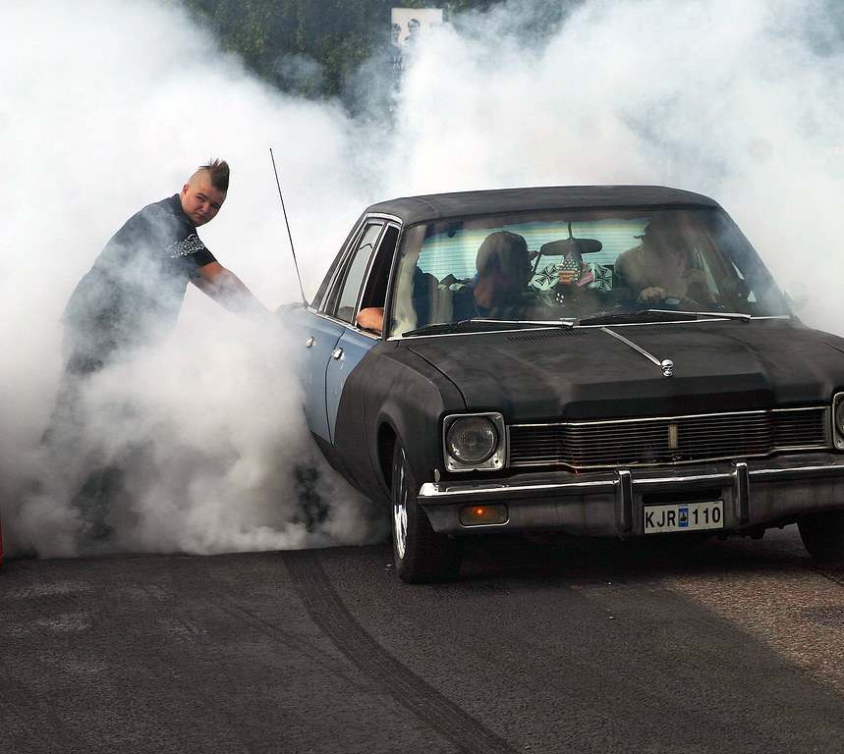
Philadelpheia goes with you everywhere.
Romans 12:10—¹⁰Be devoted to one another in brotherly love; give preference to one another in honour; (NASB)
It’s easy to be dismissive—
They say:
First meet my:
    Neighbours
    Workmates
    Flatmates
    Relatives
They say…

Slide 14
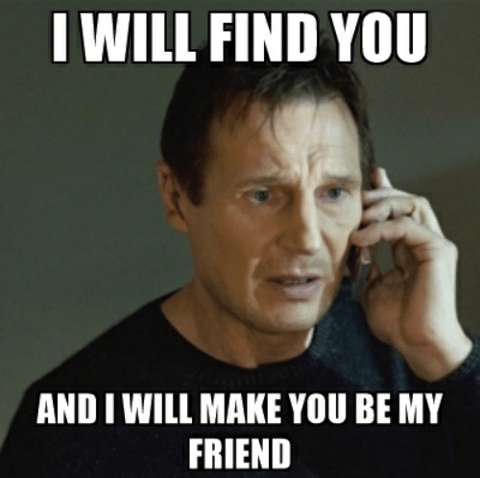
Philadelpheia goes with you everywhere.
Romans 12:10—¹⁰Be devoted to one another in brotherly love; give preference to one another in honour; (NASB)
It’s easy to be dismissive—
This is the stuff of people who want to be liked by everyone.
  They’re needy
  Willing to put up with anything
  No self-respect
They say…

Slide 15
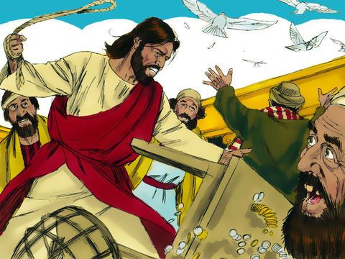
Philadelpheia goes with you everywhere.
Romans 12:10—¹⁰Be devoted to one another in brotherly love; give preference to one another in honour; (NASB)
It’s easy to be dismissive—
How much love did Jesus show those guys by destroying their businesses at the temple?
  Trying to make a dollar
  Who doesn’t profit from religion?
  MYOB
They say…

Slide 16
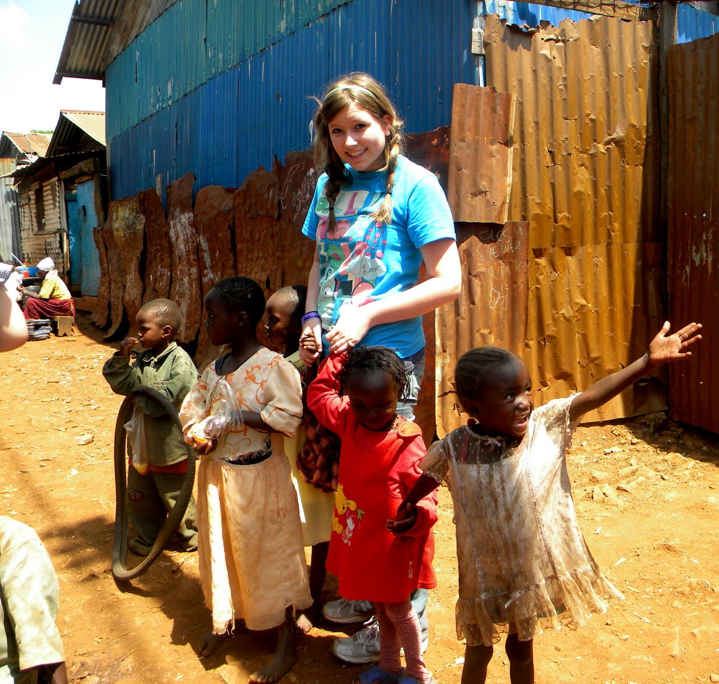
Philadelpheia goes with you everywhere.
Romans 12:10—¹⁰Be devoted to one another in brotherly love; give preference to one another in honour; (NASB)
Easily dismissed as—
The work of Millennials on short-term mission trips.
  You want to see the photos?
  Doesn’t Jesus talk about helping foreigners, somewhere?
More than meets the eye…

Slide 17

Philadelpheia goes with you everywhere.
Romans 12:10—¹⁰Be devoted to one another in brotherly love; give preference to one another in honour; (NASB)
Don’t kid yourself—
There are people in your life who are devoted to you and give you preference despite:
  Your sins
  Your habits
  Your prejudices
  Your funny ways…
And what beneath the surface

Slide 18
Philadelpheia goes with you everywhere.
Romans 12:10—¹⁰Be devoted to one another in brotherly love; give preference to one another in honour; (NASB)
Don’t kid yourself—
There are people in your life who are devoted to you and give you preference despite:
  Your sins
  Your habits
  Your prejudices
  Your funny ways…
And what beneath the surface

Slide 19
Philadelpheia goes with you everywhere.
Romans 12:10—¹⁰Be devoted to one another in brotherly love; give preference to one another in honour; (NASB)
Don’t kid yourself—
There are people in your life who are devoted to you and give you preference despite:
  Your sins
  Your habits
  Your prejudices
  Your funny ways…
And what beneath the surface

Slide 20
Philadelpheia goes with you everywhere.
Romans 12:10—¹⁰Be devoted to one another in brotherly love; give preference to one another in honour; (NASB)
Don’t kid yourself—
There are people in your life who are devoted to you and give you preference despite:
  Your sins
  Your habits
  Your prejudices
  Your funny ways…
And what beneath the surface

Slide 21
Philadelpheia goes with you everywhere.
Romans 12:10—¹⁰Be devoted to one another in brotherly love; give preference to one another in honour; (NASB)
Don’t kid yourself—
There are people in your life who are devoted to you and give you preference despite:
  Your sins
  Your habits
  Your prejudices
  Your funny ways…
And what beneath the surface

Slide 22
Philadelpheia goes with you everywhere.
Romans 12:10—¹⁰Be devoted to one another in brotherly love; give preference to one another in honour; (NASB)
Don’t kid yourself—
There are people in your life who are devoted to you and give you preference despite:
  Your sins
  Your habits
  Your prejudices
  Your funny ways…
And what beneath the surface

Slide 23
Philadelpheia goes with you everywhere.
Romans 12:10—¹⁰Be devoted to one another in brotherly love; give preference to one another in honour; (NASB)
Don’t kid yourself—
There are people in your life who are devoted to you and give you preference despite:
  Your sins
  Your habits
  Your prejudices
  Your funny ways…
And that which is beneath the surface (1Pet.1:22)

Slide 24
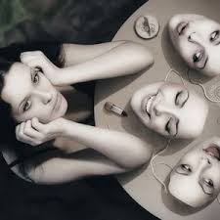
Philadelpheia—Taking off the Mask.
1 Peter 1:22—²² Now that you have purified yourselves by obeying the truth so that you have sincere love for each other, love one another deeply, from the heart.
Let God’s Word cleanse us from all pretence?—
Obedience purifies
  What is left is worth sharing
  What is left is ‘Sincere’ Brotherly love
  What is left is a deep appreciation of God’s love for us.

Slide 25
Philadelpheia—Taking off the Mask.
1 Peter 1:22—²² Now that you have purified yourselves by obeying the truth so that you have sincere love for each other, love one another deeply, from the heart.
Let God’s Word cleanse us from all pretence?—
Obedience purifies
  What is left is worth sharing
  What is left is ‘Sincere’ Brotherly love
  What is left is a deep appreciation of God’s love for us.

Slide 26
Philadelpheia—Taking off the Mask.
1 Peter 1:22—²² Now that you have purified yourselves by obeying the truth so that you have sincere love for each other, love one another deeply, from the heart.
Let God’s Word cleanse us from all pretence?—
Obedience purifies
  What is left is worth sharing
  What is left is ‘Sincere’ Brotherly love
  What is left is a deep appreciation of God’s love for us.

Slide 27
Philadelpheia—Taking off the Mask.
1 Peter 1:22—²² Now that you have purified yourselves by obeying the truth so that you have sincere love for each other, love one another deeply, from the heart.
Let God’s Word cleanse us from all pretence?—
Obedience purifies
  What is left is worth sharing
  What is left is ‘Sincere’ Brotherly love
  What is left is a deep appreciation of God’s love for us.

Slide 28
Philadelpheia—Taking off the Mask.
1 Peter 1:22—²² Now that you have purified yourselves by obeying the truth so that you have sincere love for each other, love one another deeply, from the heart.
Let God’s Word cleanse us from all pretence?—
Obedience purifies
  What is left is worth sharing
  What is left is ‘Sincere’ Brotherly love
  What is left is a deep appreciation of God’s love for us.

Slide 29
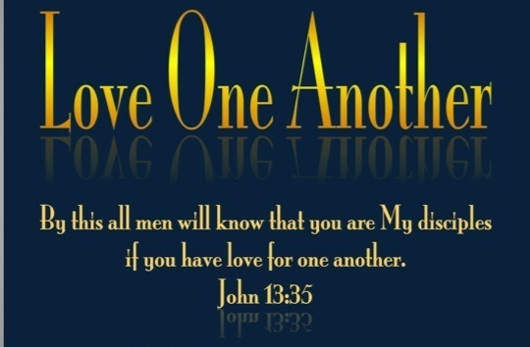
Philadelpheia Virtue
1 Peter 3:8—⁸ Finally, all of you, be like-minded, be sympathetic, love one another, be compassionate and humble.

Slide 30
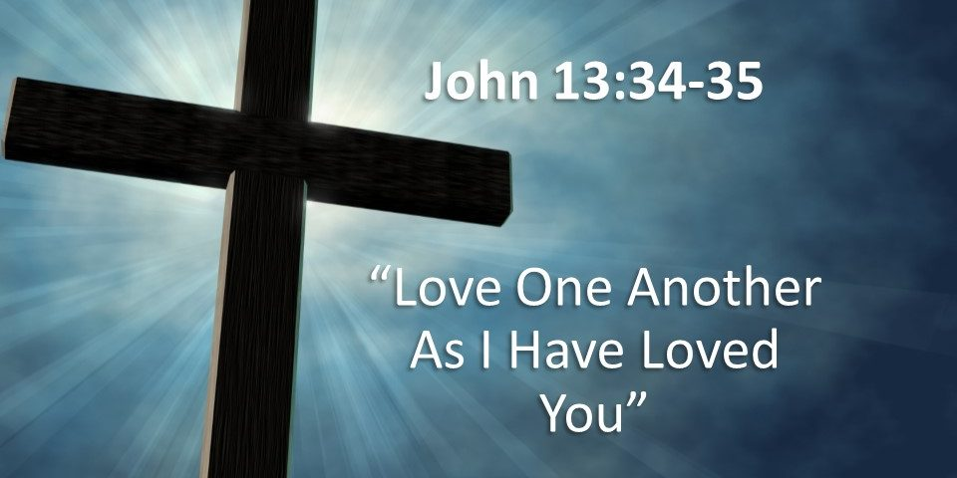
Philadelpheia Takes Action
“But whoever has this world’s goods, and sees his brother in need, and shuts up his heart from him, how does the love of God abide in him? My little children, let us not love in word or in tongue, but in deed and in truth” (1 John 3:17,18).
Rather than just sitting on the side-line or just talking and making suggestions about what should be done…

