Slide 1
“The God Who Provides.”
John Staiger
For Morningside Church of Christ
Sunday 29 March 2020
AM Sermon
Broadcast live at 11am on Facebook from 16 McClintock Road, Massey, Auckland.

Slide 2
“The God Who Provides.”

Slide 3
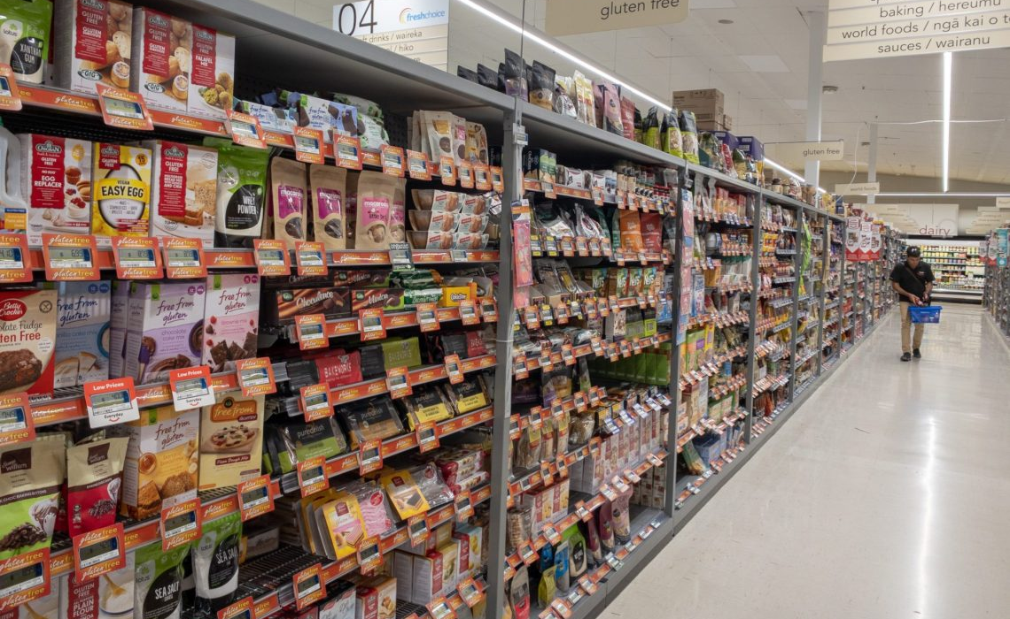
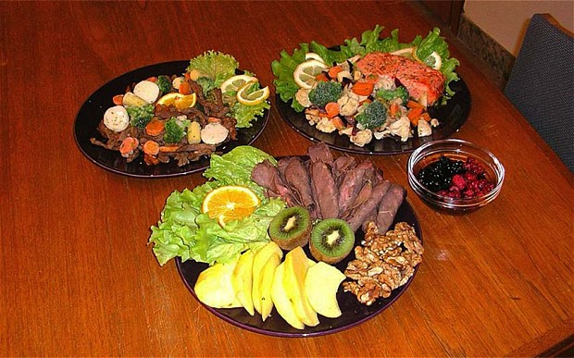
Business as usual…
We live in a land of plenty.
Can this change?
Who Knows?

Slide 4
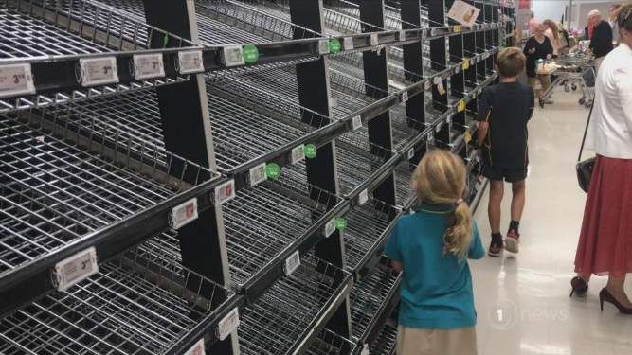

As things are today…
Providing for your needs in a time of Hoarding,
Lock-Down,
Long Queues
and Empty shelves

Slide 5



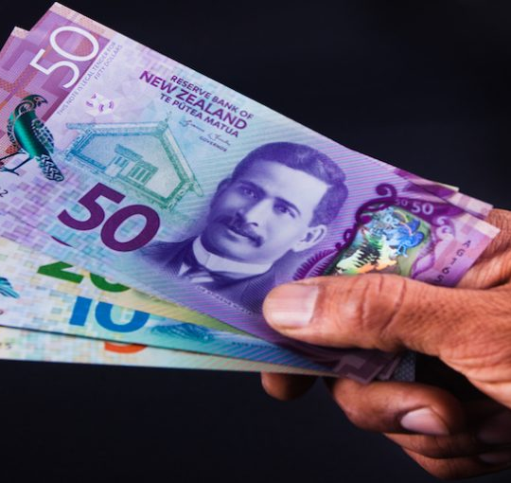
24 days from now…
The Lock-Down will be over (we pray) and things will return to ‘normal.’

Slide 6
Time to ponder…
We think in terms of what we don’t have…

Slide 7
Time to ponder…
We treat what we have as background or a landscape on which to put more things.

Slide 8
Time to ponder…
What we don’t always accept is that what we don’t have is where our heart abides.

Slide 9

Time to ponder…
What we have is diminished by what we don’t have.

Slide 10
Time to ponder…
Without it we feel deprived.
Never satisfied.

Slide 11

Time to ponder…
Instead of looking at all that God has provided.

Slide 12

Daily Provisions
When is enough…enough?
For some of us—
NEVER!

Slide 13
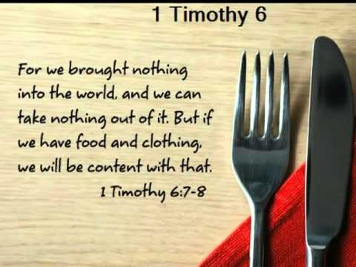
Daily Provisions
When is enough…enough?
For some of us—
NOW.

Slide 14
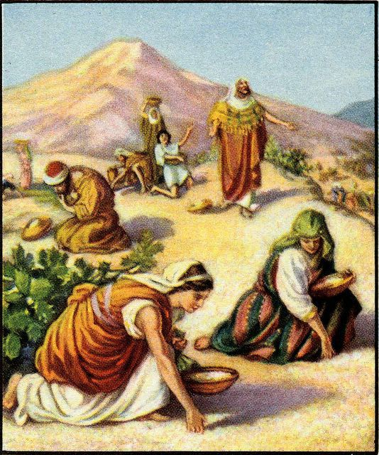
Daily Provisions
Then
God gave the Israelites
DAILY BREAD—Mana (Exodus 16)
…and 6 days a week they collected enough to live on.

Slide 15
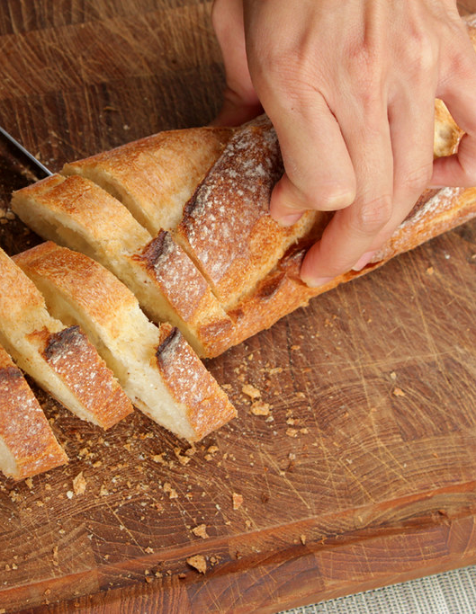
Daily Provisions
Now
Jesus calls us to prayer:
“Give us this day our
DAILY BREAD.” (Matthew 6:11)

Slide 16
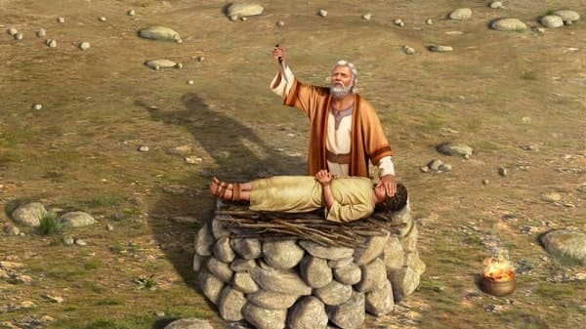
Jehovah-jireh:
"the LORD will see to it"
Genesis 22
Abraham was tested
Told to sacrifice Isaac
Before they went up the mountain, Isaac said to his father, “Where is the lamb for the burnt offering?” (Genesis 22:7).

Slide 17
Jehovah-jireh:
"the LORD will see to it"
Abraham answered, “God will provide for Himself the lamb for the burnt offering, my son.” (Genesis 22:8)

Slide 18
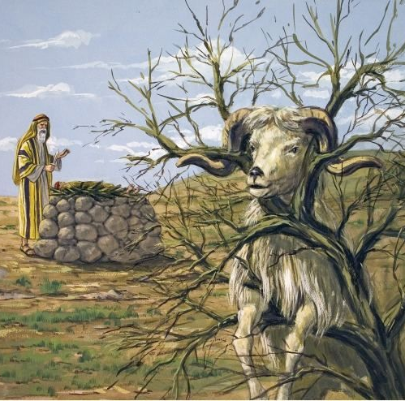
Jehovah-jireh:
"the LORD will see to it"
And when God had shown Abraham a ram caught in the thorns…
Genesis 22:14—¹⁴And Abraham called the name of that place Jehovahjireh: as it is said to this day, In the mount of the Lord it shall be seen. (KJV)

Slide 19
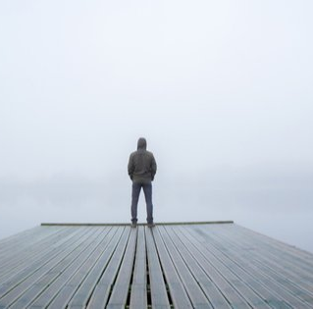
Jehovah-jireh:
"the LORD will see to it"
What God ‘sees’ He ‘SEES TO.’
Not a passive observer, but an active PROVIDER.
His seeing is with a view to DOING
God never sees without ACTING.
General Providence…

Slide 20
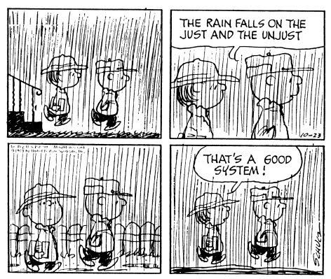
Jehovah-jireh:
"the LORD will see to it"
General Providence…
Matthew 5:45—
⁴⁵so that you may be sons of your Father who is in heaven. For he makes his sun rise on the evil and on the good, and sends rain on the just and on the unjust. (ESV)

Slide 21
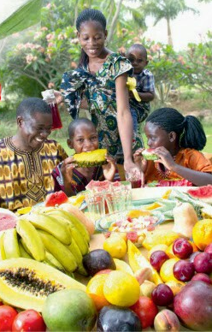
Jehovah-jireh:
"the LORD will see to it"
General Providence…
Acts 14:17—
¹⁷Yet he did not leave himself without witness, for he did good by giving you rains from heaven and fruitful seasons, satisfying your hearts with food and gladness.” (ESV)

Slide 22
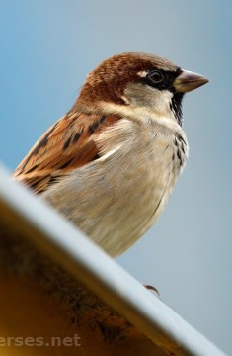
Jehovah-jireh:
"the LORD will see to it"
General Providence…
Matthew 10:29—
“Are not two sparrows sold for a cent? And yet not one of them will fall to the ground apart from your Father.”

Slide 23
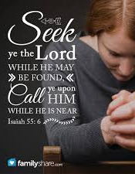
Special Providence…
Matthew 6:33—
³³ But seek first His kingdom and His righteousness, and all these things will be added to you.

Slide 24
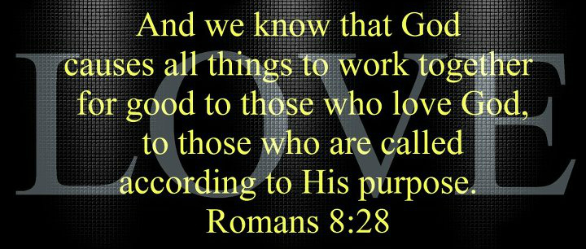
Special Providence…

Slide 25

Special Providence…

Slide 26
Special Providence…
God seeks – First and Foremost - man's spiritual good, not material benefits
Material blessings may come to one as a result of special providence (Mt.6:33).
God may also allow financial hardship, illness, or other physical trials to occur if He deems them suitable for our spiritual benefit (Rom.5:3-5; Jm.1:2-4).
His ultimate goal is the saving of our souls.

Slide 27
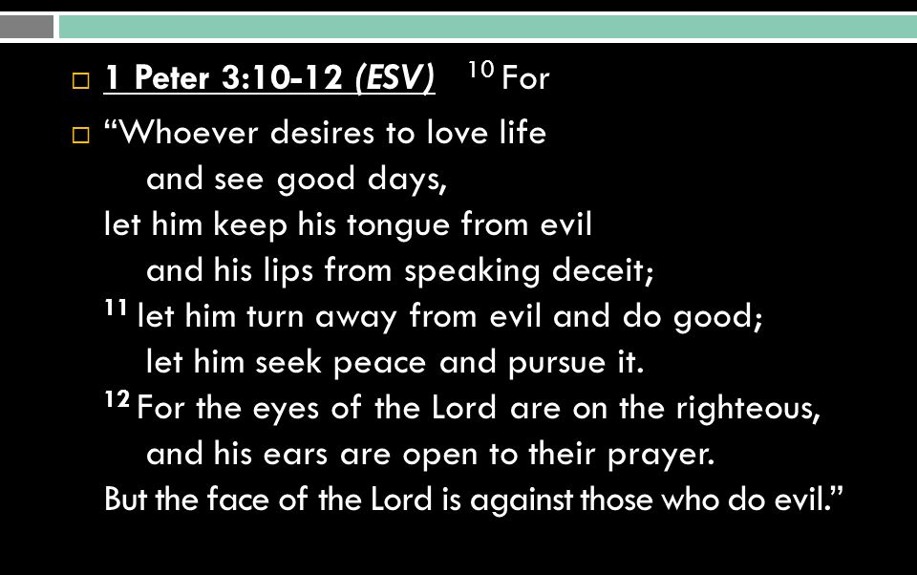
In everything give God thanks

Slide 28
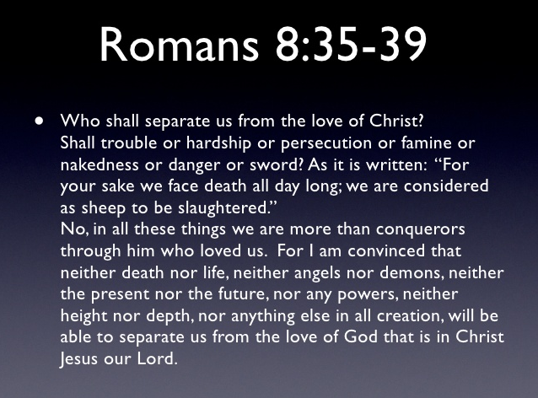

Slide 29
Back to Abraham…
God called Abraham to do the unthinkable
To sacrifice His son
A test of faith, YES!

Slide 30
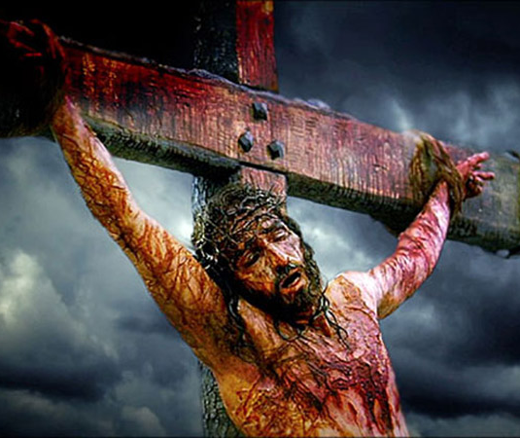
At the Cross
God Provided…
But all the Example of the truth to come
Generations later, the God of heaven would sacrifice his own Son…

Slide 31
At the Cross
God Provided…
But as Example
Generations later, the God of heaven would sacrifice his own Son…
Romans 5:6-10—⁶For while we were still helpless, at the right time Christ died for the ungodly. (NASB95)

Slide 32
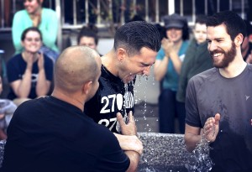
God Provides Salvation when we meet Jesus at the Cross in Baptism…
Romans 6:3—
³Or do you not know that all of us who have been baptized into Christ Jesus have been baptized into His death? (NASB95)

