Slide 1
“Add Knowledge, Too.”
John Staiger
For Morningside Church of Christ
Sunday 26 April 2020
AM Sermon
Broadcast at 6pm on Facebook Live
From 16 McClintock Road, Massey, Auckland.

Slide 2

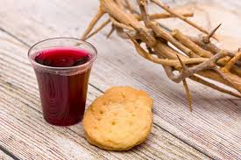

Slide 3
Welcome
Sunday 26 April 2020
Morningside Church of Christ
(42 Leslie Ave, Sandringham, Auckland)
Facebook Live
11am
6pm
And Wednesday at 7pm

Slide 4
Add Knowledge, Too
2 Peter 1:5

Slide 5
2 Peter 1:5-7
5 For this very reason, make every effort to add to your faith
goodness;
and to goodness, knowledge;
6 and to knowledge, self-control;
and to self-control, perseverance;
and to perseverance, godliness;
7 and to godliness, brotherly kindness;
and to brotherly kindness, love.

Slide 6

The Knowledge that Matters
The Facts are—
If you are not teaching your children who God really is,… I assure you the world is giving them their version

Slide 7
The Knowledge that Matters
The Facts are—
If you are not teaching your children who God really is,…
I assure you the world is giving them their version.

Slide 8
The Knowledge that Matters
The Facts are—
The Bible has transformed civilization.
Its impact is unquestioned.

Slide 9
The Knowledge that Matters
The Facts are—
The Bible will transform you!

Slide 10
The Facts are—
The Bible gives:
Peace in fear
Calm in crisis
Power and strength in weakness
Light in darkness

Slide 11
The Knowledge that Matters
The Facts are—
Yes, it has been used, abused and corrupted…
But that is what Satan does best.

Slide 12
The Knowledge that Matters
The Facts are—
Yes, it has been used, abused and corrupted…
But that is what Satan does best.

Slide 13
The Knowledge that Matters
The Facts are—
This stuff was not done out of sight.
You can see it all for what it is

Slide 14
The Knowledge that Matters
The Facts are—
Those who are diligent to seek the truth will be eternally rewarded.

Slide 15
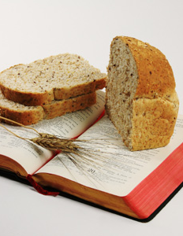
The True Bread of Life
Matthew 4:3—
³And the tempter came and said to Him, “If You are the Son of God, command that these stones become bread.”

Slide 16
The True Bread of Life
Matthew 4:4—“It is written, ‘Man shall not live on bread alone, but on every word that proceeds out of the mouth of God.’”

Slide 17
Powerful and Personal
Philippians 3:10-11
¹⁰I want to know Christ and the power of his resurrection and the fellowship of sharing in his sufferings, becoming like him in his death, ¹¹and so, somehow, to attain to the resurrection from the dead.

Slide 18
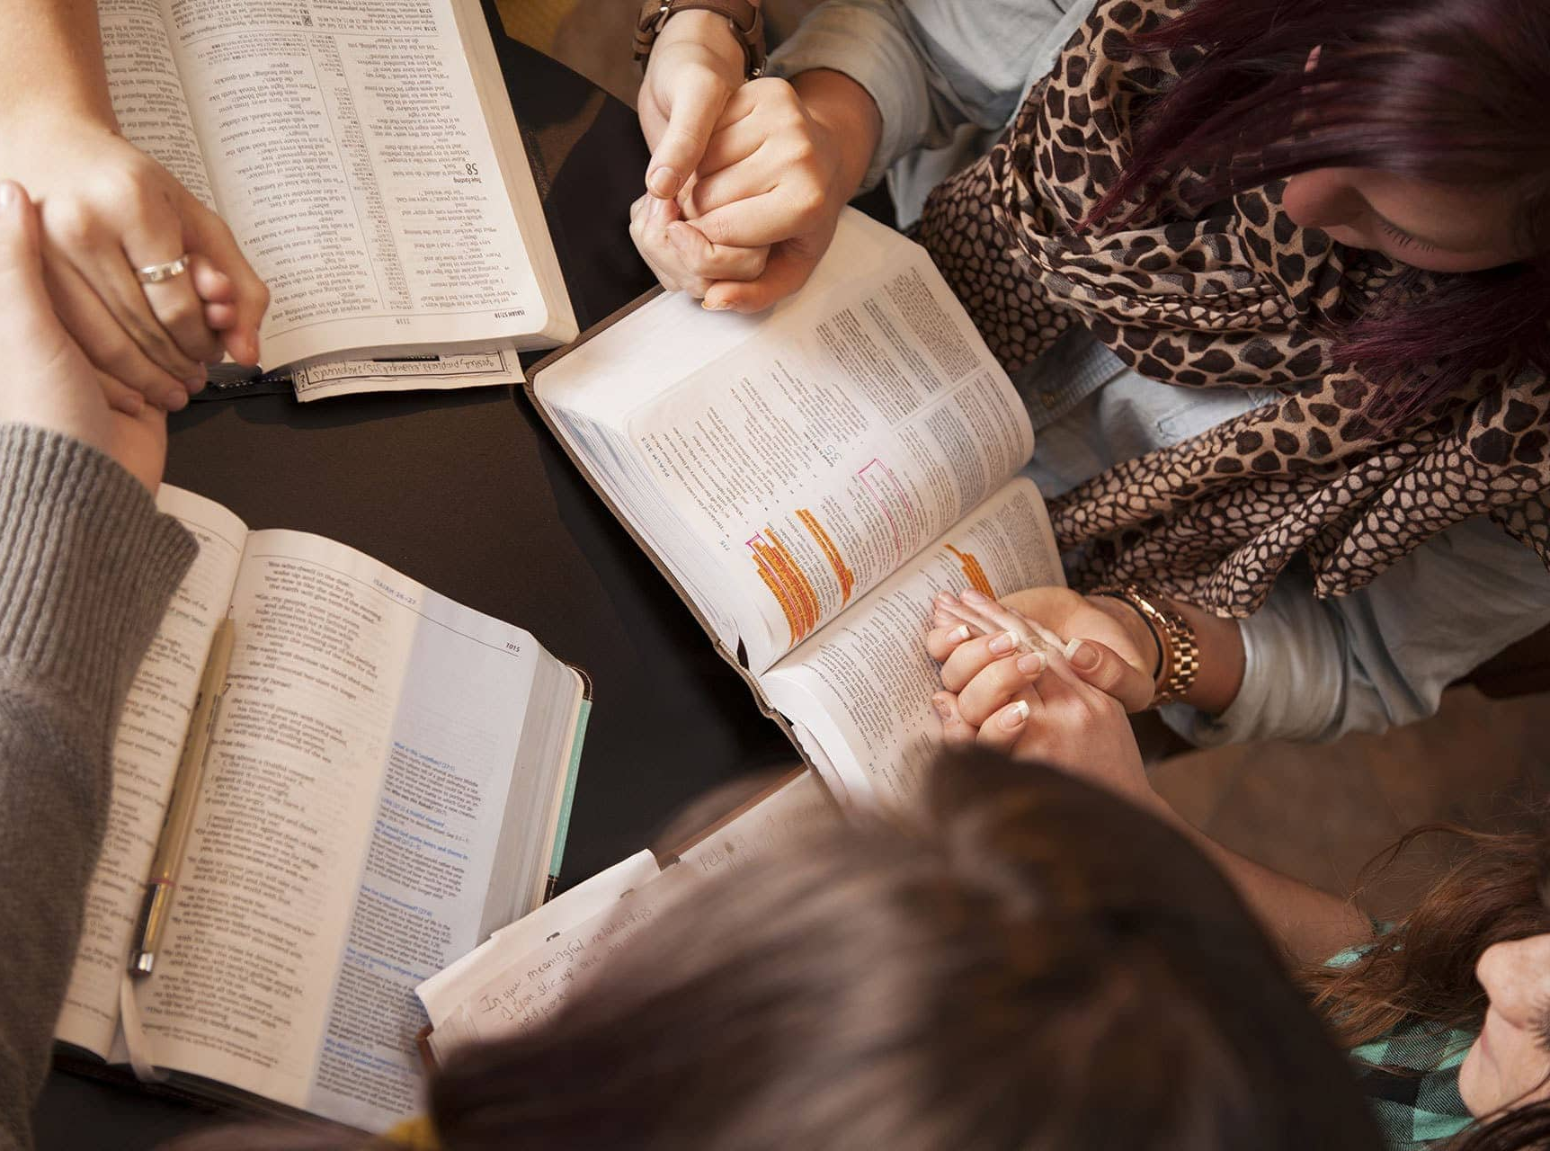
Its Up Close and Personal
Ensure trustworthy sources:
Begins with God’s revelation—The Bible
We Listen to, and observe trustworthy Christians
Experience
Test everything

Slide 19
Beware of Assumptions
Tags on migratory birds had to be changed. The Bands on the legs used to have abbreviation for: Washington
Biological
Survey–

Slide 20
Beware of Assumptions
The Department got letter from a backwoods camper:
“Dear sirs, While camping, shot one of your birds, a duck. Followed cooking instructions on the leg and it was horrible.”

Slide 21
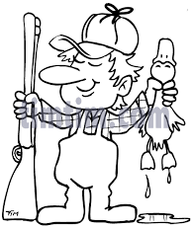
Beware of Assumptions
The abbreviation on the leg tag read:
Wash.
Biol.
Surv.

Slide 22
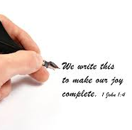
Building Truth upon Truth
Constant
Reminders
are vital:
2 Peter 1:12—¹²Therefore, I will always be ready to remind you of these things, even though you already know them, and have been established in the truth which is present with you. (NASB95)

Slide 23
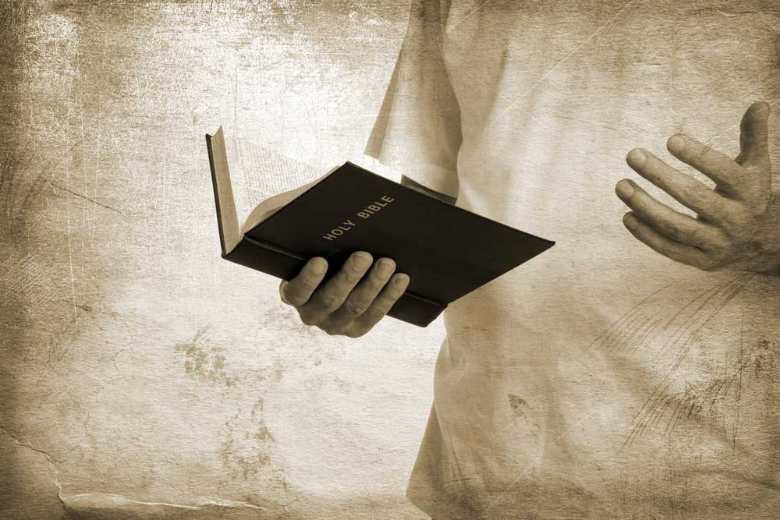
1 Corinthians 15:1
Now I make known to you, brethren, the gospel which I preached to you, which also you received, in which also you stand, (NASB95)
It Starts and Ends with Knowledge
Truth—Jesus
Proclaimed
Believed
Enacted with conviction

Slide 24
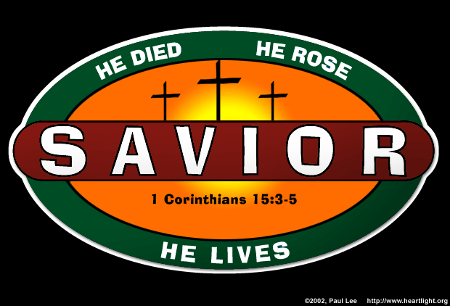
saviour
1 Corinthians 15:3-5—³For I delivered to you ^{[a]}as of first importance what I also received, that Christ died for our sins according to the Scriptures, ⁴and that He was buried, and that He was raised on the third day according to the Scriptures, ⁵and that He appeared to Cephas, then to the twelve. (NASB95) [a]Lit among the first

Slide 25
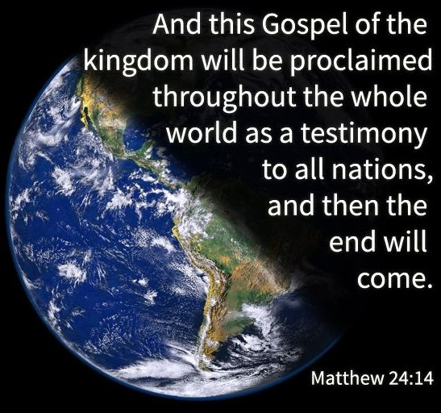
This is not
Stay at Home
Sit on your sofa
Take it or leave it
Theology Studies

Slide 26
The Kingdom of Christ is forcefully advancing.
The Bible is being taken;
It is being preached.

Slide 27
2 Timothy 1:12—¹²For this reason I also suffer these things, but I am not ashamed; for I know whom I have believed and I am convinced that He is able to guard what I have entrusted to Him ^{[a]}until that day. (NASB95) [a]Or for
It Starts and Ends with Knowledge
Paul’s conviction:
Jesus—the one in whom he believed
Was going to honour his work
That work was that of spreading that knowledge

Slide 28
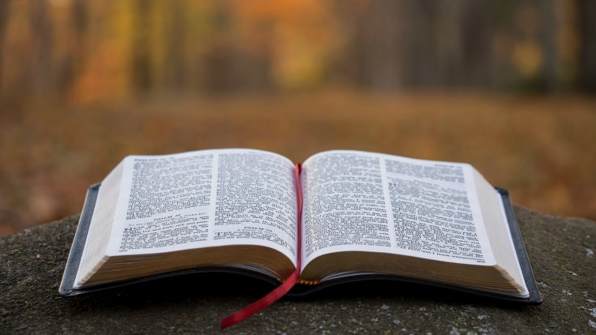

1 Peter 1:23-25—
²³ for you have been born again not of seed which is perishable but imperishable, that is, through the living and enduring word of God. ²⁴ For,
“All flesh is like grass,
And all its glory like the flower of grass.
The grass withers,
And the flower falls off,
²⁵ But the word of the Lord endures forever.” [Isaiah 40:6-8]
And this is the word which was ^{[a]}preached to you. (NASB95) [a]Lit preached as good news to you

Slide 29

Ultimately it’s
‘Who’ You Know
John 17:3—
This is eternal life, that they may know You, the only true God, and Jesus Christ whom You have sent. (NASB95)

Slide 30
Acts 22:12-16—¹² “A certain Ananias, a man who was devout by the standard of the Law, and well spoken of by all the Jews who lived there, ¹³came to me, and standing near said to me, ‘Brother Saul, receive your sight!’ And ^{[a]}at that very time I looked up at him. ¹⁴And he said, ‘The God of our fathers has appointed you to know His will and to see the Righteous One and to hear an ^{[b]}utterance from His mouth. ¹⁵For you will be a witness for Him to all men of what you have seen and heard…. (NASB95) [a]Or instantly; lit at the very hour [b]Or message; lit voice

Slide 31
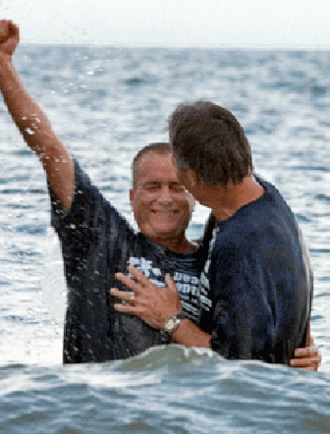
...and what you do with Him.
Acts 22:12-16—¹⁶Now why do you delay? Get up and be baptized, and wash away your sins, calling on His name.’ (NASB95)

