Slide 1
“Endure to the End.”
John Staiger
For Morningside Church of Christ
Sunday 19 April 2020
PM Sermon
Broadcast live at 11AM on Facebook Live from 16 McClintock Road, Massey, Auckland.

Slide 2
Welcome
Sunday 19 April 2020
Morningside Church of Christ
(42 Leslie Ave, Sandringham, Auckland)
Facebook Live
6pm Sermon
Next – Wednesday at 7pm

Slide 3
“Endure to the End.”

Slide 4
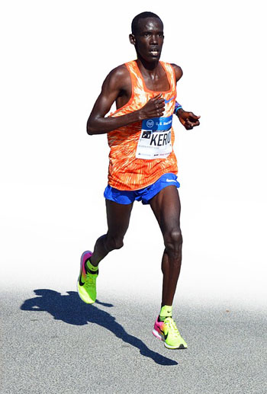
Rather you, than me.
Demands great physical and mental stamina.

Slide 5
Rather you, than me.
Excessive investment
  Years of work.
  Long distances
  Controlled Diet

Slide 6
Rather you, than me.
Punishing toll
  Injuries
  Hours alone
  Could be doing something else

Slide 7
Rather you, than me.
For what?
  A medal
  Fame
  Money
  Personal satisfaction

Slide 8
Spiritual Endurance
Demands great physical and mental stamina.
Struggle against the devil
Excesses of this world
Staying focus amidst constant distractions

Slide 9
Spiritual Endurance
Excessive investment
  2Cor.12:15—“I will most gladly spend and be expended for your souls.”
  Mt.19:21—“Sell all and give to the poor…come follow me”
  2 Timothy 4:7—⁷I have fought the good fight, I have finished the course, I have kept the faith; (NASB95)

Slide 10
Spiritual Endurance
Punishing toll
  I buffet my body (1Cor.9:27)
  Hours alone—Jesus 40 days in the desert
  Stephen could have stopped his sermon

Slide 11

Spiritual Endurance
For what?
  A medal
  Fame
  Money
  Personal satisfaction
Count it all rubbish so that I may gain Christ (Phil.3:8)

Slide 12
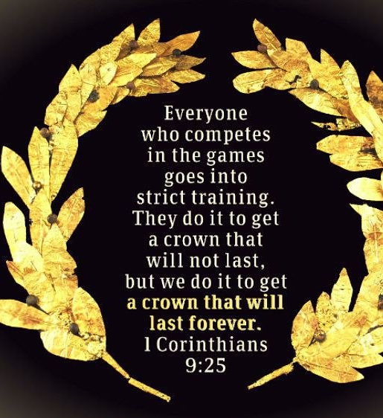
Spiritual Endurance
For what?
  Unfading crown of glory (1Pet.5:4)
  Well done good and faithful servant (Mt.25:21)
  A mansion in Heaven (Jn.14:2)

Slide 13
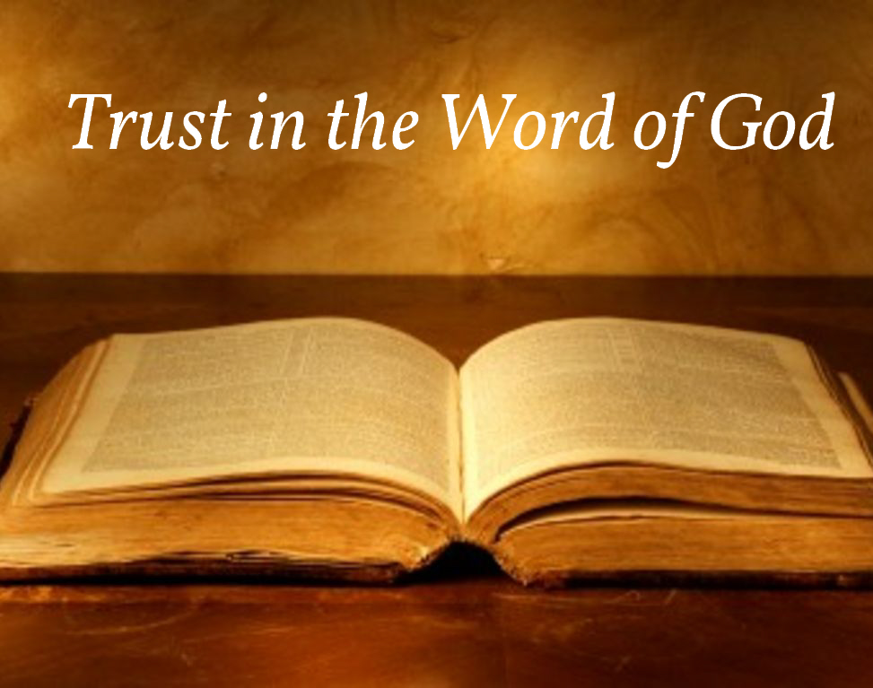
Fuel and Direction
1 Peter 1:25
But the word of the Lord endures forever.” And this is the word which was preached to you. (NASB95)

Slide 14
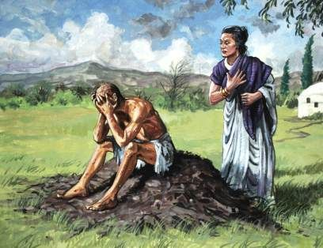
Who are your mentors?
James 5:11—¹¹ We count those blessed who endured. You have heard of the endurance of Job and have seen the outcome… of the Lord’s dealings, that the Lord is full of compassion and is merciful. (NASB95)
Job 1:22—Through all this Job did not sin nor did he blame God.

Slide 15
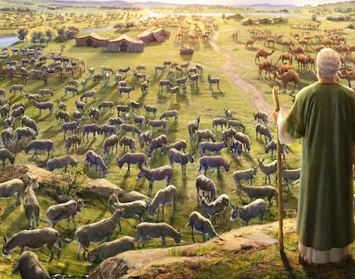
Who are your mentors?
James 5:11—¹¹ We count those blessed who endured. You have heard of the endurance of Job and have seen the outcome of the Lord’s dealings, that the Lord is full of compassion and is merciful. (NASB95)
James 5:11—¹¹ We count those blessed who endured. You have heard of the endurance of Job and have seen the outcome of the Lord’s dealings, that the Lord is full of compassion and is merciful. (NASB95)

Slide 16
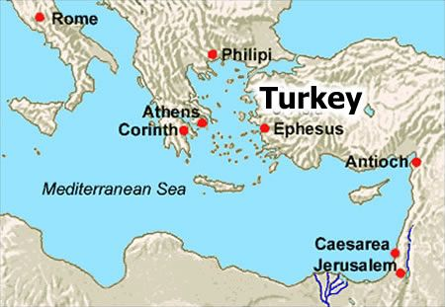
Endurance is not Everything
Revelation 2:1-4—“To the angel of the church in Ephesus write:…

Slide 17
Endurance is not Everything
Revelation 2:1-4—“To the angel of the church in Ephesus write:…²‘I know your deeds and your toil and perseverance, and that you cannot tolerate evil men, and you put to the test those who call themselves apostles, and they are not, and you found them to be false; ³and you have perseverance and have endured for My name’s sake, and have not grown weary. ⁴But…

Slide 18
Endurance is not Everything
Revelation 2:1-4—“To the angel of the church in Ephesus write:…²‘I know your deeds and your toil and perseverance, and that you cannot tolerate evil men, and you put to the test those who call themselves apostles, and they are not, and you found them to be false; ³and you have perseverance and have endured for My name’s sake, and have not grown weary. ⁴But I have this against you, that you have left your first love. (NASB95)

Slide 19
Help along the way
When dealing with hurting people, I always ask the same 4 questions:
How are you helping YOURSELF? (Eating, sleeping, mood.)
What support system do you have in place? (There are 7 days in a week, and you need 7 “arms” to lean on, so you don’t wear anybody out as you check in daily with one.)
What spiritual resources do you have?
How much stick-to-it-tiveness can you muster? (Doug Greenway)

Slide 20
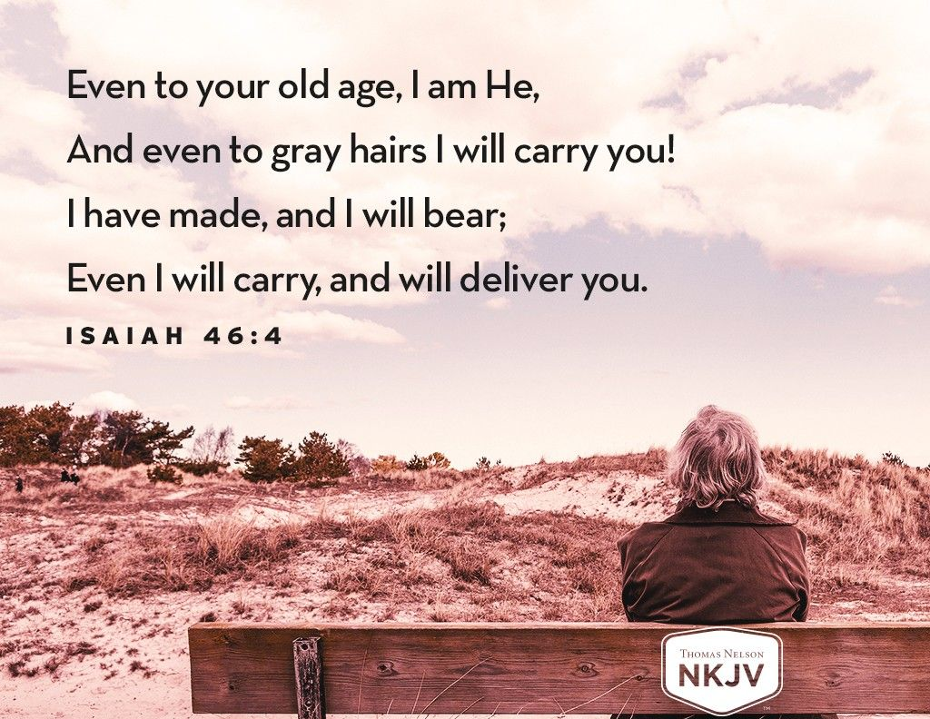

Spiritual Endurance

Slide 21
Next Live Feed
Facebook Live
Also on our Website:
morningsidechurchofchrist.org.nz
Wednesday 22 April 2020
7pm Sermon
Sunday 11am and 6pm
Morningside Church of Christ
(42 Leslie Ave, Sandringham, Auckland)

