Slide 1
“Keeping God in Sight.”
John Staiger
For Morningside Church of Christ
Sunday 12 April 2020
PM Sermon
Broadcast live at 6pm on Facebook from 16 McClintock Road, Massey, Auckland.

Slide 2
Keeping God in Sight.
You better see this!

Slide 3
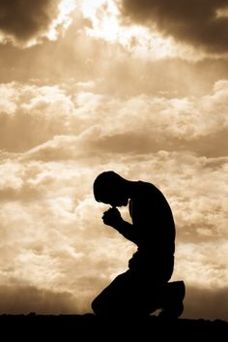
Prayer and dieting have this in common…

Slide 4
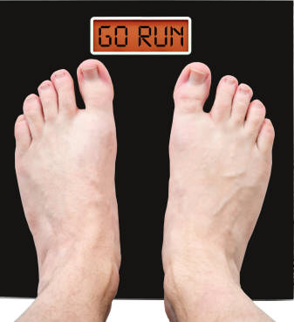
They are most often done in desperation.

Slide 5
Nothing wrong with either, but its no way to live.

Slide 6
Especially when desperation becomes
“Too late.”

Slide 7

Especially when desperation becomes
“Too late.”
The heart hardens

Slide 8
Especially when desperation becomes
“Too late.”
The heart hardens:
  Evil hides the truth

Slide 9
Especially when desperation becomes
“Too late.”
The heart hardens:
  Doubt God’s goodness

Slide 10
Especially when desperation becomes
“Too late.”
The heart hardens:
  Grumbling has set in

Slide 11
Especially when desperation becomes
“Too late.”
The heart hardens:
  Love for the Bible has grown cold

Slide 12
Especially when desperation becomes
“Too late.”
The heart hardens:
  Christians annoy you.

Slide 13

Especially when desperation becomes
“Too late.”
The heart hardens
Focus fades
Eyes that once looked to Jesus have long since lost focus.

Slide 14

Especially when desperation becomes
“Too late.”
The heart hardens
Focus fades
The way is lost

Slide 15

Where there is life there is hope:
“Choose Life.”

Slide 16
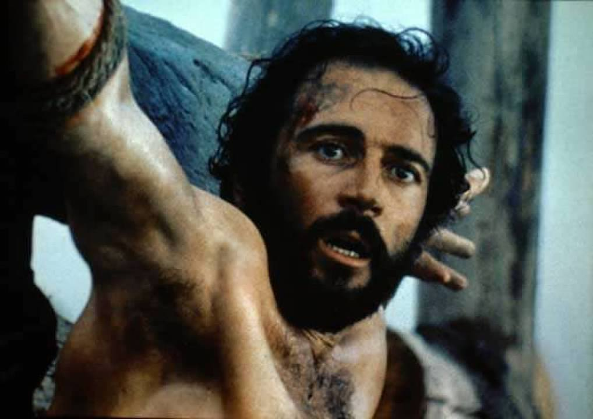
Where there is life there is hope:
“Choose Life.”
The dying Thief on the cross
Luke 23:42—⁴²And he was saying, “Jesus, remember me when You come in Your kingdom!” (NASB95)

Slide 17
Where there is life there is hope:
“Choose Life.”
The dying Thief on the cross: 9-words
Luke 23:42—⁴²And he was saying, “Jesus, remember me when You come in Your kingdom!” (NASB95)

Slide 18
Where there is life there is hope:
“Choose Life.”
The dying Thief on the cross: Answer
Luke 23:43—⁴³ And He said to him, “Truly I say to you, today you shall be with Me in Paradise.” (NASB95)

Slide 19
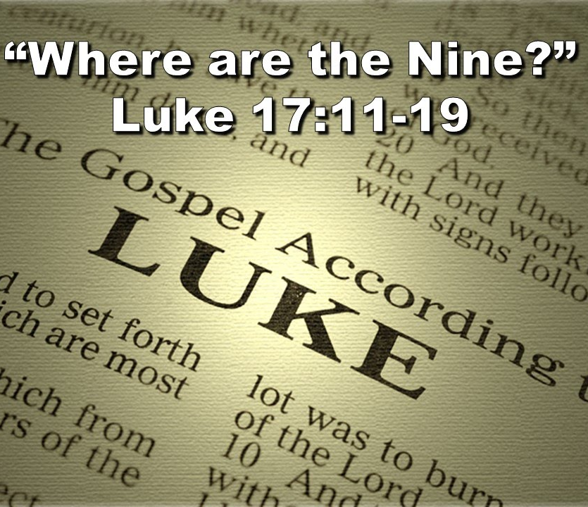
Where there is life there is hope:
“Choose Life.”
The prayer of the 10 Lepers:
6-Words
Luke 17:13—¹³ and they raised their voices, saying, “Jesus, Master, have mercy on us!” (NASB95)

Slide 20
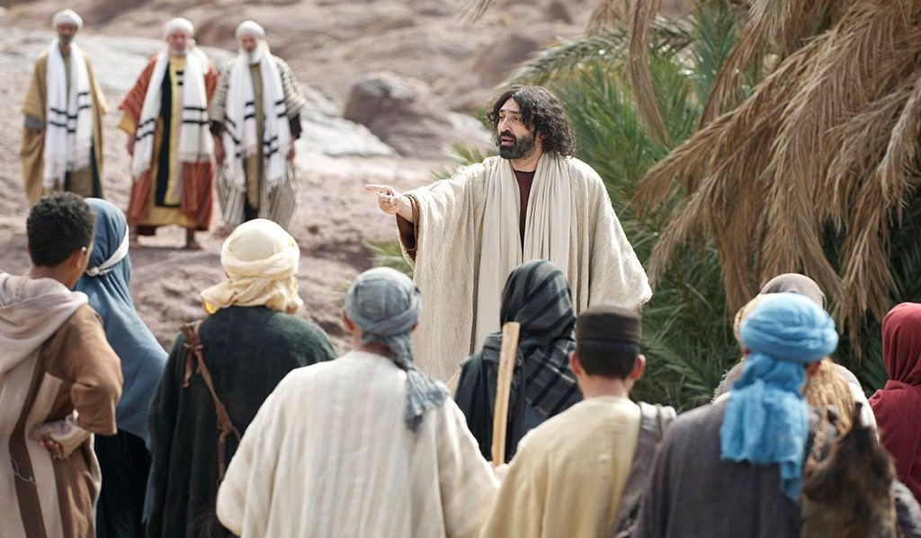
Where there is life there is hope:
“Choose Life.”
The prayer of the 10 Lepers:
6-Words
Luke 17:13—¹³ and they raised their voices, saying, “Jesus, Master, have mercy on us!” (NASB95)

Slide 21
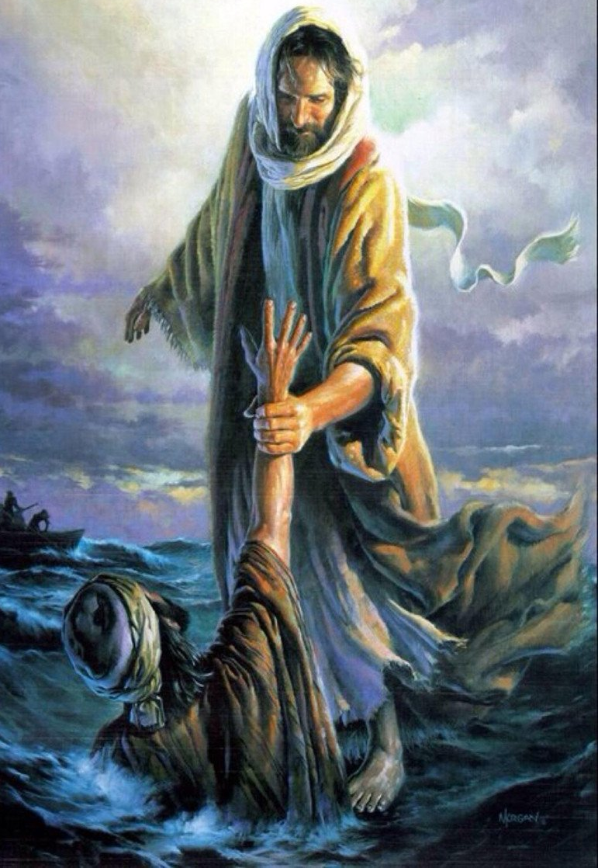
Where there is life there is hope:
“Choose Life.”
In desperation Peter cried out a very effective
3-word prayer…
Mt.14:30—“Lord, save me!”

Slide 22
Where there is life there is hope:
“Choose Life.”
In desperation Peter cried out a very effective
3-word prayer…
Mt.14:30—“Lord, save me!”

Slide 23

Where there is life there is hope:
“Choose Life.”
Paul prayed a 1-word
prayer

Slide 24
Where there is life there is hope:
“Choose Life.”
Paul prayed a 1-word
prayer
1 Corinthians 16:22—
If anyone does not love the Lord,
he is to be accursed.
Maranatha.
“O [our] Lord come!”

Slide 25
Where there is life there is hope:
“Choose Life.”
Paul prayed a 1-word
prayer
1 Corinthians 16:22—
If anyone does not love the Lord,
he is to be accursed.
Maranatha.
“O [our] Lord come!”

Slide 26
Where there is NO PRAYER
The Devil has
NO FEAR
He will sit back and watch as—
Sunday School kids turn into
“I USED TOs…”

Slide 27
Where there is NO PRAYER
The Devil has
NO FEAR
He will sit back and watch as—
Sermons turn into
“Background noise!”

Slide 28
Where there is NO PRAYER
The Devil has
NO FEAR
He will sit back and watch as—
Missionaries turn into “Travelling Pop-culture stars.”

Slide 29
Where there is NO PRAYER
The Devil has
NO FEAR
He will sit back and watch as—
Ministries turn into “Community Service Providers.”

Slide 30
Where there is NO PRAYER
The Devil has
NO FEAR
He will sit back and watch as—
Home Bible Study turns into “Tuesday Gossip Group.”

Slide 31
Where there is NO PRAYER
The Devil has
NO FEAR
He will sit back and watch as—
Church buildings become “Tourist destinations, or a free-for-all Community Hall.”

Slide 32
Where there is NO PRAYER
The Devil has
NO FEAR
He will sit back and watch as—
Christians become: “Clean-living middle-class citizens who go to church—But that’s all they do!”

Slide 33
Make the
DEVIL
FEAR
He will stand to try to resist you
—He can—
Only if you let him.
PRAY:
“Lord, clean me up for service in your church.”

Slide 34
Make the
DEVIL
FEAR
The Holy Spirit will sanctify you.
Convict you of the damage of sin.
Make you an easier person to be around.
An example of Jesus to follow

Slide 35
Make the
DEVIL
FEAR
He will stand to try to resist you
—He can—
Only if you let him.
PRAY:
“Lord, thank you that you are merciful to me—a sinner!”

Slide 36
Make the
DEVIL
FEAR
God will remove the judgemental spirit the devil has worked on for so long.
You will reach out to the lost with a heart that wants to share God’s grace with all.

Slide 37
Make the
DEVIL
FEAR
He will stand to try to resist you
—He can—
Only if you let him.
PRAY:
“Lord, forgive my troublemaking.”

Slide 38
Make the
DEVIL
FEAR
The devil will do everything he can to derail your desire and efforts to bring peace.
That’s why you must cry out to God.
You will be called, “Sons of God.”

Slide 39
Make the
DEVIL
FEAR
He will stand to try to resist you
—He can—
Only if you let him.
PRAY:
“Lord, raise up an army of missionaries.”

Slide 40
Make the
DEVIL
FEAR
The last thing the devil wants is to see churches sending the gospel to the far corners of the earth.
I am a Christian today because a congregation sent someone to NZ with the truth.

Slide 41
Make the
DEVIL
FEAR
He will stand to try to resist you
—He can—
Only if you let him.
PRAY:
“Lord, bless our Spiritual leaders.”

Slide 42
Make the
DEVIL
FEAR
The devil wants ineffective leaders.
Leaders who are:
`Sincere, but passive.
`Busy, but not pushy.
`Prayful, but not prying.
In other words, ‘Stay out of my life!’

Slide 43
If you want to change things for the better
Pray that the Lord keeps you praying for the things that make the Kingdom advance.
Things will never be the same!

