Slide 1
“Add Self-control, too!”
John Staiger
For Morningside Church of Christ
Sunday 19 April 2020
AM Sermon
Broadcast live at 11AM on Facebook Live from 16 McClintock Road, Massey, Auckland.

Slide 2
Welcome
Sunday 19 April 2020
Morningside Church of Christ
(42 Leslie Ave, Sandringham, Auckland)
Facebook Live
11am
6pm
And Wednesday at 7pm

Slide 3
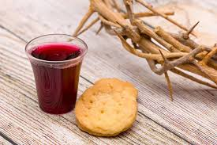

Slide 4
Add Self-control, too!
2 Peter 1:5

Slide 5
2 Peter 1:5-7
⁵For this very reason, make every effort to add to your
 | faith
 | goodness;
and to goodness, | knowledge;
⁶and to knowledge, | self-control;
and to self-control, | perseverance;
and to perseverance, | godliness;
⁷ and to godliness, | brotherly kindness;
and to brotherly kindness, | love.
2 Peter 1:5-7

Slide 6
A. Without Self-control our lives simply fall apart.
Things that mask your demise:

Slide 7
A. Without Self-control our lives simply fall apart.
Things that mask your demise:
You’ve had better days
Fumes of past success

Slide 8
A. Without Self-control our lives simply fall apart.
Things that mask your demise:
Skills have kept you in place

Slide 9
A. Without Self-control our lives simply fall apart.
Things that mask your demise:
Enablers have propped you up

Slide 10
A. Without Self-control our lives simply fall apart.
Things that mask your demise:
Resources
Money

Slide 11
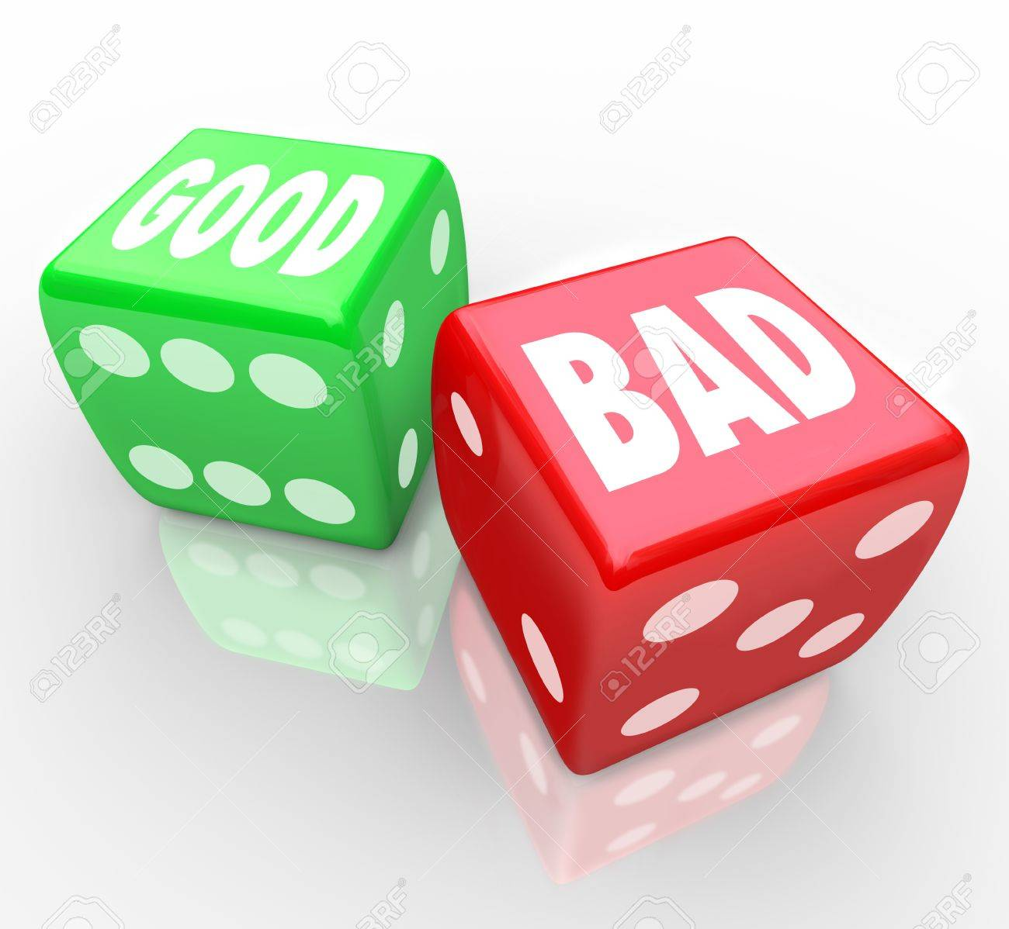
A. Without Self-control our lives simply fall apart.
The Out-come:
Sin sets in
Friends run out
Money dries up
Health goes down

Slide 12
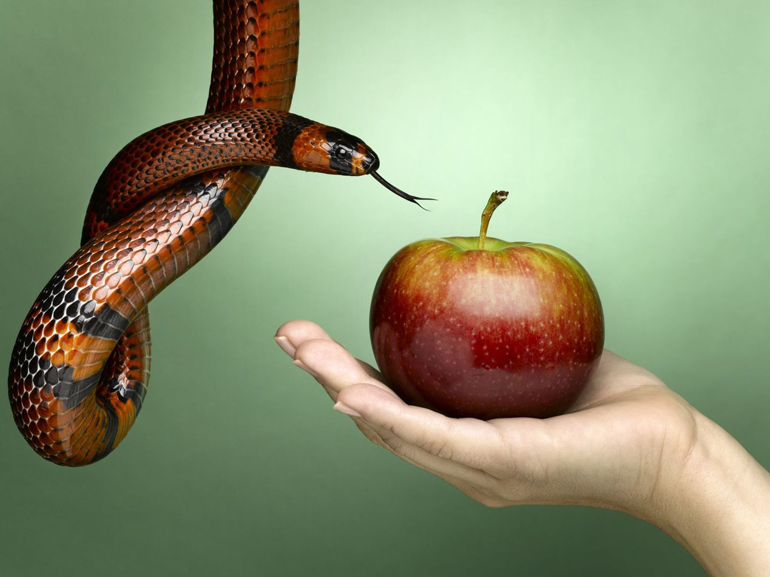
A. Without Self-control our lives simply fall apart.
The Out-come:
Sin sets in
Friends run out
Money dries up
Health goes down

Slide 13
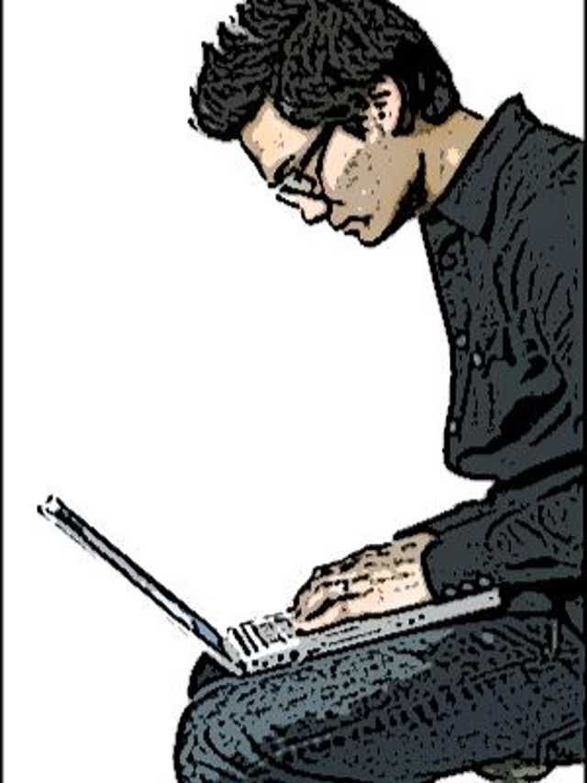
A. Without Self-control our lives simply fall apart.
The Out-come:
Sin sets in
Friends run out
Money dries up
Health goes down

Slide 14
A. Without Self-control our lives simply fall apart.
The Out-come:
Sin sets in
Friends run out
Money dries up
Health goes down

Slide 15
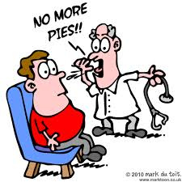
A. Without Self-control our lives simply fall apart.
The Out-come:
Sin sets in
Friends run out
Money dries up
Health goes down

Slide 16
B. Self-control is Learned.
Will-power
Temptations abound.
Titus 2:11-13—¹¹ For the grace of God has appeared, bringing salvation to all men, ¹²instructing us to deny ungodliness and worldly desires… (NASB95)
Don’t become an expert in ‘self-sabotage.’
Easy…?

Slide 17
No on said it would be easy

Slide 18
B. Self-control is Learned.
Calmness
Keeping destructive behaviours in check.
Quick to hear, slow to speak, slow to anger. (James 1:19)
A gentle word that turns away wrath
Proverbs 18:19—¹⁹A brother offended is harder to be won than a strong city, And contentions are like the bars of a citadel. (NASB95)

Slide 19
B. Self-control is Learned.
Govern Wisely
Constant and consistent Evaluation
“Do not judge according to appearance, but judge with righteous judgment.” (Jn.7:24)
Suspect you own motives
Scrutinize all angles
“But solid food is for the mature, who because of practice have their senses trained to discern good and evil.” (Heb.5:14)

Slide 20
B. Self-control is Learned.
Establish Long-term Patterns
Elders are already well practiced at this (Titus 1:8)
It will grow and manifest itself as one of “the fruit of the Spirit” (Galatians 5:23).

Slide 21
B. Self-control is Learned.
Determination
You care enough to take responsibility for your thoughts, words and actions.
“Taking every thought captive to the obedience of Christ,”(2 Corinthians 10:5b).
“See to it that no one takes you captive through philosophy and empty deception,” (Colossians 2:8a).

Slide 22
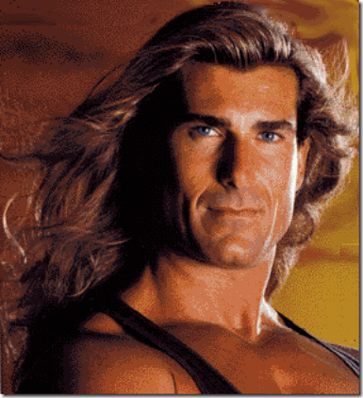
C. Self-control is shown
Absalom couldn’t wait to rule Israel – so he took control. He left Israel and his father broken hearted.

Slide 23
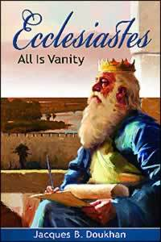
C. Self-control is shown
Solomon indulged himself in power, wealth, women and knowledge. He concluded that all was meaningless.

Slide 24
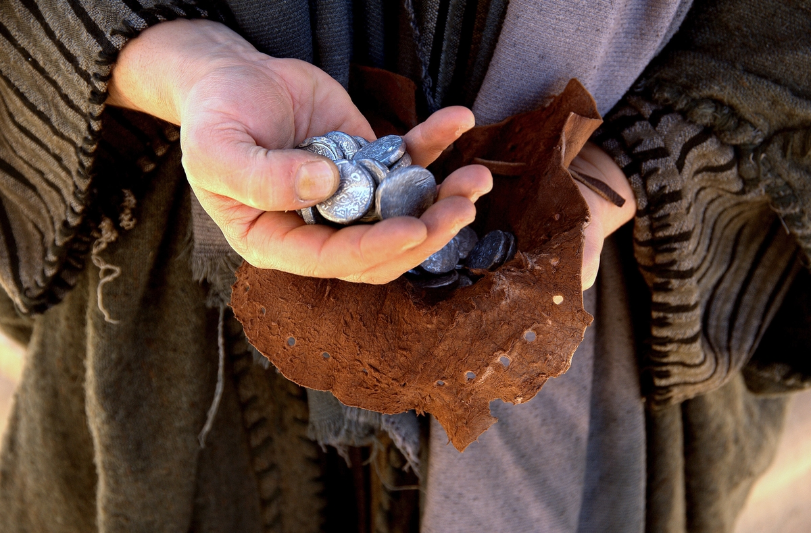
C. Self-control is shown
Judas sold out for cash.

Slide 25
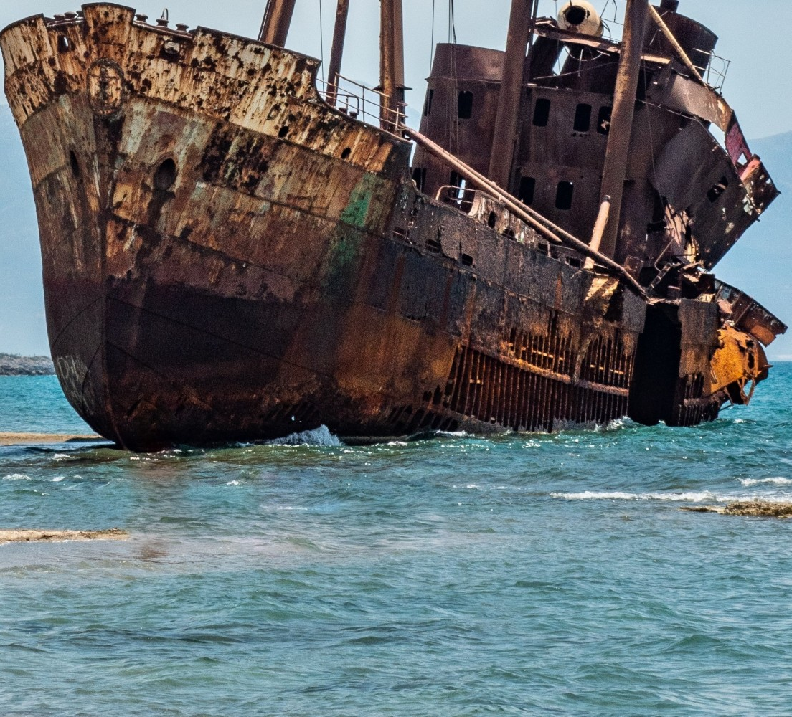
C. Self-control is shown
Hymenaeus and Alexander suffered shipwreck in regards to their faith
(1 Timothy 1:20)

Slide 27
In the Garden—Matthew 26:47-56
v.47—Judas arrived with a large crowd
v. 49—Judas Kiss.
v. 50—Jesus replied, "Friend, do what you came for.“
—Jesus arrested
v. 51—Peter cut off Malchus’ ear
v. 53—Twelve legions of angels? (72,000)
v. 56—All the disciples deserted him and fled.

Slide 28
Titus 2:11-14
¹¹For the grace of God has appeared that offers salvation to all people. ¹²It teaches us to say “No” to ungodliness and worldly passions, and to live self-controlled, upright and godly lives in this present age, ¹³ while we wait for the blessed hope—the appearing of the glory of our great God and Saviour, Jesus Christ, ¹⁴ who gave himself for us to redeem us from all wickedness and to purify for himself a people that are his very own, eager to do what is good.

Slide 29
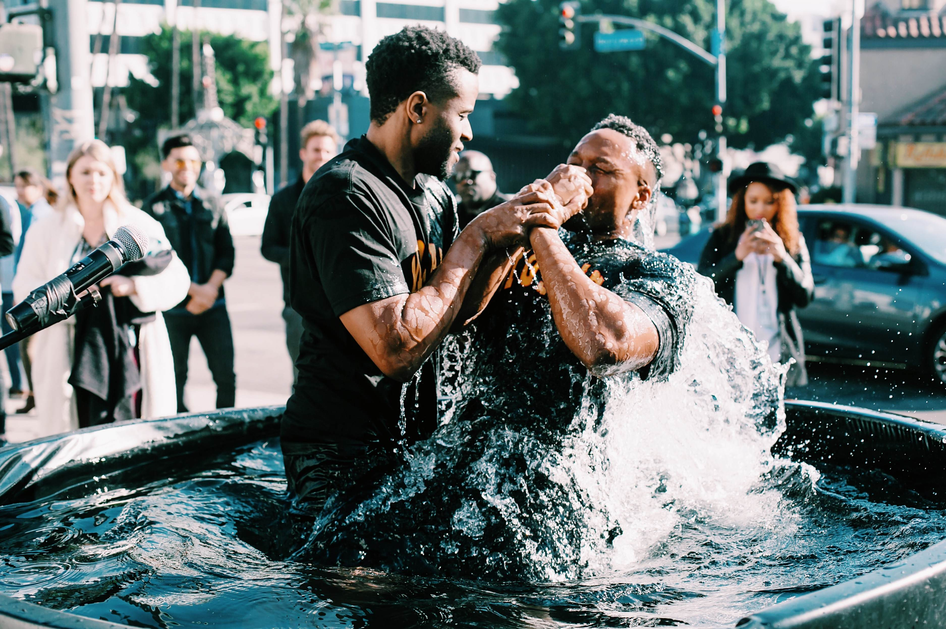
Baptism now saves you…1 Peter 3:21

