Slide 1
“Strength in Battle.”
John Staiger
For Morningside Church of Christ
Sunday 12 April 2020
AM Sermon
Broadcast live at 6pm on Facebook from 16 McClintock Road, Massey, Auckland.

Slide 2
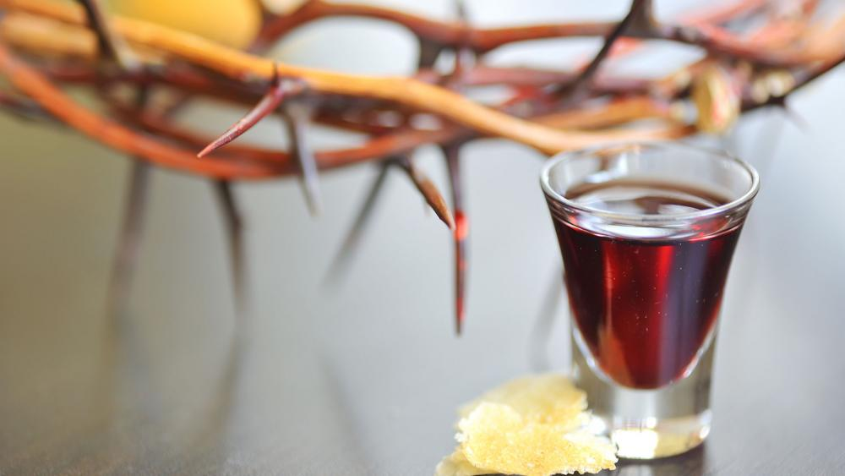

Slide 3
Strength in Battle
Spiritual Warfare

Slide 4
Ephesians 6:10—
¹⁰Finally, be strong in the Lord and in the strength of His might. (NASB95)

Slide 5

A call to strength by the Lord demands action:

Slide 6
A call to strength by the Lord demands action:
Awareness
Preparation
Offensive
Defensive

Slide 7
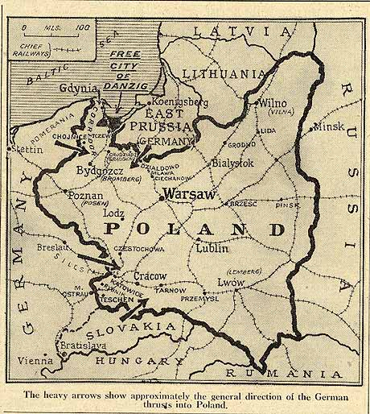
The most dangerous battle is the one you do not know you are in.
Until it is too late…

Slide 8
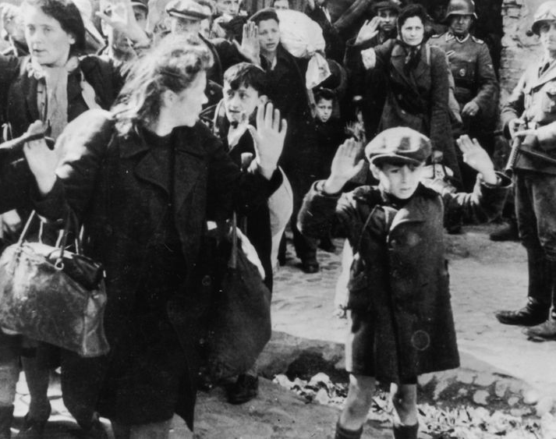
Poland was invaded by Nazi Germany on 1 Sept. 1939 and by the Soviet Union on 17 Sept. 1939.

Slide 9
Poland found themselves in between two murderous armies.

Slide 10
They were totally unprepared for warfare

Slide 11

A war rages…
It’s happening around you right now

Slide 12
Ephesians 6:11—¹¹ Put on the full armor of God, so that you will be able to stand firm against the schemes of the devil. (NASB95)

Slide 13
A war rages…
In the Heavenly Places

Slide 14
Ephesians 6:12—¹²For our struggle is not against ^{[a]}flesh and blood, but against the rulers, against the powers, against the world forces of this darkness, against the spiritual forces of wickedness in the heavenly places. (NASB95) [a]Lit blood and flesh

Slide 15
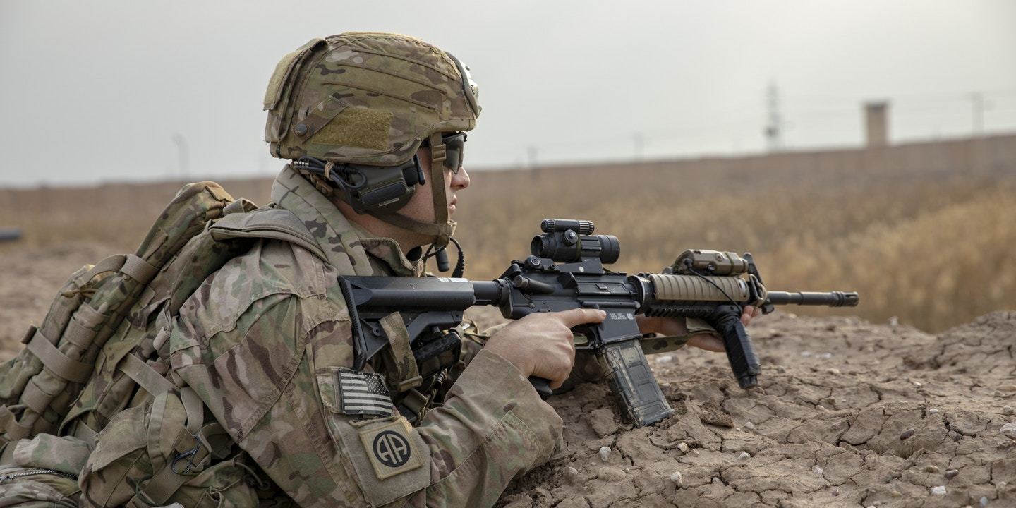
Ephesians 6:12—
NOT:
Flesh and blood…, but

Slide 16
BUT:
Against the rulers,
Against the powers,
against the world forces of this darkness
Against the spiritual forces of wickedness
In the heavenly places. (Eph.6:12)

Slide 17
A war rages…
You are involved in it everyday—whether you know it, or not.

Slide 18
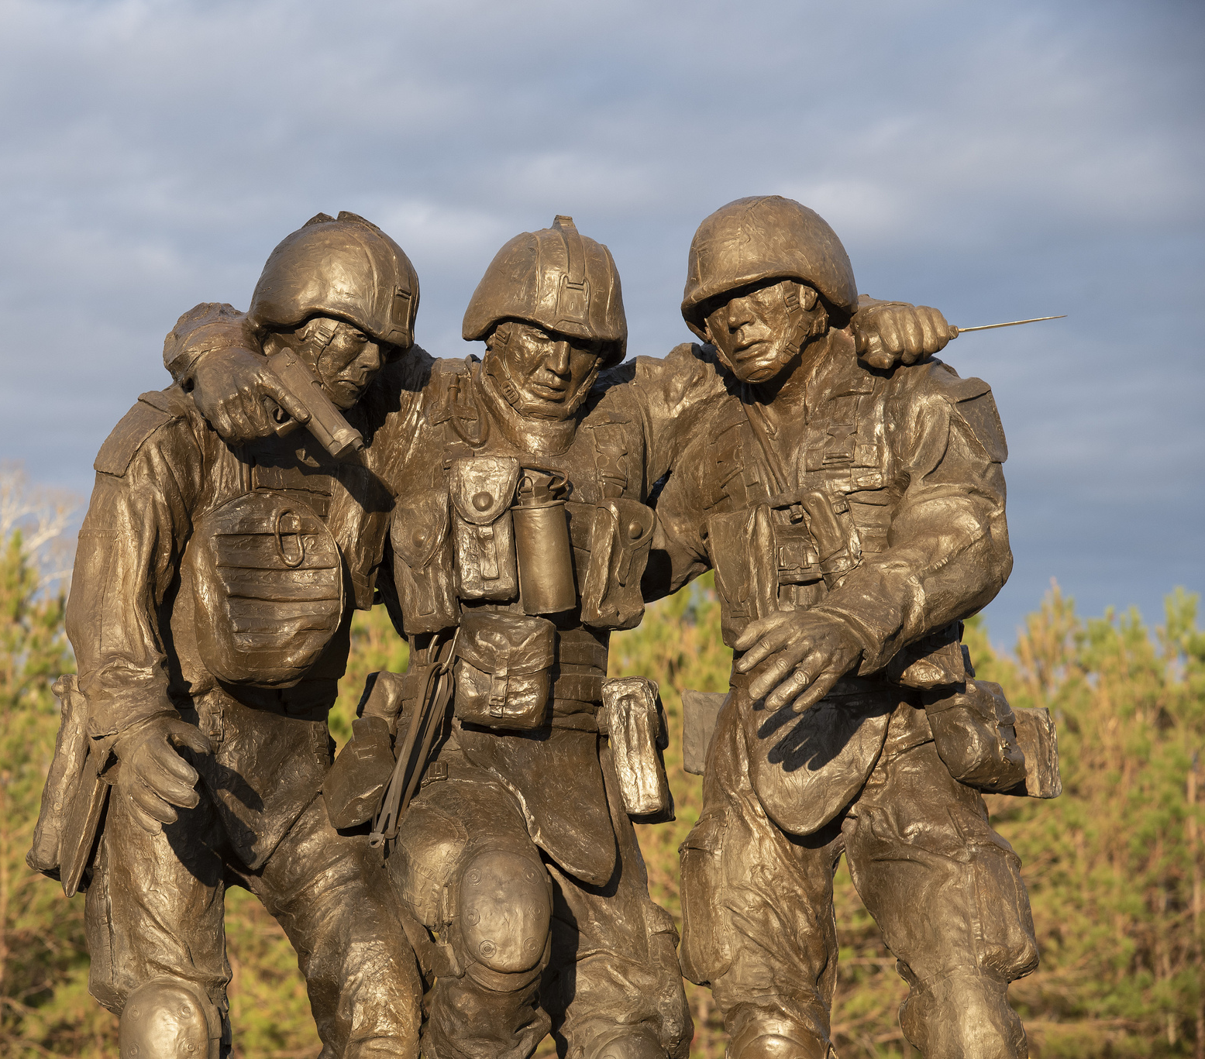
Any day that you are not prepared…
You will be wounded.

Slide 19

Any day that you are not prepared…
Those who depend on you put at risk.

Slide 20
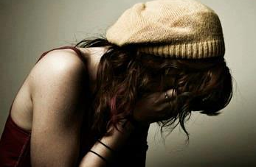
Any day that you are not prepared…
Your strength will begin to diminish

Slide 21


Everyday—

Slide 22

Everyday—
Some days we are keenly aware…

Slide 23
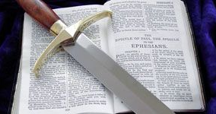
Everyday—
That the Devil is to be fought in hand to hand combat
Ephesians 6:17— “Take…the sword of the Spirit, which is the word of God.”

Slide 24
Everyday—
Armor-Up
  Resist
  Stand
Eph.6:13—Therefore, take up the full armor of God, so that you will be able to resist in the evil day, and having done everything, to stand firm. (NASB95)

Slide 25
Everyday—
He will flee if you resist him
James 4:7—Submit therefore to God. Resist the devil and he will flee from you. (NASB95)

Slide 26

Everyday—
Some days we are lulled asleep

Slide 27
Everyday—
Some days we are lulled asleep
Caught unaware
Forgive…“so that no advantage would be taken of us by Satan, for we are not ignorant of his schemes” (2Cor.2:11-NASB95)

Slide 28
Everyday—
Some days we are lulled asleep
Caught unaware
Victims
1 John 2:16—¹⁶For all that is in the world, the lust of the flesh and the lust of the eyes and the boastful pride of life, is not from the Father, but is from the world. (NASB95)

Slide 29
Everyday—
Some days we are lulled asleep
Caught unaware
Victims
Since when has the vices of this life been offered as a solution to any problems?
  They cause pain
  They worsen suffering

Slide 30
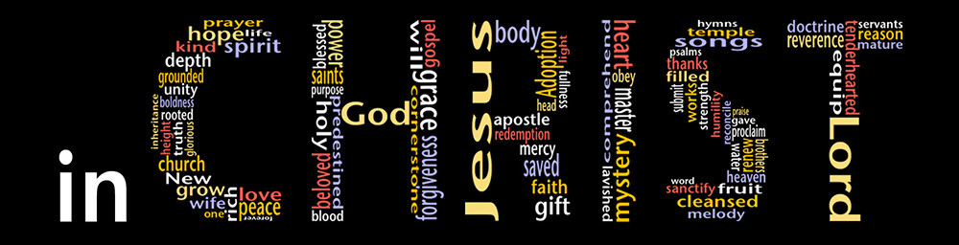
Praise God!
Because—

Slide 31

Praise God!
In Christ…
All wounds can be healed

Slide 32

Praise God!
In Christ…
All guilt can be washed away.

Slide 33
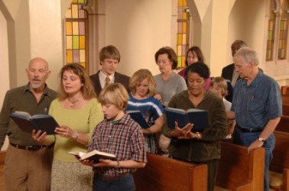
Praise God!
In Christ…
We are in fellowship with God and His church

Slide 34
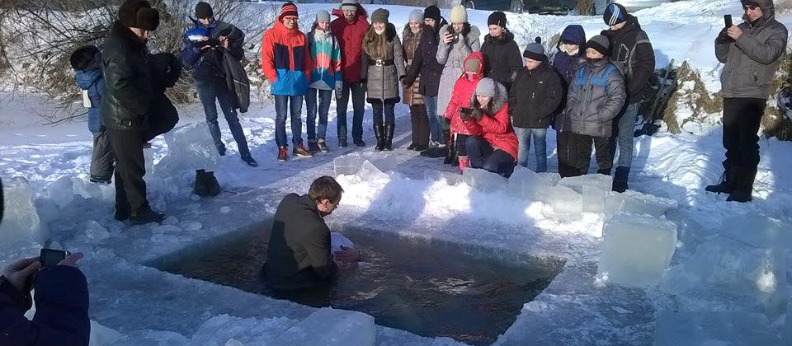
Acts 22:16—Now why do you delay? Get up and be baptized, and wash away your sins, calling on His name.’ (NASB95)

