Slide 1
“The Company you Keep.”
John Staiger
For Morningside Church of Christ
Sunday 5 April 2020
PM Sermon
Broadcast live at 6pm on Facebook from 16 McClintock Road, Massey, Auckland.

Slide 2
The Company you Keep

Slide 3
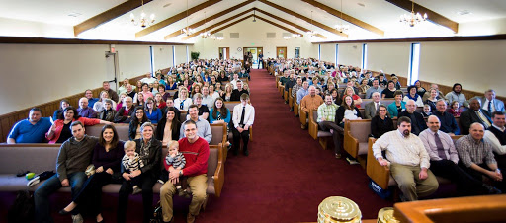
Sooner or later we all come together
Worship
Weddings
Funerals

Slide 4
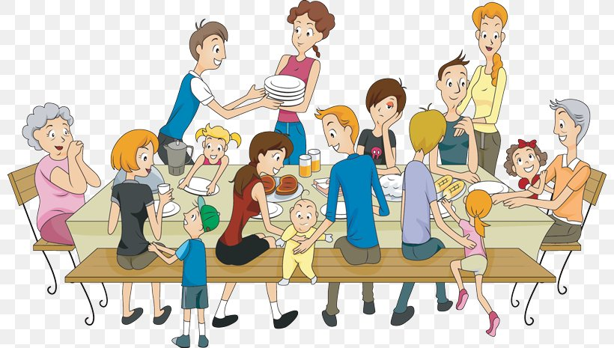
Sooner or later we all come together
Family
Food
Festivals

Slide 5
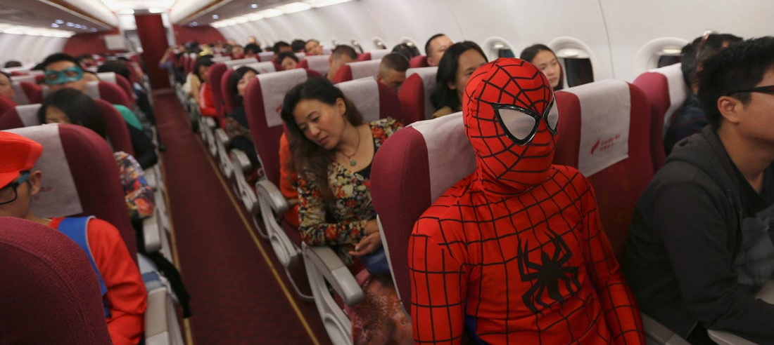
Sooner or later we all come together
Planes
Trains
Automobiles

Slide 6

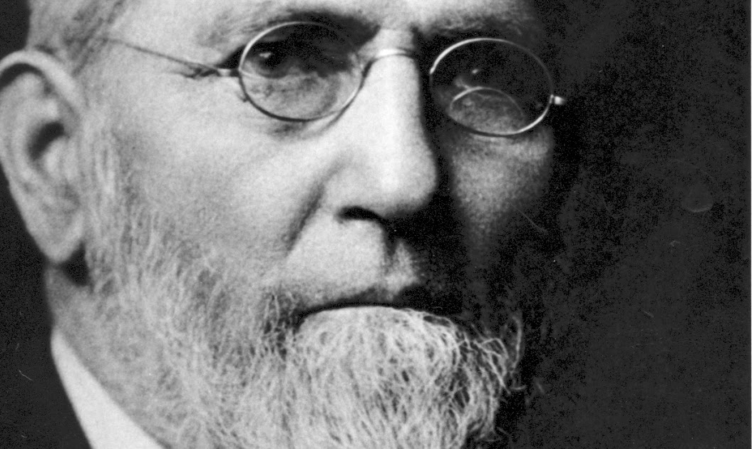
In our personal Spaces of Choice
Friends – Mentors -Favourites

Slide 7
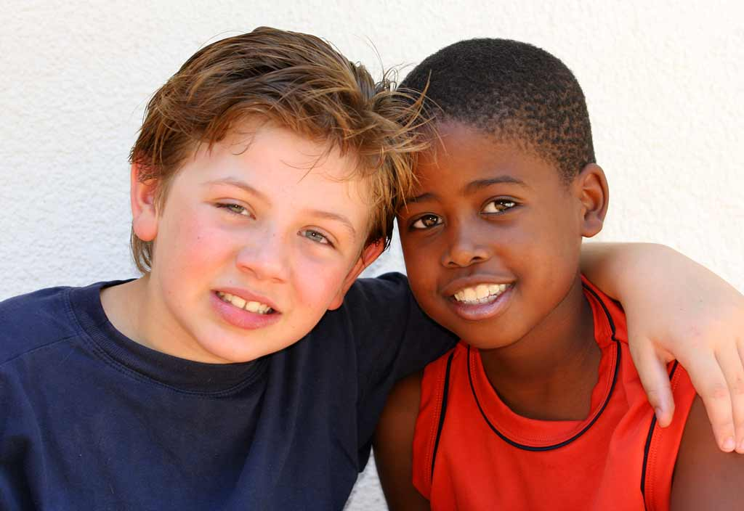
In our personal Spaces of Choice
We want them to be in our lives.
Proverbs 17:17—A friend loves at all times, And a brother is born for adversity.

Slide 8
In our personal Spaces of Choice
They influence our minds and hearts.

Slide 9

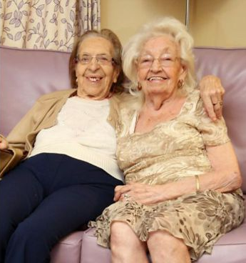
In our personal Spaces of Choice
It’s a very good place to be.

Slide 10
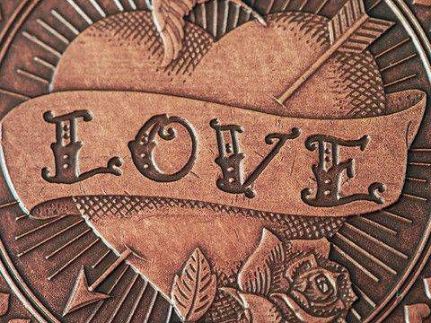
There’s another side of this coin

Slide 11
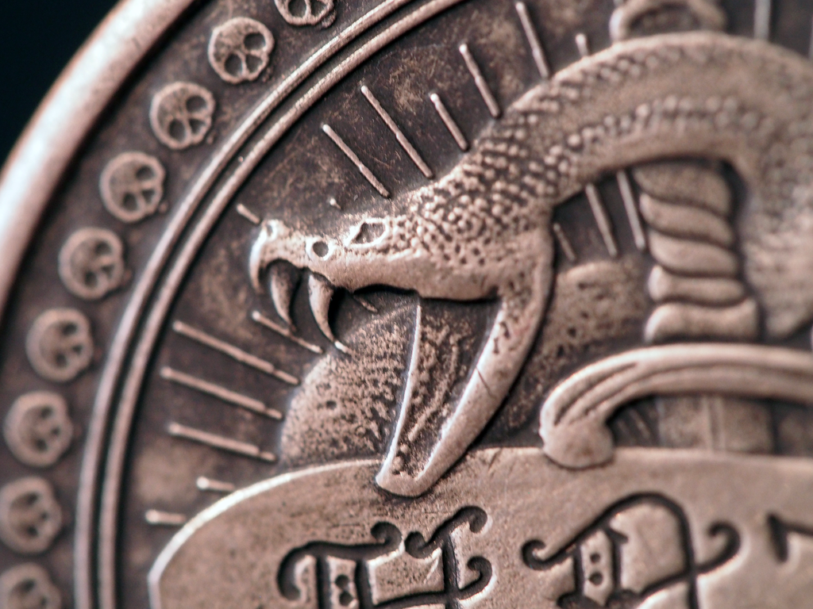
One that bites deep
Not always intentional
But deadly, all the same.

Slide 12
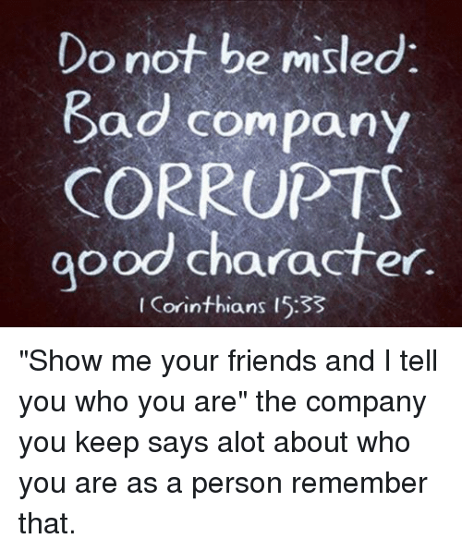
Oft Quoted – Too often ignored

Slide 13
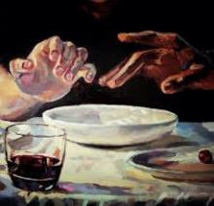
Jesus worked hard with Judas the betrayer.
Matthew 26:23—
And He answered, “He who dipped his hand with Me in the bowl is the one who will betray Me. (NASB95)

Slide 14
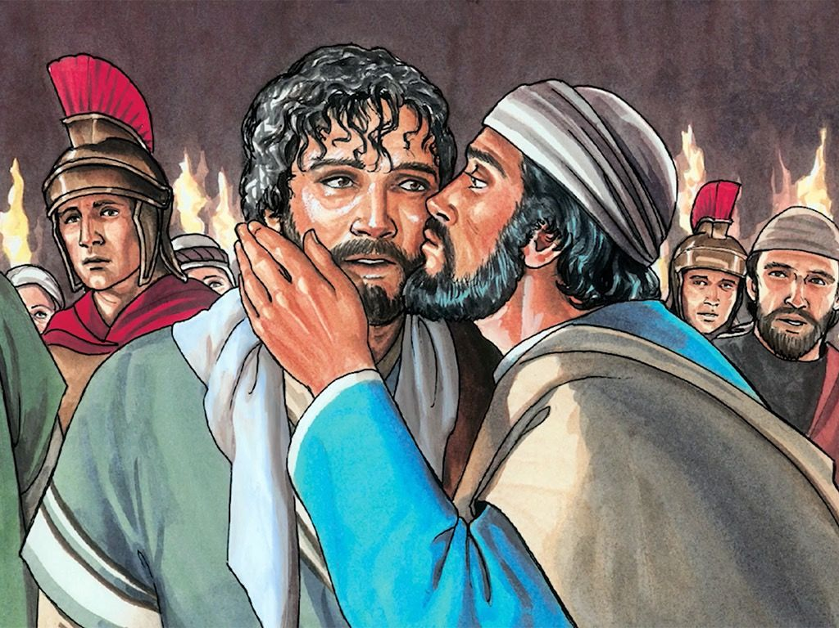
Luke 22:48—
But Jesus said to him, “Judas, are you betraying the Son of Man with a kiss?”
(NASB95)

Slide 15
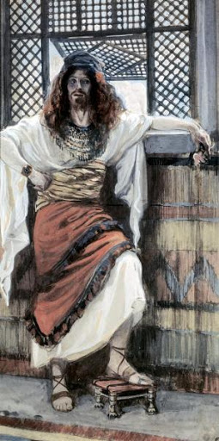
Bad Company
Jonadab
and
Amnon
(2Sam.13)

Slide 16
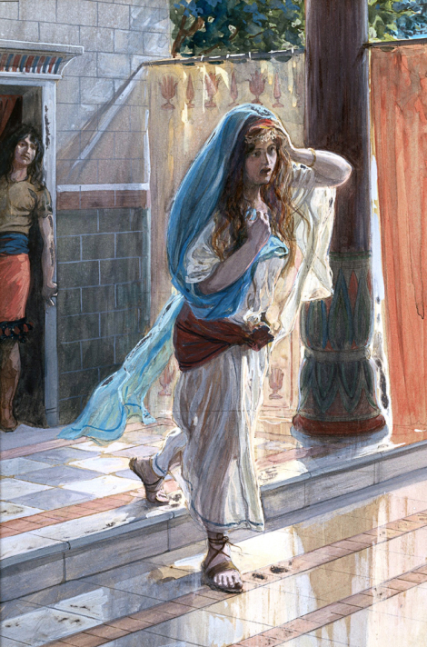
Bad Company
Jonadab told Amnon how to violate Tamar
(2Sam.13)

Slide 17
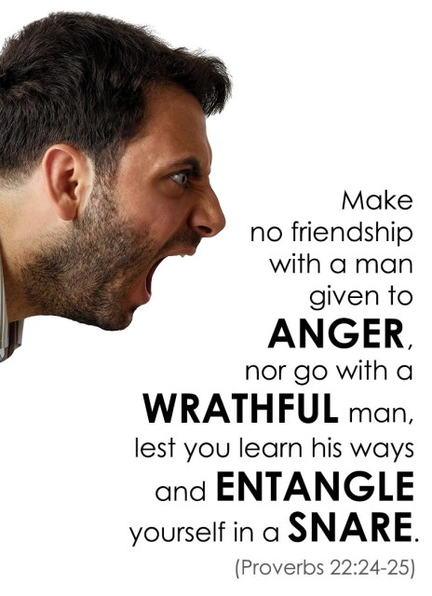
Bad Company
Some people are to be avoided!

Slide 18
Bad Company
You will either be a convert or a victim to him.
Choose today!

Slide 19
Bad Company
Luke 17:1-4—He said to His disciples, “It is inevitable that stumbling blocks come, but woe to him through whom they come! ²It would be better for him if a millstone were hung around his neck and he were thrown into the sea, than that he would cause one of these little ones to stumble. ³Be on your guard! If your brother sins, rebuke him; and if he repents, forgive him. ⁴And if he sins against you seven times a day, and returns to you seven times, saying, ‘I repent,’ forgive him.” (NASB95)

Slide 20
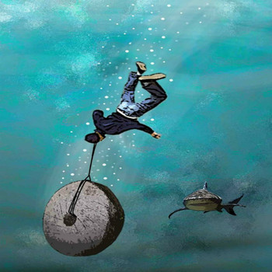

Slide 21
Bad Company
Remember that God forgives you and I multiple times a day
7 times is being generous
Jesus has made friends of ‘Bad Company.’
John 15:12-14—¹² “This is My commandment, that you love one another, just as I have loved you. ¹³Greater love has no one than this, that one lay down his life for his friends. ¹⁴ You are My friends if you do what I command you. (NASB95)

Slide 22

Acts 4:13—¹³ Now as they observed the confidence of Peter and John and understood that they were uneducated and untrained men, they were amazed, and began to recognize them as having been with Jesus. (NASB95)

