Slide 1
The church—What do you see?
The church doing its work

Slide 2
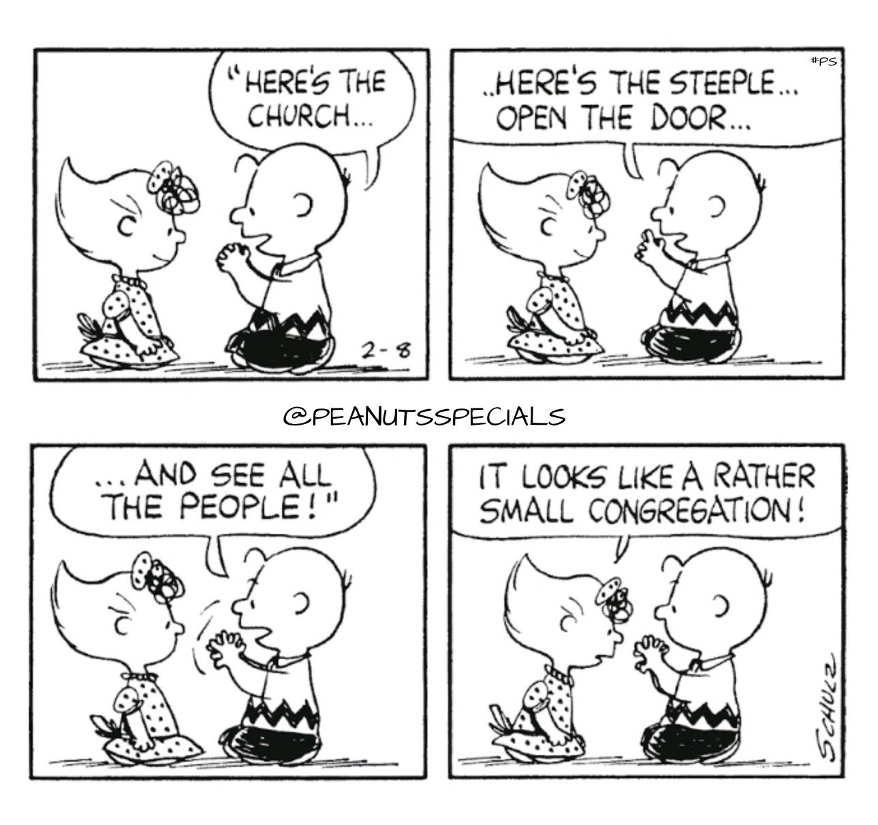
It used to be just this easy—
If you built it, they would come!

Slide 3
It used to be just this easy—
If you built it, they would come!

Slide 4
It used to be just this easy—
If you built it, they would come!

Slide 5
It used to be just this easy—
If you built it, they would come!

Slide 6
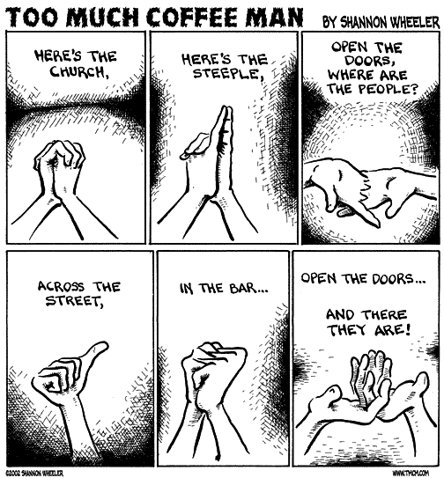
Some offer other theories…

Slide 7
Some offer other theories…

Slide 8
Once upon a time…
They say…
The people turned up to church to work, because they believed that the work was theirs.
When they went to worship they went to work.
When you came to share in praise, you also came to share in sacrifice.

Slide 9
Once upon a time…
They say…
The people turned up to church to work, because they believed that the work was theirs.
When they went to worship they went to work.
When you came to share in praise, you also came to share in sacrifice.

Slide 10
Once upon a time…
They say…
The people turned up to church to work, because they believed that the work was theirs.
When they went to worship they went to work.
When you came to share in praise, you also came to share in sacrifice.

Slide 11
Once upon a time…
They say…
The people turned up to church to work, because they believed that the work was theirs.
When they went to worship they went to work.
When you came to share in praise, you also came to share in sacrifice.

Slide 12
Once upon a time…
They say…also:
Times have changed.
Around the world there are still places where the church is growing as it once did.
But in our society many things are falling apart that we could once rely on…

Slide 13
Once upon a time…
They say…also:
Times have changed.
Around the world there are still places where the church is growing as it once did.
But in our society many things are falling apart that we could once rely on…

Slide 14
Once upon a time…
They say…also:
Times have changed.
Around the world there are still places where the church is growing as it once did.
But in our society many things are falling apart that we could once rely on…

Slide 15
Once upon a time…
They say…also:
Times have changed.
Around the world there are still places where the church is growing as it once did.
But in our society many things are falling apart that we could once rely on.

Slide 16
Once upon a time…
My jury is out on some of these things:
Not much has changed at the core.
The committed—
  The workers worked then—they work now!
  The givers gave then—They give now!
  The evangelistic...
  The teachers…
  Those who cared…
What about Numbers…?

Slide 17
Once upon a time…
My jury is out on some of these things
Numbers are merely indicators of:
a. Good things
3000 on Pentecost
2 in a jail in Philippi
1 on a cross

Slide 18
Once upon a time…
My jury is out on some of these things
Numbers are merely indicators of:
a. Good things
3000 on Pentecost
2 in a jail in Philippi
1 on a cross
b. Bad things
A mob crying, ‘crucify him!’
Herod and Pilate
1 Traitor

Slide 19
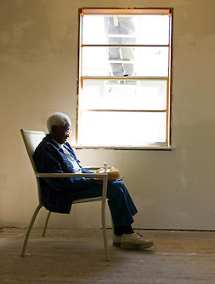
Open the family doors what will you find—?

Slide 20
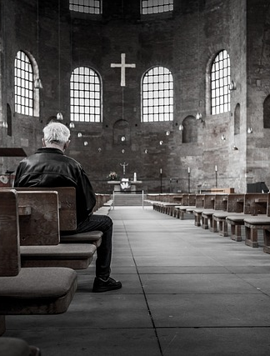
Open the doors of many church buildings and what will you find—?

Slide 21
Open the doors at Morningside and what will you find…?

Slide 22
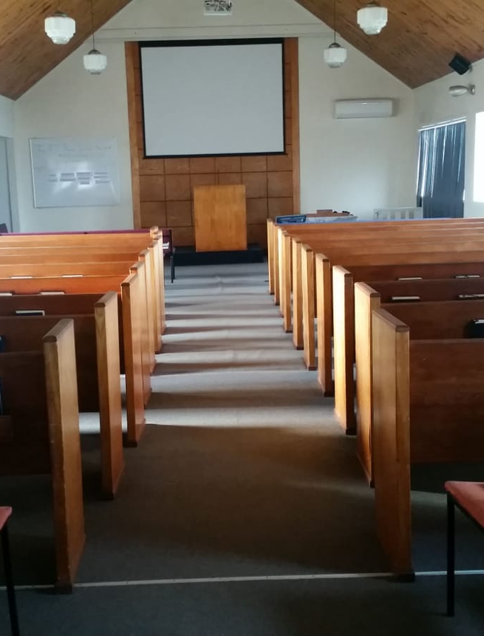
Open the doors at Morningside and what will you find…?

Slide 23
For now, anyway.
We’ll be Back!

Slide 24
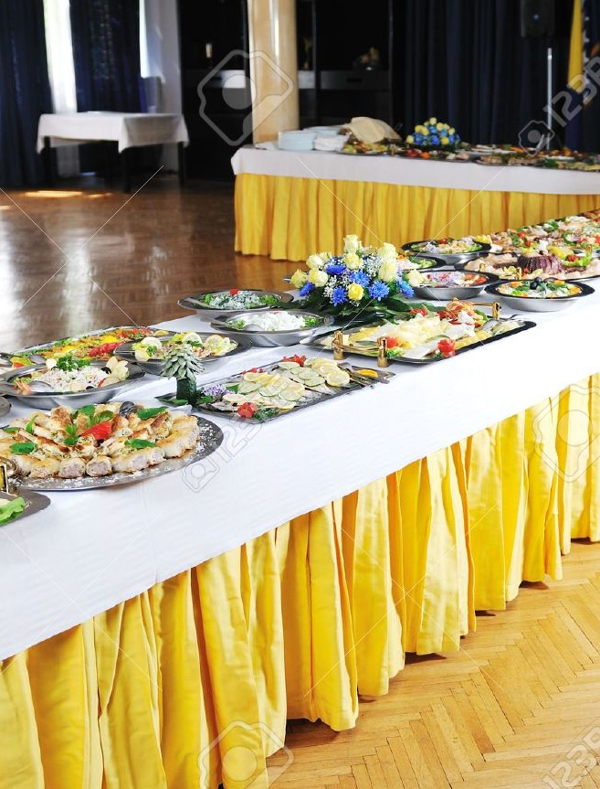
This I know for sure…
There have been and always will be smorgasbord Christians.

Slide 25
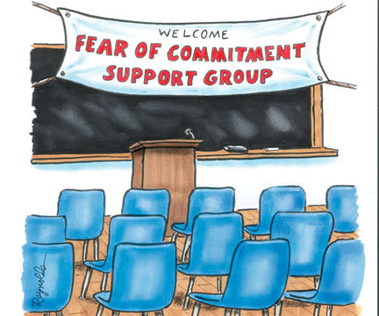
This I know for sure…
There have been and always will be non-starters

Slide 26
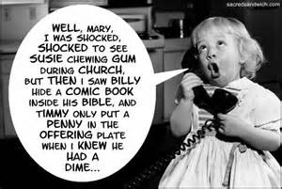
This I know for sure…
There have been and always will be gossips

Slide 27
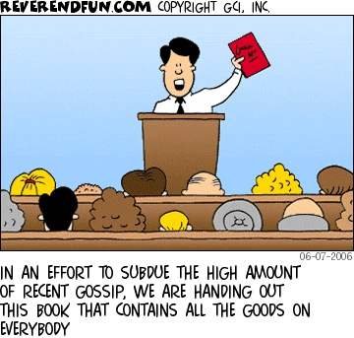
This I know for sure…

Slide 28
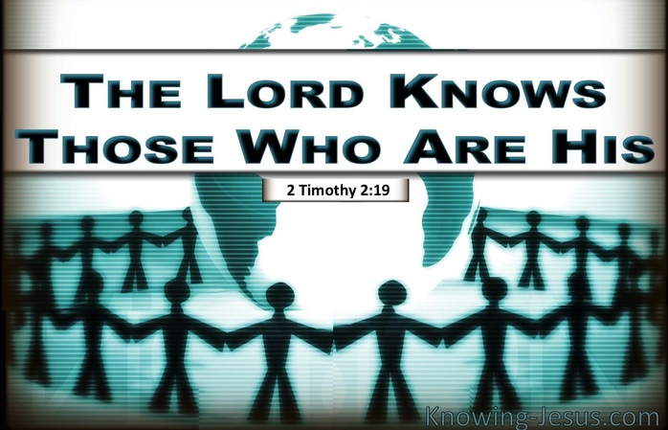
This I know for sure…Too!

Slide 29
This I know for sure…Too!
2 Timothy 2:19—¹⁹ Nevertheless, the firm foundation of God stands, having this seal,
“The Lord knows those who are His,” and,
“Everyone who names the name of the Lord is to abstain from wickedness.” (NASB95)

Slide 30
This I know for sure…Too!
2 Timothy 2:19—¹⁹ Nevertheless, the firm foundation of God stands, having this seal,
“The Lord knows those who are His,” and,
“Everyone who names the name of the Lord is to abstain from wickedness.” (NASB95)

Slide 31
This I know for sure…Too!
2 Timothy 2:19—¹⁹ Nevertheless, the firm foundation of God stands, having this seal,
“The Lord knows those who are His,” and,
“Everyone who names the name of the Lord is to abstain from wickedness.” (NASB95)

Slide 32
This I know for sure…Too!
Ephesians 2:19-22—¹⁹Consequently, you are no longer foreigners and strangers, but fellow citizens with God’s people and also members of his household, ²⁰built on the foundation of the apostles and prophets, with Christ Jesus himself as the chief cornerstone. ²¹In him the whole building is joined together and rises to become a holy temple in the Lord. ²²And in him you too are being built together to become a dwelling in which God lives by his Spirit.

Slide 33
This I know for sure…Too!
The church is not doors and steeples—its God and His people!
Built on love and sacrifice.
Built on truth-teachings of apostles and prophets.
Built as a house for all-all invited
Built as a house for God-This is how God has chosen to live among people.

Slide 34
This I know for sure…Too!
The church is a body
Ephesians 5:29-30—²⁹ After all, no one ever hated their own body, but they feed and care for their body, just as Christ does the church— ³⁰ for we are members of his body.

Slide 35
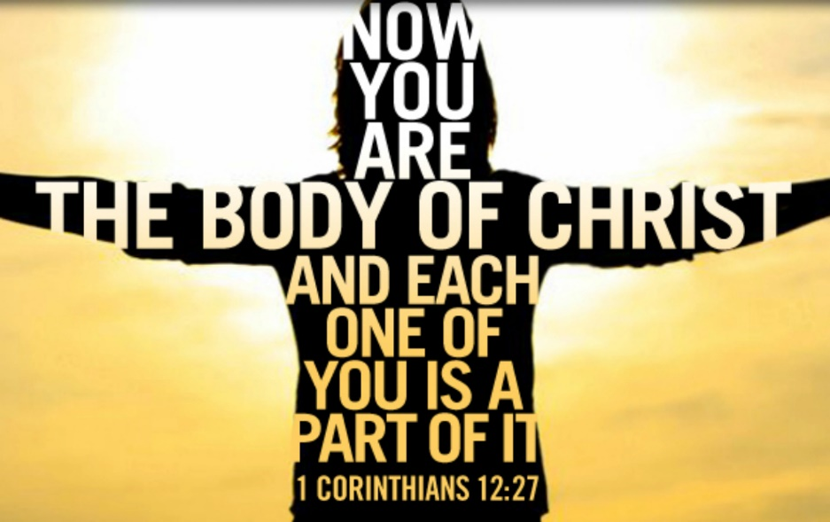
This I know for sure…Too!
All of us are important
He counts you as significant-just as we count every part of our body as vital.
Every part has a role to fulfil.
When we leave the body—
We leave life.

