Slide 1
“Time for Change.”
John Staiger
For Morningside Church of Christ
Sunday 5 April 2020
AM Sermon
Broadcast live at 6pm on Facebook from 16 McClintock Road, Massey, Auckland.

Slide 2

Looking to the future

Slide 3
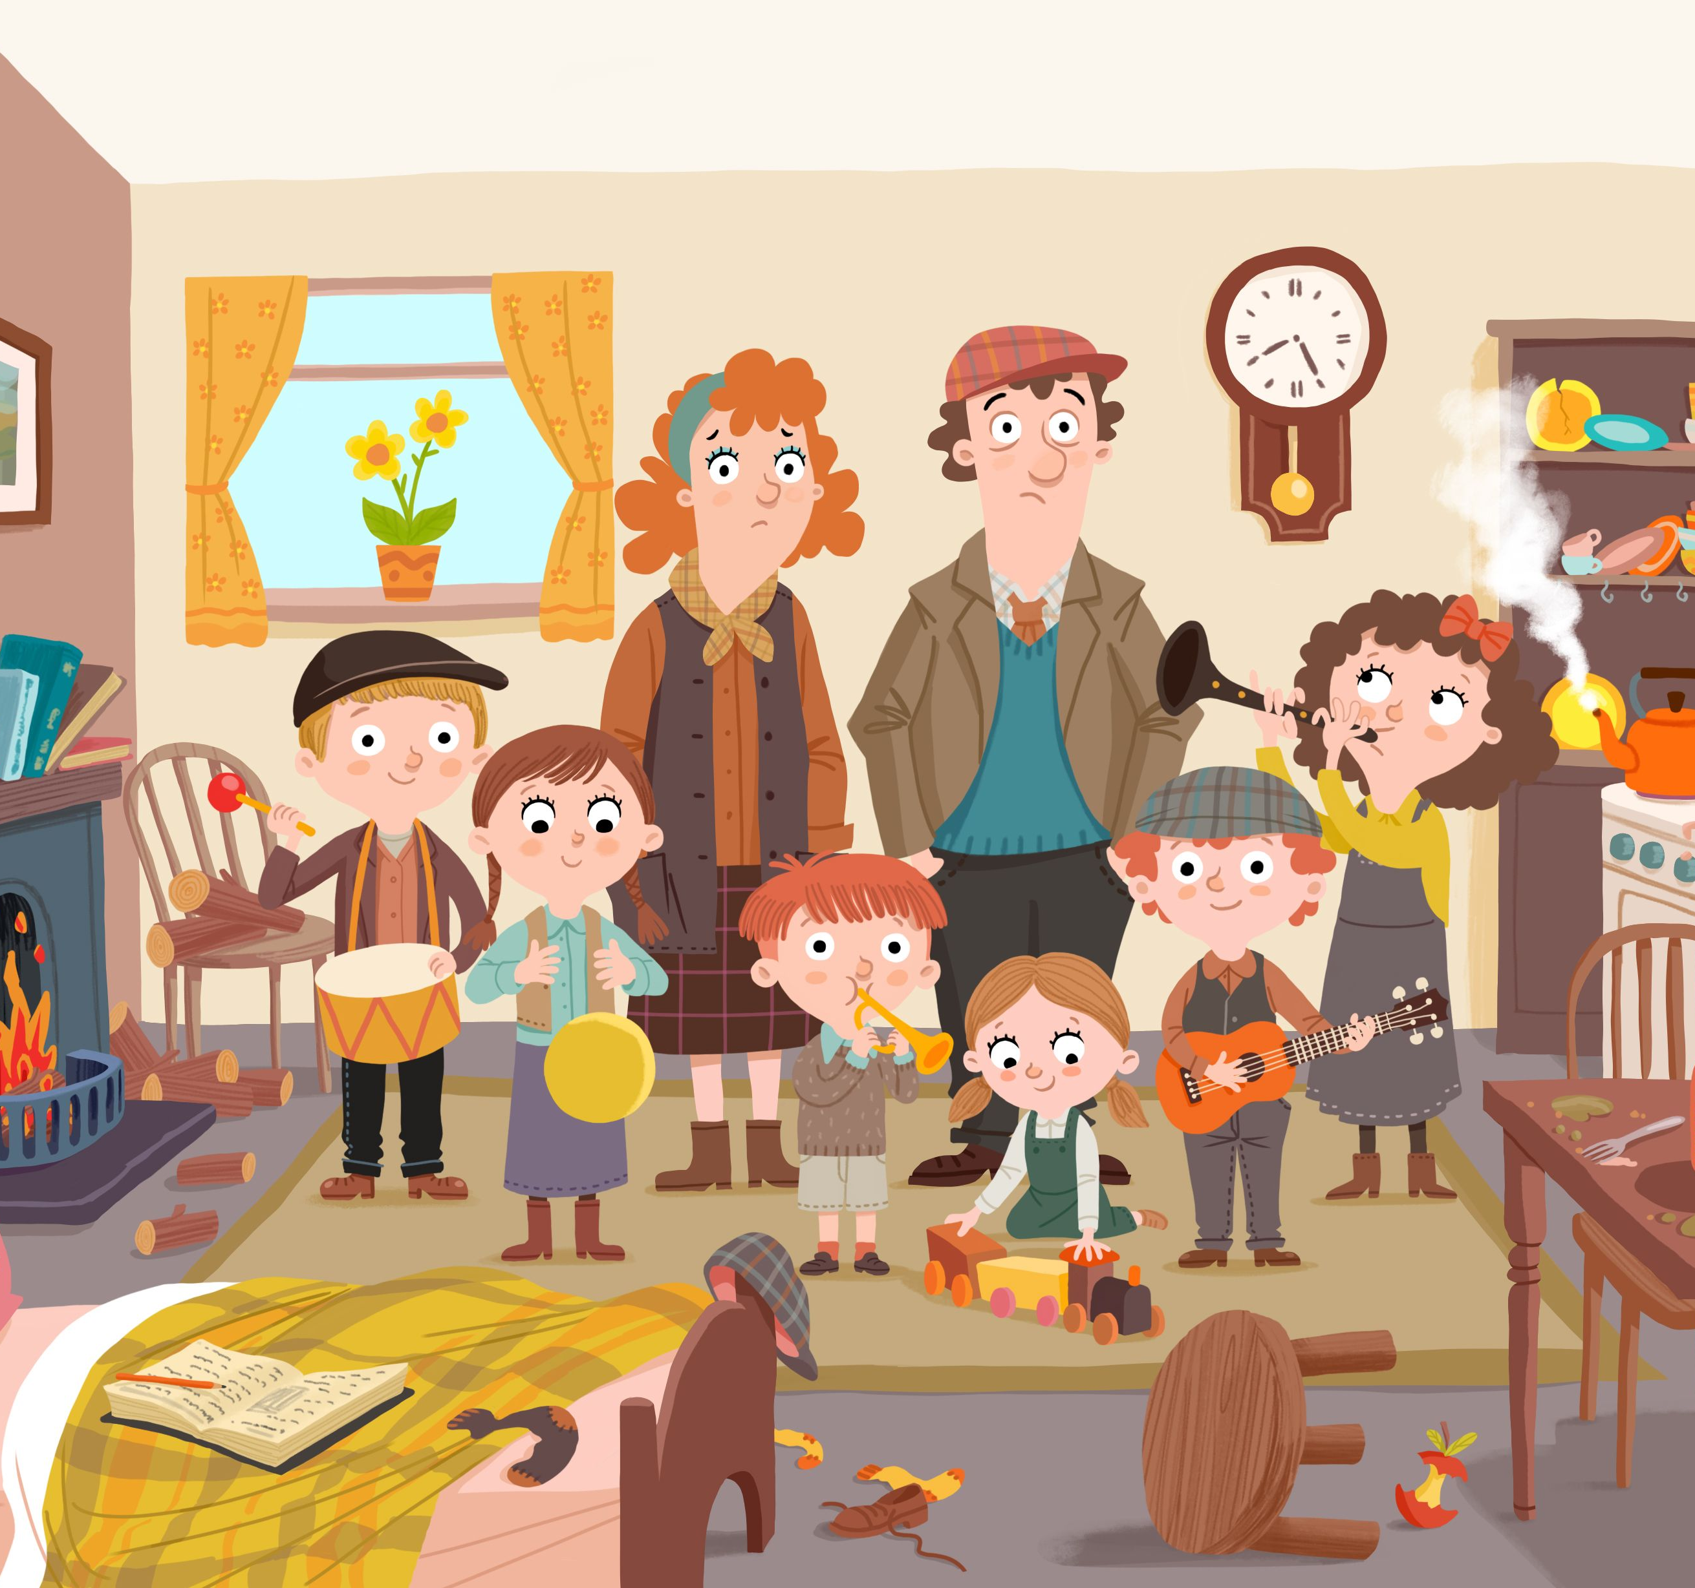
You must be Joking…?
It’s Day 11 of Lock-Down in NZ

Slide 4

Back to normal doesn’t seem so far away.

Slide 5
But Change We Must

Slide 6

I pray that the good things are getting better…
Each one of us has a role—Even in isolation

Slide 7
…better
Priorities:
Spiritual
    “Grow in the grace and knowledge of our Lord and Saviour Jesus Christ” (2Pet.3:18).
Each one of us has a role

Slide 8

Get clever in your Bible study

Slide 9

Start family devotionals
Make it fun

Slide 10
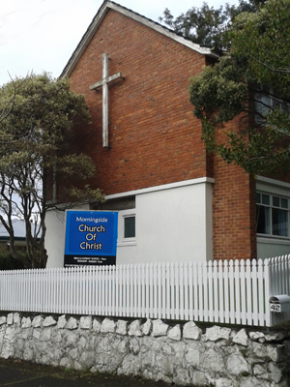
Find Online Resources—Good ones
Articles
Sermons
Information
Contacts
morningsidechurchofchrist.org.nz

Slide 11
…better
Priorities:
Spiritual
    Pray
      Lost
      Elderly
      Sick
      Unemployed
      Opportunities
Each one of us has a role

Slide 12
…better
Priorities:
Spiritual
    Repent
      Selfishness
      Impatience
It cleanses the soul
Clears the air
Lifts the spirits
Makes us useful to God
Each one of us has a role

Slide 13
…better
Priorities:
Relationships
    Family
      Christlike
      Lead
        Example
        Inspire
        Creative
Each one of us has a role

Slide 14


Slide 15


Slide 16
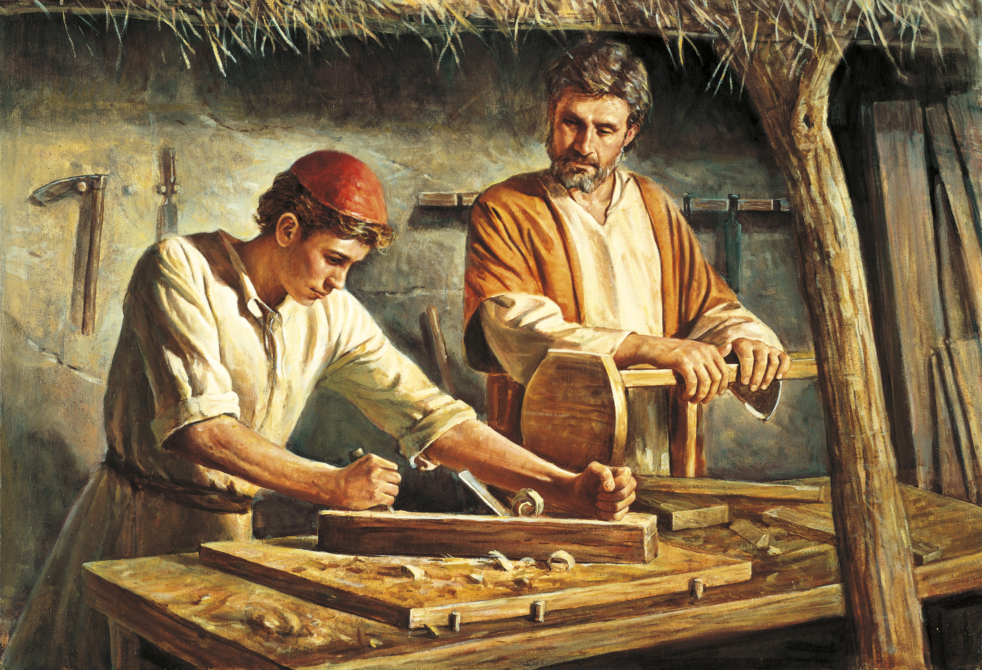
Jesus’ father taught him what he knew

Slide 17
…better
Priorities:
Relationships
    Neighbours
      Finally visible
      Present needs
      Bring hope
  Let your good works glorify God (Mt.5:16)
  Powerful evangelism
Each one of us has a role

Slide 18
…better
Priorities:
Relationships
    Brethren
      Phone them
      Text
      Email
Only in 1 of 3 places…
Each one of us has a role

Slide 19
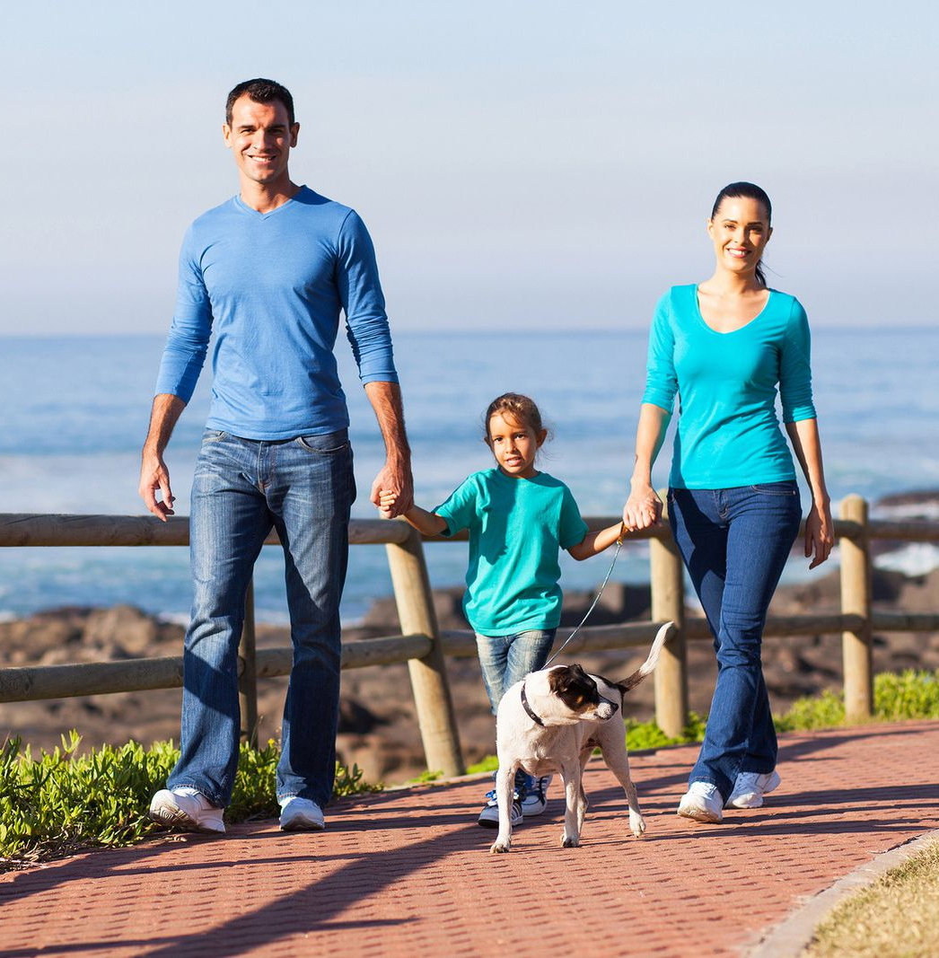
Each one of us has a role

Slide 20

Each one of us has a role

Slide 21
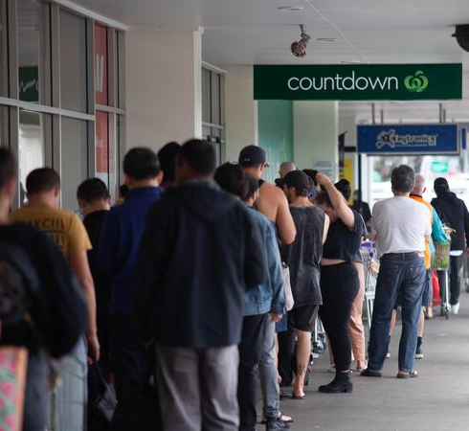
Each one of us has a role

Slide 22

Allow God to change things that need to be changed…
I need to adjust to a new reality

Slide 23
…changed
Don’t want:
  To continue in godless thinking—
I need to adjust to a new reality

Slide 24
Yes,
“Think for yourself!”
However,…
I need to adjust to a new reality

Slide 25

However,…
Matthew 15:18-20—But those things which proceed out of the mouth come from the heart, and they defile a man. (NKJV)

Slide 26

However,…
Matthew 15:18-20—¹⁹For out of the heart proceed evil thoughts, murders, adulteries, fornications, thefts, false witness, blasphemies.

Slide 27

However,…
Matthew 15:18-20—²⁰These are the things which defile a man, but to eat with unwashed hands does not defile a man.” (NKJV)

Slide 28

Think
Twice
2 Corinthians 10:5—We are destroying speculations and every lofty thing raised up against the knowledge of God, and we are taking every thought captive to the obedience of Christ, (NASB95)

Slide 29
…changed
Don’t want:
  To be caught up in
  godless viewing—
I need to adjust to a new reality

Slide 30


This stuff is endless…

Slide 31
This stuff is endless…
1. The Good
  A powerful tool for learning and encouragement

Slide 32
This stuff is endless…
The Bad
  Mindless nonsense that will stunt your soul
  And make you evangelistically useless

Slide 33
This stuff is endless…
And the godless
  You can’t grow Godly hearts, churches and families with ungodly junk pouring into your mind.

Slide 34
…changed
Don’t want:
  To be caught burying my talents—
Everyone can be useful

Slide 35
Prepare for your return today…
Encourage that teacher
Plan to paint that room
Deliver groceries
Visit the sick

Slide 36
Prepare for your return today…
Teach a Sunday School class
Go to church
Find good in others
Fix something

Slide 37
Prepare for your return today…
Talk to someone about your soul

Slide 38
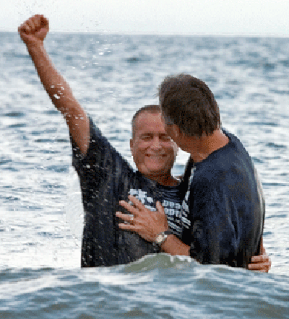
Acts 2:37-38— Peter said to them, “Repent, and each of you be baptized in the name of Jesus Christ for the forgiveness of your sins; and you will receive the gift of the Holy Spirit. (NASB95)

