Slide 1
“Add Faith, Too.”
John Staiger
For Morningside Church of Christ
Sunday 24 May 2020
AM Sermon
Broadcast from home of John Staiger

Slide 2
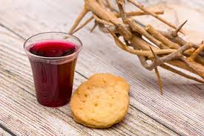
Sunday 24 May 2020

Slide 3
Welcome
Sunday 24 May 2020
John Staiger
For Morningside Church of Christ
(42 Leslie Ave, Sandringham, Auckland)
Facebook Live
11am
6pm
And Wednesday at 7pm

Slide 4
Add
Faith,
Too
2 Peter 1:5

Slide 5
2 Peter 1:5-7
⁵For this very reason, make every effort to add to your faith
goodness;
and to goodness, knowledge;
⁶and to knowledge, self-control;
and to self-control, perseverance;
and to perseverance, godliness;
⁷and to godliness, brotherly kindness;
and to brotherly kindness, love.

Slide 6
We live in a world of struggles

Slide 7
We all long for meaning
and
significance.

Slide 8
Everyone wants to put their trust in
something
immovable.

Slide 9
Belief in something
that is valuable
beyond
question

Slide 10
Faith in Something

Slide 11
Faith in Something
1. It is expressed in life through ‘acts of worship.’
Time
Money
Good deeds
Fellowship
Discussion

Slide 12
Faith in Something
1. It is expressed in life through ‘acts of worship.’
Time
Money
Good deeds
Fellowship
Discussion

Slide 13
Faith in Something
2. It brings meaning
Convictions that matter
Ideals to be lived up to
Ideas to uplift the spirit

Slide 14
Faith in Something
2. It brings meaning
Convictions that matter
Ideals to be lived up to
Ideas to uplift the spirit

Slide 15
Faith in Something
3. It brings Community
Camaraderie
Friendship
Mutual trust

Slide 16
Faith in Something
3. It brings Community
Camaraderie
Friendship
Mutual trust

Slide 17

Good Questions to ask:
1. What do you have faith in?
Self
Others
Evolution
Islam
Buddhist thought

Slide 18
Good Questions to ask:
1. What do you have faith in?
Self
Others
Evolution
Islam
Buddhist thought

Slide 19
Good Questions to ask:
2. How has it changed your life?
Better / Worse
Character
Self-control
Family involvement
Skills

Slide 20
Good Questions to ask:
2. How has it changed your life?
Better / Worse
Character
Self-control
Family involvement
Skills

Slide 21
Good Questions to ask:
3. Have you considered Jesus?
Why not?
What have you seen?
What have you heard?

Slide 22
Good Questions to ask:
3. Have you considered Jesus?
Why not?
What have you seen?
What have you heard?

Slide 23
Good Questions to ask:
4. Can I tell you about my faith in Jesus?

Slide 24
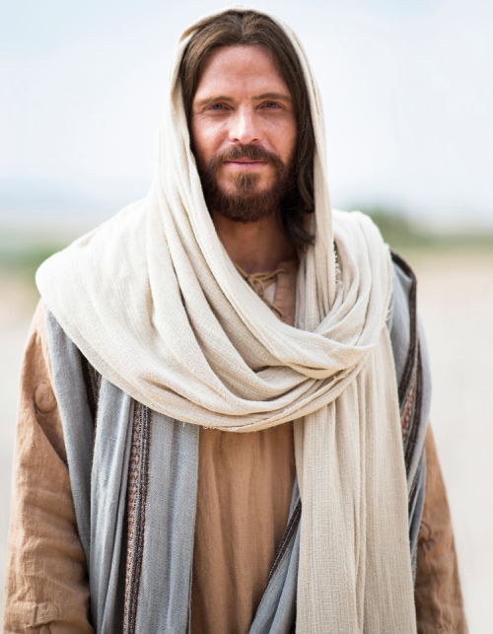
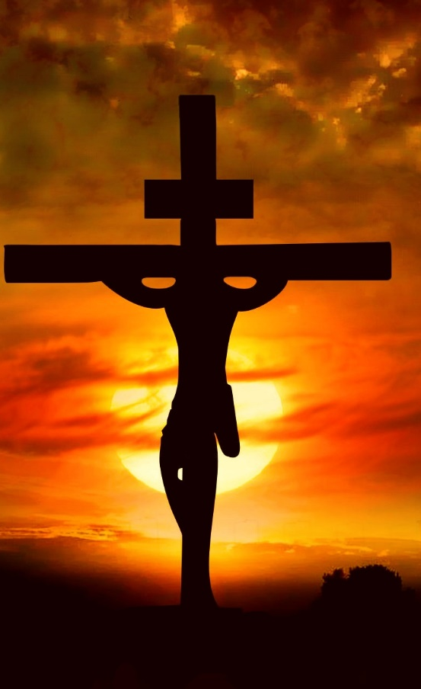
Good Questions to ask:
4. Can I tell you about my faith in Jesus?
a. He is Saviour of the world
Titus 3:4-5—⁴But when the kindness of God our Savior and His love for mankind appeared, ⁵He saved us, not on the basis of deeds which we have done in righteousness, but according to His mercy, by the washing of regeneration and renewing by the Holy Spirit,

Slide 25
Good Questions to ask:
4. Can I tell you about my faith in Jesus?
a. He is Saviour of the world
Titus 3:4-5—⁴But when the kindness of God our Saviour and His love for mankind appeared, ⁵He saved us, not on the basis of deeds which we have done in righteousness, but according to His mercy, by the washing of regeneration and renewing by the Holy Spirit,

Slide 26
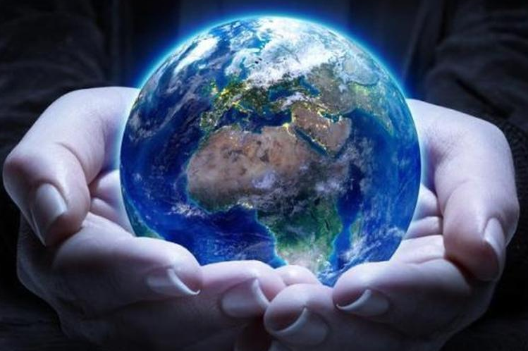
Good Questions to ask:
4. Can I tell you about my faith in Jesus?
b. He is creator of all things
John 1:3—³ All things came into being through Him, and apart from Him nothing came into being that has come into being.

Slide 27
Good Questions to ask:
4. Can I tell you about my faith in Jesus?
b. He is creator of all things
John 1:3—³ All things came into being through Him, and apart from Him nothing came into being that has come into being.

Slide 28
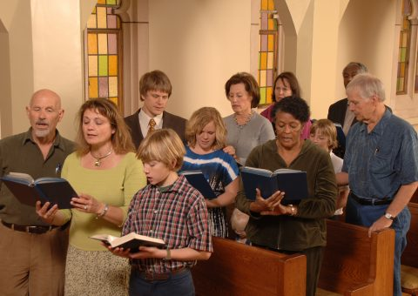
Good Questions to ask:
4. Can I tell you about my faith in Jesus?
c. He is the head of the body
Ephesians 1:22-23

Slide 29
Good Questions to ask:
4. Can I tell you about my faith in Jesus?
c. He is the head of the body
Ephesians 1:22-23—²²And He put all things in subjection under His feet, and gave Him as head over all things to the church, ²³which is His body, the fullness of Him who fills all in all. (NASB95)

Slide 30

Good Questions to ask:
4. Can I tell you about my faith in Jesus?
d. He is coming back to judge the living and the dead
Hebrews 9:27-28—²⁷And inasmuch as it is appointed for men to die once and after this comes judgment, ²⁸so Christ also, having been offered once to bear the sins of many, will appear a second time for salvation without reference to sin, to those who eagerly await Him.

Slide 31
Good Questions to ask:
4. Can I tell you about my faith in Jesus?
d. He is coming back to judge the living and the dead
Hebrews 9:27-28—²⁷And inasmuch as it is appointed for men to die once and after this comes judgment, ²⁸so Christ also, having been offered once to bear the sins of many, will appear a second time for salvation without reference to sin, to those who eagerly await Him.

Slide 32
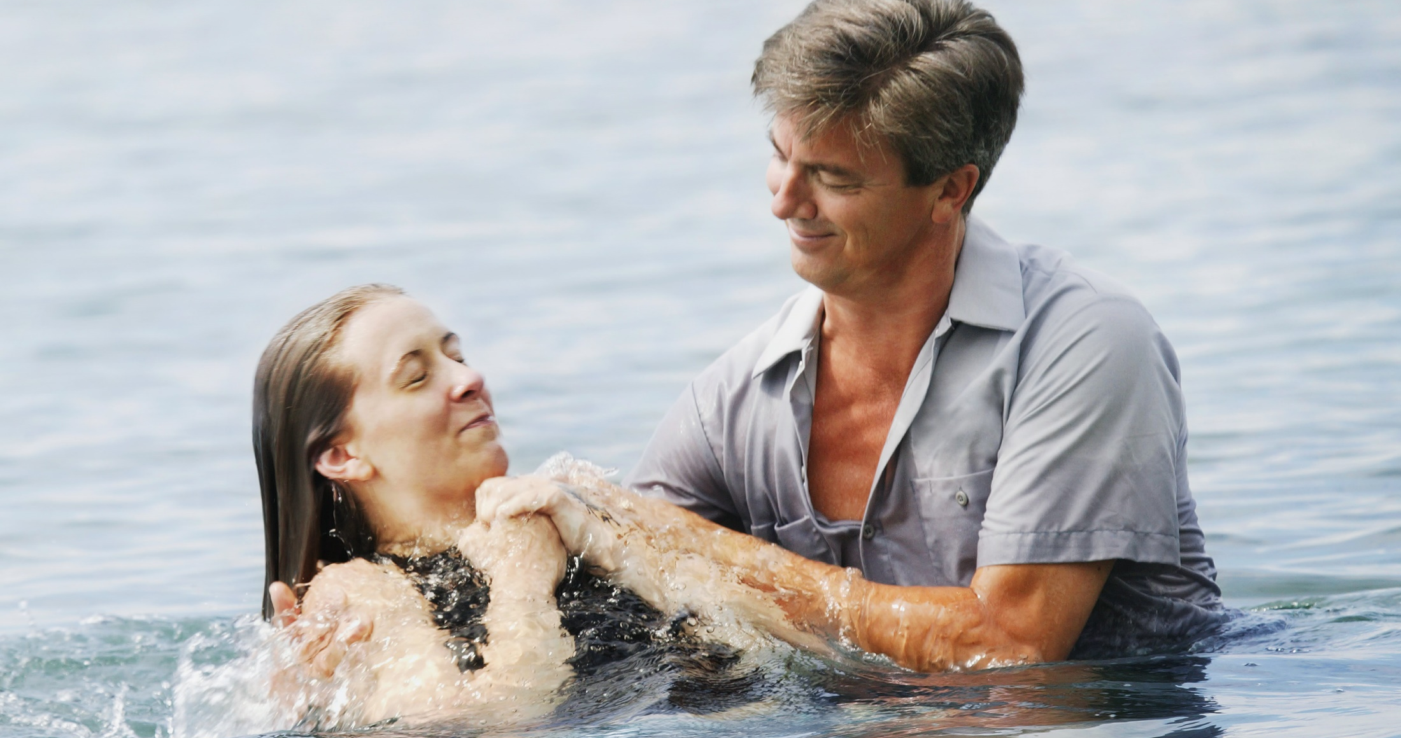
Mark 16:16—¹⁶He who has believed and has been baptized shall be saved; but he who has disbelieved shall be condemned. (NASB95)

Slide 33
See you again…
Facebook Live
6 o’clock
This Evening
And Wednesday at 7pm

