Slide 1
“Add Godliness, Too.”
John Staiger
For Morningside Church of Christ
Sunday 10 May 2020
AM Sermon
Broadcast at 6pm on Facebook Live
From 16 McClintock Road, Massey, Auckland.

Slide 2
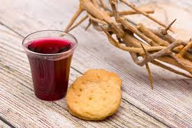
Sunday 10 May 2020

Slide 3
Welcome
Sunday 10 May 2020
Morningside Church of Christ
(42 Leslie Ave, Sandringham, Auckland)
Facebook Live
11am
6pm
And Wednesday at 7pm

Slide 4
Add Godliness, Too.
2 Peter 1:7

Slide 5
2 Peter 1:3-4
3 His divine power has given us everything we need for life and godliness through our knowledge of him who called us by his own glory and goodness. 4Through these he has given us his very great and precious promises, so that through them you may participate in the divine nature and escape the corruption in the world caused by evil desires.

Slide 6
2 Peter 1:5-7
5 For this very reason, make every effort
to add to your faith
goodness;
and to goodness, knowledge;
6 and to knowledge, self-control;
and to self-control, perseverance;
and to perseverance, godliness;
7 and to godliness, brotherly kindness;
and to brotherly kindness, love.

Slide 7

2 Peter 1:3—³seeing that His divine power has granted to us everything pertaining to life and godliness, through the true knowledge of Him who called us ^{[a]}by His own glory and ^{[b]}excellence. (NASB95) [a]Or to [b]Or virtue

Slide 8
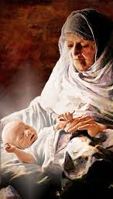
Luke 2:36-38—³⁶And there was a prophetess, ^{[a]}Anna the daughter of Phanuel, of the tribe of Asher. She was advanced in ^{[b]}years and had lived with her husband seven years after her ^{[c]}marriage,

Slide 9
Luke 2:36-38—
³⁷and then as a widow to the age of eighty-four. She never left the temple, serving night and day with fastings and prayers.

Slide 10
Luke 2:36-38—
³⁸At that very ^{[d]}moment she came up and began giving thanks to God, and continued to speak of Him to all those who were looking for the redemption of Jerusalem. (NASB95) [a]Or Hannah [b]Lit days [c]Lit virginity [d]Lit hour

Slide 11


Slide 12


Slide 13
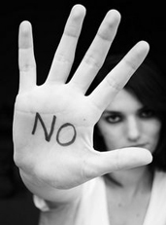
Titus 2:11-12—¹¹For the grace of God has appeared, ^{[a]}bringing salvation to all men, ^{12[b]}instructing us to deny ungodliness and worldly desires and to live sensibly, righteously and godly in the present age, (NASB95) [a]Or to all men, bringing [b]Or disciplining

Slide 14

Does the 21st century person know what ungodliness is?

Slide 15
We have dragged some our 20th century habits along with us!

Slide 16
We still believe:
“As long as it doesn’t hurt anyone, it is not sin.”

Slide 17
Very Naïve!

Slide 18
Name some ungodly people who do not believe they are hurting anyone—

Slide 19
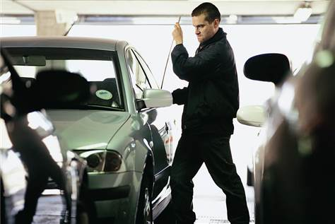
Thief

Slide 20
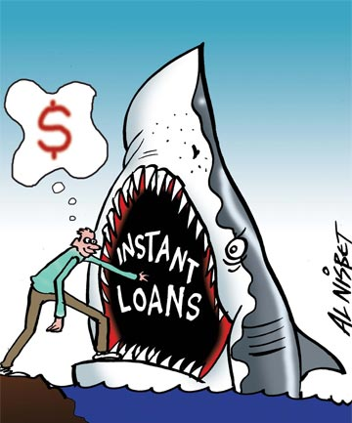
Loan shark

Slide 21

Home
Wreckers:
Adultery
Porn
Addictions
Laziness
Over-spending
Selfishness

Slide 22

Liar

Slide 23

Liar

Slide 24

The only way to overcome ungodliness:

Slide 25
The only way to overcome ungodliness:
1. Be righteous before God.

Slide 26
The only way to overcome ungodliness:
Be righteous before God.
Godly Words transform you.

Slide 27
The only way to overcome ungodliness:
Be righteous before God.
Godly Words transform you.
Godly people inspire you

Slide 28
The only way to overcome ungodliness:
Be righteous before God.
Godly Words transform you.
Godly people inspire you
Godly actions change the world.

Slide 29
I accept full responsibility
For my actions and the actions of those I am accountable for!

Slide 30

Colossians 3:5—Therefore consider the members of your earthly body as dead to immorality, impurity, passion, evil desire, and greed, which amounts to idolatry. (NASB95)

Slide 31

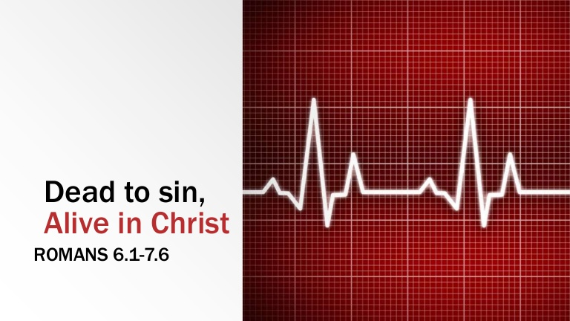

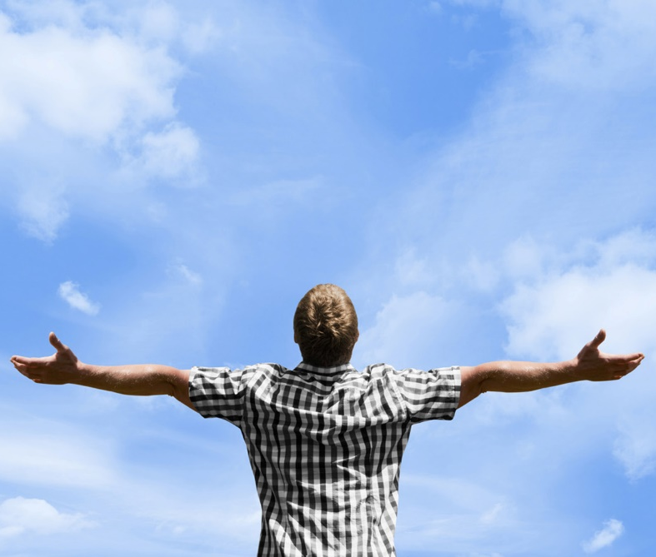
Romans 6:11—Even so consider yourselves to be dead to sin, but alive to God in Christ Jesus. (NASB95)

Slide 32

1 Timothy 4:7—⁷ But ^{[a]}have nothing to do with worldly fables fit only for old women. On the other hand, discipline yourself for the purpose of godliness; (NASB95) [a]Or reject

Slide 33
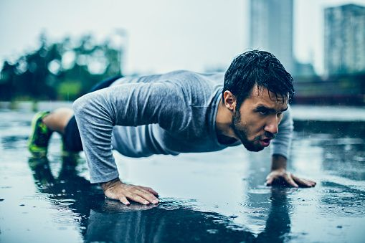
1 Timothy 4:8—⁸ for bodily discipline is only of little profit, but godliness is profitable for all things, since it holds promise for the present life and also for the life to come. (NASB95)

Slide 34

2 Timothy 3:12—¹² Indeed, all who desire to live godly in Christ Jesus will be persecuted. (NASB95)

Slide 35
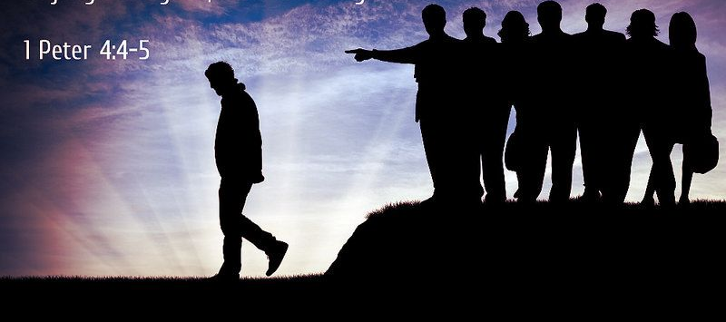
1 Peter 4:4—⁴In all this, they are surprised that you do not run with them into the same excesses of dissipation, and they malign you; (NASB95)

Slide 36
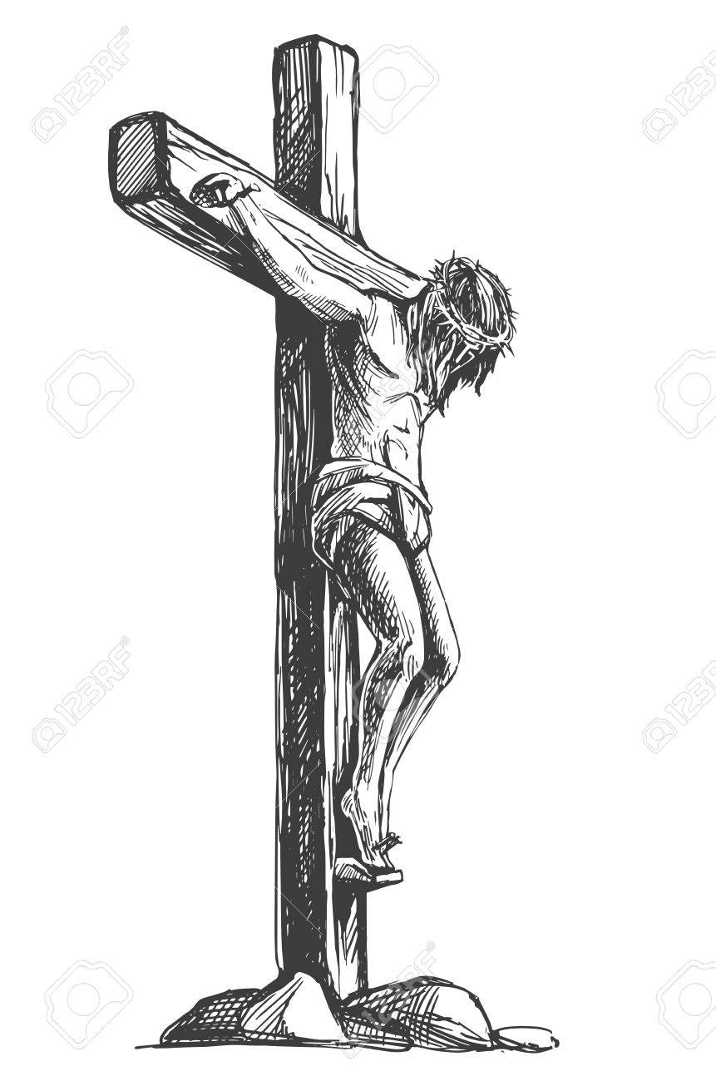
Romans 5:6—⁶ For while we were still helpless, at the right time Christ died for the ungodly. (NASB95)

Slide 37
1 Peter 2:24—²⁴and He Himself ^{[a]}bore our sins in His body on the ^{[b]}cross, so that we might die to ^{[c]}sin and live to righteousness; for by His ^{[d]}wounds you were healed. (NASB95) [a]Or carried...up to the cross [b]Lit wood [c]Lit sins [d]Lit wound; or welt

Slide 38
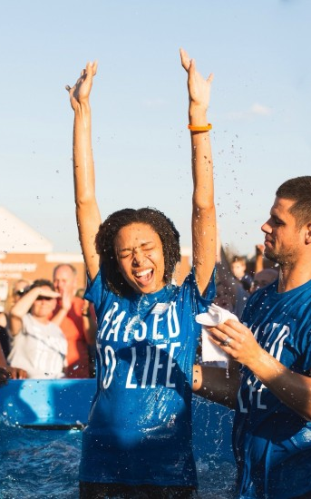
Romans 6:4—⁴Therefore we have been buried with Him through baptism into death, so that as Christ was raised from the dead through the glory of the Father, so we too might walk in newness of life. (NASB95)

