Slide 1
“Add Love, Too.”
John Staiger
For Morningside Church of Christ
Sunday 17 May 2020
AM Sermon
Broadcast from home of Gavin and Colleen de Steur

Slide 2
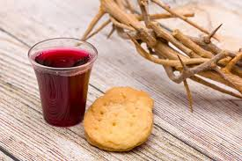
Sunday 17 May 2020

Slide 3
Welcome
Sunday 26 April 2020
For Morningside Church of Christ
(42 Leslie Ave, Sandringham, Auckland)
Facebook Live
11am
6pm
And Wednesday at 7pm

Slide 4
Add Love, Too
2 Peter 1:5

Slide 5
2 Peter 1:5-7
⁵For this very reason, make every effort to add to your faith
goodness;
and to goodness, knowledge;
⁶and to knowledge, self-control;
and to self-control, perseverance;
and to perseverance, godliness;
⁷and to godliness, brotherly kindness;
and to brotherly kindness, love.

Slide 6
Love— Dangerous when ill-defined.
“I Love You.”

Slide 7
Love— Dangerous when ill-defined.
It pays to check for any unrealistic conditions

Slide 8
Conditional Love
…you stay attractive to me!

Slide 9
Conditional Love
…you make me feel good!

Slide 10
Conditional Love
…you do what I say!

Slide 11
Conditional Love
…you don’t expect me to change!

Slide 12
Conditional Love
…you satisfy my wants and needs!

Slide 13
Conditional Love
…you love me!

Slide 14
Love— As
defined
by
God
Beyond…
Hollywood
Today’s definition of
Love is sex and short-lived Romance

Slide 15
Love— As
defined
by
God
Beyond…
Trying to fulfill
Today’s temporary
Needs and Wants.

Slide 16
Love— As
defined
by
God
Beyond…
Trying to adjust
Today’s
Circumstances

Slide 17
Love— As
defined
by
God
Beyond…
Trying to adjust
Today’s
Feelings…

Slide 18
What do you do when this happens…?

Slide 19
Love— As
defined
by
God
.
.

Slide 20
Love— As
defined
by
God
God First!

Slide 21
Love— As
defined
by
God
God First!
Matthew 22:37—³⁷And He said to him, “‘You shall love the Lord your God with all your heart, and with all your soul, and with all your mind.’ (NASB95)

Slide 22
Love— As
defined
by
God
Love for All!
Matthew 22:37—³⁷And He said to him, “‘You shall love the Lord your God with all your heart, and with all your soul, and with all your mind.’ (NASB95)

Slide 23
Love— As
defined
by
God
Love for All!
Matthew 22:39—³⁹The second is like it, ‘You shall love your neighbor as yourself.’(NASB95)

Slide 24
"We can only treat badly those…people whose souls we disregard.“ (Thomas Moore)

Slide 25
To treat people well is to honour their souls.

Slide 26
To honour their souls is to understand what it means to “love your neighbour.”

Slide 27
Demonstrated
John 13:34—³⁴A new commandment I give to you, that you love one another, even as I have loved you, that you also love one another. (NASB95)

Slide 28
Demonstrated
John 13:34—³⁴A new commandment I give to you, that you love one another, even as I have loved you, that you also love one another. (NASB95)

Slide 29
Demonstrated
John 15:13—¹³ Greater love has no one than this, that one lay down his life for his friends. (NASB95)

Slide 30
Demonstrated
Col.1:13-15—¹³For He rescued us from the domain of darkness, and transferred us to the kingdom of His beloved Son, ¹⁴in whom we have redemption, the forgiveness of sins.

Slide 31
Demonstrated
Luke 7:47—⁴⁷For this reason I say to you, her sins, which are many, have been forgiven, for she loved much; but he who is forgiven little, loves little.” (NASB95)

Slide 32
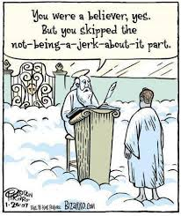

Slide 33
1 John 4:19-21
¹⁹ We love because God first loved us. ²⁰ If people say, “I love God,” but hate their brothers or sisters, they are liars. Those who do not love their brothers and sisters, whom they have seen, cannot love God, whom they have never seen. ²¹ And God gave us this command: Those who love God must also love their brothers and sisters.

Slide 34
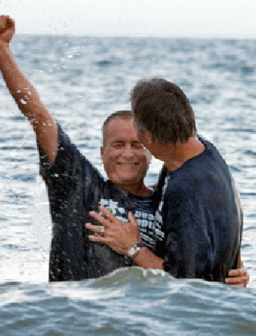
Love— The place to start
Acts 22:12-16—¹⁶Now why do you delay? Get up and be baptized, and wash away your sins, calling on His name.’ (NASB95)

Slide 35
See you again…
Facebook Live
6 o’clock
This Evening
And Wednesday at 7pm

