Slide 1
“Free at Last.”
John Staiger
Morningside Church of Christ
Sunday 31 May 2020
AM Sermon

Slide 2
Free at Last

Slide 3
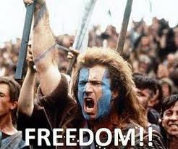
We have just spent 66 days away from each other

Slide 4
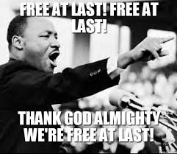
Symbols of Freedom
Martin Luther King

Slide 5
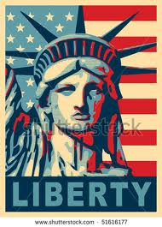
Symbols of Freedom
USA has built their Nation of this Dream

Slide 6
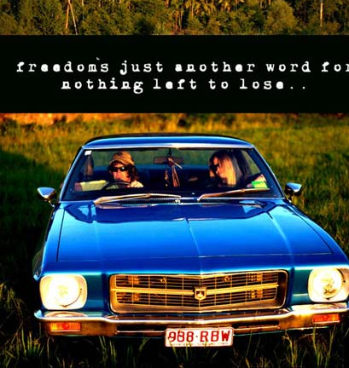
Symbols of Freedom
This remains an Ideal

Slide 7
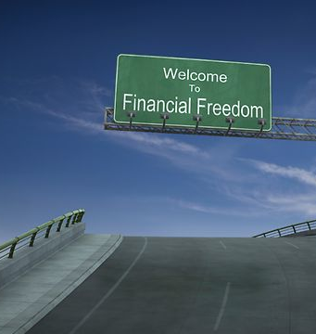
Symbols of Freedom
Why isn’t Everyone
Financially Independent?

Slide 8
Real Freedom is on the inside

Slide 9
Real Freedom is on the inside
Not reliant on externals
We can spend our days:
    Rich—but still be impoverished
    Full—but still be starving
    Dressed—But still be naked
    Surrounded—But still be lonely
    Mobile—But going nowhere

Slide 10
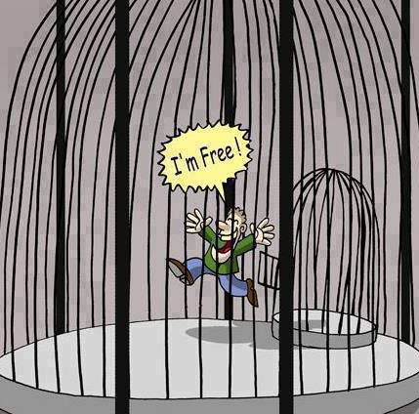
From one cell to another

Slide 11
From one cell to another
2 Peter 2:19—¹⁹promising them freedom while they themselves are slaves of corruption; for by what a man is overcome, by this he is enslaved. (NASB95)

Slide 12
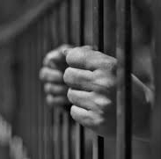
Going Back Inside

Slide 13
Going Back Inside
2 Peter 2:20—²⁰For if, after they have escaped the defilements of the world by the knowledge of the Lord and Saviour Jesus Christ, they are again entangled in them and are overcome, the last state has become worse for them than the first. (NASB95)

Slide 14
Going Back Inside
Galatians 5:1—It is for freedom that Christ has set us free. Stand firm, then, and do not let yourselves be burdened again by a yoke of slavery.

Slide 15
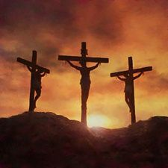
Prison Break

Slide 16
Prison Break
Hebrews 2:14-15—
¹⁴Since the children have flesh and blood, he too shared in their humanity so that by his death he might break the power of him who holds the power of death—that is, the devil— ¹⁵and free those who all their lives were held in slavery by their fear of death.

Slide 17

‘Freedom’ is best when defined!

Slide 18
‘Freedom’ is best when defined!
John 8:36
So if the Son makes you free, you will be free indeed.
John 8:32
And you shall know the truth, and the truth shall make you free." NKJV

Slide 19
Freedom—What do I do with it?

Slide 20
Freedom—What do I do with it?
1 Corinthians 9:19—
¹⁹For though I am free from all men, I have made myself a slave to all, so that I may win more. (NASB95)
1 Corinthians 9:22—
²²To the weak I became weak, that I might win the weak; I have become all things to all men, so that I may by all means save some. (NASB95)

Slide 21
Freedom—What do I do with it?
1 Corinthians 9:19—
¹⁹For though I am free from all men, I have made myself a slave to all, so that I may win more. (NASB95)
1 Corinthians 9:22—
²²To the weak I became weak, that I might win the weak; I have become all things to all men, so that I may by all means save some. (NASB95)

Slide 22
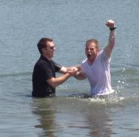
Free at Last!
This is how and when a sinner receives eternal life.

Slide 23
Free at Last!
Salvation is a gift.

Slide 24
Free at Last!
If it could be bought at an auction, millionaires would compete for the purchase and most people would be excluded.

Slide 25
Free at Last!
But God’s forgiveness is free for the asking. Nothing we can do will ever earn it.

