Slide 1
“Jesus at the centre of your Home .”
John Staiger
For Morningside Church of Christ
Sunday 10 May 2020
PM Sermon
Broadcast at 6pm on Facebook Live
From 16 McClintock Road, Massey, Auckland.

Slide 2
Welcome
Sunday 10 May 2020
Morningside Church of Christ
(42 Leslie Ave, Sandringham, Auckland)
Facebook Live
6pm
And Wednesday at 7pm

Slide 3

Jesus at the centre of your Home.

Slide 4
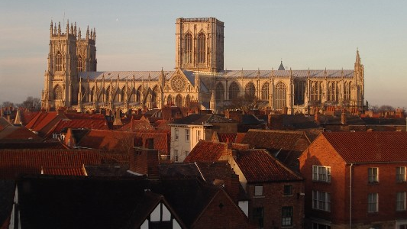
The York Minster Cathedral—It took 252 years to complete. Construction began in 1220 and ended in 1472.

Slide 5

Chartres Cathedral—This one was built in a hurry.

Slide 6

Chartres Cathedral—This one was built in a hurry. Mostly constructed between 1194 and 1220 (26 years)

Slide 7
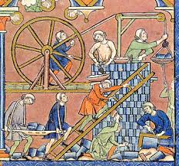
Fathers, sons and grandsons could spend their whole lives working on one of these structures.

Slide 8
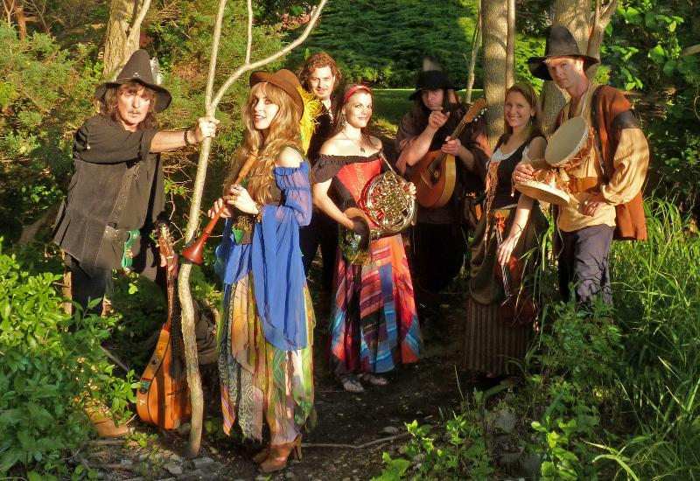
Meanwhile, out on the roads…

Slide 9
Meanwhile, out on the roads…
Lifestyle choices determined many things.

Slide 10
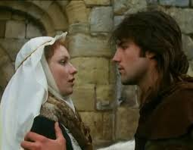
Depends on who you’re looking for…
Who you married was going to determine a lot of things—

Slide 11
Depended on what you were looking for…
A wise choice can mean… travelling from place to place singing and dancing or settling down to build a cathedral.

Slide 12
Depended on what you were looking for…
A wise choice could mean… travelling from place to place singing and dancing or settling down to build a cathedral.

Slide 13
Depended on what you were looking for…
A wise choice could mean travelling from place to place singing and dancing or… settling down to build a cathedral.

Slide 14
Depended on what you were looking for…
A wise choice could mean travelling from place to place singing and dancing or settling down to build a cathedral.

Slide 15
Depended on what you were looking for…
A Bad choice could mean travelling from place to place singing and dancing or settling down to build a cathedral.

Slide 16
Depended on what you were looking for…
A Bad choice could mean travelling from place to place singing and dancing or… settling down to build a cathedral.

Slide 17
Depended on what you were looking for…
A Bad choice could mean travelling from place to place singing and dancing or settling down to build a cathedral.

Slide 18

If you are wanting this…

Slide 19

Then, forget this guy…

Slide 20

Don’t expect him home for dinner…

Slide 21

God’s will for a family
Together
Husband and wife
Put
God and His word at the
forefront
of the
relationship.

Slide 22
God’s will for a family
Together
Husband and wife
Put
God and His word at the
forefront
of the
relationship.

Slide 23
God’s will for a family
Together
Husband and wife
Are to put
God and His word at the
forefront
of the
relationship.

Slide 24
God’s will for a family
Together
Husband and wife
Seek
God’s wisdom
and direction
in all things from His word and in prayer.

Slide 25
God’s will for a family
Together
Husband and wife
Are to
work
as members of
the
household of God.

Slide 26
God’s will for a family
Together
Husband and wife
Are to make your
home a place where it is obvious to everyone that Jesus lives and rules there.

Slide 27
How do you make God the centre of your home?

Slide 28

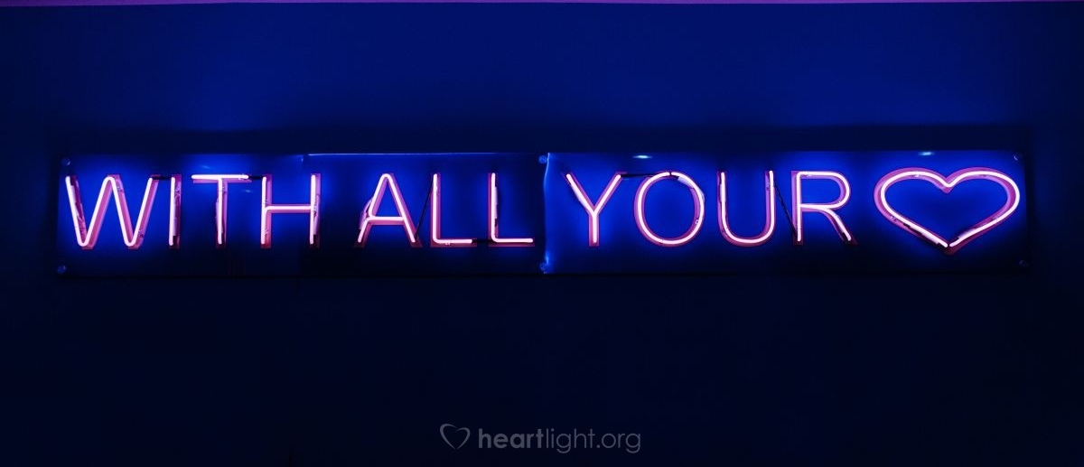
Deut.6:4-9—⁴“Hear, O Israel! The Lord is our God, the Lord is one! ⁵You shall love the Lord your God with all your heart and with all your soul and with all your might.

Slide 29
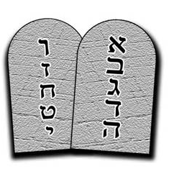
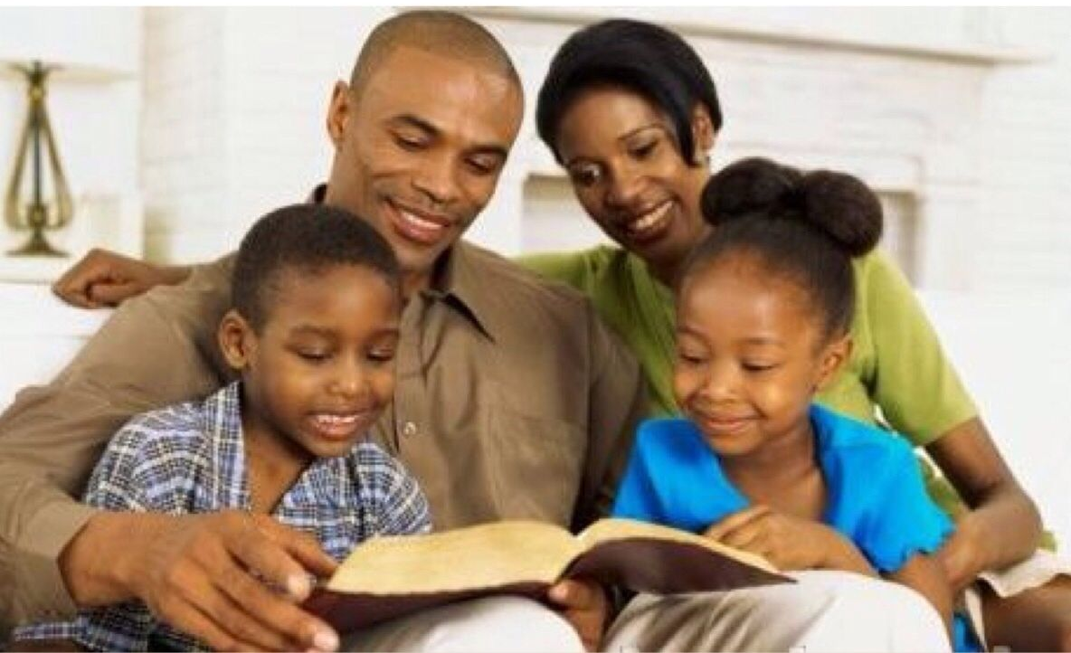
Deut.6:4-9—⁶These words, which I am commanding you today, shall be on your heart. ⁷You shall teach them diligently to your sons and shall talk of them when you sit in your house and when you walk by the way and when you lie down and when you rise up.

Slide 30
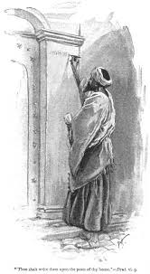
Deut.6:4-9—⁸You shall bind them as a sign on your hand and they shall be as ^{[a]}frontals ^{[b]}on your forehead. ⁹You shall write them on the doorposts of your house and on your gates. (NASB95) [a]Or frontlet bands [b]Lit between your eyes

Slide 31

In a Nutshell and from the Manual:
1. Husband—Love your wife (Eph.5:33)
2. Wife—Respect your husband (Eph.5:33)
3. Children—Honour your mother and father (Eph.6:1)

Slide 32
In a Nutshell and from the Manual:
1. Husband—Love your wife (Eph.5:33)
2. Wife—Respect your husband (Eph.5:33)
3. Children—Honour your mother and father (Eph.6:1)

Slide 33
In a Nutshell and from the Manual:
1. Husband—Love your wife (Eph.5:33)
2. Wife—Respect your husband (Eph.5:33)
3. Children—Honour your mother and father (Eph.6:1)

Slide 34
In a Nutshell and from the Manual:
1. Husband—Love your wife (Eph.5:33)
2. Wife—Respect your husband (Eph.5:33)
3. Children—Honour your mother and father (Eph.6:1)

Slide 35
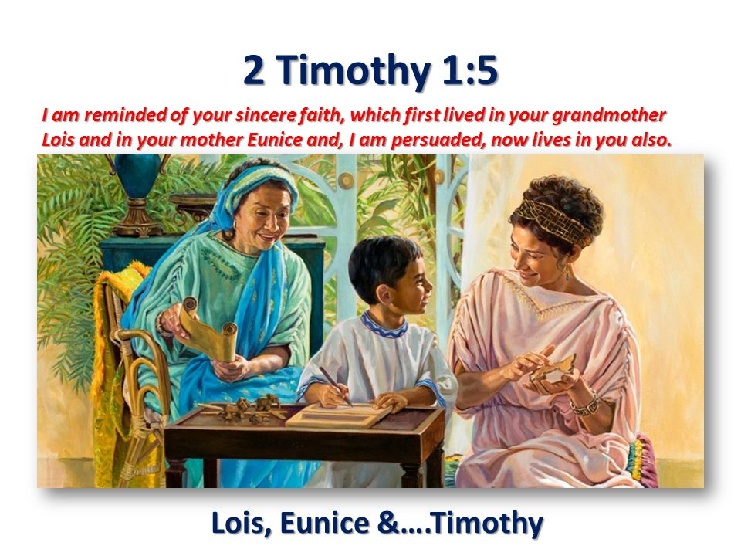
Multi-generational perspective

Slide 36
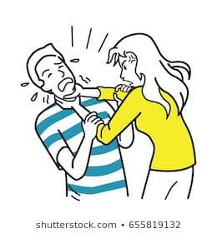
Seven Words—
Husbands, when trouble comes…
Seven of the most important words you’ll ever know.
Need to practice them, so you’ll never forget them.
Got it?”

Slide 37
Seven Words.
Husbands, when trouble comes…
Seven of the most important words you’ll ever know.

Slide 38
Seven Words.
Husbands, when trouble comes…
You need to practice them, so you’ll never forget them.

Slide 39
Seven Words.
Husbands, when trouble comes…
Got it?”

Slide 40


Slide 41
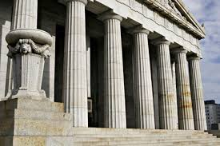
Seven Pillars for Home
Christ-like
Biblical
Permanent
Thankful
Sacrificial
Welcoming
Generational

Slide 42
Seven Pillars for Home
Christ-like
Biblical
Permanent
Thankful
Sacrificial
Welcoming
Generational

Slide 43
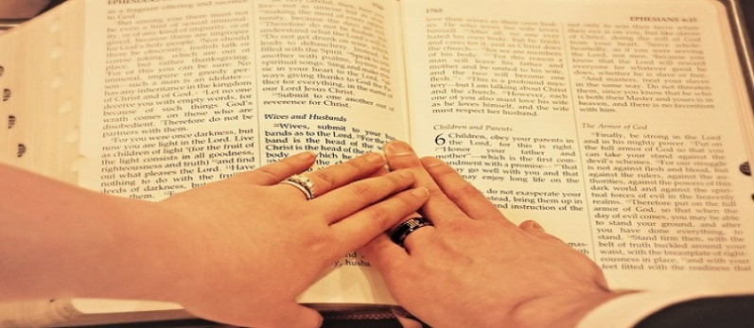
Seven Pillars for Home
Christ-like
Biblical
Permanent
Thankful
Sacrificial
Welcoming
Generational

Slide 44
Seven Pillars for Home
Christ-like
Biblical
Permanent
Thankful
Sacrificial
Welcoming
Generational

Slide 45
Seven Pillars for Home
Christ-like
Biblical
Permanent
Thankful
Sacrificial
Welcoming
Generational

Slide 46
Seven Pillars for Home
Christ-like
Biblical
Permanent
Thankful
Sacrificial
Welcoming
Generational

Slide 47
Seven Pillars for Home
Christ-like
Biblical
Permanent
Thankful
Sacrificial
Welcoming
Generational

Slide 48
Seven Pillars for Home
Christ-like
Biblical
Permanent
Thankful
Sacrificial
Welcoming
Generational

Slide 49
See You Again
Facebook Live
Wednesday 13 May 2020
7pm

