Slide 1
Moral Excellence, Too.
2 Peter 1:5

Slide 2
“Add Moral Excellence, Too.”
John Staiger
For Morningside Church of Christ
Sunday 3 May 2020
AM Sermon
Broadcast at 6pm on Facebook Live
From 16 McClintock Road, Massey, Auckland.

Slide 3
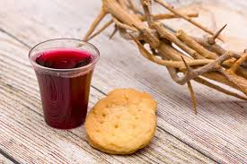

Slide 4
Welcome
Sunday 3 May 2020
Morningside Church of Christ
(42 Leslie Ave, Sandringham, Auckland)
Facebook Live
11am
6pm
And Wednesday at 7pm

Slide 5
Add Moral Excellence, Too.
2 Peter 1:5

Slide 6
2 Peter 1:5-7
5 For this very reason, make every effort to add to your faith
goodness;
and to goodness, knowledge;
6 and to knowledge, self-control;
and to self-control, perseverance;
and to perseverance, godliness;
7 and to godliness, brotherly kindness;
and to brotherly kindness, love.

Slide 7
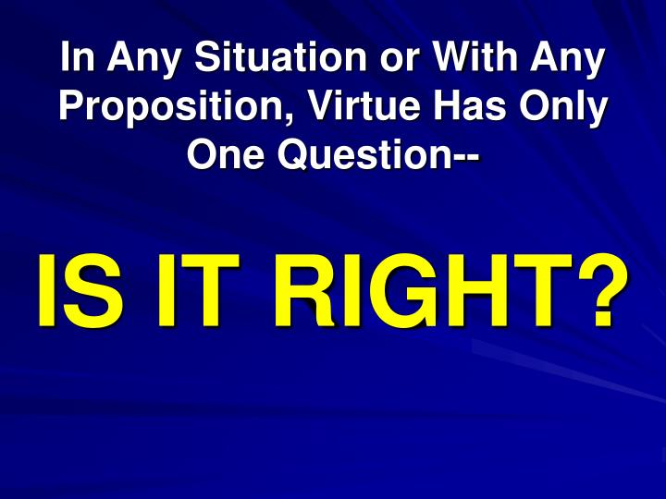
2 Peter 1:3-7
3 His divine power has given us everything we need for life and godliness through our knowledge of him who called us by his own glory and goodness. 4Through these he has given us his very great and precious promises, so that through them you may participate in the divine nature and escape the corruption in the world caused by evil desires.

Slide 8
2 Peter 1:3-7
5For this very reason, make every effort to
add to your faith
goodness;
and to goodness, knowledge;
6 and to knowledge, self-control;
and to self-control, perseverance;
and to perseverance, godliness;
7and to godliness, brotherly kindness;
and to brotherly kindness, love. (NIV1984)

Slide 9
Man is made in the Image of God
God’s Character is reflected in man

Slide 10
Man is made in the Image of God
God’s Character is reflected in man
Love
Goodness
Kindness
Mercy
Compassion
Grace
Righteousness

Slide 11
If there was ever a time that was in need of moral heroes, this would be the time.

Slide 12
If there was ever a time that was in need of moral heroes, this would be the time.
Our generation is very much like those described in the book of Judges where it says that "everyone did what was right in his own eyes." (Judges 21:25)

Slide 13
1 Peter 2:9—
⁹But you are a chosen race, a royal priesthood, a holy nation, a people for God’s own possession, so that you may proclaim the excellencies of Him who has called you out of darkness into His marvelous light; (NASB95)

Slide 14
^{Moral Excellence—}
^{Does not ask:}

Slide 15
^{Moral Excellence—}
^{Does not ask:}
^{What will others think?}

Slide 16
^{Moral Excellence—}
^{Does not ask:}
^{What will others think?}
^{How much will this cost me?}

Slide 17
^{Moral Excellence—}
^{Does not ask:}
^{What will others think?}
^{How much will this cost me?}
^{Will I be persecuted?}

Slide 18
^{Moral Excellence—}
^{Does not ask:}
^{What will others think?}
^{How much will this cost me?}
^{Will I be persecuted?}
^{Will the outcome be pleasant?}

Slide 19
^{In any situation—}
^{Moral Excellence}
Demands that only one question be asked:

Slide 20
^{In any situation—}
^{Moral Excellence}
Demands that only one question be asked:

Slide 21
⁸ Finally, brethren,
whatever is true,
whatever is honourable,
whatever is right,
whatever is pure,
whatever is ^{[a]}lovely,
whatever is of good repute,
if there is any excellence
and if anything worthy of praise,
^{[b]}dwell on these things.
(NASB95) [a]Or lovable and gracious [b]Lit ponder these things

Slide 22
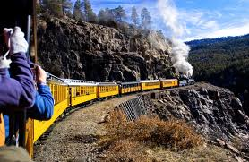
Add (or supply)…
As Carriages to a train.

Slide 23
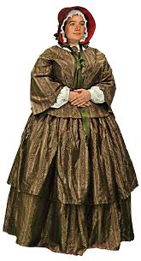
What does
Moral Excellence look like?

Slide 24
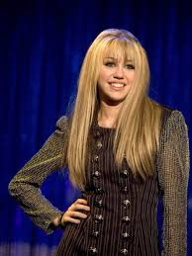
Sadly, she has often dressed in an undignified manner in public.

Slide 25
But…
Moral Excellence is
Not
centred in
“Thou Shalt-Nots”

Slide 26
We are not simply talking about a list of taboos or overt sins such as:

Slide 27
Adultery
Fornication
Drunkenness
Lying
Gossiping
Stealing
Cheating
We are not simply talking about a list of taboos or overt sins such as:

Slide 28
Excelling in the moral will of God
Touches every area of the Christian’s life.

Slide 29
Values
Attitudes
Priorities
Goals or purposes
Devotion
Christ-like character
Excelling in the moral will of God
Touches every area of the Christian’s life.

Slide 30

Moral excellence means the pursuit of the moral will of God

Slide 31
1 Peter 2:21-25—²¹To this you were called, because Christ suffered for you, leaving you an example, that you should follow in his steps. ²²"He committed no sin, and no deceit was found in his mouth." ²³When they hurled their insults at him, he did not retaliate; when he suffered, he made no threats. Instead, he entrusted himself to him who judges justly. ²⁴He himself bore our sins in his body on the tree, so that we might die to sins and live for righteousness; by his wounds you have been healed. ²⁵For you were like sheep going astray, but now you have returned to the Shepherd and Overseer of your souls.

Slide 32

Moral Excellence
In the home
On the job
At assembly
Hobbies
Entertainment

Slide 33
Moral
Excellence
is something that
characterizes
the Christian
everywhere
and
in everything.

Slide 34
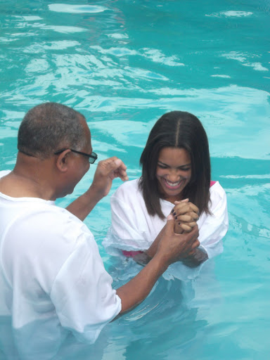
Galatians 3:27
For all of you who were baptized into Christ have clothed yourselves with Christ. (NASB95)

