Slide 1
“Seeing Yourself.”
John Staiger
For Morningside Church of Christ
Sunday 17 May 2020
PM Sermon
Broadcast from home of Gavin and Colleen de Steur

Slide 2
Welcome
Sunday 17 May 2020
For Morningside Church of Christ
(42 Leslie Ave, Sandringham, Auckland)
Facebook Live
6pm
And Wednesday at 7pm

Slide 3
Seeing Yourself

Slide 4
As a man was driving down the motorway, his cell phone rang. Answering, he heard his wife's voice urgently warning him, “Frank, I just heard on the news that there's a car going the wrong way on the Motorway. Please be careful!

Slide 5
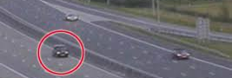
As a man was driving down the motorway, his cell phone rang. Answering, he heard his wife's voice urgently warning him, “Frank, I just heard on the news that there's a car going the wrong way on the Motorway. Please be careful!

Slide 6
“It's not just ONE car,” said Frank.
“It's HUNDREDS of them!”

Slide 7
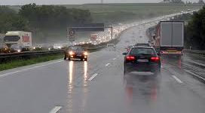
“It's not just ONE car,” said Frank.
“It's HUNDREDS of them!”

Slide 8
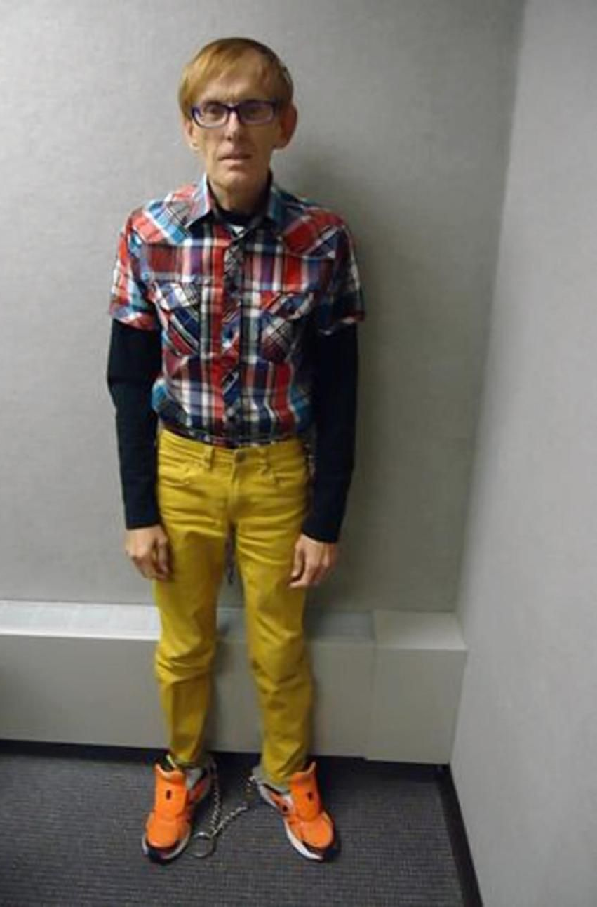
Human beings are not famous for seeing themselves as they really appear.

Slide 9
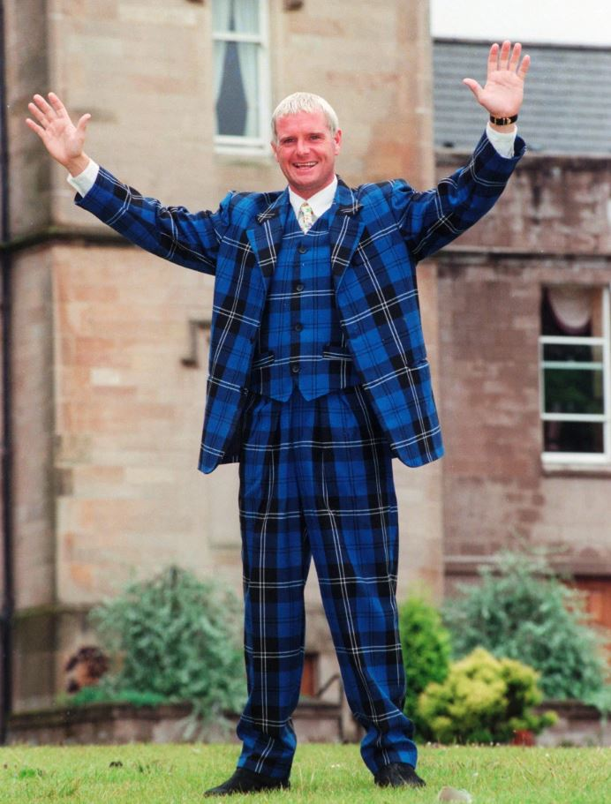
It’s not the outside.

Slide 10

It’s our habits that build over time…

Slide 11

It’s our habits that build over time…
Thoughtlessness
Rudeness in the name of humour
Arrogance
Messiness
Eating habits
Wastefulness
Selfishness
Aggression
Judgmental
Bad language

Slide 12
It’s our habits that build over time…
Thoughtlessness
Rudeness in the name of humour
Arrogance
Messiness
Eating habits
Wastefulness
Selfishness
Aggression
Judgmental
Bad language

Slide 13
It’s our habits that build over time…
Thoughtlessness
Rudeness in the name of humour
Arrogance
Messiness
Eating habits
Wastefulness
Selfishness
Aggression
Judgmental
Bad language

Slide 14
It’s our habits that build over time…
Thoughtlessness
Rudeness in the name of humour
Arrogance
Messiness
Eating habits
Wastefulness
Selfishness
Aggression
Judgmental
Bad language

Slide 15
It’s our habits that build over time…
Thoughtlessness
Rudeness in the name of humour
Arrogance
Messiness
Eating habits
Wastefulness
Selfishness
Aggression
Judgmental
Bad language

Slide 16
It’s our habits that build over time…
Thoughtlessness
Rudeness in the name of humour
Arrogance
Messiness
Eating habits
Wastefulness
Selfishness
Aggression
Judgmental
Bad language

Slide 17
It’s our habits that build over time…
Thoughtlessness
Rudeness in the name of humour
Arrogance
Messiness
Eating habits
Wastefulness
Selfishness
Aggression
Judgmental
Bad language

Slide 18
It’s our habits that build over time…
Thoughtlessness
Rudeness in the name of humour
Arrogance
Messiness
Eating habits
Wastefulness
Selfishness
Aggression
Judgmental
Bad language

Slide 19
It’s our habits that build over time…
Thoughtlessness
Rudeness in the name of humour
Arrogance
Messiness
Eating habits
Wastefulness
Selfishness
Aggression
Judgmental
Bad language

Slide 20
It’s our habits that build over time…
Thoughtlessness
Rudeness in the name of humour
Arrogance
Messiness
Eating habits
Wastefulness
Selfishness
Aggression
Judgmental
Bad language

Slide 21

Matthew 23:25-26—
²⁵“Woe to you, scribes and Pharisees, hypocrites! For you clean the outside of the cup and of the dish, but inside they are full of robbery and self-indulgence. ²⁶You blind Pharisee, first clean the inside of the cup and of the dish, so that the outside of it may become clean also. (NASB95)

Slide 22
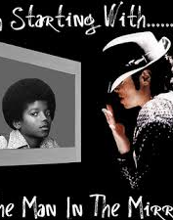
If we could see ourselves as
others
see us,
would we be like we are?

Slide 23
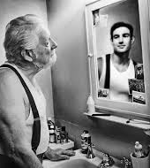
If we could see ourselves as we
imagine
we are,
would we be like we are?

Slide 24
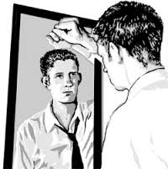
James 1:22-24—²²Do not merely listen to the word, and so deceive yourselves. Do what it says. ²³Anyone who listens to the word but does not do what it says is like a man who looks at his face in a mirror ²⁴and, after looking at himself, goes away and immediately forgets what he looks like.

Slide 25

2 Corinthians 10:12—¹²We do not dare to classify or compare ourselves with some who commend themselves. When they measure themselves by themselves and compare themselves with themselves, they are not wise.

Slide 26
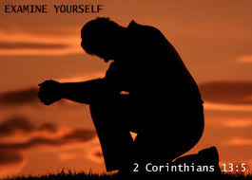
2 Corinthians 13:5—⁵Test yourselves to see if you are in the faith; examine yourselves! Or do you not recognize this about yourselves, that Jesus Christ is in you—unless
indeed you fail
the test?

Slide 27
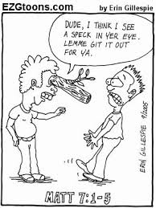
Matthew 7:3
"Why do you look at the speck of sawdust in your brother's eye and pay no attention to the plank in your own eye?

Slide 28

2 Corinthians 3:18—And we, who with unveiled faces all reflect the Lord's glory, are being transformed into his likeness with ever-increasing glory, which comes from the Lord, who is the Spirit.

