Slide 2
God at Work—Again

Slide 3

Working with the end in mind…
Philippians 1:6—⁶For I am confident of this very thing, that He who began a good work in you will perfect it until the day of Christ Jesus. (NASB95)

Slide 4

God’s will, God’s work, God’s purpose!
Philippians 2:12-13—¹²So then, my beloved, just as you have always obeyed, not as in my presence only, but now much more in my absence, work out your salvation with
fear and trembling;
¹³ for it is God who
is at work in you,
both to will and to
work for His good
pleasure. (NASB95)

Slide 5
Four things that God wants:
.

Slide 6
Four things that God wants:
Maturity
    Grow in faith and knowledge
    Leaving behind an infantile life
Ephesians 4:14—As a result, we are no longer to be children, tossed here and there by waves and carried about by every wind of doctrine, by the trickery of men, by craftiness in deceitful scheming; (NASB95)

Slide 7
Four things that God wants:
Decisiveness
Choose this day
    Joshua 24:15—If it is disagreeable in your sight to serve the Lord, choose for yourselves today whom you will serve: whether the gods which your fathers served which were beyond the River, or the gods of the Amorites in whose land you are living; but as for me and my house, we will serve the Lord.” (NASB95)

Slide 8
Four things that God wants:
Decisiveness
Some are neither ‘Hot nor cold.’
  Revelation 3:15-16—¹⁵‘I know your deeds, that you are neither cold nor hot; I wish that you were cold or hot. ¹⁶So because you are lukewarm, and neither hot nor cold, I will ^{[a]}spit you out of My mouth. (NASB95) [a]Lit vomit

Slide 9
Four things that God wants:
Consistency
Rid yourself of doubts
Some burn ‘Hot and cold.’
James 1:6—But he must ask in faith without any doubting, for the one who doubts is like the surf of the sea, driven and tossed by the wind. (NASB95)

Slide 10
Four things that God wants:
Strength
    Isaiah 40:29—He gives strength to the weary, And to him who lacks might He increases power. (NASB95)

Slide 11
Four things that God wants:
Strength
1 Peter 4:11—Whoever speaks, is to do so as one who is speaking the utterances of God; whoever serves is to do so as one who is serving by the strength which God supplies; so that in all things God may be glorified through Jesus Christ, to whom belongs the glory and dominion forever and ever. Amen. (NASB95)

Slide 12
Four things that God wants:
Strength
James 5:8—
You too be patient;
strengthen your hearts,
for the coming of the Lord is near. (NASB95)

Slide 13
If you want God to work in you
Hebrews 13:20-21—²⁰Now the God of peace, who brought up from the dead the great Shepherd of the sheep ^{[a]}through the blood of the eternal covenant, even Jesus our Lord, ²¹equip you in every good thing to do His will, working in us that which is pleasing in His sight, through Jesus Christ, to whom be the glory forever and ever. Amen. (NASB95) [a]Lit in

Slide 14
If you want God to work in you
Hebrews 13:20-21—²⁰Now the God of peace, who brought up from the dead the great Shepherd of the sheep ^{[a]}through the blood of the eternal covenant, even Jesus our Lord, ²¹equip you in every good thing to do His will, working in us that which is pleasing in His sight, through Jesus Christ, to whom be the glory forever and ever. Amen. (NASB95) [a]Lit in
Seek that which is pleasing in His sight.

Slide 15

Word of God
1 Thessalonians 2:13—¹³For this reason we also constantly thank God that when you received the word of God which you heard from us, you accepted it not as the word of men, but for what it
really is, the word
of God, which also
performs its work in
you who believe.
(NASB95)

Slide 16
Working in Faith, Hope & Love
1 Thessalonians 1:3—
³constantly bearing in mind your
work of faith
and
labour of love
and
steadfastness of hope
in our Lord Jesus Christ
in the presence of our God and Father,
(NASB95)

Slide 17
Do not lose what you have worked for:
2 John 8—
⁸ Watch yourselves, that you do not lose what we have accomplished, but that you may receive a full reward.(NASB95)

Slide 18
Son appeared to destroy the devil’s work
1 John 3:8—
⁸the one who practices sin
is of the devil;
for the devil
^{[a]}has sinned from the beginning.
The Son of God
appeared for this purpose,
to destroy
the works of the devil.
(NASB95) [a]Lit sins

Slide 19
Sanctifying work of the Spirit
2 Thessalonians 2:13—
¹³But we should always give thanks to God for you, brethren beloved by the Lord, because God has chosen you ^{[a]}from the beginning for salvation ^{[b]}through sanctification ^{[c]}by the Spirit and faith in the truth.
(NASB95) [a]One early ms reads first fruits [b]Lit in [c]Lit of

Slide 20
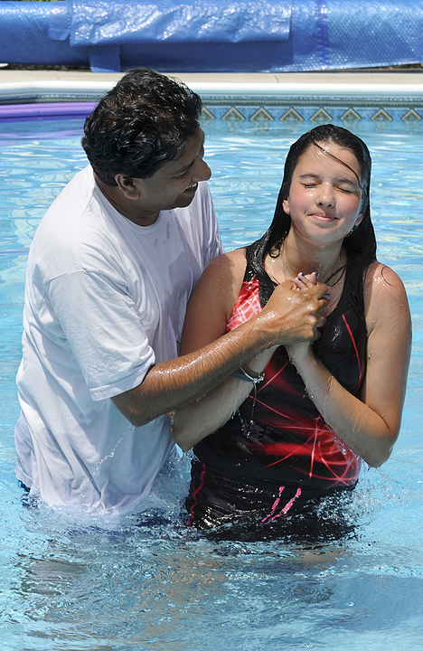
Colossians 2:12—¹²having been buried with Him in baptism, in which you were also raised up with Him through faith in the working of God, who raised Him from the dead.
(NASB95)

