Slide 1
“I am Resolved!”
John Staiger
Morningside Church of Christ
Sunday 21 June 2020
AM Sermon

Slide 2
I am Resolved!

Slide 3

Not These kinds of Resolutions
Easily made
Easily broken
Easily forgotten

Slide 4
Not These kinds of Resolutions
Habits are hard to break
If you do not fill the void, Satan will.

Slide 5
Not These kinds of Resolutions
When I was young, I was a slave to my passions. Now that I am old, I am a slave to my habits.

Slide 6

Living in Maybe-Land
God doesn’t abide there
Nothing much gets done of any value

Slide 7
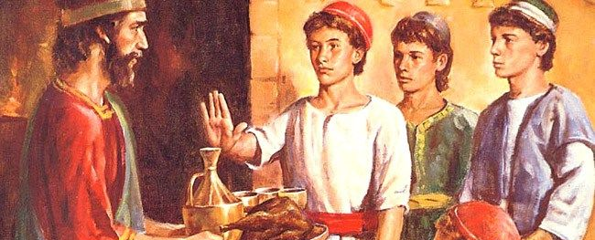
Daniel
Daniel 1:8—⁸But Daniel resolved that he would not defile himself with the king's food, or with the wine that he drank. Therefore he asked the chief of the eunuchs to allow him not to defile himself. (ESV)

Slide 8
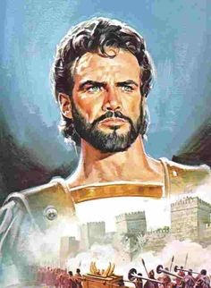
Joshua 24:15—
¹⁵ If it is disagreeable in your sight to serve the Lord, choose for yourselves today whom you will serve: whether the gods which your fathers served which were beyond the River, or the gods of the Amorites in whose land you are living; but as for me and my house, we will serve the Lord.” (NASB95)
Joshua

Slide 9

Mary
Luke 1:37-38—³⁷For with God nothing shall be impossible. ³⁸And Mary said, Behold the handmaid of the Lord; be it unto me according to thy word. And the angel departed from her. (KJV)

Slide 10
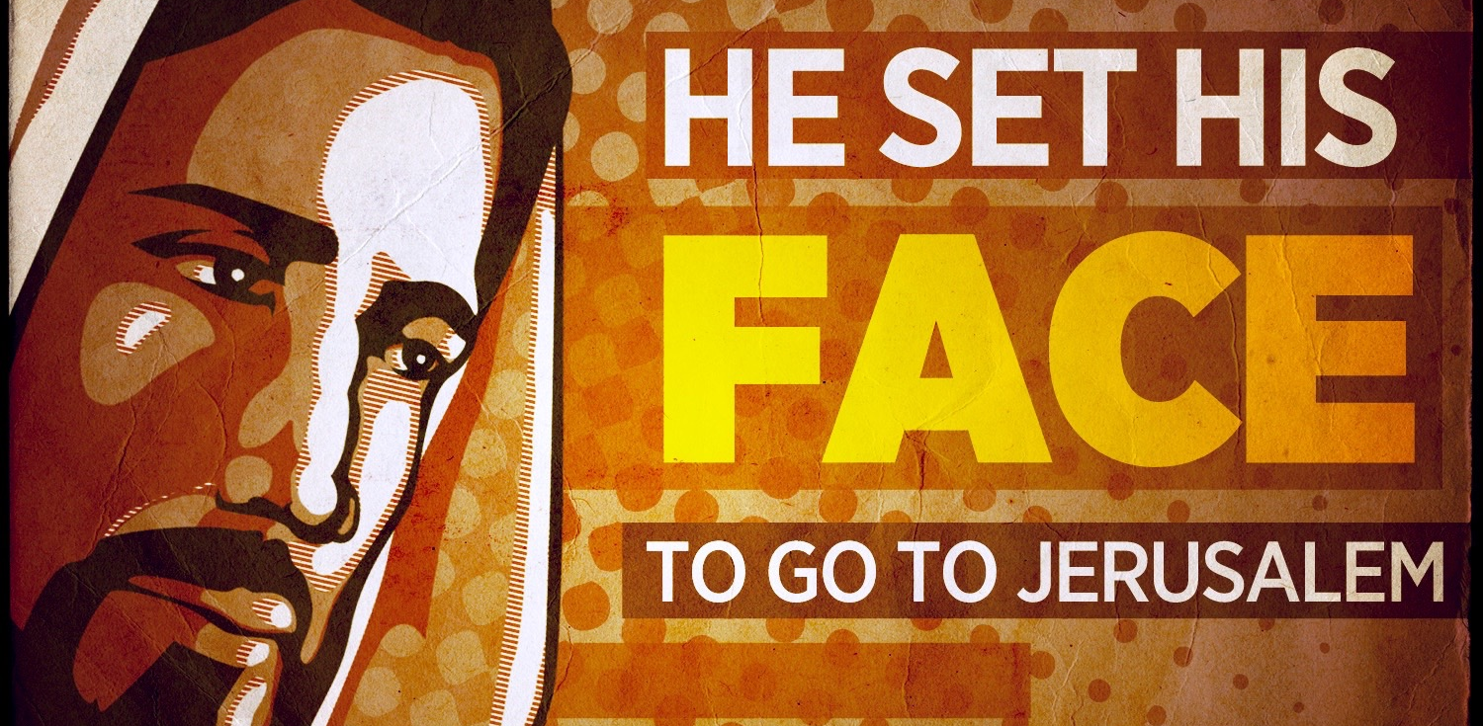
Jesus
Luke 9:51—⁵¹When the days drew near for him to be taken up, he set his face to go to Jerusalem. (ESV)

Slide 11

Timothy
1 Timothy 4:13-16—¹³ Until I come, give attention to the public reading of Scripture, to exhortation and teaching. (NASB95)

Slide 12
Timothy
1 Timothy 4:13-16—¹⁴Do not neglect the spiritual gift within you, (NASB95)

Slide 13
Timothy
1 Timothy 4:13-16—⁵Take pains with these things; be absorbed in them, so that your progress will be evident to all. (NASB95)

Slide 14
Timothy
1 Timothy 4:13-16—¹⁶Pay close attention to yourself and to your teaching; persevere in these things, for as you do this you will ensure salvation both for yourself and for those who hear you. (NASB95)

Slide 15

You and Me
Proverbs 16:1—
Commit your work to the Lord,
and your plans will be established. (ESV)

Slide 16
You and Me
Always mean: “Lord willing.”
James 4:15—Instead, you ought to say, “If the Lord wills, we will live and also do this or that.” (NASB95)
Are we afraid to say it lest we doubt God’s good intentions?
He is always Faithful!

Slide 17
You and Me
Resolving is ultimately about determining to do the right thing.

Slide 18
You and Me
The Christian focuses and refocuses

Slide 19
You and Me
Constant honouring of God

Slide 20
You and Me
Secret resolve to do our own thing does not go unnoticed by God
A son honours his father, and a servant his master. If then I am the Father, where is My honour? And if I am a Master, where is My reverence? (Malachi 1:6)

Slide 21
You and Me
There’s no shortage of things to pray for:
The souls of the Lost (Mk.16:15-16)
The unity of believers (John 17:20-23)
Our enemies (Mt.5:44)
Wisdom (James 1:5-8)
Daily provision (Mt.6:11)
Boldness (Acts 4:24-31)
Our rulers (1Tim.2:1-4)

Slide 22
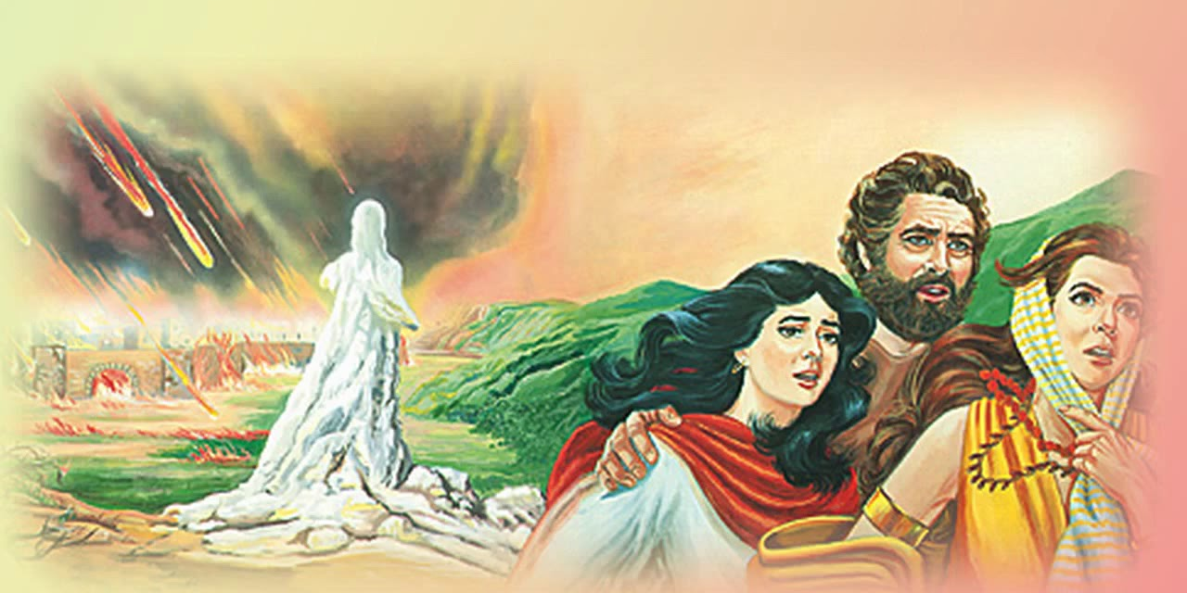
What are you waiting for…?
Genesis 19:26—But Lot's wife, behind him, looked back, and she became a pillar of salt. (ESV)

Slide 23
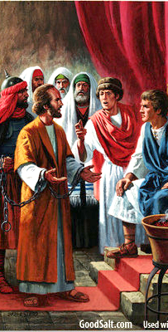
What are you waiting for…?
Felix
Acts 24:25— ²⁵But as he was discussing righteousness, self-control and the judgment to come, Felix became frightened and said, “Go away for the present, and when I find time I will summon you.” (NASB95)

Slide 24
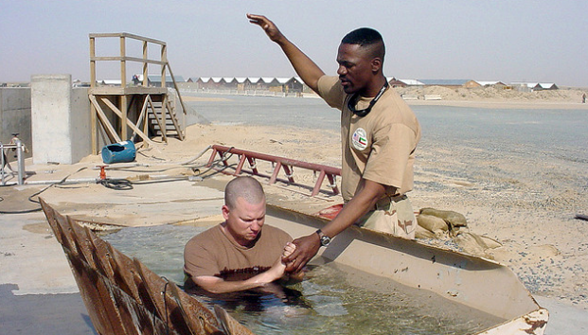
What are you waiting for…?
Acts 22:15-16—¹⁶ Now why do you delay? Get up and be baptized, and wash away your sins, calling on His name.’ (NASB95)

