Slide 1
“Relationships 102—Before you commit
John Staiger
Morningside Church of Christ
Sunday 7 June 2020
PM Sermon

Slide 2
Relationships 102
“Before you Commit.”

Slide 3
Some things are best learned now

Slide 4
All relationships are to be based on love for God and, in turn, love for one another.

Slide 5
1 Corinthians 13:4-8—
⁴Love is patient, love is kind and is not jealous; love does not brag and is not arrogant, ⁵does not act unbecomingly; it does not seek its own, is not provoked, does not take into account a wrong suffered, ⁶does not rejoice in unrighteousness, but rejoices with the truth; ⁷bears all things, believes all things, hopes all things, endures all things.
⁸Love never fails;

Slide 6
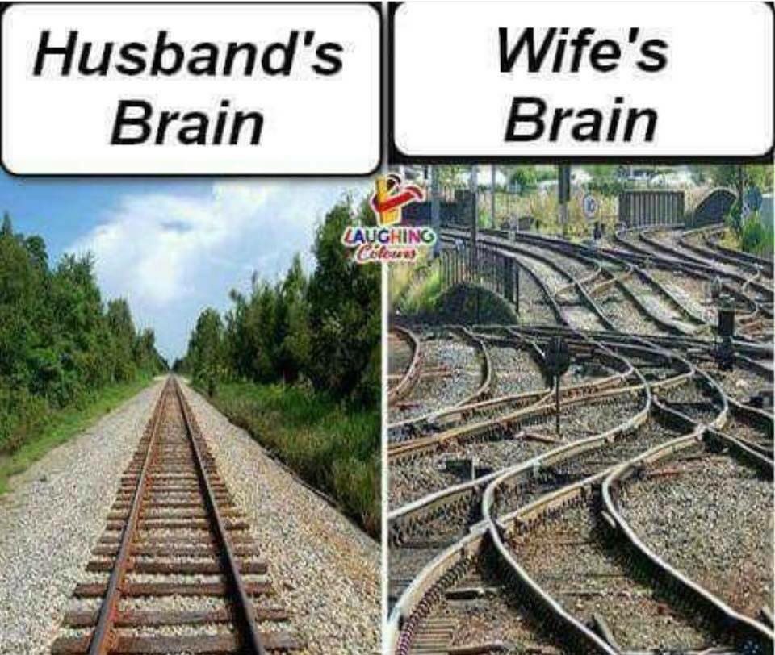
Some things are best learned now

Slide 7
Some things are best learned now
*Disagreement doesn’t change facts

Slide 8
Some things are best learned now
*Disagreement doesn’t change facts
*Both parties find this reality hard to believe

Slide 9
Some things are best learned now
*Disagreement doesn’t change facts
*Both parties find this reality hard to believe
*But men can actually chew gum and walk at the same time

Slide 10
Stereotypes go both ways

Slide 11

Stereotypes go both ways

Slide 12
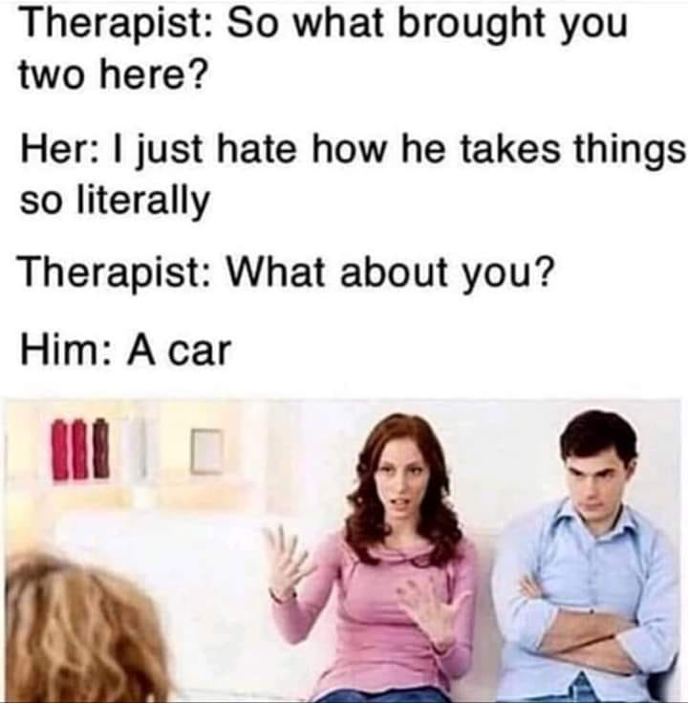
Stereotypes go both ways

Slide 13
Stereotypes go both ways
Stereotypes go both ways
*There are a variety personality types

Slide 14
Stereotypes go both ways
Stereotypes go both ways
*There are a variety personality types
*Only God can change the heart

Slide 15
Stereotypes go both ways
Stereotypes go both ways
*There are a variety personality types
*Only God can change the heart
*Men and women communicate differently

Slide 16
Stereotypes go both ways
Stereotypes go both ways
*There are a variety personality types
*Only God can change the heart
*Men and women communicate differently
*Adjust you must!

Slide 17
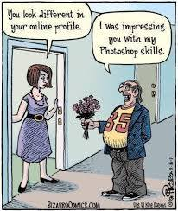
Finding the right man/woman

Slide 18
Finding the right man/woman
*Spiritual is as spiritual does:
  Attendance?
  Prayerful?
  Bible literate?
  Language?
  Kindness?
  Generosity?
  Contentious?

Slide 19
Finding the right man/woman
*What’s the track record?
  All surprises aren’t gifts worth having
  Some people are to be avoided
  You are looking for Christlike quality

Slide 20
Finding the right man/woman
*Check out the family
  What’s that about apples and trees?
  You marry into a family
  It is nice when you are in a good family

Slide 21
Finding the right man/woman
*Respect is paramount
  How do they view others?
  The disadvantaged?
  Compassion
  Who he/she respects says a lot
  Mentors?
  These things change

Slide 22
Finding the right man/woman
*Beauty only goes so far
  The beauty of youth stays with the youth
  Maturity looks past the exterior
  A beautiful heart is beyond value

Slide 23
Finding the right man/woman
*Employable?
  Money only goes so far, but…
  Love only pays the bills when it is spelled
  w-o-r-k.
  It pays to have some when you need it

Slide 24
Before you commit

Slide 25

Before you commit

Slide 26
Before you commit
Spiritual Test

Slide 27
Before you commit
Spiritual Test
Are you going to heaven?

Slide 28
Before you commit
Spiritual Test
Are you going to heaven?
  Does it matter to her/him?

Slide 29
Before you commit
Spiritual Test
Are you going to heaven?
  Does it matter to her/him?
    Yes, you are responsible for the spiritual influence you have on your spouse and children

Slide 30
Before you commit
Spiritual Test
Are you going to heaven?
  Does it matter to her/him?
    Yes, you are responsible for the spiritual influence you have on your spouse and children
    Many close their ears to this fact

Slide 31
Before you commit
Spiritual Test
Are you going to heaven?
  Does it matter to her/him?
    Yes, you are responsible for the spiritual influence you have on your spouse and children
    Many close their ears to this fact
    It is better that a millstone be hung around your neck…

Slide 32
Before you commit
Spiritual Test
Is he/she going to heaven?

Slide 33
Before you commit
Spiritual Test
Is he/she going to heaven?
  Is that for you to judge?

Slide 34
Before you commit
Spiritual Test
Is he/she going to heaven?
  Is that for you to judge?
    You had better

Slide 35
Before you commit
Spiritual Test
Is he/she going to heaven?
  Is that for you to judge?
    You had better
    Because God designed couples to go in the same direction

Slide 36
Before you commit
Spiritual Test
Is he/she going to heaven?
  Is that for you to judge?
    You had better
    Because God designed couples to go in the same direction
    Towards Him

Slide 37
Before you commit
Spiritual Test
How are you at keeping promises/commitments?

Slide 38
Before you commit
Spiritual Test
How are you at keeping promises/commitments?
  ‘Not very good so far, but surely I can get better?
    Marriage is all about keeping promises and commitments
    Love can’t thrive without them
    Good times are the fruit
    Hard times are overcome

Slide 39
Before you commit
Spiritual Test
How are you at keeping promises/commitments?
  ‘Not very good so far, but surely I can get better?
    Marriage is all about keeping promises and commitments
    Love can’t thrive without them
    Good times are the fruit
    Hard times are overcome

Slide 40
Before you commit
Spiritual Test
How are you at keeping promises/commitments?
  ‘Not very good so far, but surely I can get better…?
    Marriage is all about keeping promises and commitments
    Love can’t thrive without them
    Good times are the fruit
    Hard times are overcome

Slide 41
Before you commit
Spiritual Test
How are you at keeping promises/commitments?
  ‘Not very good so far, but surely I can get better?
    Marriage is all about keeping promises and commitments
    Love can’t thrive without them
    Good times are the fruit
    Hard times are overcome

Slide 42
Before you commit
Spiritual Test
How are you at keeping promises/commitments?
  ‘Not very good so far, but surely I can get better?
    Marriage is all about keeping promises and commitments
    Love can’t thrive without them
    Good times are the fruit
    Hard times are overcome

