Slide 1
“Relationships 103—I’m Married.”
John Staiger
Morningside Church of Christ
Sunday 14 June 2020
PM Sermon

Slide 2
Relationships 103
I’m Married

Slide 3
Relationships Series
This is #3 in our series on Relationships

Slide 4
Relationships Series
This is #3 in our series on Relationships
    101—Relationships—Generally speaking

Slide 5
Relationships Series
This is #3 in our series on Relationships
    101—Relationships—Generally speaking
    102—Before you Commit

Slide 6
Relationships Series
This is #3 in our series on Relationships
    101—Relationships—Generally speaking
    102—Before you Commit
    103—I’m Married

Slide 7
Relationships Series
I am a self-proclaimed expert to Marriage

Slide 8
Relationships Series
I am a self-proclaimed expert to Marriage
Why, you ask…?

Slide 9
Relationships Series
I am a self-proclaimed expert to Marriage
Why, you ask…?
      Distance between Auckland, NZ and Benoni, South Africa is…

Slide 10
Relationships Series
I am a self-proclaimed expert to Marriage
Why, you ask…?
      Distance between Auckland, NZ and Benoni, South Africa is…
      12187 km = 7573 miles

Slide 11
Relationships Series
Where is my wife?

Slide 12
Relationships Series
Where is my wife?
      In Benoni, South Africa
      12187 km (7573 miles) away…

Slide 13
What you signed up to…
Eph.5:22-24—²² Wives, be subject to your own husbands, as to the Lord. ²³ For the husband is the head of the wife, as Christ also is the head of the church, He Himself being the Savior of the body. ²⁴ But as the church is subject to Christ, so also the wives ought to be to their husbands in everything. (NASB95)

Slide 14
What you signed up to…
Eph.5:25-27—²⁵ Husbands, love your wives, just as Christ also loved the church and gave Himself up for her, ²⁶ so that He might sanctify her, having cleansed her by the washing of water with the word, ²⁷ that He might present to Himself the church in all her glory, having no spot or wrinkle or any such thing; but that she would be holy and blameless. (NASB95)

Slide 15
What you signed up to…
Marriage is a very good place to be!

Slide 16
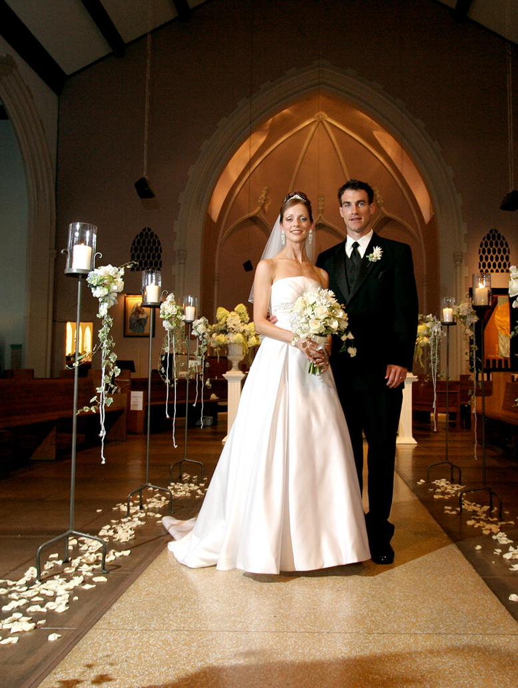
I’m Married
Till Death Do Us Part—

Slide 17
I’m Married
Till Death Do Us Part—
“I do!”

Slide 18
I’m Married
Till Death Do Us Part—
1. Nothing stays the same

Slide 19
I’m Married
Till Death Do Us Part—
2. It’s not supposed to.

Slide 20
I’m Married
Till Death Do Us Part—
3. Two are learning to be the ‘one’ they are.

Slide 21
I’m Married
Till Death Do Us Part—
4. If you want kids, you want change—

Slide 22
I’m Married
Till Death Do Us Part—
4. If you want kids, you want change—Children change everything

Slide 23
I’m Married
Till Death Do Us Part—
5. Love grows through the changes

Slide 24
I’m Married
Marriage starts like this…
And Lord willing…

Slide 25
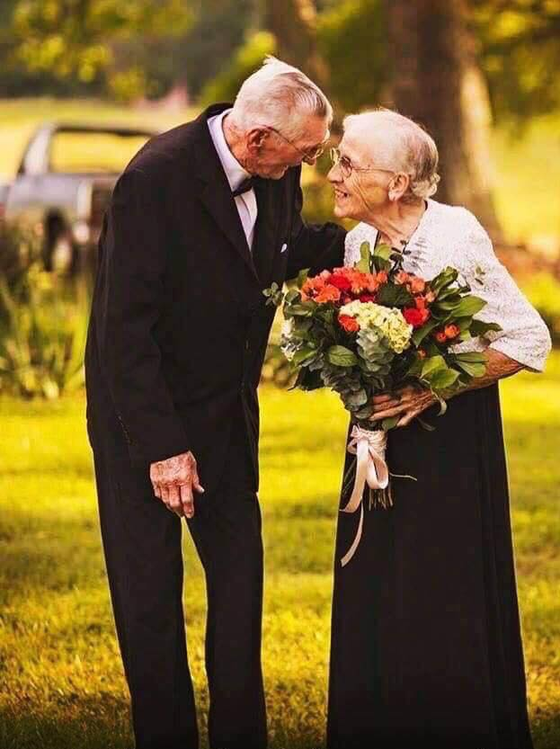
I’m Married
I’m Married
…it will grow to be this!

Slide 26
I’m Married
I’m Married
Till Death Do Us Part—
6. Others will love you, but your wife/husband will care about your deepest needs to the end!

Slide 27
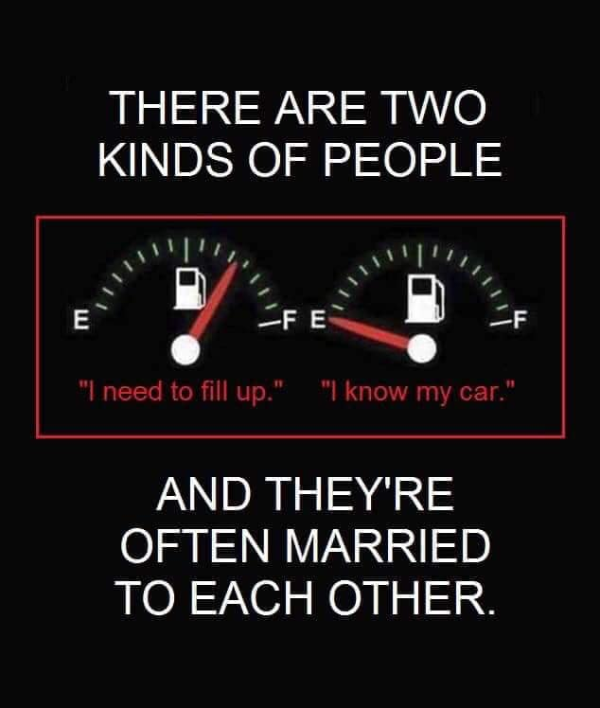

Slide 30
You may have heard that marriage can have some rough patches…?

Slide 31

You may have heard that marriage can have some rough patches…?

Slide 32

I hate to burst your bubble…

Slide 33
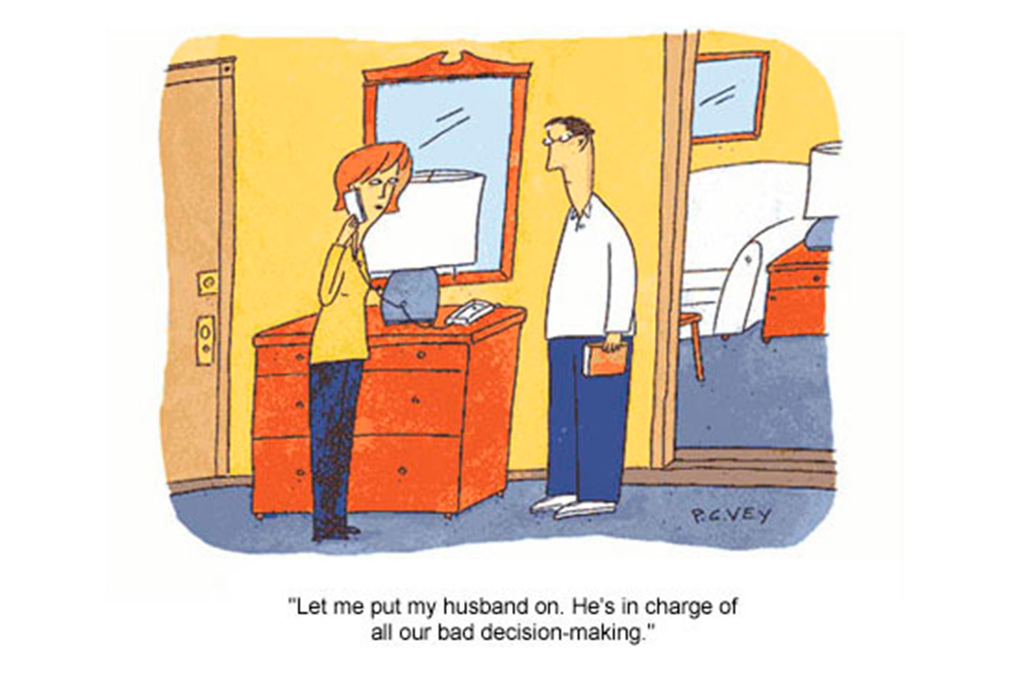
It can get tough…!

Slide 34
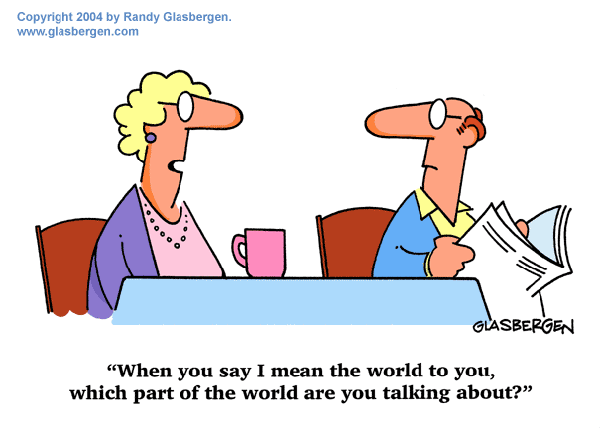
It can get tough…!

Slide 35
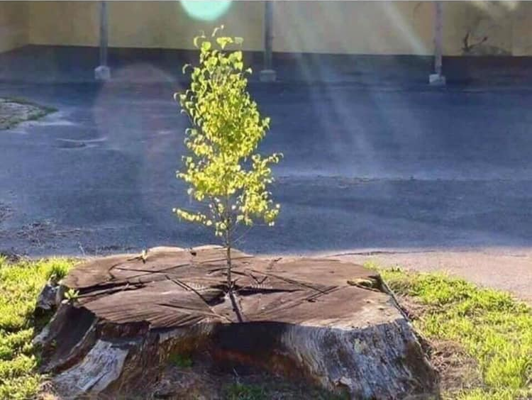
When two Christians are committed to God and to each other
they can overcome the toughest of times.

Slide 36
Start as you mean to go on

Slide 37
Start as you mean to go on
1. I am a man/woman of God!

Slide 38
Start as you mean to go on
I am a man/woman of God!
  We walk with God

Slide 39
Start as you mean to go on
I am a man/woman of God!
  We walk with God
  I want God to unite us

Slide 40
Start as you mean to go on
2. I am committed to you!

Slide 41
Start as you mean to go on
2. I am committed to you!
  My love says, “We can do all things through Christ who strengthens us.”

Slide 42
Start as you mean to go on
2. I am committed to you!
  My love says, “We can do all things through Christ who strengthens us.”
  Your soul and your joy in Christ are my heart’s desire

Slide 43
Start as you mean to go on
2. I am committed to you!
  My love says, “We can do all things through Christ who strengthens us.”
  Your soul and your joy in Christ are my heart’s desire
  I keep my vows—No matter what…!

Slide 44
Start as you mean to go on
2. I committed to you!
"I take thee to be my wedded wife/husband, to have and to hold from this day forward, for better, for worse, for richer, for poorer, in sickness and in health, to love and to cherish, till death do us part, according to God's holy ordinance; and thereto I pledge thee my faith."

Slide 45
Start as you mean to go on
3. We will help each other to:

Slide 46
Start as you mean to go on
3. We will help each other to:
  Grow in the Lord

Slide 47
Start as you mean to go on
3. We will help each other to:
  Grow in the Lord
  See the best in each other

Slide 48
Start as you mean to go on
3. We will help each other to:
  Grow in the Lord
  See the best in each other
  Share the workload

Slide 49
Start as you mean to go on
3. We will help each other to:
  Grow in the Lord
  See the best in each other
  Share the workload
  Clean up our attitudes

Slide 50
Start as you mean to go on
3. We will help each other to:
  Grow in the Lord
  See the best in each other
  Share the workload
  Clean up our attitudes
  Look for the good in all things

Slide 51
Start as you mean to go on
3. We will help each other to:
  Grow in the Lord
  See the best in each other
  Share the workload
  Clean up our attitudes
  Look for the good in all things
  NOT to excuse sin

Slide 52
Reality is Fun only if you accept it

Slide 53
Reality is Fun only if you accept it
Communication

Slide 54
Reality is Fun only if you accept it
Communication
  You speak different languages

Slide 55
Reality is Fun only if you accept it
Communication
  You speak different languages
  Words change meaning suddenly and without warning

Slide 56
Reality is Fun only if you accept it
Communication
  You speak different languages
  Words change meaning suddenly and without warning
  Listening carefully can be a waste of time—do it anyway

Slide 57
Reality is Fun only if you accept it
Communication
  You speak different languages
  Words change meaning suddenly and without warning
  Listening carefully can be a waste of time—do it anyway
  Humour is an acquired taste

Slide 58
Reality is Fun only if you accept it
Communication
  You speak different languages
  Words change meaning suddenly and without warning
  Listening carefully can be a waste of time—do it anyway
  Humour is an acquired taste
  Couples fight differently

Slide 59
Reality is Fun only if you accept it
2. Money

Slide 60
Reality is Fun only if you accept it
2. Money
  It all belongs to God

Slide 61
Reality is Fun only if you accept it
2. Money
  It all belongs to God
  Give to God first

Slide 62
Reality is Fun only if you accept it
2. Money
  It all belongs to God
  Give to God first
  What’s yours is mine

Slide 63
Reality is Fun only if you accept it
2. Money
  It all belongs to God
  Give to God first
  What’s yours is mine
  Debt can hasten marital demise

Slide 64
Reality is Fun only if you accept it
2. Money
  It all belongs to God
  Give to God first
  What’s yours is mine
  Debt can hasten marital demise
  Learning the hard way—Not ideal…

Slide 65
Reality is Fun only if you accept it
2. Money
  It all belongs to God
  Give to God first
  What’s yours is mine
  Debt can hasten marital demise
  Learning the hard way—Not ideal
  But as long as you are learning…!

Slide 66
Reality is Fun only if you accept it
3. Self-control

Slide 67
Reality is Fun only if you accept it
3. Self-control
  What you watch

Slide 68
Reality is Fun only if you accept it
3. Self-control
  What you watch
  Listen to

Slide 69
Reality is Fun only if you accept it
3. Self-control
  What you watch
  Listen to
  Where you go

Slide 70
Reality is Fun only if you accept it
3. Self-control
  What you watch
  Listen to
  Where you go
  Who you talk to

Slide 71
Reality is Fun only if you accept it
3. Self-control
  What you watch
  Listen to
  Where you go
  Who you talk to
  What you read

Slide 72
Reality is Fun only if you accept it
3. Self-control
  What you watch
  Listen to
  Where you go
  Who you talk to
  What you read
  All affect the health of your marriage

Slide 73
Reality is Fun only if you accept it
4. Your marriage is God’s Ministry
  Hospitality

Slide 74
Reality is Fun only if you accept it
4. Your marriage is God’s Ministry

Slide 75
Reality is Fun only if you accept it
4. Your marriage is God’s Ministry
  Hospitality

Slide 76
Reality is Fun only if you accept it
4. Your marriage is God’s Ministry
  Hospitality
  An example

Slide 77
Reality is Fun only if you accept it
4. Your marriage is God’s Ministry
  Hospitality
  An example
  A resource of talents for the church

Slide 78
Reality is Fun only if you accept it
4. Your marriage is God’s Ministry
  Hospitality
  An example
  A resource of talents for the church
  A stable relationship for others to enjoy

Slide 79
Reality is Fun only if you accept it
4. Your marriage is God’s Ministry
  Hospitality
  An example
  A resource of talents for the church
  A stable relationship for others to enjoy
  A blessing to bless each other and all

