Slide 2
Relationships 104—I’m a Parent

Slide 3
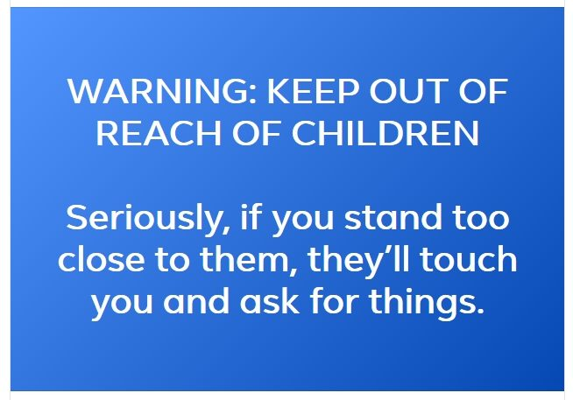

Slide 5

Psalm 127:3-5
³ Behold, children are a heritage from the Lord,
the fruit of the womb a reward.
⁴ Like arrows in the hand of a warrior
are the children of one's youth.
⁵ Blessed is the man
who fills his quiver with them!
He shall not be put to shame
when he speaks with his enemies in the gate. ^{(ESV)}

Slide 6
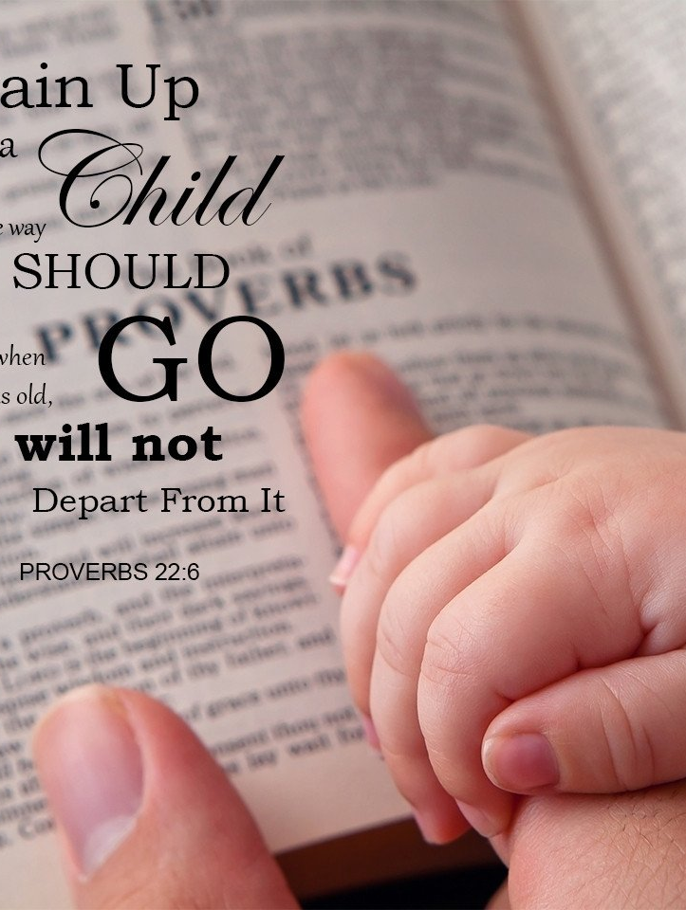
Leaving a legacy
1. First things first
Proverbs 22:6—
⁶Train up a child in the way he should go:
and when he is old, he will not depart from it. (KJV)

Slide 7
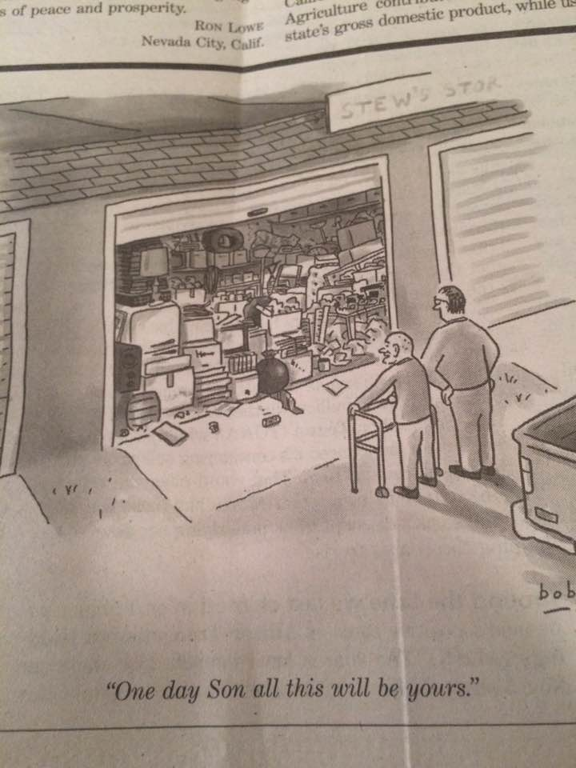
Leaving a legacy
2. Not that kind of valuable inheritance

Slide 8
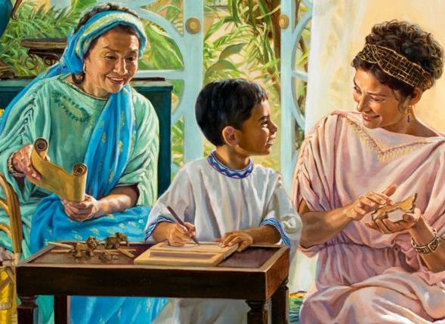
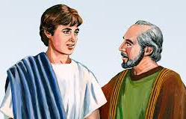
Leaving a legacy
3. Spiritual Legacy
Timothy was raised by a godly grandmother and an equally godly mother to become a great man of God!

Slide 9

When evaluating frustrations:
1. Ask— “Lord, what do you think?”

Slide 10
When evaluating frustrations:
2. Don’t overreact!
Ask—
“Is this going to matter in 100 years?”

Slide 11
When evaluating frustrations:
3. Ask— “What is happening around this?”

Slide 12
When evaluating frustrations:
4. Ask— “Do I need to give this space to dissipate?”

Slide 13
When evaluating frustrations:
5. Ask— “How can I prepare for the next time?”

Slide 14
When evaluating frustrations:
6. Ask— “How can I avoid a next time?”

Slide 15

Bringing things into perspective
Children are a blessing:
1. They have minds of their own

Slide 16
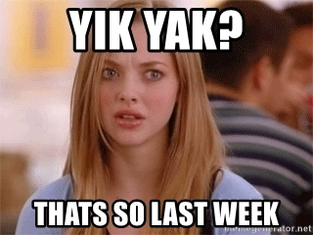
Bringing things into perspective
Children are a blessing:
2. They change

Slide 17

Bringing things into perspective
Children are a blessing:
3. They are expensive

Slide 18
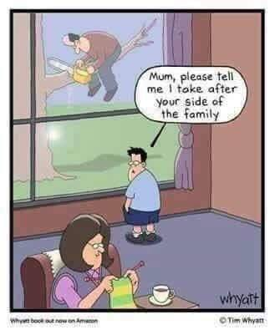
Bringing things into perspective
Children are a blessing:
4. They will be like you one day

Slide 19
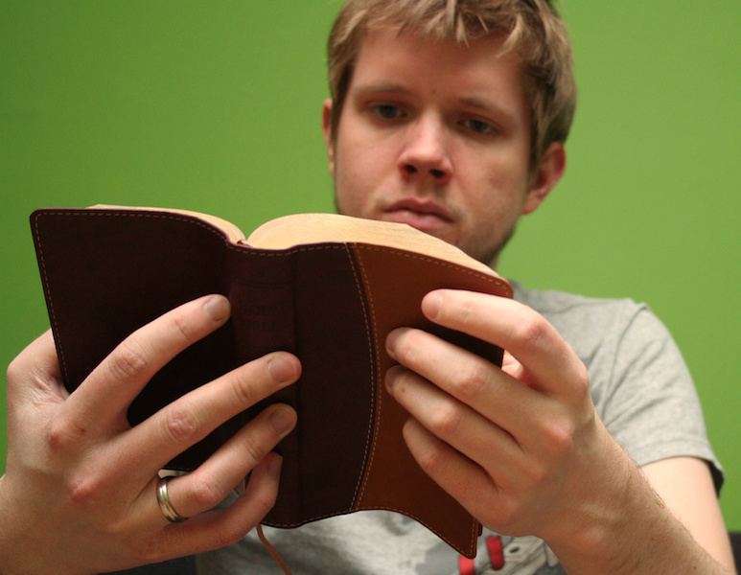
Bringing things into perspective
Children are a blessing:
4. They must develop a faith for themselves

Slide 20
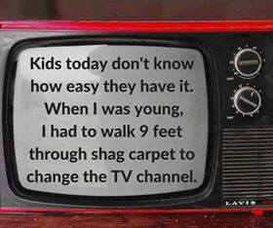
Bringing things into perspective
Children are a blessing:
5. They have heard all your stories

Slide 21
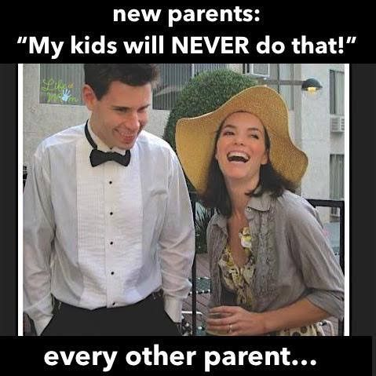
Avoid the embarrassment
Never, ever, ever, say:
1. My kids will never do that…

Slide 22
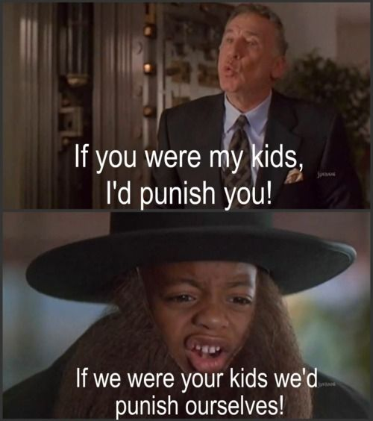
Avoid the embarrassment
Never, ever, ever, say:
2. If that were my kid…

Slide 23
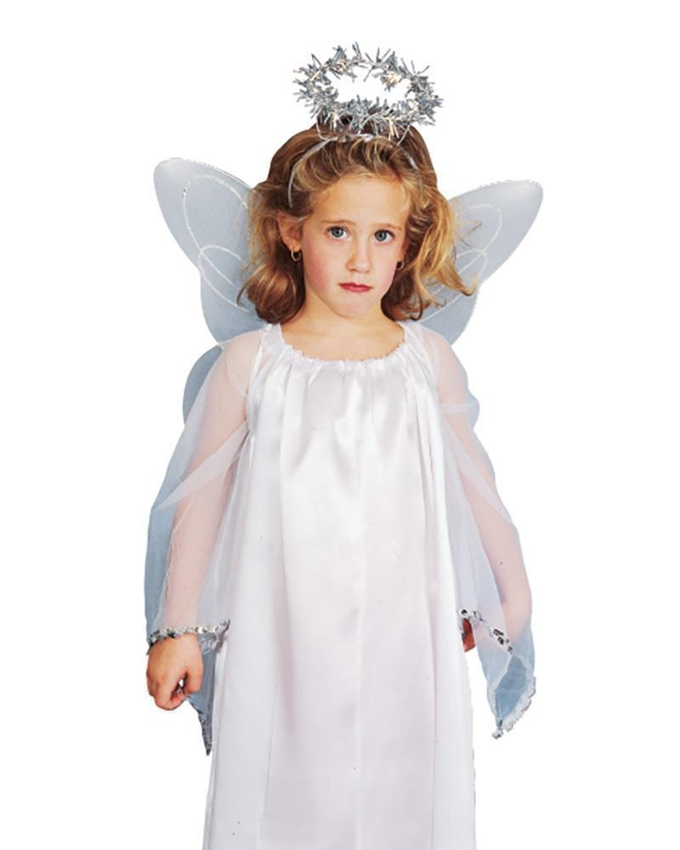
Avoid the embarrassment
Never, ever, ever, say:
3. My kids were raised properly…

Slide 24

Honouring your child
Long term planning:
1. Raise them for eternity

Slide 25

Honouring your child
Ideal parenting:
2. “What kind of parent would you want if you were a child again?”

Slide 26
Honouring your child
Hebrews 12:9—
⁹ Furthermore, we had earthly fathers to discipline us, and we respected them; shall we not much rather be subject to the Father of spirits, and live? (NASB95)
Ideal parenting:
3. Discipline with direction

Slide 27
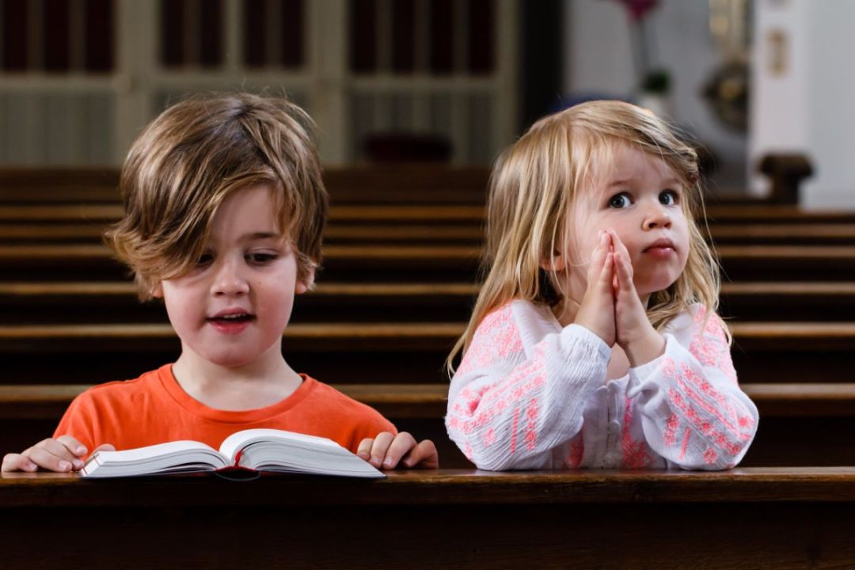
Honouring your child
Ideal parenting:
4. Church is home and family

Slide 28
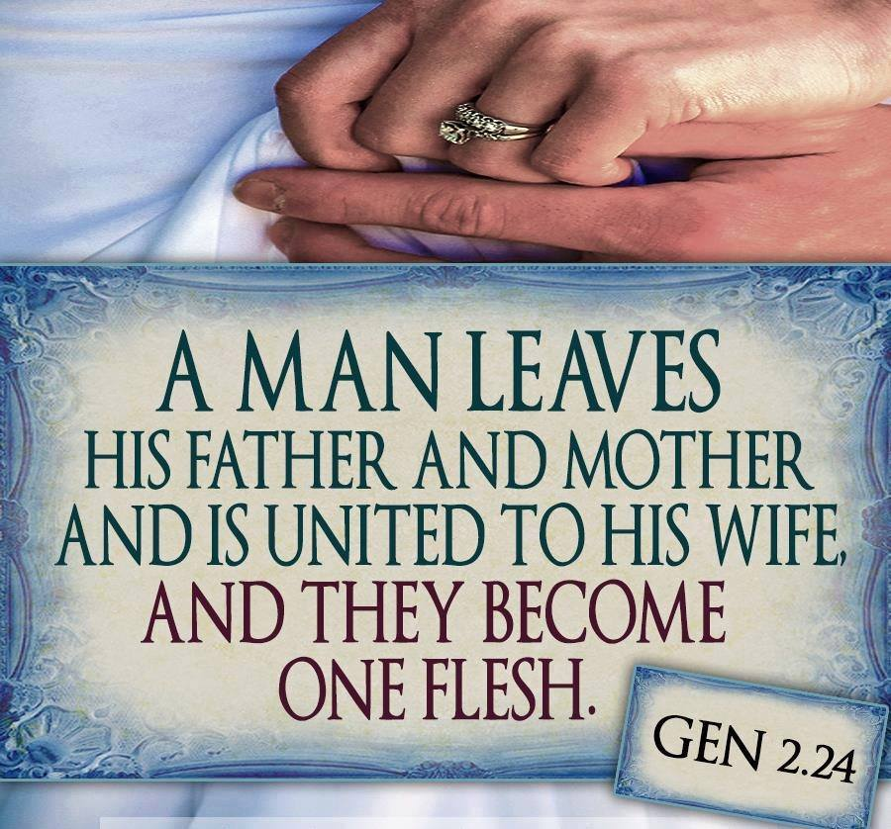
Honouring your child
Cut the apron strings:
5. Raise them to be good spouses and parents

