Slide 2
The Mind of Christ

Slide 3
Philippians 2:5-8—
⁵Have this attitude ^{[a]}in yourselves which was also in Christ Jesus, ⁶who, although He existed in the form of God, did not regard equality with God a thing to be ^{[b]}grasped, ⁷but ^{[c]}emptied Himself, taking the form of a bond-servant, and being made in the likeness of men. ⁸Being found in appearance as a man, He humbled Himself by becoming obedient to the point of death, even death ^{[d]}on a cross. (NASB95) [a]Or among [b]I.e. utilized or asserted [c]I.e. laid aside His privileges [d]Lit of

Slide 4

Christ’s Mind
Humble—
  Emptied Himself
  Servant
  Son of Man
  Obedient—cross
  Saviour

Slide 5
Christ’s Mind—It’s impact upon you!

Slide 6
Christ’s Mind—It’s impact upon you!
1. It is in you—

Slide 7
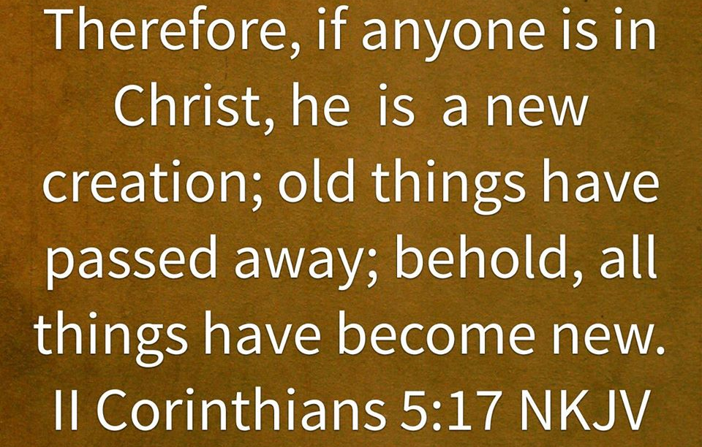
Christ’s Mind—It’s impact upon you!
1. It is in you—
If you are a Christian

Slide 8

Christ’s Mind—It’s impact upon you!
1. It is in you—
If you are a Christian
If you let it be

Slide 9
Christ’s Mind—It’s impact upon you!
We Think His thoughts

Slide 10
Christ’s Mind—It’s impact upon you!
We display His attitudes

Slide 11
Christ’s Mind—It’s impact upon you!
We do as He did

Slide 12
Christ’s Mind—It’s impact upon you!
We act in unison with His will

Slide 13
Christ’s Mind—It’s impact upon you!
Our lives mimic His at its core

Slide 14
Christ’s Mind—It’s impact upon you!
Private thoughts:
Praise
Purity
Justice
Spiritual
Victorious thoughts

Slide 15
Christ’s Mind—It’s impact upon you!
Private thoughts:
Unholy
Unhealthy
Worry • Fear • Anxiety
Criticism
Vengeance, Anger and Hatred
Discouraging thoughts

Slide 16
Christ’s Mind—How do we know?

Slide 17
Christ’s Mind—How do we know?
1. He has left a Witness—

Slide 18

Christ’s Mind—How do we know?
1. He has left a Witness—The Bible

Slide 19
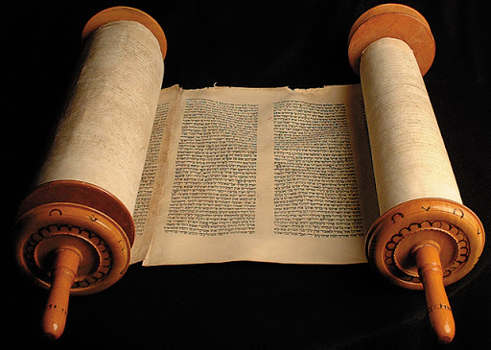
Christ’s Mind—How do we know?
1. He has left a Witness—The Bible
OT anticipates Him

Slide 20
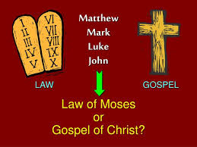
Christ’s Mind—How do we know?
1. He has left a Witness—The Bible
OT anticipates Him
Gospels reveal Him

Slide 21
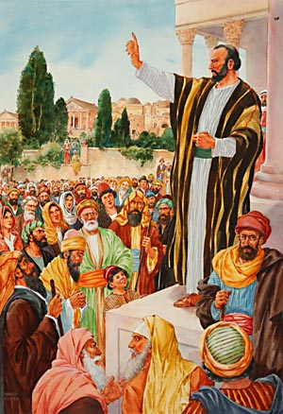
Christ’s Mind—How do we know?
1. He has left a Witness—The Bible
OT anticipates Him
Gospels reveal Him
Acts preaches Him

Slide 22
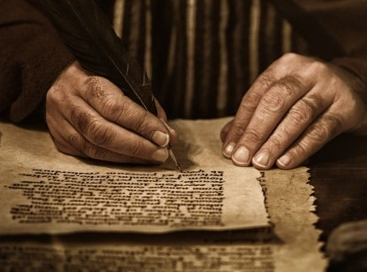
Christ’s Mind—How do we know?
1. He has left a Witness—The Bible
OT anticipates Him
Gospels reveal Him
Acts preaches Him
Letters teach Him

Slide 23
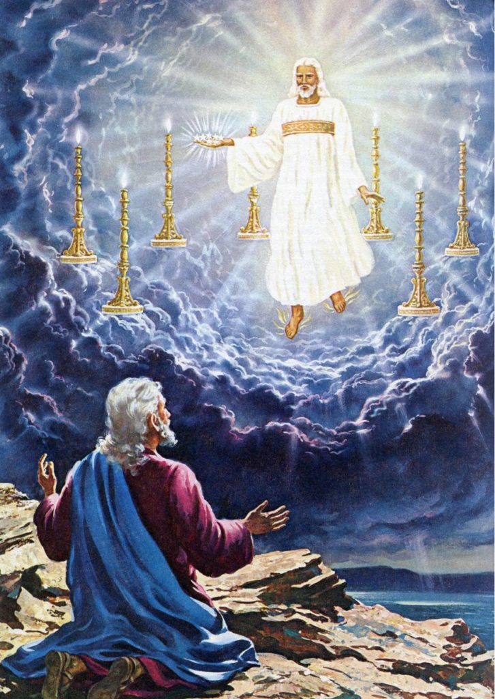
Christ’s Mind—How do we know?
1. He has left a Witness—The Bible
OT anticipates Him
Gospels reveal Him
Acts preaches Him
Letters teach Him
Revelation glorifies Him

Slide 24
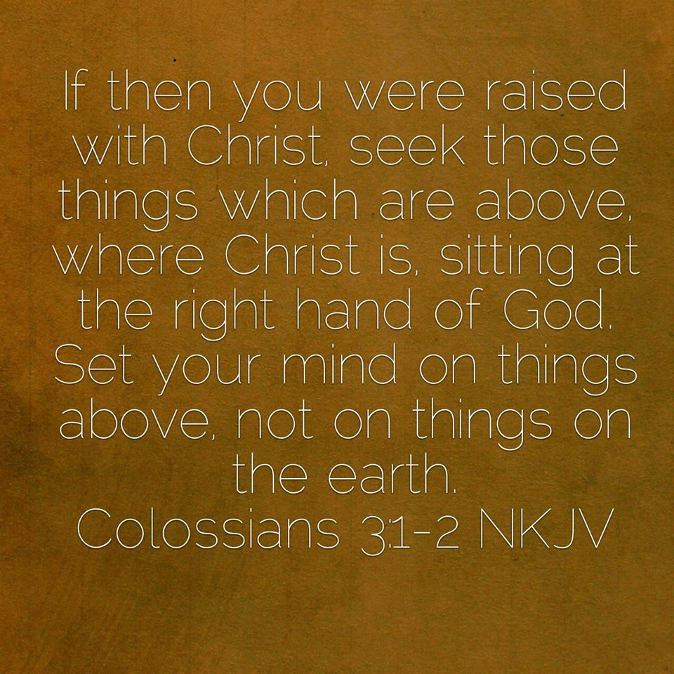
Christ’s Mind
Romans 5:19—¹⁹For as through the one man’s disobedience the many were made sinners, even so through the obedience of the One the many will be made righteous. (NASB95)
Obedient
to the
will
of the father to secure
our righteousness

Slide 25
Christ’s Mind
A
Spiritual mindset
is a
Mind Set
in only
One direction
Colossians 3:1-2—
Therefore if you have been raised up with Christ, keep seeking the things above, where Christ is, seated at the right hand of God. ²Set your mind on the things above, not on the things that are on earth. (NASB95)

Slide 26
Your Spiritual Battles
Are won or lost in your mind.
Defeat or victory is determined almost always in your mindset.
Your battles with sin and Satan are won or lost in your mind.
Sin never begins as an action...it begins as a thought.
  James 1:14-15—
  ¹⁴ But each one is tempted when he is carried away and enticed by his own lust. ¹⁵ Then when lust has conceived, it gives birth to sin; and when sin is accomplished, it brings forth death.

Slide 27
We have the mind of Christ
Operating in us—in every:
Decision we make.
In Every Attitude we embrace.
In Every Prayer we pray.
In Every Observation we make.
In Every Belief we adopt.
This is what it means to have the Mind of Christ.

Slide 28
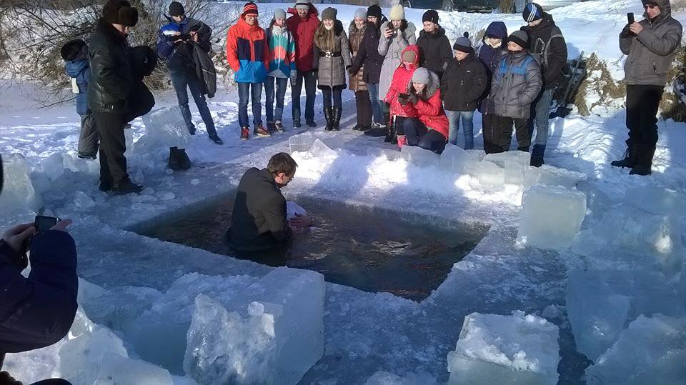
Matthew 28:19-20—¹⁹ Therefore go and make disciples of all nations, baptizing them in the name of the Father and of the Son and of the Holy Spirit, ²⁰ and teaching them to obey everything I have commanded you. And surely I am with you always, to the very end of the age.”

