Slide 1
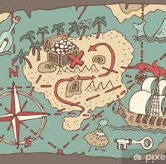
A Treasure Hunt for a Worm
Psalm 22:6

Slide 2
The Quest Initiation
As we search and research the Word diligently, we travel the path of hermeneutic. We interpret the scripture to better guide our lives and confirm our faith into certainty. Jewish hermeneutics has a specific type of interpretation known as remez. Simply put, a remez is a hint of a hidden message that is found by searching out the deeper meaning; often, this is done by analysing a word, recognising the power of symbolic language, and/or connecting with other supportive scripture.
A remez, like the pearl of great price, is a tiny treasure that reside within the word, just below the surface, or presents itself hidden in plain sight.

Slide 3
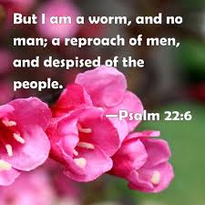
A Remez in Psalm 22:6
There’s an interesting remez in verse six of Psalm 22. This psalm is prophetic of the cross of Jesus, and verse six says, “But I am a worm, and no man…” Jesus was certainly a man on the cross, so what did the psalmist mean when he wrote, “But I am a worm”?

Slide 4
The Importance of this Worm
First, we need to get clear on the Hebrew word for worm and through the definition we will finds contextual meaning. This connotation directly from the word “worm” Biblically travels all the way from the Exodus wilderness to be lifted up, be hung on a cross, and leave a stain that cleanses us for our lifting up into eternity.
So, let’s seek after the meaning of the word “worm”: the Tolaath

Slide 5
Defining the Hebrew Worm
The most common Hebrew translation of worm is rimmah (Strong’s number 7415 (rimmah), means maggots. This is symbolic, as we see maggots when something is rotting or decaying. In the Bible, mankind is considered rimmah, not because they are the smallest, and most repulsive of all worms, but because of the sinful decay that man is constantly undergoing.
The second Hebrew translation of worm, found in Psalm 22:6, is Tola, Tolaat, or Tow la ath, (Strong’s number 8438 (tola) and is translated worm, crimson, scarlet, which is not the normal Hebrew word for worm as the usual word for worm is rimmah (maggot).

Slide 6
Getting Very Clear
If Psalm 22 is supposed to be directly connected to prophecy of the Messiah’s death, why would the Bible state that Jesus was a worm? The Messiah was not associating Himself with the maggots that represent a sinful life symbolized by the word ‘rimmah’; but rather the Tolaath specific worm with a specific name needs to be studied in a way that reveals His glory.

Slide 7
The Crimson Worm (scientific name: Coccus ilicis or Kermes ilicis, Cermes vermilio) (Hebrew name: tola, tola’at shani, )
The Crimson Worm looks more like a grub than a worm. In the lifecycle of this worm is found a remez (hidden meaning) that points to the sacrifice of Jesus on the cross.

Slide 8
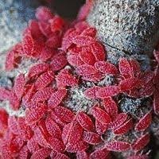
The scarlet worm uses it final strength to climb up the Kermes Oak tree and draws in sap.
The instinctive nature drives this worm to go upward. It ascends to give birth to its young which causes its death.
Jesus foretold that He too had to be lifted up. He made a conscious choice to obey the will of His Father
Just as Moses lifted up the snake in the wilderness, so the Son of Man must be lifted up,
John 3:14

Slide 9
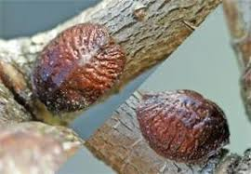
The scarlet worm pierces the thin bark of the Kermes Oak to draw in the sap.
The worm uses the sap to seal itself to the tree.
And you also were included in Christ when you heard the message of truth, the gospel of your salvation. When you believed, you were marked in him with a seal, the promised Holy Spirit,
Ephesian 1:13

Slide 10
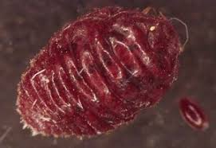
This sap is used to prepare a waxy scale to protect its soft body.
This transformed sap creates a layer of protection for its offspring.
Its body has become a protective shell that will enclose the soft bodies of the vulnerable young.
This shelter protects from spiders, ants, and birds.
I give them eternal life, and they shall never perish; no one will snatch them out of my hand. My Father, who has given them to me, is greater than all; no one can snatch them out of My Father’s hand. I and the Father are one.”
John 10:28-29

Slide 11
The eggs are laid under its body.
Jesus loves his followers and it willing to provide his blood as a protecting atonement.
"Jerusalem, Jerusalem, you who kill the prophets and stone those sent to you, how often I have longed to gather your children together, as a hen gathers her chicks under her wings, and you were not willing.”
Luke 13:34
May the Lord repay you for what you have done. May you be richly rewarded by the Lord, the God of Israel, under whose wings you have come to take refuge.”
Ruth 2:12

Slide 12
The scarlet worm would tuck its tail into its head and took on the shape of a heart.
And the peace of God, which transcends all understanding, will guard your hearts and your minds in Christ Jesus.
Philippians 4:7
let us draw near with a sincere heart in full assurance of faith, having our hearts sprinkled clean from an evil conscience and our bodies washed with pure water.
Hebrews 10:22

Slide 13
During the birthing process, it secretes a crimson fluid.
“…that at that time you were without Christ, being aliens from the commonwealth of Israel and strangers from the covenants of promise, having no hope and without God in the world. But now in Christ Jesus you who once were far off have been brought near by the blood of Christ.”
Ephesians 2:12-13
“For the life of a creature is in the blood, and I have given it to you to make atonement for yourselves on the altar; it is the blood that makes atonement for one’s life.”
Leviticus 17:11

Slide 14
The scarlet gel stains its body and all the eggs.
And they *sang a new song, saying, “Worthy are You to take the book and to break its seals; for You were slain, and purchased for God with Your blood men from every tribe and tongue and people and nation. “You have made them to be a kingdom and priests to our God; and they will reign upon the earth.”
Revelation 5:9-10

Slide 15
This brood have no other source of food so - they literally feed off the worms living body.
"Most assuredly, I say to you, unless you eat the flesh of the Son of Man and drink His blood, you have no life in you. Whoever eats My flesh and drinks My blood has eternal life, and I will raise him up at the last day. For My flesh is food indeed and My blood is drink indeed." For my flesh is real food and my blood is real drink.“
John 6:53-55
The crimson worm was the sent by God to eat the manna when too much was collected. (Exodus 16:20)

Slide 16
The husk from the worm releases a crimson stained brood.
We were buried therefore with him through baptism to death, that just like Christ was raised from the dead through the glory of the Father, so we also might walk in newness of life.
Roman 6:4

Slide 17
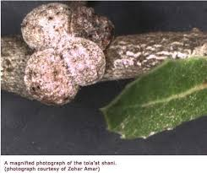
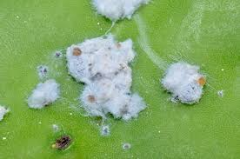
About three days later, the dead crimson worm turns pure white and becomes a wooly waxy corpse.
The waxy husk can be collected and used to manufacture shellac as a preservative.
Come now, let us reason together, says the LORD. "Though your sins are like scarlet (tola), they shall be as white as snow; though they are red as crimson, they shall be like wool.
Isaiah 1:18

Slide 18
This crimson fluid leaves a permanent stain on the tree.
but coming to Jesus, when they saw that He was already dead, they did not break His legs. But one of the soldiers pierced His side with a spear, and immediately blood and water came out.
John 19:33-34
For God was pleased to have all His fullness dwell in Him, and through Him to reconcile to Himself all things, whether things on earth or things in heaven, by making peace through His blood, shed on the cross.
Colossians 1:19-20

Slide 19
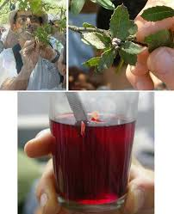
Scrapping the crimson worm from the tree will provide fluid for making crimson dye.
It takes about 750,000 crimson worms to make 1 pound of powdered dye.
It was used in the Old Testament for:
The priest robes
Covering for the Tabernacle
Religious rituals and Sacrifices
Scarlet threads/cords
It is being harvested and condensed today.
Harvesting the worm destroys the life cycle.

Slide 20
When it is crushed, it has a sweet fragrance.
and walk in love, even as the Christ loved us, and delivered himself up for us, an offering and sacrifice to God for a sweet-smelling savour.
Ephesians 5:2

Slide 21
Bildad’s Pertinent Question
"How then can a man be just with God? Or how can he be clean who is born of woman? "If even the moon has no brightness And the stars are not pure in His sight, How much less man, that maggot (rimmah), And the Son of Man, that worm(tola)!" Job 25:4-6

Slide 22
"How then can a man be just with God?”
The Son of man became the very crimson worm Bildad spoke of, giving His life He shed His blood so that everyone could have the opportunity to be made as white as freshly fallen snow.
That is how God has done it and that is the only way a person can be made just before Him.

Slide 23
Conclusion
So Jesus last words were
'It is finished. It is done. Paid in full. Father into your hands I commit my spirit.” John 19:30
He had completed His Father business, bowed His head, and died as a scarlet worm upon the tree.
The last verse of Psalm 22, the source of our message, confirms that in the ages to come:
A seed shall serve Him; it shall be accounted to the Lord for a generation. They shall come and shall declare His righteousness unto a people that shall be born, that He hath done this.
Psalms 22:30-31

