Slide 2
Clean Your Heart!
Part 1.
Traditions verses Commandments

Slide 3
Tradition verses Commandment
Matthew 15:1-2—
Then some Pharisees and scribes *came to Jesus from Jerusalem and said, ²“Why do Your disciples break the tradition of the elders? For they do not wash their hands when they eat bread.” (NASB95)

Slide 4
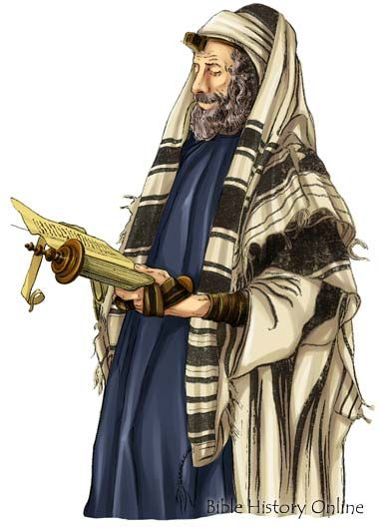
Traditions of the Elders
Scribes and Pharisees saw the oral traditions of ‘The Elders’ as authoritative:

Slide 5
Traditions of the Elders
They saw themselves as part of a succession of leaders passing on God’s will…

Slide 6
Traditions of the Elders
Moses

Slide 7
Traditions of the Elders
Moses
Aaron

Slide 8
Traditions of the Elders
Moses
Aaron
Priests

Slide 9
Traditions of the Elders
Moses
Aaron
Priests
70 Elders

Slide 10
Traditions of the Elders
Moses
Aaron
Priests
70 Elders
Tribes of Israel

Slide 11
Traditions of the Elders
Moses
Aaron
Priests
70 Elders
Tribes of Israel
Synagogues

Slide 12
Traditions of the Elders
Moses
Aaron
Priests
70 Elders
Tribes of Israel
Synagogues
Themselves

Slide 13
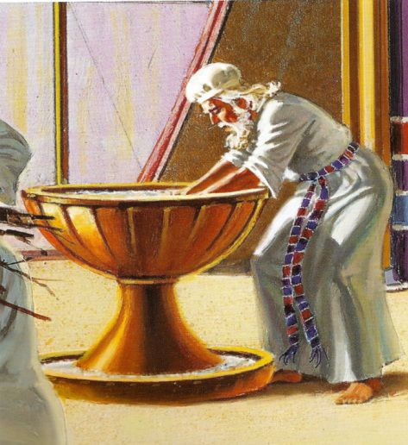
Washing of Hands
Yes, the priests during sacrifices were commanded to wash their hands, but…

Slide 14
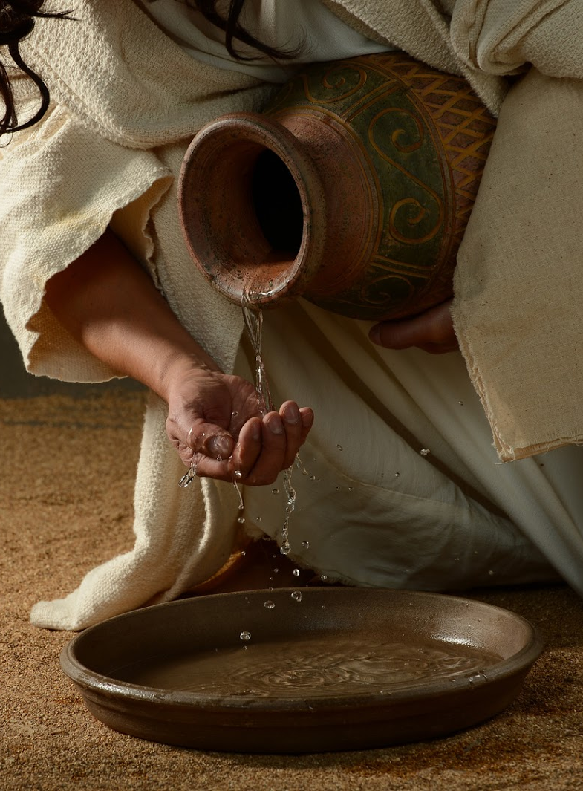
Washing of Hands
…The average Israelite was never commanded directly to do so before eating.

Slide 15
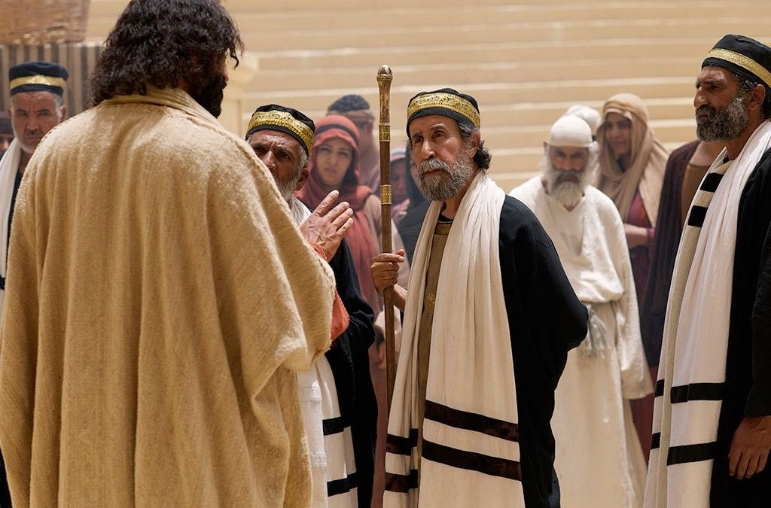
Broken Commandments
.

Slide 16
Broken Commandments
Matthew 15:1-3—
³ And He answered and said to them, “Why do you yourselves transgress the commandment of God for the sake of your tradition? (NASB95)

Slide 17
Broken Commandments
Jesus locks in the inevitable consequences of religious traditions becoming law.

Slide 18
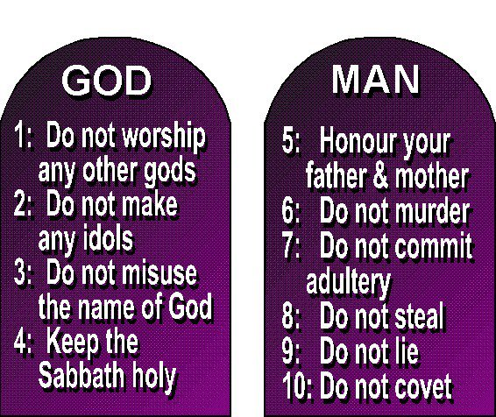
Broken Commandments
Matthew 15:4
⁴For God said, ‘Honour your father and mother,’ and, ‘He who speaks evil of father or mother is to ^{[a]}be put to death.’ (NASB95) [a]Lit die the death
V.4—The Fifth Commandment

Slide 19
Broken Commandments
Matthew 15:5
⁵ But you say, ‘Whoever says to his father or mother, “Whatever I have that would help you has been ^{[a]}given to God,” (NASB95) [a] Lit a gift; i.e. an offering
V.4—The Fifth Commandment
V.5—Traditions inserted

Slide 20
Broken Commandments
Matthew 15:6—
⁶he is not to honour his father or his mother^{[a]}.’ And by this you invalidated the word of God for the sake of your tradition. (NASB95) [a]I.e. by supporting them with it
V.4—The Fifth Commandment
V.5—Traditions inserted
V.6—Commandment replaced

Slide 21

V.7—Loophole Theology

Slide 22
Broken Commandments
Matthew 15:7—
⁷ You hypocrites, rightly did Isaiah prophesy of you: (NASB95)
V.7—Loophole Theology

Slide 23
Broken Commandments
Matthew 15:7—
⁷ You hypocrites, rightly did Isaiah prophesy of you: (NASB95)
V.7—Loophole Theology
All of the possessions are in a living trust.

Slide 24
Broken Commandments
Matthew 15:7—
⁷ You hypocrites, rightly did Isaiah prophesy of you: (NASB95)
V.7—Loophole Theology
All of the possessions are in a living trust.
All belongs to God

Slide 25
Broken Commandments
Matthew 15:7—
⁷ You hypocrites, rightly did Isaiah prophesy of you: (NASB95)
V.7—Loophole Theology
All of the possessions are in a living trust.
All belongs to God
Used until death

Slide 26
Broken Commandments
Matthew 15:7—
⁷ You hypocrites, rightly did Isaiah prophesy of you: (NASB95)
V.7—Loophole Theology
All of the possessions are in a living trust.
All belongs to God
Used until death
Parents can’t have it

Slide 27
Broken Commandments
Matthew 15:7—
⁷ You hypocrites, rightly did Isaiah prophesy of you: (NASB95)
V.7—Loophole Theology
All of the possessions are in a living trust.
All belongs to God
Used until death
Parents can’t have it
‘Talk to God about it!’

Slide 28
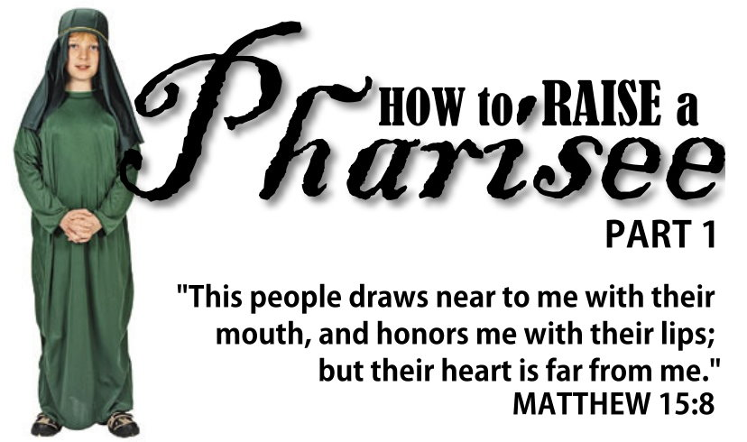
V.8—Lip service

Slide 29
Broken Commandments
Matthew 15:8—
⁸ ‘This people honours Me with their lips,
But their heart is far away from Me. (NASB95)
V.8—Lip service
When all that is really being offered is words

Slide 30
Broken Commandments
Matthew 15:8—
⁸ ‘This people honours Me with their lips,
But their heart is far away from Me. (NASB95)
V.8—Lip service
When all that is really being offered is words
When your heart
is not in your
worship it is
somewhere
else
(Where?)

Slide 31

V.9—Vain Worship

Slide 32
Broken Commandments
Matthew 15:9—
⁹ ‘But in vain do they worship Me,
Teaching as doctrines the precepts of men.’” (NASB95)
V.9—Vain Worship

Slide 33
Broken Commandments
Matthew 15:9—
⁹ ‘But in vain do they worship Me,
Teaching as doctrines the precepts of men.’” (NASB95)
V.9—Vain Worship
Waste of God’s time

Slide 34
Broken Commandments
Matthew 15:9—
⁹ ‘But in vain do they worship Me,
Teaching as doctrines the precepts of men.’” (NASB95)
V.9—Vain Worship
Waste of God’s time
Meaningless and soul destroying

Slide 35
Broken Commandments
Matthew 15:9—
⁹ ‘But in vain do they worship Me,
Teaching as doctrines the precepts of men.’” (NASB95)
V.9—Vain Worship
Waste of God’s time
Meaningless and soul destroying
Men’s rules take over

Slide 36
Broken Commandments
Matthew 15:9—
⁹ ‘But in vain do they worship Me,
Teaching as doctrines the precepts of men.’” (NASB95)
V.9—Vain Worship
Waste of God’s time
Meaningless and soul destroying
Men’s rules take over
No application required

Slide 37


Slide 38
Teachings of God
Bible must be our only guide

Slide 39
Teachings of God
Bible must be our only guide
We can turn anything into a tradition

Slide 40
Teachings of God
Bible must be our only guide
We can turn anything into a tradition
We all have them

Slide 41
Teachings of God
Bible must be our only guide
We can turn anything into a tradition
We all have them
Does it help or hinder:

Slide 42
Teachings of God
Bible must be our only guide
We can turn anything into a tradition
We all have them
Does it help or hinder:
  The spread of the gospel?

Slide 43
Teachings of God
Bible must be our only guide
We can turn anything into a tradition
We all have them
Does it help or hinder:
  The spread of the gospel?
  The unity of the church?

Slide 44
Teachings of God
Bible must be our only guide
We can turn anything into a tradition
We all have them
Does it help or hinder:
  The spread of the gospel?
  The unity of the church?
  Spiritual growth of the congregation

Slide 45
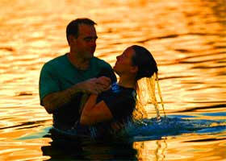
Acts 8:36—³⁶ As they went along the road they came to some water; and the eunuch *said, “Look! Water! What prevents me from being baptized?” (NASB95)

