Slide 1
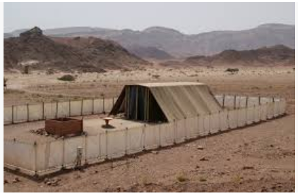
The New Testament Church as seen through the Old Covenant Tabernacle.

Slide 2
The True Tabernacle
Hebrews 8: 1 to 6
Now this is the main point of the things we are saying: We have such a High Priest, who is seated at the right hand of the throne of the Majesty in the heavens, ² a Minister of the sanctuary and of the true tabernacle which the Lord erected, and not man.
³ For every high priest is appointed to offer both gifts and sacrifices. Therefore it is necessary that this One also have something to offer. ⁴ For if He were on earth, He would not be a priest, since there are priests who offer the gifts according to the law; ⁵ who serve the copy and shadow of the heavenly things, as Moses was divinely instructed when he was about to make the tabernacle. For He said, “See that you make all things according to the pattern shown you on the mountain.” ⁶ But now He has obtained a more excellent ministry, inasmuch as He is also Mediator of a better covenant, which was established on better promises.

Slide 3
The Tabernacle – The Old Testament Holy Place.

Slide 4
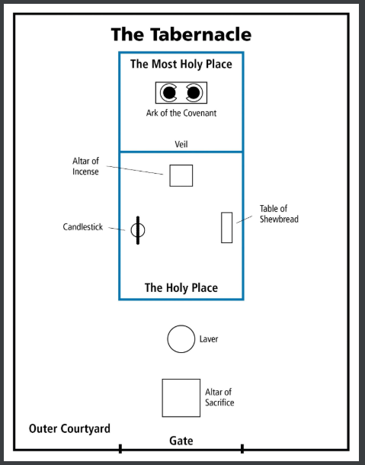
The Tabernacle:
Aerial View.

Slide 6
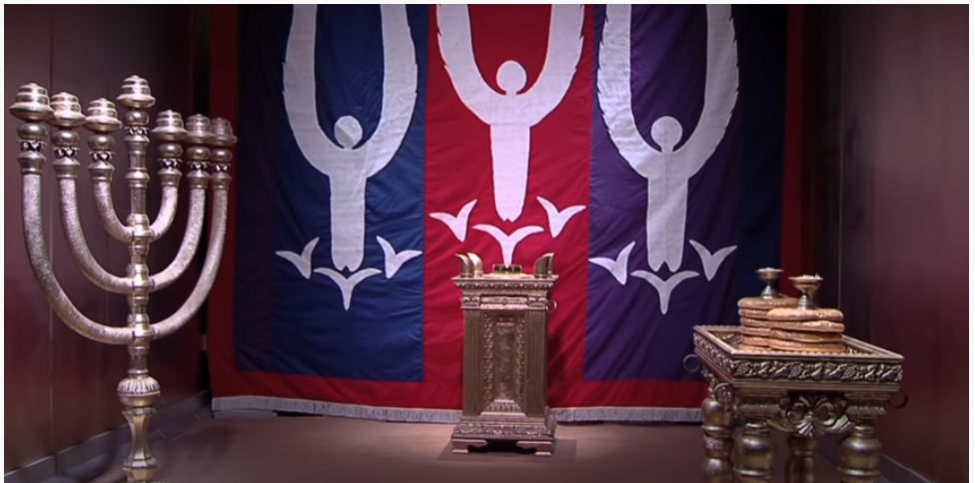
The Holy Place within the Tabernacle.

Slide 7
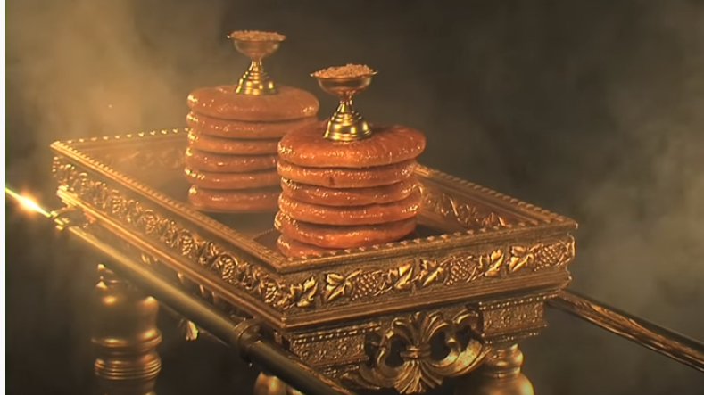
Table of Showbread – Exodus 25: 23 – 30

Slide 8
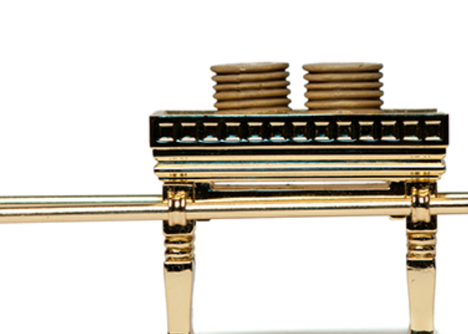
Table of Showbread – Exodus 25: 23 – 30
³⁰ And you shall set the showbread on the table before Me always.
Matthew Chapter 6.
³² Then Jesus said to them, “Most assuredly, I say to you, Moses did not give you the bread from heaven, but My Father gives you the true bread from heaven.
35 And Jesus said to them, “I am the bread of life. He who comes to Me shall never hunger, and he who believes in Me shall never thirst.

Slide 9
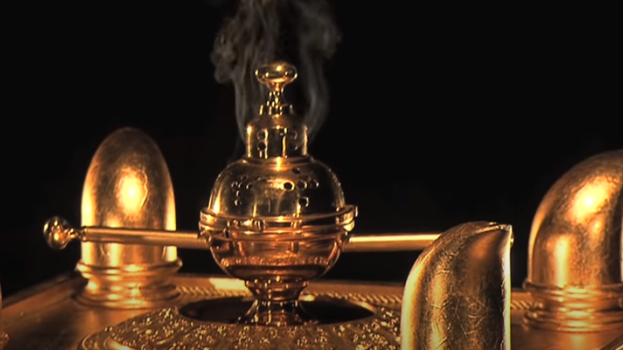
The Alter Of Incense – Exodus 30 1 to 10.

Slide 10
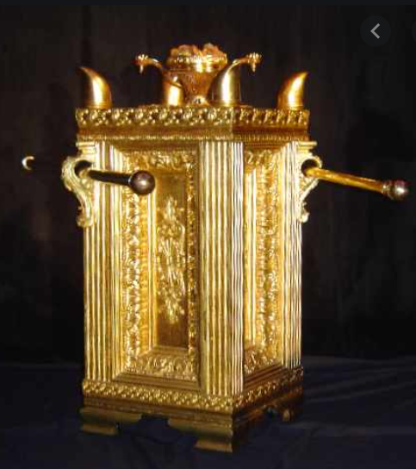
The Alter Of Incense – Exodus 30 1 to 10.
⁷ “Aaron shall burn on it sweet incense every morning; when he tends the lamps, he shall burn incense on it. ⁸ And when Aaron lights the lamps at twilight, he shall burn incense on it, a perpetual incense before the Lord throughout your generations.
1 Thessalonians 5
¹⁷ pray without ceasing, in everything give thanks, for this is the will of GOD in CHRIST JESUS for you.
Revelations 8 vs 4.
And the smoke of incense, with the prayers of the saints, ascended before GOD from the Angels hand.

Slide 11
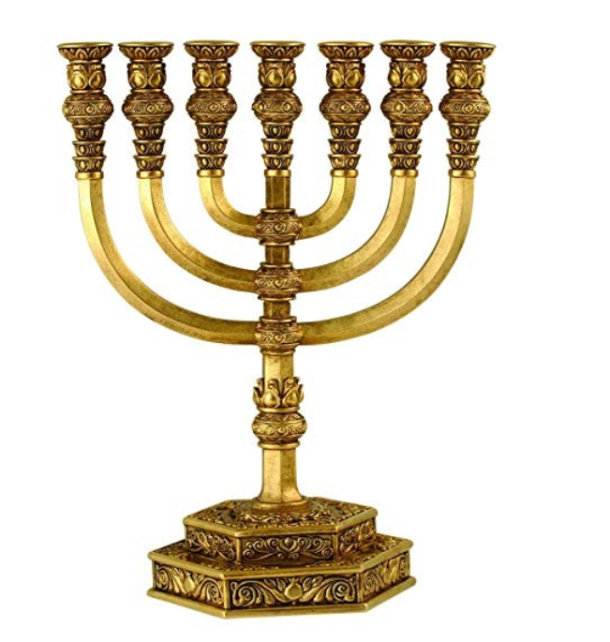
The Lampstand. Exodus 25: 31- 40

Slide 12
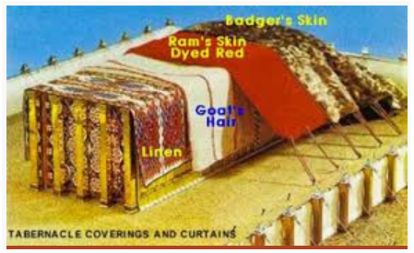
The Tabernacle – coverings.

Slide 13
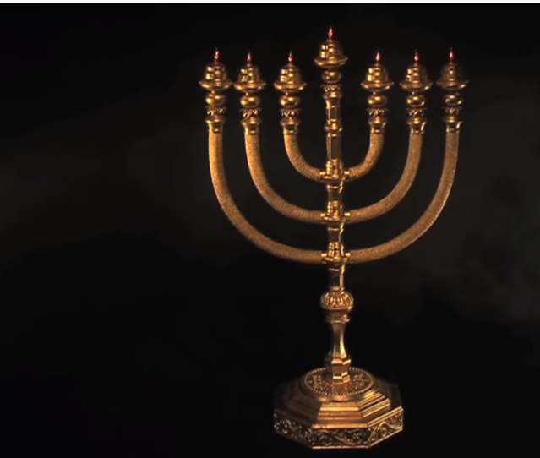
The Menora: Exodus 25: 31-40
John 8:12
“I am the light of the world. Whoever follows me will never walk in darkness but will have the light of life.”
John 12:46
“I have come into the world as a light, so that no one who believes in me should stay in darkness.”

Slide 14
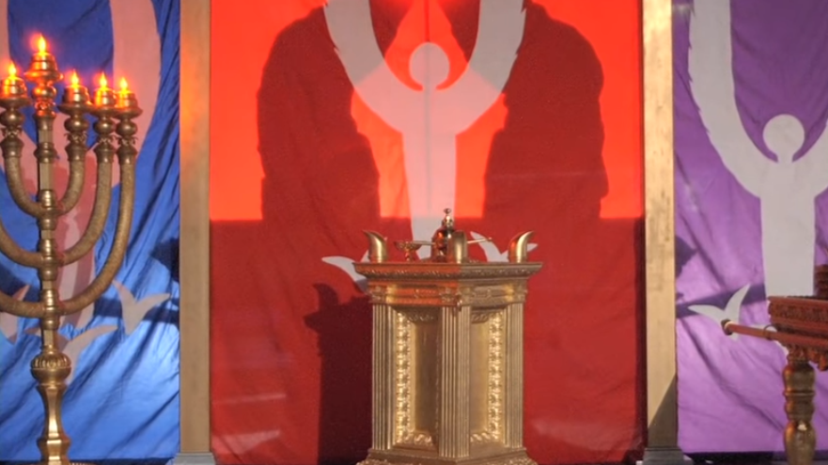
The Ark of the Covenant when Hidden behind the Veil

Slide 15
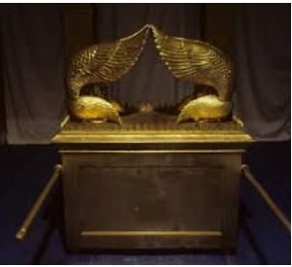
The Ark of the Testimony and the Mercy Seat- Exodus 25 10 – 22.

Slide 16
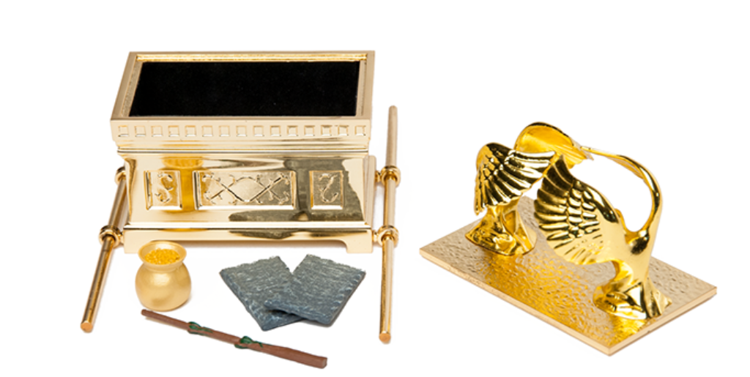
^{Leviticus 16}
¹⁴ He shall take some of the blood of the bull and sprinkle it with his finger on the mercy seat on the east side; and before the mercy seat he shall sprinkle some of the blood with his finger seven times.

Slide 17
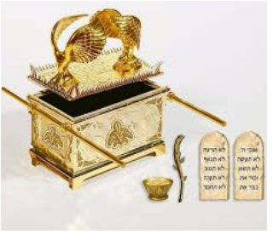
Exodus 25:21
²¹ You shall put the mercy seat on top of the Ark, and in the Ark you shall put the Testimony that I will give you. And there I will meet with you, and I will speak with you from above the Mercy Seat, from between the two cherubim, which are on the Ark of the Testimony, about everything I will give you in commandment to the Children of Israel.

Slide 18
Approaching the Holiest of Holies, GODS Presence.

Slide 19
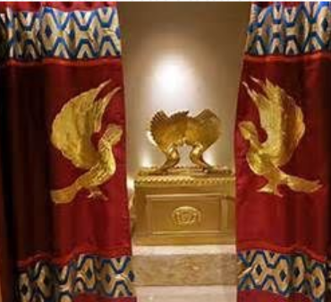
Entering the “Most Holy Place”.
^{Matthew 27}
¹ Then, behold, the veil of the temple was torn in two from top to bottom; and the earth quaked, and the rocks were split, ⁵² and the graves were opened; and many bodies of the saints who had fallen asleep were raised; ⁵³ and coming out of the graves after His resurrection, they went into the holy city and appeared to many.

Slide 20
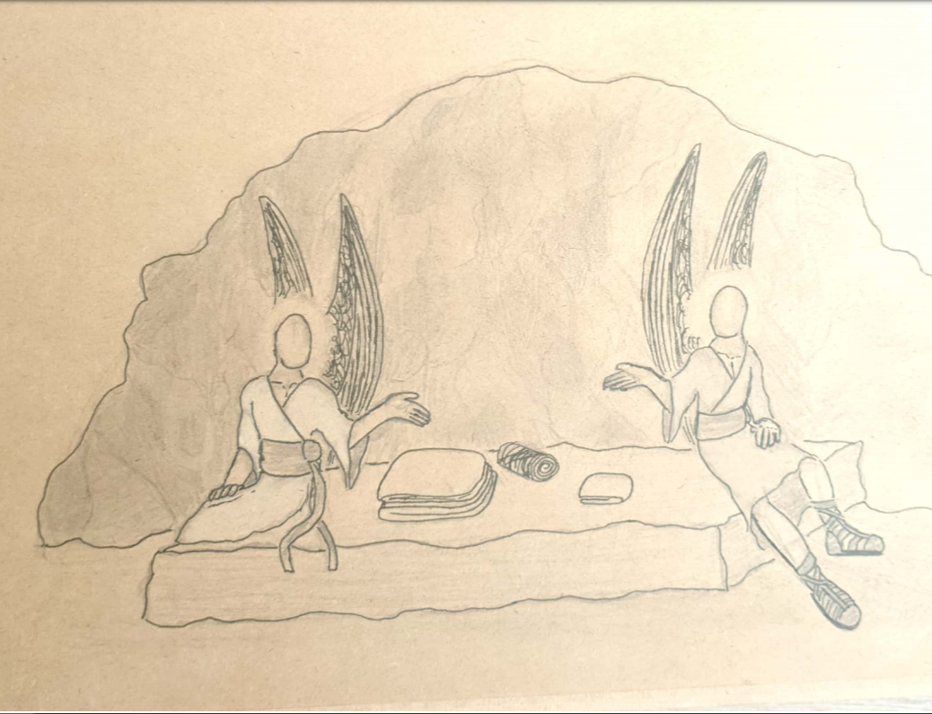

Slide 21
John 20 Verse 11 to 13.
But Mary stood outside the tomb weeping, but as she wept, she stooped and looked into the tomb, 12 and she saw two angels in white sitting, one at the head, and the other at the feet where Jesus had lain. 13. The they said to her, Woman, why are you weeping?

