Slide 2
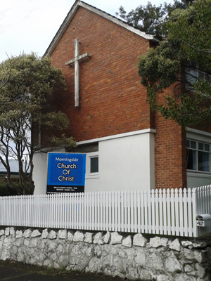
Why do you go to Church?

Slide 3
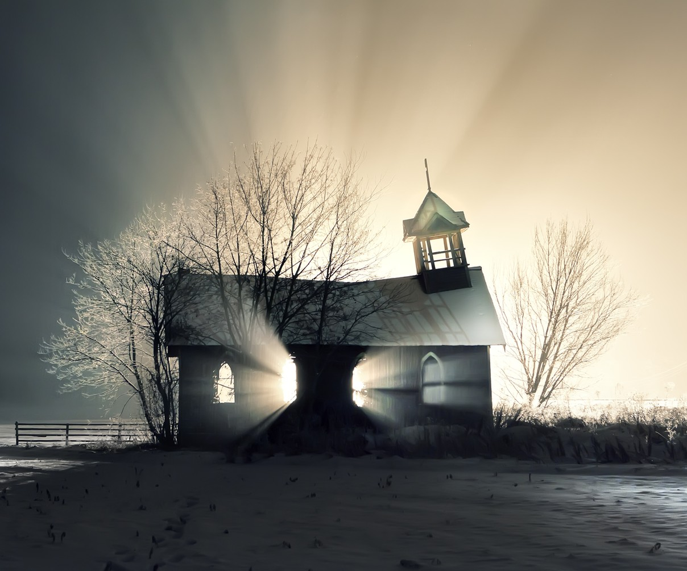

Slide 4
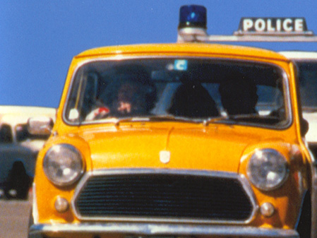
Where are you going in such a hurry?
In 1978 a Christian sister, who was late for church told me that had been pulled over by a traffic officer for speeding.
She said to me, “When he asked me where I was going in such a hurry, I didn’t say, ‘I’m going to church,’ I said,
‘I am going to worship God.’ I believe there is a difference.”

Slide 5
Where are you going in such a hurry?
In 1978 a Christian sister, who was late for church told me that had been pulled over by a traffic officer for speeding.
She said to me, “When he asked me where I was going in such a hurry, I didn’t say, ‘I’m going to church,’ I said,
‘I am going to worship God.’ I believe there is a difference.”

Slide 6
Where are you going in such a hurry?
In 1978 a Christian sister, who was late for church told me that had been pulled over by a traffic officer for speeding.
She said to me, “When he asked me where I was going in such a hurry, I didn’t say, ‘I’m going to church,’ I said,
‘I am going to worship God.’ I believe there is a difference.”

Slide 7
Is saying, “I’m going to church” a problem?
YES, If…
…it means a church building
  Because ‘Church’ has nothing to do with man-made structures.
…it means anything other than God’s people
  Business
  Secular charities

Slide 8
Is saying, “I’m going to church” a problem?
NO, If…
‘Church’ is understood as Jesus’ followers who:
  Confess Jesus as Lord and Saviour
  Congregate together to worship
  Work to meet needs to a spiritual end
  SO…?

Slide 9
Why do you go to Church?

Slide 10
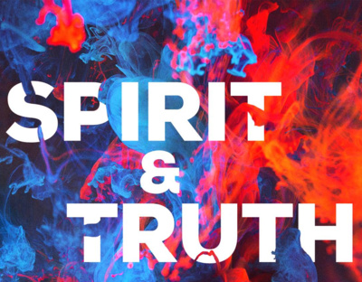
1. Because of who we are worshiping.
John 4:24
God is spirit,
and those who
worship Him
must worship in
spirit and truth.” (NASB95)

Slide 11
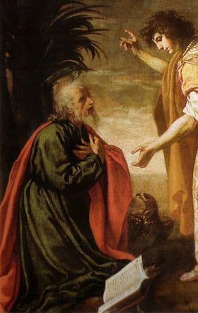
1. Because of who we are worshiping.
Revelation 22:9
But he *said to me, “Do not do that. I am a fellow servant of yours and of your brethren the prophets and of those who heed the words of this book. Worship God.”

Slide 12
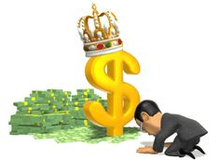
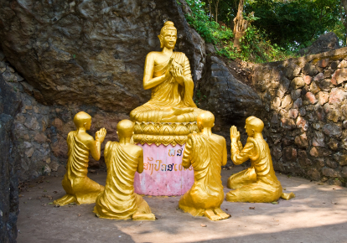
1. Because of who we are worshiping.
Romans 1:25
For they exchanged the truth of God for a lie, and worshiped and served the creature rather than the Creator, who is blessed forever. Amen. (NASB95)

Slide 13
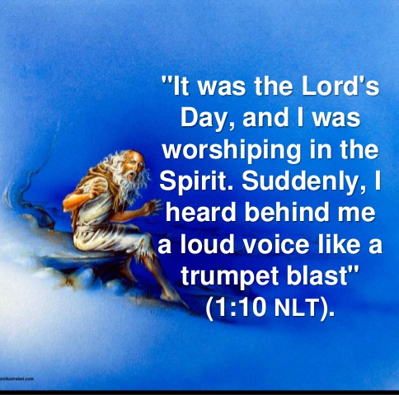
2. Because Jesus is alive
Jesus rose from the dead.
We worship and serve a risen Saviour.
“The Lord’s Day.”
The Day that he rose—Sunday

Slide 14
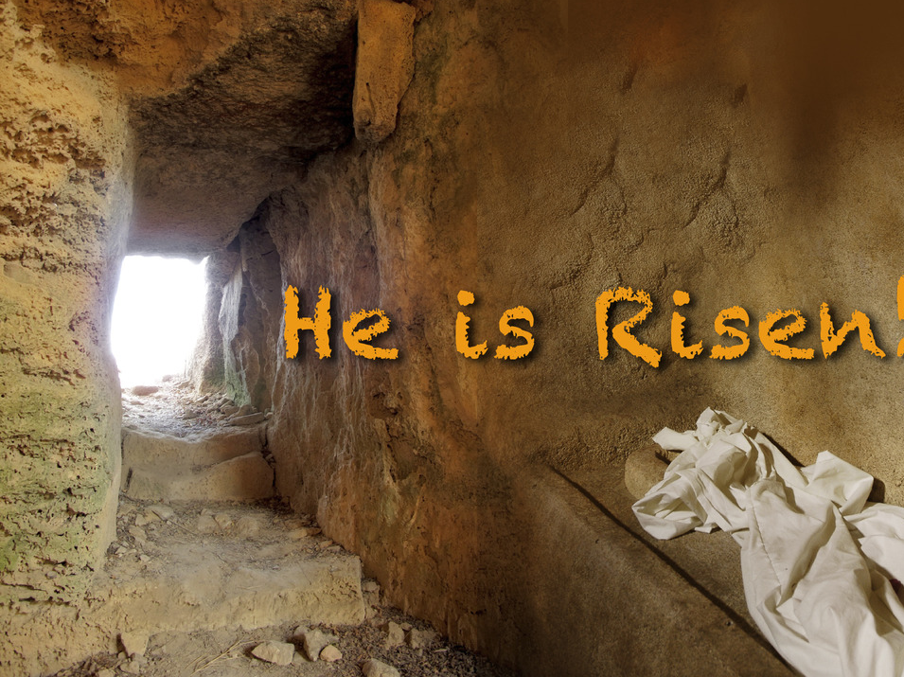
2. Because Jesus is alive
2 Timothy 2:8
⁸Remember Jesus Christ, risen from the dead, descendant of David, according to my gospel, (NASB95)

Slide 15
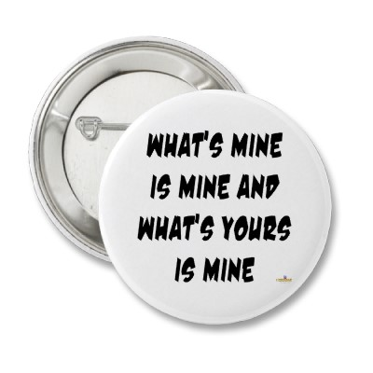
3. Because we want to remember and practice gospel values.
Some words are easy to learn…
  “This is Mine!” and “No!”
Other words are more difficult…
  “Thank you” and “I’m sorry.”
But learn them we must!

Slide 16
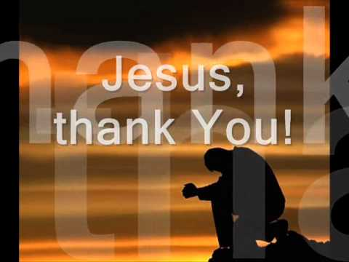
3. Because we want to remember and practice gospel values.
Church is a place where we can practice these words in the most important ways.
We can hear his words of forgiveness to us and say, “Thank you, Jesus, for saving me.”
We can see our sin and what it means, we can feel regret in our hearts and say, “I’m sorry, God, for sinning against you.”

Slide 17

3. Because we want to remember and practice gospel values.
Hebrews 10:24
²⁴ and let us consider how to stimulate one another to love and good deeds, (NASB95)

Slide 18
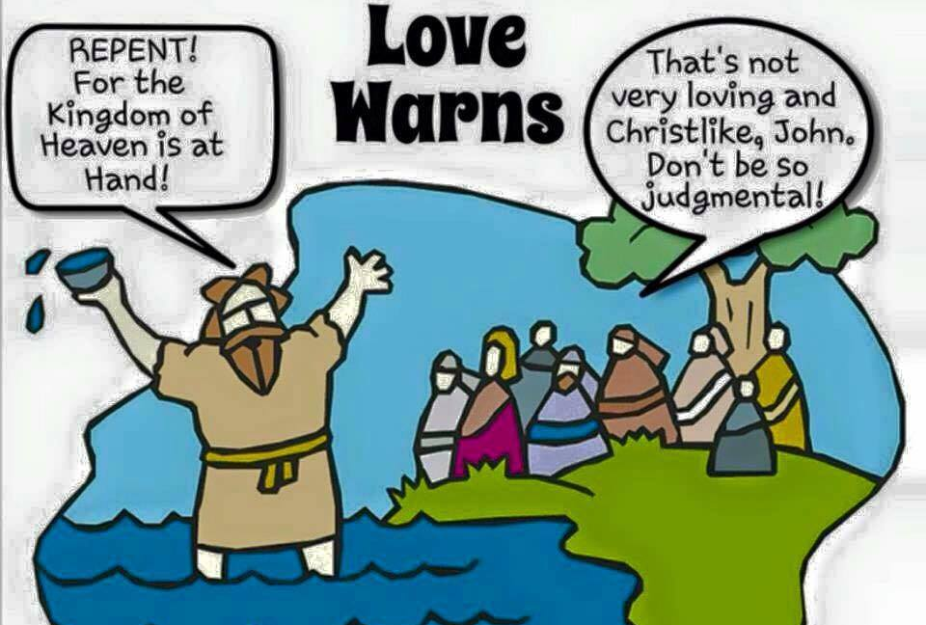
3. Because we want to remember and practice gospel values.
Matthew 3:2

Slide 19
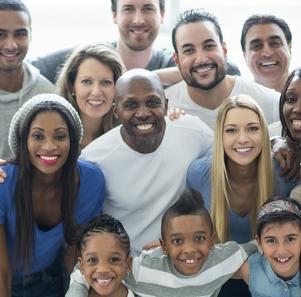
4. Because we want to learn to love people different from us.
Acts 10:34-35—³⁴ Opening his mouth, Peter said: “I most certainly understand now that God is not one to show partiality, ³⁵but in every nation the man who fears Him and does what is right is welcome to Him. (NASB95)

Slide 20
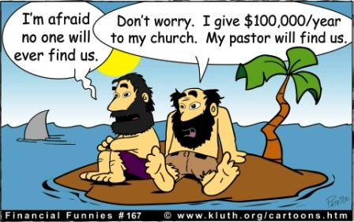

Slide 21
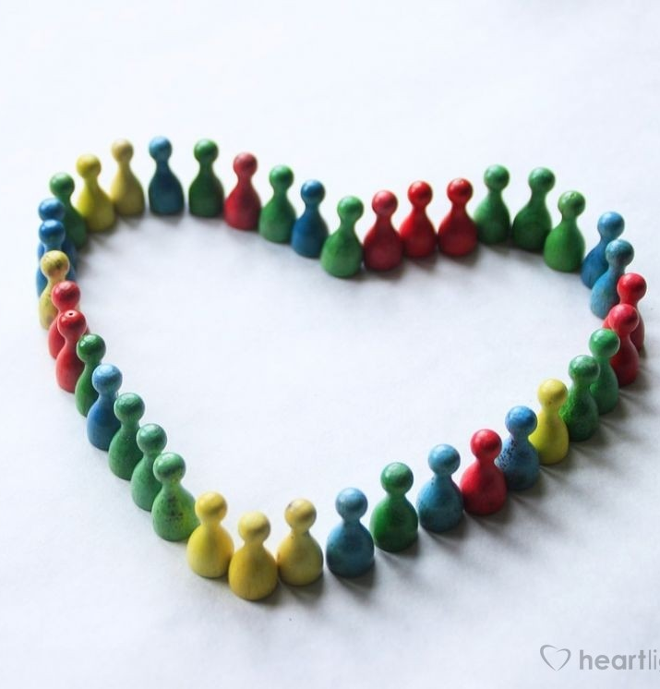
4. Because we want to learn to love people different from us.
Hebrews 10:25
²⁵not forsaking our own assembling together, as is the habit of some, but encouraging one another; and all the more as you see the day drawing near. (NASB95)

Slide 22
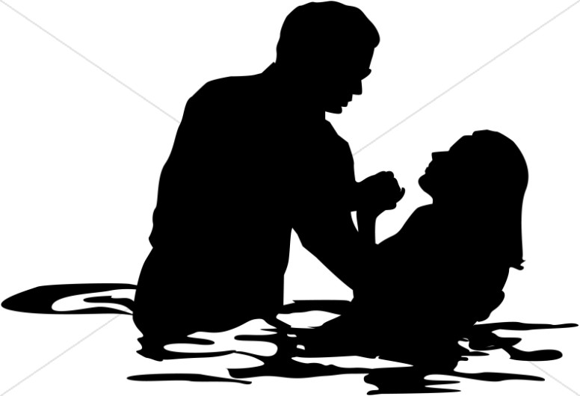
4. Because we want to learn to love people different from us.
Acts 2:47—And the Lord was adding to their number day by day those who were being saved. (NASB95)

