Slide 1
“I’m Sorry.”
John Staiger
Morningside Church of Christ
Sunday 2 August 2020
PM Sermon

Slide 3
I’m Sorry

Slide 4
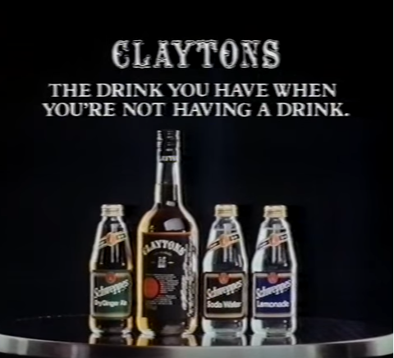
Clayton’s Apology
The apology you make when you’re not really sorry.

Slide 5
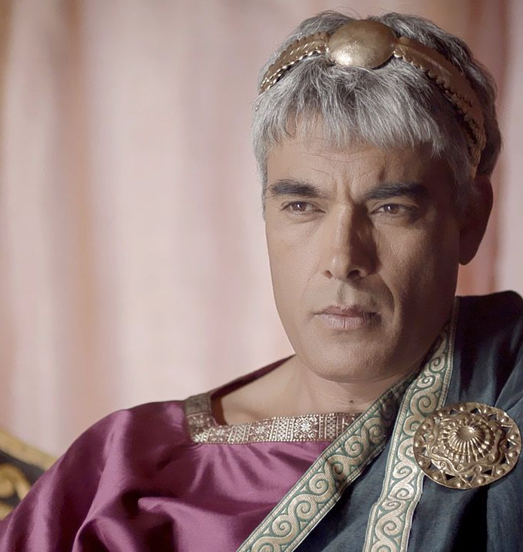
Herod’s sorrow didn’t save
John The Baptizer
Mark 6:26—²⁶And although the king was very sorry, yet because of his oaths and because of ^{[a]}his dinner guests, he was unwilling to refuse her. (NASB95) [a]Lit those reclining at the table

Slide 6
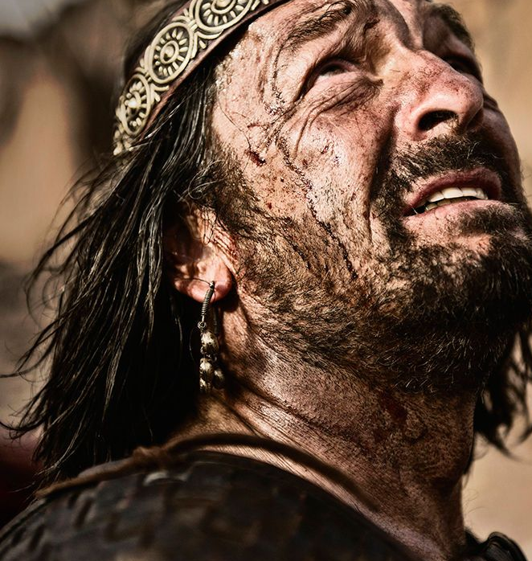
Saul’s sorrow didn’t stop him from trying to kill David
1 Samuel 24:16—¹⁶ When David had finished speaking these words to Saul, Saul said, “Is this your voice, my son David?” Then Saul lifted up his voice and wept. (NASB95)

Slide 7

The Corinthians Commended
2 Corinthians 7:10—¹⁰For the sorrow that is according to the will of God produces a repentance ^{[a]}without regret, leading to salvation, but the sorrow of the world produces death. (NASB95) [a]Or leading to a salvation without regret

Slide 8
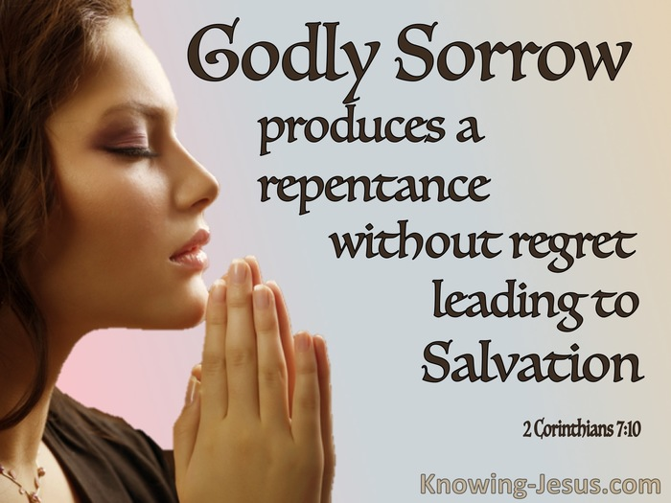

Slide 9

Worldly Sorrow
If it makes me sad, it must be bad!
Drown it out with…!
  Work
  Music
  Therapists
  Booze (even medication)
  More indulgence

Slide 10
Godly Sorrow
Repentance is a change of mind.
meta—change;
noeo — to think
Not just an intellectual alteration
An “OK, you got me.”
But an acknowledgement that you have sinned against God

Slide 11
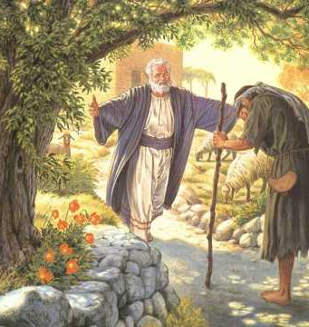
Godly Sorrow
Luke 15:17-19—¹⁷But when he came to ^{[a]}his senses, he said, ‘How many of my father’s hired men have more than enough bread, but I am dying here with hunger! ¹⁸I will get up and go to my father, and will say to him, “Father, I have sinned against heaven, and ^{[b]}in your sight; ¹⁹I am no longer worthy to be called your son; make me as one of your hired men.”’ (NASB95) [a]Lit himself [b]Lit before you

Slide 12
Godly Sorrow
The Prodigal Son
But when he came to his senses

Slide 13
Godly Sorrow
The Prodigal Son
Considered his options in light of his new ‘non-son’ status
He said, ‘How many of my father’s hired men have more than enough bread, but I am dying here with hunger! (NASB95)

Slide 14
Godly Sorrow
The Prodigal Son
Humility—I have sinned!
I will get up and go to my father, and will say to him, “Father, I have sinned against heaven, and in your sight; (NASB95)
Against
God and Man

Slide 15
Godly Sorrow
The Prodigal Son
Humility—I am not worthy!
¹⁹I am no longer worthy to be called your son; make me as one of your hired men.”’ (NASB95)

Slide 16
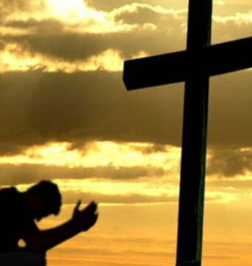
Godly Sorrow
3000 Sorrowful Souls
Peter accuses them—You killed him!
Acts 2:36—
³⁶Therefore let all the house of Israel know for certain that God has made Him both Lord and Christ—this Jesus whom you crucified.” (NASB95)

Slide 17
Godly Sorrow
3000 Sorrowful Souls
Cut to the heart
Acts 2:37—
³⁷Now when they heard this, they were pierced to the heart, and said to Peter and the rest of the apostles, “Brethren, what shall we do?” (NASB95)

Slide 18
Godly Sorrow
3000 Sorrowful Souls
Solution offered
Acts 2:38—
³⁸Peter said to them, “Repent, and each of you be baptized in the name of Jesus Christ for the forgiveness of your sins; and you will receive the gift of the Holy Spirit. (NASB95)

