Slide 1
“My place in the plan.”
John Staiger
Morningside Church of Christ
Sunday 2 August 2020
AM Sermon

Slide 2
My place in the Plan.

Slide 3
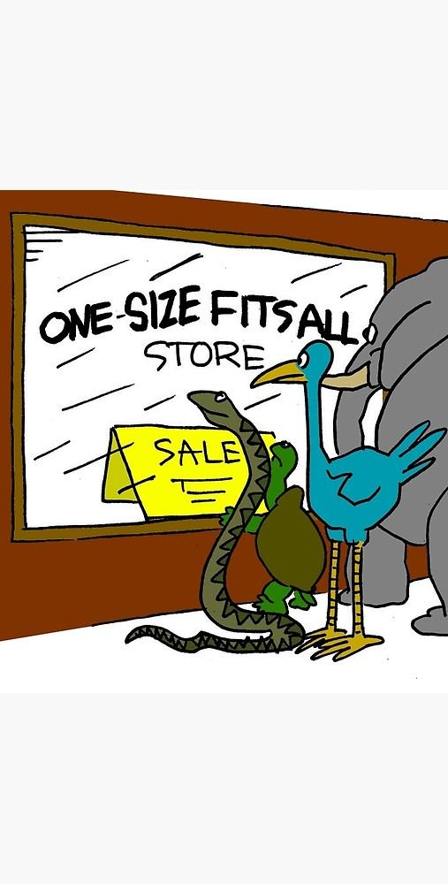
Is there a church where everyone fits?
A one-size-fits-all?

Slide 4
Is there a church where everyone fits?
A one-size-fits-all?
Some say “NO!”

Slide 5
Is there a church where everyone fits?
They say, “We are all different, with different preferences.”
Thus…

Slide 6
Is there a church where everyone fits?
You can take you pick

Slide 7
Is there a church where everyone fits?
You can take you pick
That is only true if…

Slide 8
Is there a church where everyone fits?
That is true, if…
We see the church as a place tailor made to meet our tastes

Slide 9
Is there a church where everyone fits?
That is true, if…
We see the church as a place where we are there to be served.

Slide 10
Is there a church where everyone fits?
That is true, if…
Jesus’ mission on earth is individually defined

Slide 11
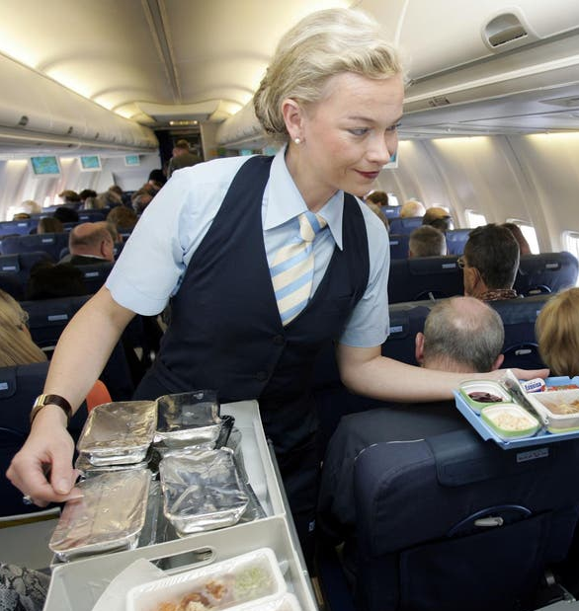
What is the purpose of the Church?

Slide 12
What is the purpose of the Church?
It is not that we are to be served
But…

Slide 13
What is the purpose of the Church?
But…
That we serve the interests of Christ
Yes…

Slide 14
What is the purpose of the Church?
Yes…
We serve each others’ needs
But…

Slide 15
What is the purpose of the Church?
But…
For the purpose of the growth of the body of Christ
How…

Slide 16

What part do we play?
For the purpose of the growth of the Body of Christ—

Slide 17
What part do we play?
Each has a part to play—
1 Peter 4:10-12—
  ¹⁰As each one has received a special gift, employ it in serving one another as good stewards of the manifold grace of God. (NASB95)

Slide 18
What part do we play?
Each has a part to play—
  1 Peter 4:11a—¹¹ Whoever speaks, is to do so as one who is speaking the utterances of God; (NASB95)

Slide 19
What part do we play?
Each has a part to play—
  1 Peter 4:11b—whoever serves is to do so as one who is serving by the strength which God supplies; so that… (NASB95)

Slide 20
What part do we play?
Each has a part to play—
  1 Peter 4:11c—so that in all things
    God may be glorified
    through Jesus Christ,
    to whom belongs the glory and dominion
    forever and ever. Amen. (NASB95)

Slide 21
What part do we play?
Each has a part to play—
Romans 12:3-8

Slide 22
What part do we play?
Each has a part to play—
Romans 12:3-8—
  ³ For through the grace given to me I say to everyone among you not to think more highly of himself than he ought to think; but to think so as to have sound judgment, as God has allotted to each a measure of faith. (NASB95)

Slide 23
What part do we play?
Each has a part to play—
Romans 12:3-8—
  ⁴ For just as we have many members in one body and all the members do not have the same function, (NASB95)

Slide 24
What part do we play?
Each has a part to play—
Romans 12:3-8—
  ⁵so we, who are many, are one body in Christ, and individually members one of another. (NASB95)

Slide 25
What part do we play?
Each has a part to play—
Romans 12:3-8—
  ⁶ Since we have gifts that differ according to the grace given to us, each of us is to exercise them accordingly:

Slide 26
What part do we play?
Each has a part to play—
Romans 12:3-8—
    if prophecy, according to the proportion of his faith;
    ⁷if service, in his serving;
    or he who teaches, in his teaching;
    ⁸or he who exhorts, in his exhortation;
    he who gives, with liberality;
    he who leads, with diligence;
    he who shows mercy, with cheerfulness. (NASB95)

Slide 27

Where to begin…
1 Corinthians 12:13—
¹³For by one Spirit we were all baptized into one body, whether Jews or Greeks, whether slaves or free, and we were all made to drink of one Spirit. (NASB95)

