Slide 1
“Render unto Caesar!
John Staiger
Morningside Church of Christ
Sunday 19 July 2020
AM Sermon

Slide 2
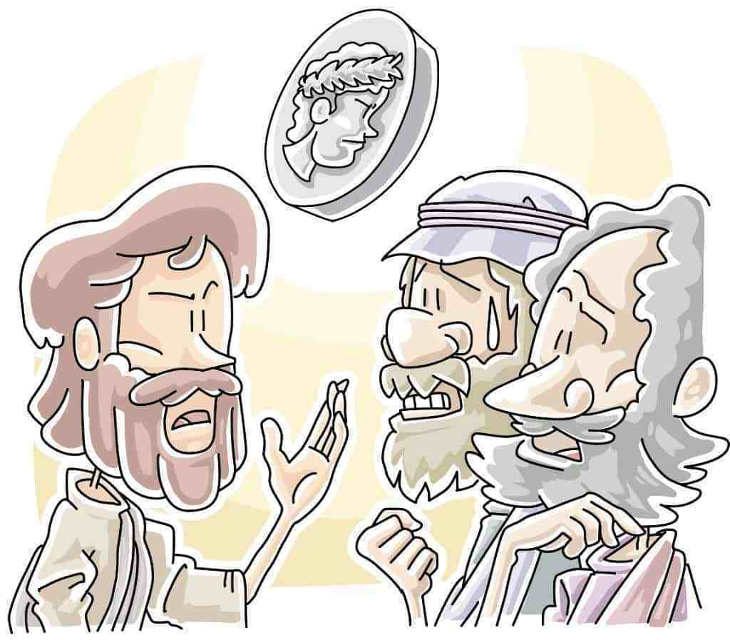
Render unto Caesar!
Matthew 22:15-22

Slide 3
Matthew 22:15-22—¹⁵Then the Pharisees went and ^{[a]}plotted together how they might trap Him ^{[b]}in what He said. ¹⁶And they *sent their disciples to Him, along with the Herodians, saying, “Teacher, we know that You are truthful and teach the way of God in truth, and ^{[c]}defer to no one; for You are not partial to any. ¹⁷Tell us then, what do You think? Is it ^{[d]}lawful to give a poll-tax to Caesar, or not?” ¹⁸But Jesus perceived their ^{[e]}malice, and said, “Why are you testing Me, you hypocrites?

Slide 4
Matthew 22:15-22—
¹⁹Show Me the coin used for the poll-tax.” And they brought Him a ^{[f]}denarius. ²⁰And He *said to them, “Whose likeness and inscription is this?” ²¹They *said to Him, “Caesar’s.” Then He *said to them, “Then render to Caesar the things that are Caesar’s; and to God the things that are God’s.” ²²And hearing this, they were amazed, and leaving Him, they went away. (NASB95) [a]Lit took counsel [b]Lit in word [c]Lit it is not a concern to You about anyone; i.e. You do not seek anyone’s favour [d]Or permissible [e]Or wickedness [f]The denarius was a day’s wages

Slide 5
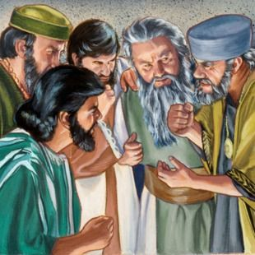
Matthew 22:15—¹⁵Then the Pharisees went and plotted together how they might trap Him in what He said.

Slide 6
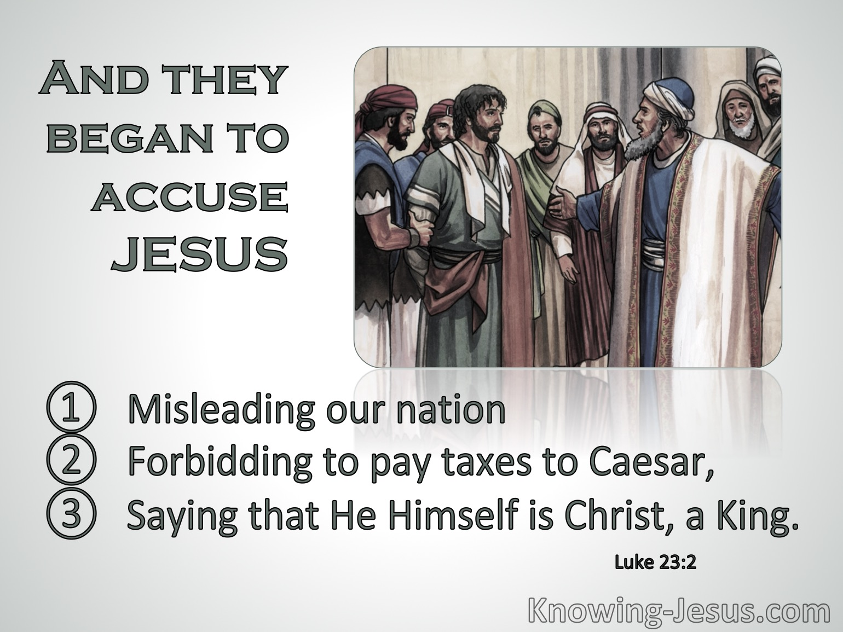
Later—Jesus on trial
Luke 23:1-2—
Then the whole body of them got up and brought Him before Pilate. ²And they began to accuse Him, saying, “We found this man misleading our nation and forbidding to pay taxes to Caesar, and saying that He Himself is Christ, a King.” (NASB95)

Slide 7
Later—Jesus on trial

Slide 8
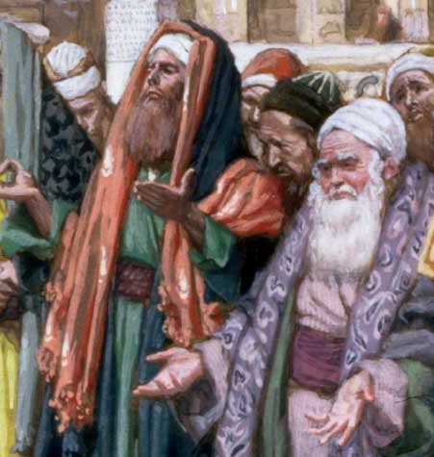
Matthew 22:16—
¹⁶And they *sent their disciples to Him, along with the Herodians, saying, “Teacher, we know that You are truthful and teach the way of God in truth, and defer to no one; for You are not partial to any.

Slide 9
Matthew 22:16—
¹⁶And they *sent their disciples to Him, along with the Herodians, saying, “Teacher, we know that You are truthful and teach the way of God in truth, and defer to no one; for You are not partial to any.
Flattery
Praising his:
Integrity
Impartiality
and
Devotion to Truth.

Slide 10
Kings and Coins
If Jesus said, “Yes”:
A Traitor to the nation of Israel
“No”:
A Revolutionary against Caesar
Matthew 22:17—
¹⁷Tell us then, what do You think? Is it lawful to give a poll-tax to Caesar, or not?”

Slide 11
Motives shine through
Matthew 22:18—
¹⁸But Jesus perceived their malice, and said, “Why are you testing Me, you hypocrites?
Motive:
Matthew 27:18—¹⁸For he [Pilate] knew that because of envy they had handed Him over. (NASB95)

Slide 12
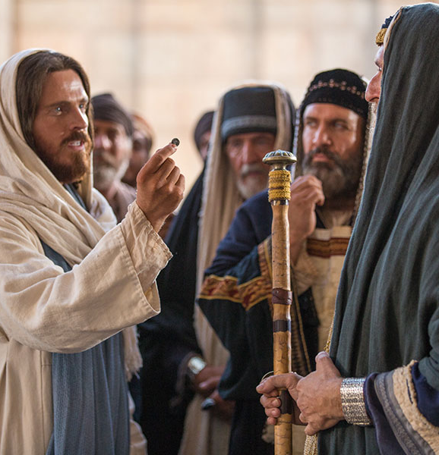
Matthew 22:19—
¹⁹Show Me the coin used for the poll-tax.” And they brought Him a denarius.
Man’s Currency

Slide 13
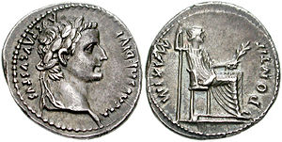
Matthew 22:20—
²⁰And He *said to them, “Whose likeness and inscription is this?”
Man’s Currency

Slide 14
Matthew 22:21a—²¹They *said to Him, “Caesar’s.”
Man’s Currency

Slide 15
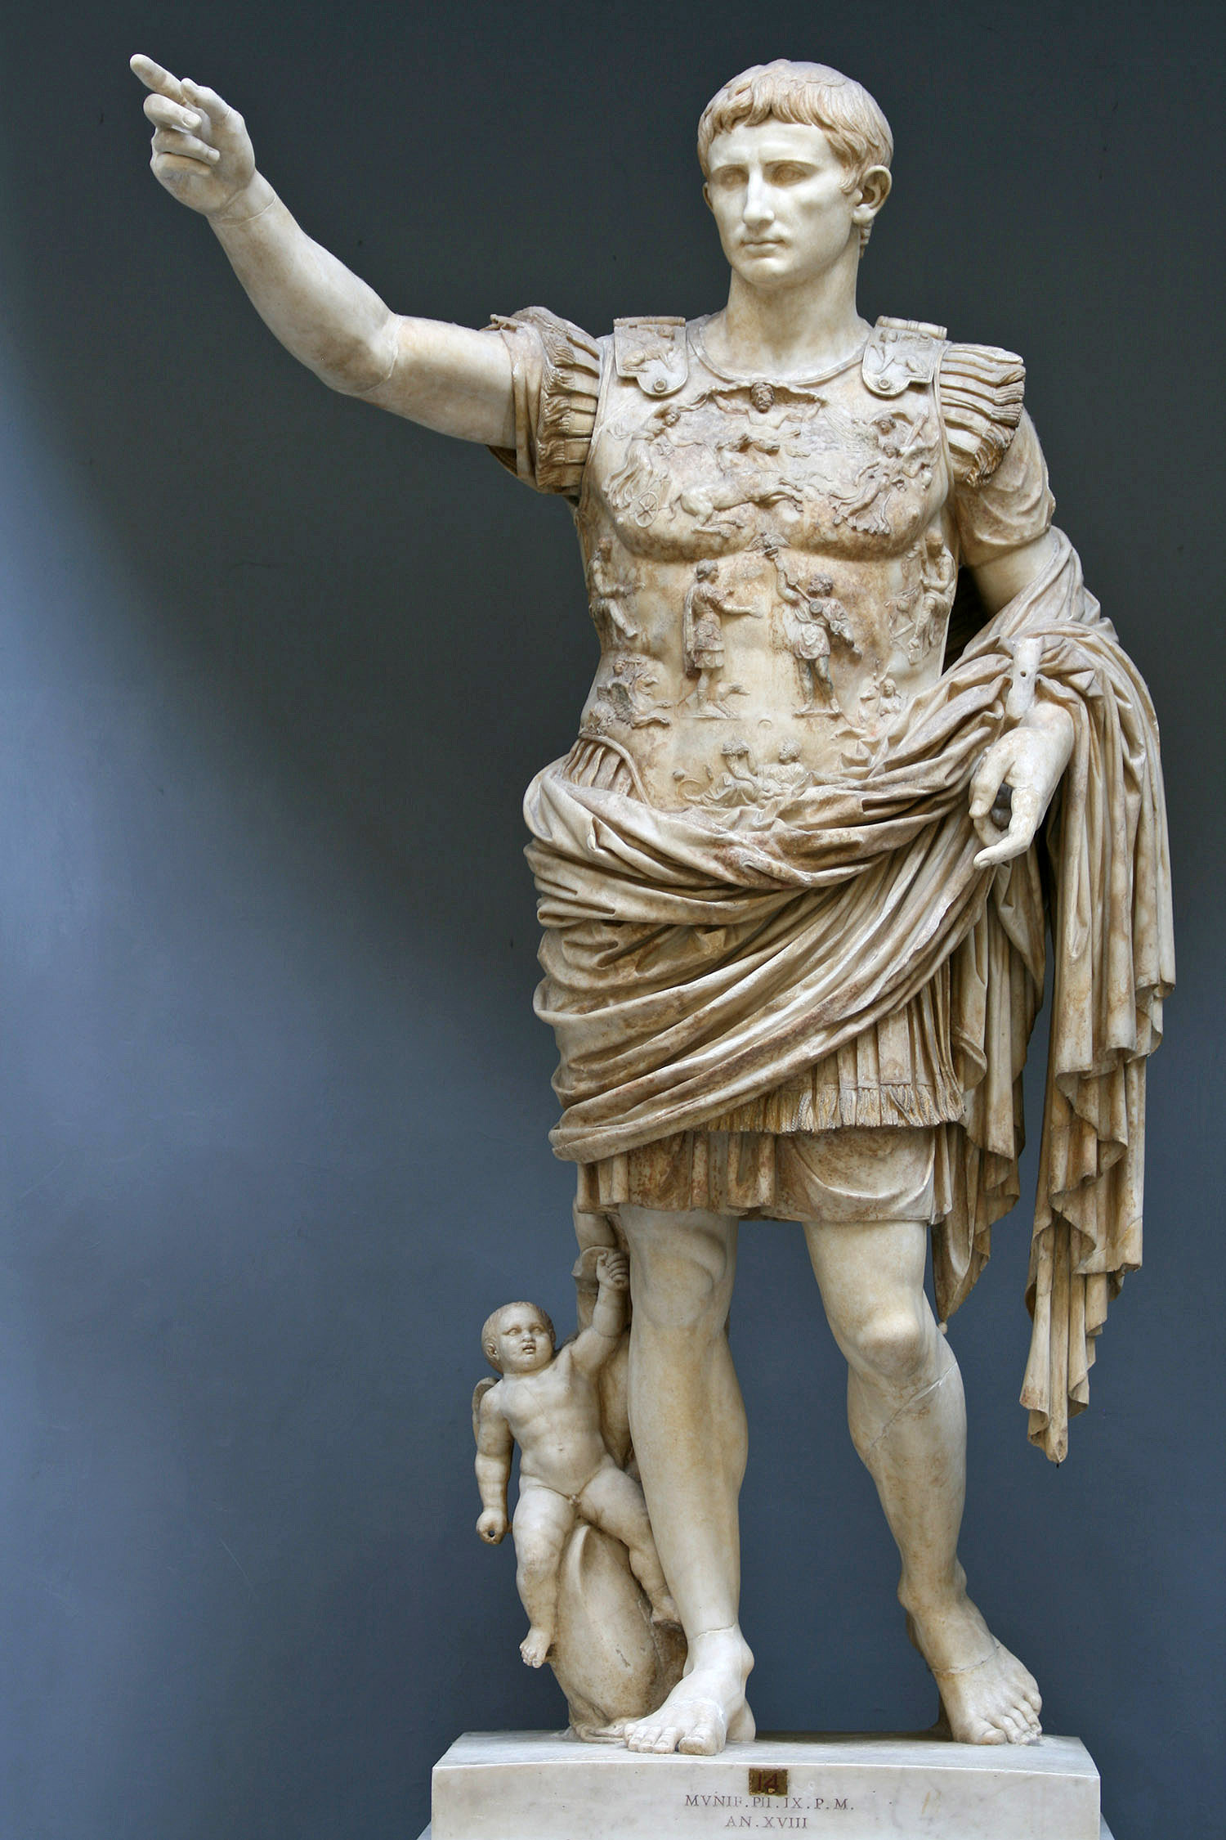
Matthew 22:21—²¹…Then He *said to them, “Then render to Caesar the things that are Caesar’s; and to God the things that are God’s.”

Slide 16
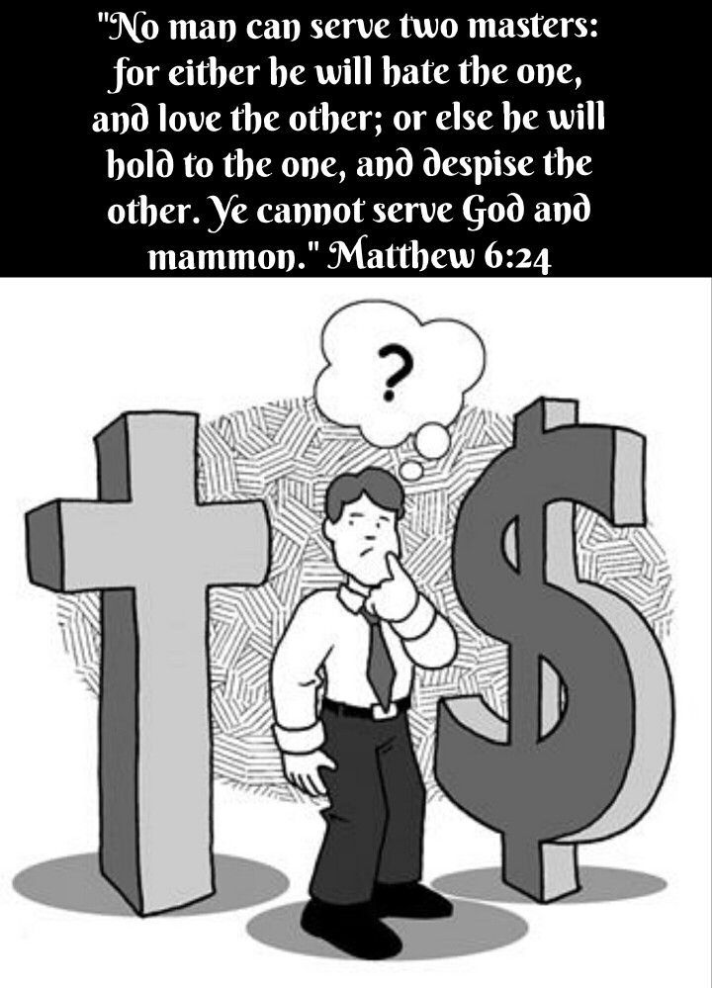
Matthew 22:21—²¹…Then He *said to them, “Then render to Caesar the things that are Caesar’s; and to God the things that are God’s.”

Slide 17
Nothing has changed in 200 years
The Point:
1. It was never about tax issues between church and government

Slide 18
Nothing has changed in 200 years
The Point:
2. It is about your choice:
God or Money

Slide 19
Nothing has changed in 200 years
The Point:
3. God says:
“Pay your Taxes” (Rom.13:7)

Slide 20
Nothing has changed in 200 years
The Point:
4. The Inland Revenue Dept. says:
“Pay your Taxes”

Slide 21
Nothing has changed in 200 years
The Point:
5. God says:
“The authorities that exist have been established by God” (Rom.13:1).

Slide 22
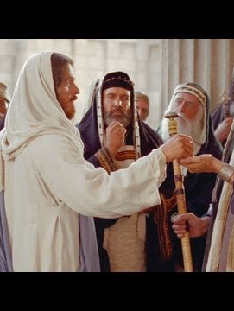
Matthew 22:22—
²²And hearing this, they were amazed, and leaving Him, they went away. (NASB95)

Slide 23
Matthew 22:22—
²²And hearing this, they were amazed, and leaving Him, they went away. (NASB95)
So should we!

Slide 24
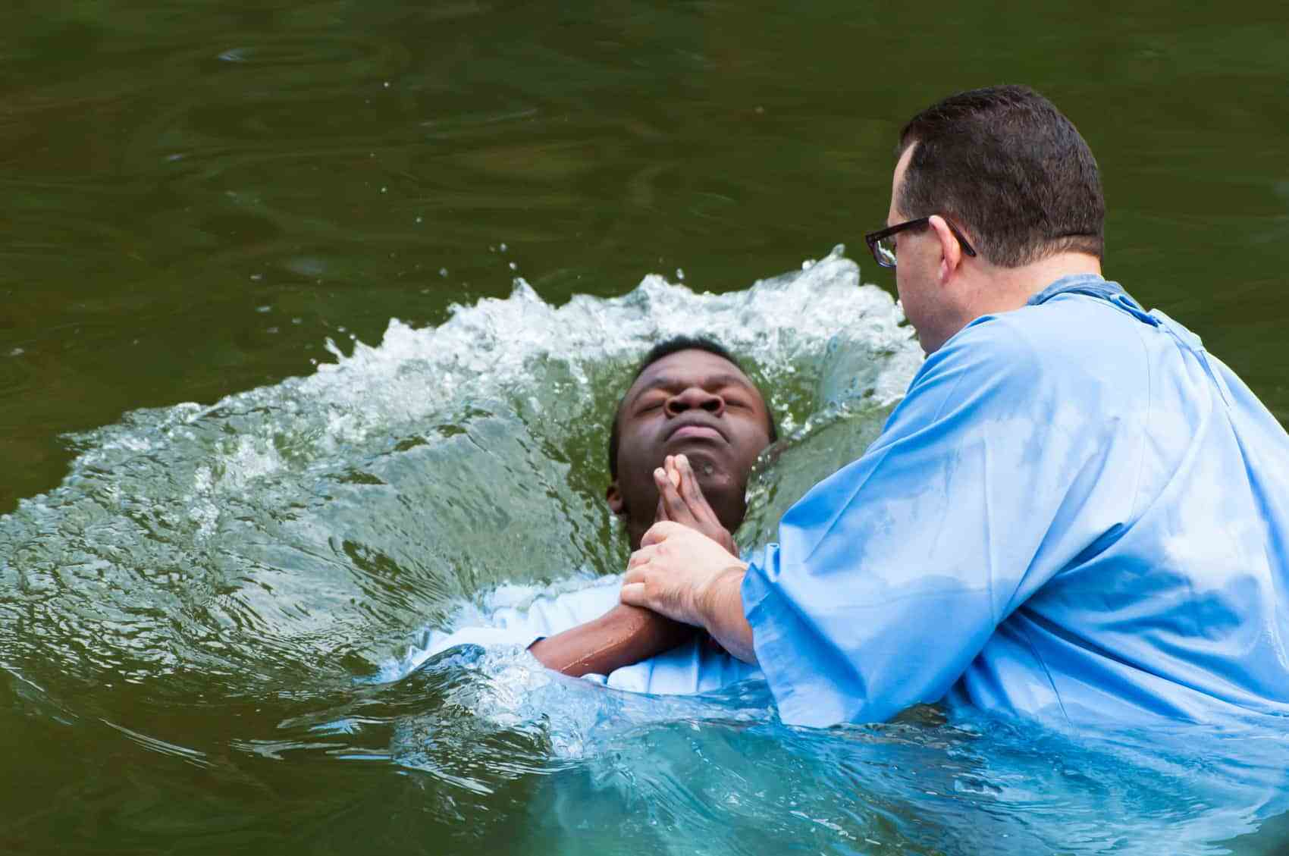
Acts 8:36—³⁶ As they went along the road they came to some water; and the eunuch *said, “Look! Water! What prevents me from being baptized?” (NASB95)

