Slide 1
“Family – How to survive Adversity.”
John Staiger
For Morningside Church of Christ
Sunday 13 September 2020
PM Sermon
Broadcast on Facebook Live from Massey, AKL, NZ.

Slide 2
Family – How to survive Adversity.

Slide 3
The Expected Unexpected
Adversities come in many shapes and sizes

Slide 4

The Expected Unexpected
What do we do to survive?

Slide 5
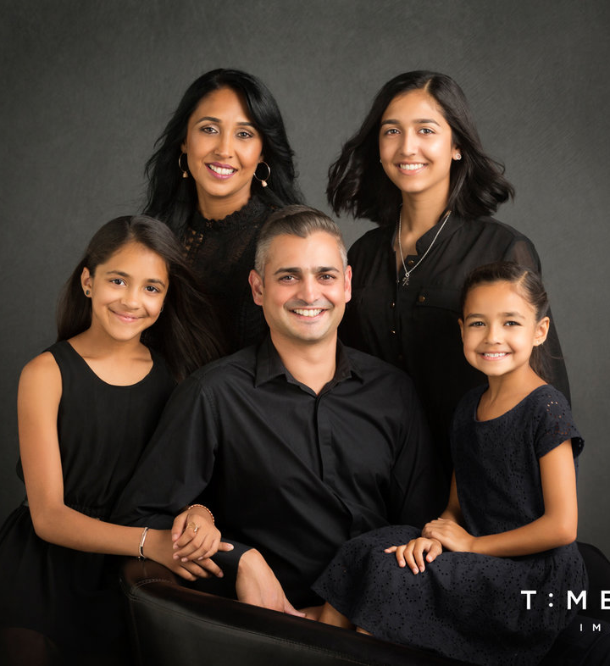
The Expected Unexpected
Families are not picture perfect

Slide 6
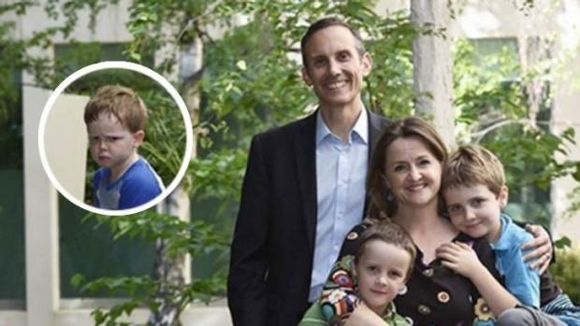
The Expected Unexpected
The family portrait doesn’t always tell the whole or true story

Slide 7
The Expected Unexpected
In real life there are no do-overs.

Slide 8
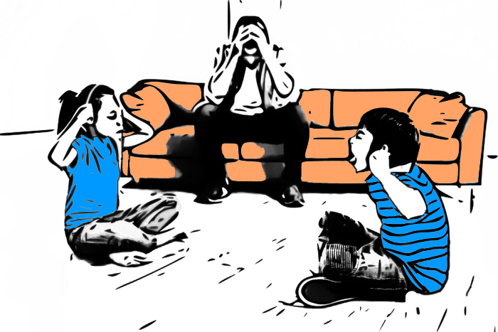
The Expected Unexpected
Daily tribulations just happen in families

Slide 9
The family that will survive Adversity

Slide 10
The family that will survive Adversity
God is the Unquestioned Head

Slide 11
The family that will survive Adversity
God is the Unquestioned Head
1 Corinthians 11:3—
³But I want you to understand that
  Christ is the head of every man,
  and the man is the head of a woman,
  and God is the head of Christ. (NASB95)

Slide 12
The family that will survive Adversity
God is the Unquestioned Head
Not because of superiority, but the need to lead in the family

Slide 13
The family that will survive Adversity
God is the Unquestioned Head
Not because of superiority, but the need to lead in the family
    Christ ‘subjected himself’ to God

Slide 14
The family that will survive Adversity
God is the Unquestioned Head
Not because of superiority, but the need to lead in the family
    Christ ‘subjected himself’ to God
    Husband ‘subjects himself’ to Christ

Slide 15
The family that will survive Adversity
God is the Unquestioned Head
Not because of superiority, but the need to lead in the family
    Christ ‘subjected himself’ to God
    Husband ‘subjects himself’ to Christ
    Wife ‘subjects herself’ to her husband

Slide 16
The family that will survive Adversity
God is the Unquestioned Head
Not because of superiority, but the need to lead in the family
    Christ ‘subjected himself’ to God
    Husband ‘subjects himself’ to Christ
    Wife ‘subjects herself’ to her husband
    Children ‘subject themselves’ to their parents

Slide 17
The family that will survive Adversity
God is the Unquestioned Head
This is God’s way of taking care of the home

Slide 18
The family that will survive Adversity
God is the Unquestioned Head
This is God’s way of taking care of the home
It is not an
HONOUR
he bestows upon a husband and father,…

Slide 19
The family that will survive Adversity
God is the Unquestioned Head
This is God’s way of taking care of the home
It is not an
HONOUR
he bestows upon a husband and father,
it is a
RESPONSIBILITY

Slide 20
The family that will survive Adversity
God is the Unquestioned Head
For God’s plan to work:

Slide 21
The family that will survive Adversity
God is the Unquestioned Head
For God’s plan to work:
    God must be the head of each house

Slide 22
The family that will survive Adversity
God is the Unquestioned Head
For God’s plan to work:
    God must be the head of each house
    And God must have a head in that house whom he can trust

Slide 23
The family that will survive Adversity
God is the Unquestioned Head
For God’s plan to work:
    God must be the head of each house
    And God must have a head in that house whom he can trust
Colossians 3:18—

Slide 24
The family that will survive Adversity
God is the Unquestioned Head
Colossians 3:18-19—
    ¹⁸ Wives, be subject to your husbands, as is fitting in the Lord. ¹⁹ Husbands, love your wives and do not be embittered against them. (NASB95)

Slide 25
The family that will survive Adversity
God is the Unquestioned Head
All this is designed for the protection of the home

Slide 26
The family that will survive Adversity
God is the Unquestioned Head
All this is designed for the protection of the home
Also: Colossians 3:20-21—
    ²⁰Children, be obedient to your parents in all things, for this is well-pleasing to the Lord. ²¹Fathers, do not exasperate your children, so that they will not lose heart. (NASB95)

Slide 27
The family that will survive Adversity
God is the Unquestioned Head
God has given leadership—

Slide 28
The family that will survive Adversity
God is the Unquestioned Head
God has given leadership—
    Not for ‘authority’ sake.

Slide 29
The family that will survive Adversity
God is the Unquestioned Head
God has given leadership—
    Not for ‘authority’ sake.
    But because of the need for effective leadership.

Slide 30
The family that will survive Adversity
God is the Unquestioned Head
If God is the Head of your home:

Slide 31
The family that will survive Adversity
God is the Unquestioned Head
If God is the Head of your home:
    You are in a blessed home

Slide 32
The family that will survive Adversity
God is the Unquestioned Head
If God is the Head of your home:
    You are in a blessed home
    One equipped to survive adversity

Slide 33
The family that will survive Adversity
God is the Unquestioned Head
It is built for adversity if it built on the Word of God

Slide 34
The family that will survive Adversity
God is the Unquestioned Head
It is built for adversity if it built on the Word of God
Matthew 7:24-25—
    ²⁴“Therefore everyone who hears these words of Mine and acts on them, may be compared to a wise man who built his house on the rock. ²⁵And the rain fell, and the floods came, and the winds blew and slammed against that house; and yet it did not fall, for it had been founded on the rock. (NASB95)

Slide 35
The family that will survive Adversity
God is the Unquestioned Head
All homes

Slide 36
The family that will survive Adversity
God is the Unquestioned Head
All homes
Single

Slide 37
The family that will survive Adversity
God is the Unquestioned Head
All homes
Single
Couples

Slide 38
The family that will survive Adversity
God is the Unquestioned Head
All homes
Single
Couples
Kids

Slide 39
The family that will survive Adversity
God is the Unquestioned Head
All homes
Single
Couples
Kids
Post-kids

Slide 40
The family that will survive Adversity
God is the Unquestioned Head
All homes
Single
Couples
Kids
Post-kids
Have the same Head and the same goal—

Slide 41
The family that will survive Adversity
God is the Unquestioned Head
All homes
Single
Couples
Kids
Post-kids
Have the same Head and the same goal—
To bring souls to Glory under God!

Slide 42
The family that will survive Adversity
Marriage is Sacred

Slide 43
The family that will survive Adversity
Marriage is Sacred
What makes it so?
The
“ONE FLESH FACTOR”

Slide 44
The family that will survive Adversity
Marriage is Sacred
Society Laws and traditions have changed
    Standards change
    But Christian standards remain unchanged
    The Bible still says: “Man and Wife.”
    Without hate we hold to the standard in our homes and churches
    Genesis 2:24—

Slide 45
The family that will survive Adversity
Marriage is Sacred
Gen.2:24—²⁴ For this reason a man shall leave his father and his mother, and be joined to his wife; and they shall become one flesh. (NASB95)

Slide 46
The family that will survive Adversity
Marriage is Sacred
When committed to each other because we are committed to God—
    Marriage works!
    And God works in it.
    Hebrews 13:4—

Slide 47
The family that will survive Adversity
Marriage is Sacred
Hebrews 13:4—
    ⁴ Marriage is to be held in honour among all, and the marriage bed is to be undefiled; for fornicators and adulterers God will judge. (NASB95)

Slide 48
The family that will survive Adversity
Marriage is Sacred
These things allow God to build our homes for adversity…

Slide 49
The family that will survive Adversity
Marriage is Sacred
These things allow God to build our homes for adversity
    Purity outside

Slide 50
The family that will survive Adversity
Marriage is Sacred
…These things allow God to build our homes for adversity
    Fidelity inside

Slide 51
The family that will survive Adversity
Marriage is Sacred
As Christian families we are exclusively devoted to:
Christ
Spouses
Children

Slide 52
The family that will survive Adversity
Children are Treasured
When children arrive:
    The chance to ‘Find our self’ is over!
    Their care is your responsibility
    You only get one chance
    You are the grown-up
    Psalm 127:3

Slide 53
The family that will survive Adversity
Children are Treasured
When children arrive:
    The chance to ‘Find our self’ is over!
    Their care is your responsibility
    You only get one chance
    You are the grown-up
    Psalm 127:3

Slide 54
The family that will survive Adversity
Children are Treasured
Psalm 127:3-5a—
    ³ Behold, children are a gift of the Lord,
    The fruit of the womb is a reward.
    ⁴ Like arrows in the hand of a warrior,
    So are the children of one’s youth.
    ⁵ How blessed is the man whose quiver is full of them; (NASB95)

Slide 55
The family that will survive Adversity
Children are Treasured
Work
  Hobbies
    Friendships
      have there joys and fulfilments
    But…

Slide 56
The family that will survive Adversity
Children are Treasured
Nothing is more fulfilling than seeing the fruits of:
Tender Care
Fervent Prayer
Loving Bible instruction
Caring Fellowship
Generous Time
Careful Money

Slide 57
The family that will survive Adversity
Trouble is Expected
Problems don’t usually keep to timetables
Make sure everyone knows that when troubles come—this is where you go!
Love and forgiveness is a staple commodity
Col.3:12-13—

Slide 58
The family that will survive Adversity
Trouble is Expected
Problems don’t usually keep to timetables
Make sure everyone knows that when troubles come—this is where you go!
Love and forgiveness is a staple commodity
Col.3:12-13—

Slide 59
The family that will survive Adversity
Trouble is Expected
Col.3:12-13—
¹² So, as those who have been chosen of God, holy and beloved, put on a heart of compassion, kindness, humility, gentleness and patience; ¹³ bearing with one another, and forgiving each other, whoever has a complaint against anyone; just as the Lord forgave you, so also should you. (NASB95)

Slide 60
The family that will survive Adversity
Trouble is Expected
When trouble comes our first impulse is to forgive
We are people who lead with forgiveness
Costly—Maybe
Inconvenient—Probably
The last thing you need right now—Yes!

Slide 61
The family that will survive Adversity
Trouble is Expected
Jesus went to the cross to bring us home
Where would we be without his forgiveness?—Lost!

