Slide 1
“Family – Husband and Wife—I don’t say a word.”
John Staiger
For Morningside Church of Christ
Sunday 27 September 2020
PM Sermon
Broadcast on Facebook Live from Morningside Church, Auckland NZ.

Slide 2
Family
—
Husband and Wife
—
“I don’t say a word.”

Slide 3

Communication
It’s a wonderful thing!

Slide 4
Communication
If you keep it going.

Slide 5
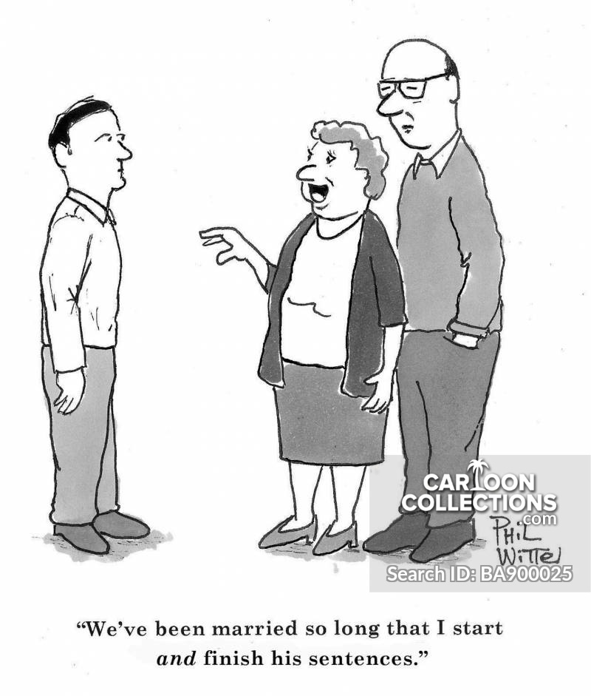

Slide 6
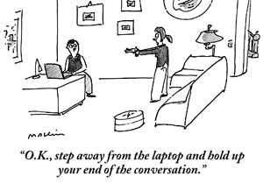

Slide 7
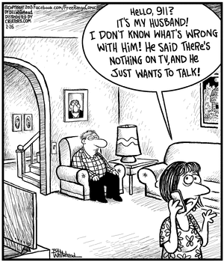

Slide 8

Communication
Husbands
1 Peter 3:7—
⁷You husbands in the same way, live with your wives in an understanding way, as with ^{[a]}someone weaker, since she is a woman; and show her honor as a fellow heir of the grace of life, so that your prayers will not be hindered. (NASB95) [a]Lit a weaker vessel

Slide 9
Communication
Husbands
1 Peter 3:7—
Husbands…live with your wives in an understanding way
  Understanding that she have needs, wants, responsibilities…
  Nothing is to be taken for granted
  Wisdom and Know-how—seek it.
  Trial and error

Slide 10
Communication
Husbands
1 Peter 3:7—
Husbands…live with your wives in an understanding way
  Understanding that she have needs, wants, responsibilities…
  Nothing is to be taken for granted
  Wisdom and Know-how—seek it.
  Trial and error

Slide 11
Communication
Husbands
1 Peter 3:7—
Husbands…live with your wives in an understanding way
  Understanding that she have needs, wants, responsibilities…
  Nothing is to be taken for granted
  Wisdom and Know-how—seek it.
  Trial and error

Slide 12
Communication
Husbands
1 Peter 3:7—
Husbands…live with your wives in an understanding way
  Understanding that she have needs, wants, responsibilities…
  Nothing is to be taken for granted
  Wisdom and Know-how—seek it.
  Trial and error

Slide 13
Communication
Husbands
1 Peter 3:7—
Husbands…live with your wives in an understanding way
  Understanding that she have needs, wants, responsibilities…
  Nothing is to be taken for granted
  Wisdom and Know-how—seek it.
  According to the manner of scripture

Slide 14
Communication
Husbands
1 Peter 3:7—
As with someone weaker, since she is a woman
  She is not another man
  Wired differently
  Self-control is needed
  Especially when emotions are involved

Slide 15
Communication
Husbands
1 Peter 3:7—
As with someone weaker, since she is a woman
  She is not another man
  Wired differently
  Self-control is needed
  Especially when emotions are involved

Slide 16
Communication
Husbands
1 Peter 3:7—
As with someone weaker, since she is a woman
  She is not another man
  Wired differently
  Self-control is needed
  Especially when emotions are involved

Slide 17
Communication
Husbands
1 Peter 3:7—
As with someone weaker, since she is a woman
  She is not another man
  Wired differently
  Self-control is needed
  Especially when emotions are involved

Slide 18
Communication
Husbands
1 Peter 3:7—
As with someone weaker, since she is a woman
  She is not another man
  Wired differently
  Self-control is needed
  You are her protector and support

Slide 19
Communication
Husbands
1 Peter 3:7—
As with someone weaker, since she is a woman
  She is not another man
  Wired differently
  Self-control is needed
  You are her protector and support
  She has beauty and delicacy

Slide 20
Communication
Husbands
1 Peter 3:7—
And show her honour as a fellow heir of the grace of life
  We are first and foremost brothers and sisters in Christ
  Roles differ honour doesn’t
  We are quickened sustained by the same Spirit

Slide 21
Communication
Husbands
1 Peter 3:7—
And show her honour as a fellow heir of the grace of life
  We are first and foremost brothers and sisters in Christ
  Roles differ honour doesn’t
  We are quickened sustained by the same Spirit

Slide 22
Communication
Husbands
1 Peter 3:7—
And show her honour as a fellow heir of the grace of life
  We are first and foremost brothers and sisters in Christ
  Roles differ honour doesn’t
  We are quickened sustained by the same Spirit

Slide 23
Communication
Husbands
1 Peter 3:7—
And show her honour as a fellow heir of the grace of life
  We are first and foremost brothers and sisters in Christ
  Roles differ honour doesn’t
  We are quickened sustained by the same Spirit

Slide 24
Communication
Husbands
1 Peter 3:7—
So that your prayers will not be hindered.

Slide 25
Communication
Husbands
1 Peter 3:7—
So that your prayers will not be hindered.
  Don’t make God deaf to your prayers

Slide 26
Communication
Husbands
1 Peter 3:7—
So that your prayers will not be hindered.
  Don’t make God deaf to your prayers
  It is the responsibility of the husband to monitor the spiritual well-being of the family

