Slide 1
“Family – The Price is Right—The Extended Family of God.”
John Staiger
For Morningside Church of Christ
Sunday 20 September 2020
PM Sermon
Broadcast on Facebook Live from Massey, AKL, NZ.

Slide 2
Family
—
The Price is Right
—
The Extended
Family of God

Slide 3

Whatever your role in the family…

Slide 4
Mum
Dad
Brother / Sister
Grandma
Grandpa
Favourite aunt
Hip uncle
Church friends who have been there forever
Greatest Sunday teacher ever
Preacher – Elder – Deacon

Slide 5
If you are a Christian

Slide 6
You are involved in something of God’s design

Slide 7
You are making an investment with
Eternal Returns

Slide 8

What is the cost?

Slide 9


What is the cost?
  Maturity

Slide 10
What is the cost?
  Maturity
    I have grown up in all aspects into Him who is the head, even Christ (Eph.4:15)

Slide 11

What is the cost?
  Maturity
    My ‘Yes’ is ‘Yes,’
    and my ‘No’ is ‘No.’

Slide 12
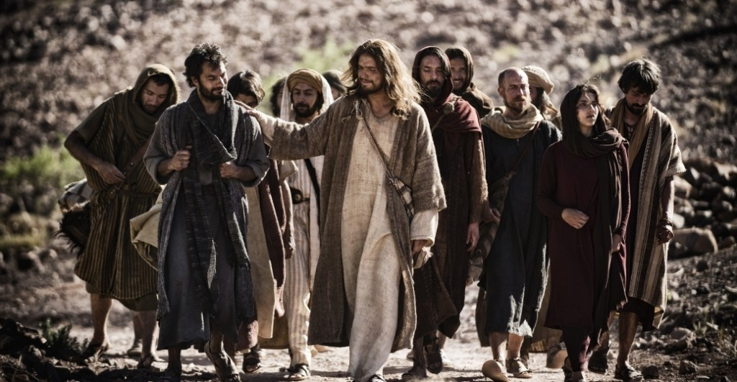
What is the cost?
  Mentorship

Slide 13
What is the cost?
  Mentorship
    Everyone can see me—welcomed!

Slide 14
What is the cost?
  Mentorship
    Everyone can see me—welcomed!
      1 Cor.11:1—Follow my example, as I follow the example of Christ

Slide 15

What is the cost?
  Investment

Slide 16
What is the cost?
  Investment
    I seeking wisdom in Prayer

Slide 17
What is the cost?
  Investment
    I take the time to grow together in Christ

Slide 18
What is the cost?
  Investment
    I wisely use money to build a firm spiritual foundation

Slide 19

What is the cost?
  Accountability

Slide 20
What is the cost?
  Accountability
    I will welcome God’s judgement

Slide 21
What is the cost?
  Accountability
    I will welcome God’s judgement
      This side and the next

Slide 22
What is the cost?
  Accountability
    My words reflect my life and motives

Slide 23
What is the cost?
  Accountability
    My words reflect my life and motives
      Mt.12:37;

Slide 24
What is the cost?
  Accountability
    I’ll do what I can—When I can

Slide 25
What is the cost?
  Accountability
    I’ll do what I can—When I can
      Life has seasons

Slide 26
What is the cost?
  Accountability
    Success and failure is for God to judge

Slide 27
What is the cost?
  Accountability
    Success and failure is for God to judge
      Pro.16:1—

Slide 28
Pro.16:1—
The plans of the heart belong to man,
But the answer of the tongue is from the Lord.

