Slide 1


Slide 2
“Respect Begets Respect.”
John Staiger
For Morningside Church of Christ
Sunday 6 September 2020
AM Sermon
Broadcast on Facebook Live from North Shore, AKL, NZ.

Slide 3
Respect Begets Respect

Slide 4

Respect—A value necessary for life
God
Church
Marriage
Family
Family roles
Those in authority

Slide 5

Respect—A value necessary for life
Vows

Slide 6
Respect—A value necessary for life
Matthew 5:37
³⁷Let what you say be simply ‘Yes’ or ‘No’; anything more than this comes from evil.^{[a]}
(ESV)
[a]Or the evil one

Slide 7

Respect—A value necessary for life
Vows
Parents

Slide 8
Respect—A value necessary for life
Exodus 20:12
¹² “Honor your father and your mother, that your days may be prolonged in the land which the Lord your God gives you. (NASB95)

Slide 9
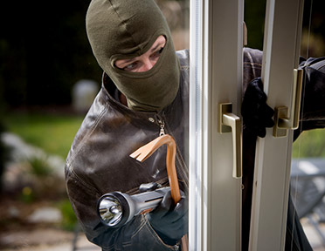
Respect—A value necessary for life
Vows
Parents
Laws

Slide 10

Respect—A value necessary for life
Vows
Parents
Laws
Police

Slide 11
Respect—A value necessary for life
Romans 13:3
³ For rulers are not a terror to good conduct, but to bad. Would you have no fear of the one who is in authority? Then do what is good, and you will receive his approval, (ESV)

Slide 12

Respect—A value necessary for life
Vows
Parents
Laws
Police
Government

Slide 13
Respect—A value necessary for life
1 Peter 2:13-17 (ESV)
¹³Be subject for the Lord's sake to every human institution, whether it be to the emperor as supreme, ¹⁴ or to governors as sent by him to punish those who do evil and to praise those who do good.

Slide 14
Respect—A value necessary for life
1 Peter 2:13-17 (ESV)
¹⁵ For this is the will of God, that by doing good you should put to silence the ignorance of foolish people.

Slide 15
Respect—A value necessary for life
1 Peter 2:13-17 (ESV)
¹⁶ Live as people who are free, not using your freedom as a cover-up for evil, but living as servants of God. ¹⁷Honour everyone. Love the brotherhood. Fear God. Honour the emperor.

Slide 16
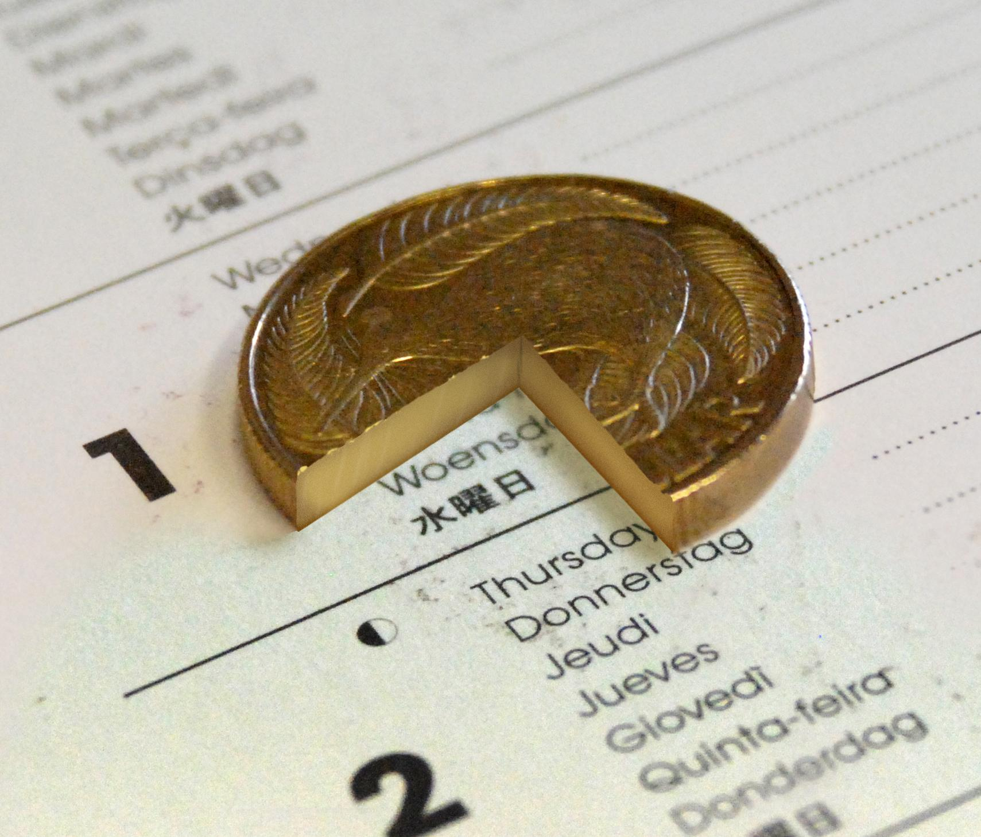
Respect—A value necessary for life
Vows
Parents
Laws
Police
Government
Taxes

Slide 17
Respect—A value necessary for life
Romans 13:5-6
⁵ Therefore one must be in subjection, not only to avoid God's wrath but also for the sake of conscience. ⁶ For because of this you also pay taxes, for the authorities are ministers of God, attending to this very thing. (ESV)

Slide 18

What to do…?

Slide 19
What to do…?
Four ways to build respect

Slide 20
What to do…?
Four ways to build respect
Change your attitude—find the good in people, events and things.

Slide 21
What to do…?
Four ways to build respect
Change your attitude—find the good in people, events and things.
Change your conversation—speak the truth in love.

Slide 22
What to do…?
Four ways to build respect
Change your attitude—find the good in people, events and things.
Change your conversation—speak the truth in love.
Find better sources of information—you don’t have to listen to the news.

Slide 23
What to do…?
Four ways to build respect
Change your attitude—find the good in people, events and things.
Change your conversation—speak the truth in love.
Find better sources of information—you don’t have to listen to the news.
Stop listening to wreckers—bad company

Slide 24
We are being observed

Slide 25

We are being observed
Brethren

Slide 26
We are being observed
Brethren
Romans 12:10—¹⁰Love one another with brotherly affection. Outdo one another in showing honour. (ESV)

Slide 27

We are being observed
Brethren
Children

Slide 28
We are being observed
Brethren
Children
Ephesians 6:1-3—Children, obey your parents in the Lord, for this is right. ²“Honour your father and mother” (this is the first commandment with a promise),³ “that it may go well with you and that you may live long in the land.” (ESV)

Slide 29
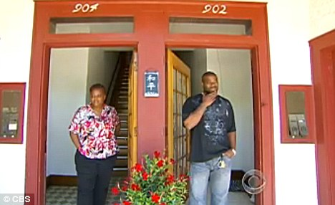
We are being observed
Brethren
Children
Neighbours

Slide 30
We are being observed
Brethren
Children
Neighbours
Proverbs 12:26
²⁶ The righteous is a guide to his neighbour,
But the way of the wicked leads them astray. (NASB95)

Slide 31
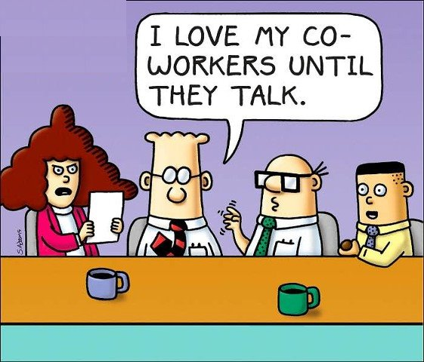
We are being observed
Brethren
Children
Neighbours
Workmates

Slide 32
We are being observed
Brethren
Children
Neighbours
Workmates
Romans 12:17—¹⁷Never pay back evil for evil to anyone. Respect what is right in the sight of all men. (NASB95)

Slide 33

It starts here
Respect for parents is foundational to civilization
Homes fall apart when Biblical family roles are not respected
Ephesians 5:33
³³ However, let each one of you love his wife as himself, and let the wife see that she respects her husband. (ESV)

Slide 34
