Slide 1
“Restoring Joy – Seek Peace & Pursue it.”
John Staiger
For Morningside Church of Christ
Sunday 20 September 2020
AM Sermon
Broadcast on Facebook Live from Browns Bay, AKL, NZ.

Slide 2
Restoring Joy
---------
Seek Peace & Pursue it

Slide 3

1 Peter 3:10-12—Seek Peace and Pursue it.
1 Peter 3:10-12—
¹⁰ For,
“The one who
desires life,
to love
and see good days,

Slide 4
1 Peter 3:10-12—Seek Peace and Pursue it.
1 Peter 3:10-12—
¹¹“He must
turn away
from evil
and
do good;

Slide 5
1 Peter 3:10-12—Seek Peace and Pursue it.
1 Peter 3:10-12—
He must
seek peace
and
pursue it.

Slide 6
1 Peter 3:10-12—Seek Peace and Pursue it.
1 Peter 3:10-12—
¹² “For the
eyes of the Lord
are toward the righteous,

Slide 7
1 Peter 3:10-12—Seek Peace and Pursue it.
1 Peter 3:10-12—
And His ears
attend to their prayer,

Slide 8
1 Peter 3:10-12—Seek Peace and Pursue it.
1 Peter 3:10-12—
But the
face of the Lord
is against those
who do evil.”
(NASB95)

Slide 9
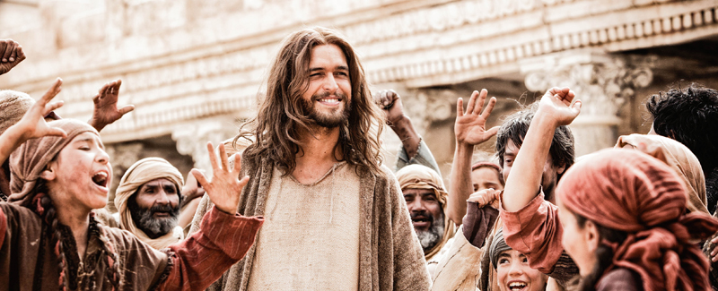
Peace is only found in Jesus
John 16:33—³³These things I have spoken to you, so that in Me you may have peace. In the world you have tribulation, but take courage; I have overcome the world.” (NASB95)

Slide 10

Preached and heard
Acts 10:36—³⁶As for the word that he sent to Israel, preaching good news of peace through Jesus Christ (he is Lord of all) (ESV)

Slide 11

Gospel
Peace by its nature
Ephesians 3:14-15—¹⁴ Stand firm therefore, having girded your loins with truth, and having put on the breastplate of righteousness, ¹⁵and having shod your feet with the preparation of the gospel of peace; (NASB95)

Slide 12

It is a Gift of God’s own nature
2 Thessalonians 3:16
¹⁶Now may the Lord of peace himself give you peace at all times in every way. The Lord be with you all. (ESV)

Slide 13
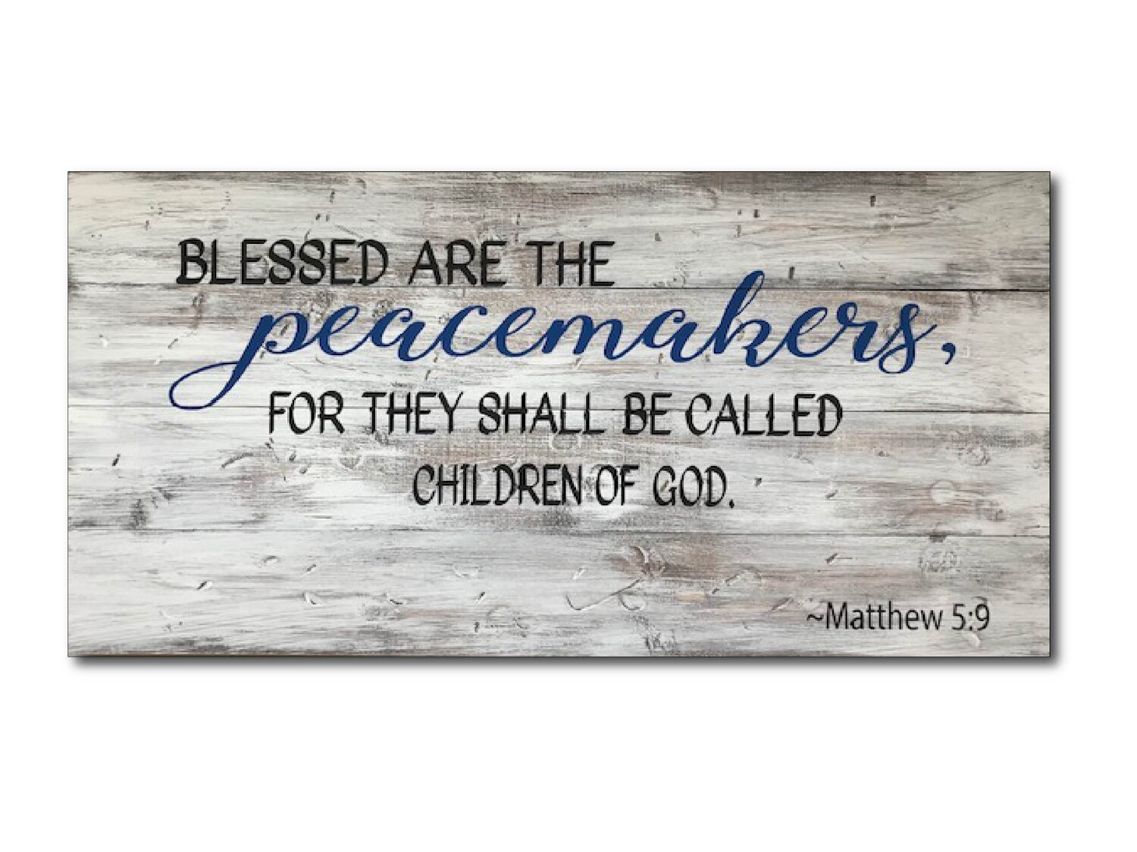
Peace:
Its overflow
Proverbs 16:7—
⁷When a man’s ways are pleasing to the Lord,
He makes even his enemies to be at peace with him. (NASB95)

Slide 14
Peace:
Its overflow
Ephesians 4:31-32—³¹Let all bitterness and wrath and anger and clamour and slander be put away from you, along with all malice. ³²Be kind to one another, tender-hearted, forgiving each other, just as God in Christ also has forgiven you. (NASB95)

Slide 15
Peace:
Its overflow
PUT AWAY:
All bitterness
  Wrath
    Anger
      Clamour
        Slander
          Malice.

Slide 16
Peace:
Its overflow
No Wonder Joy is diminished and then lost.
Ehp.4:32—³²Be kind to one another, tender-hearted, forgiving each other, just as God in Christ also has forgiven you. (NASB95)

Slide 17
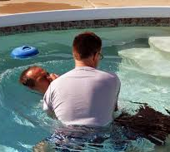
Galatians 3:27—
²⁷For all of you who were
baptized
into Christ have
clothed yourselves with Christ. (NASB95)

