Slide 1
“Restoring Joy through Thankfulness.”
John Staiger
For Morningside Church of Christ
Sunday 13 September 2020
AM Sermon
Broadcast on Facebook Live from Massey, AKL, NZ.

Slide 2
Restoring
Joy through
Thankfulness

Slide 3
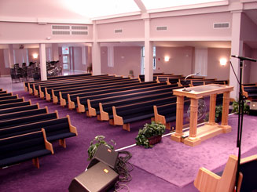
If God automatically divided the congregation every Sunday morning into two groups

Slide 4
Worshipers on the right and whinners on the left

Slide 5
I wonder which side of the building would need an extension?

Slide 6

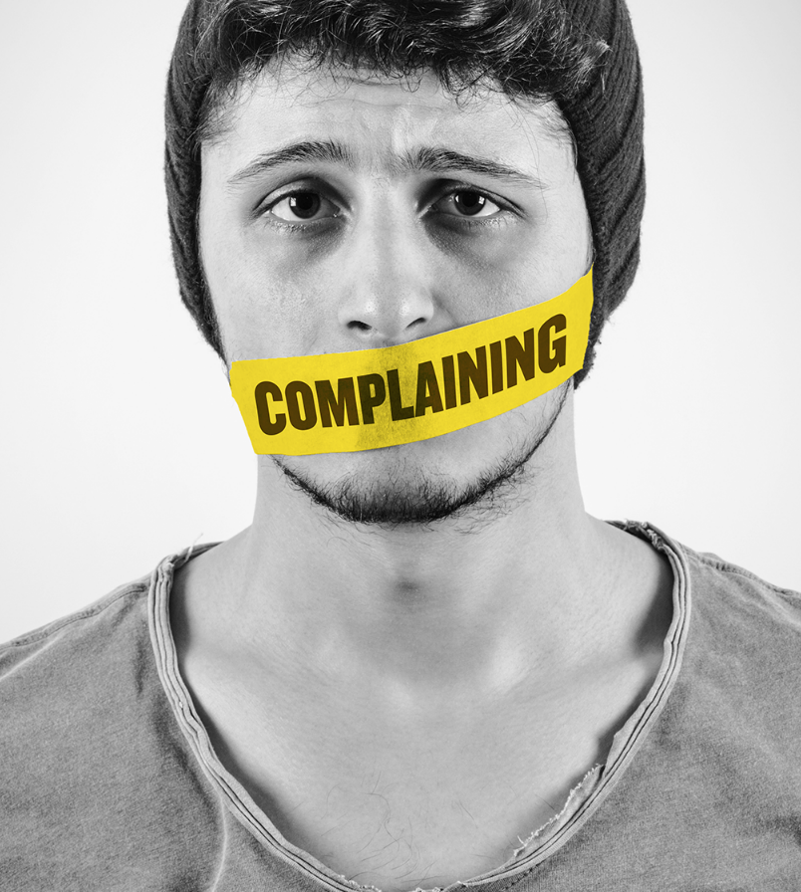
We are either whining or worshiping—

Slide 7
We are either whining or worshiping—
Sin makes us only see what we lack:

Slide 8
We are either whining or worshiping—
Sin makes us only see what we lack:
What we don’t have

Slide 9
We are either whining or worshiping—
Sin makes us only see what we lack:
What we don’t have
What’s gone wrong in our lives.

Slide 10
We are either whining or worshiping—
Yes, if things need to change…

Slide 11
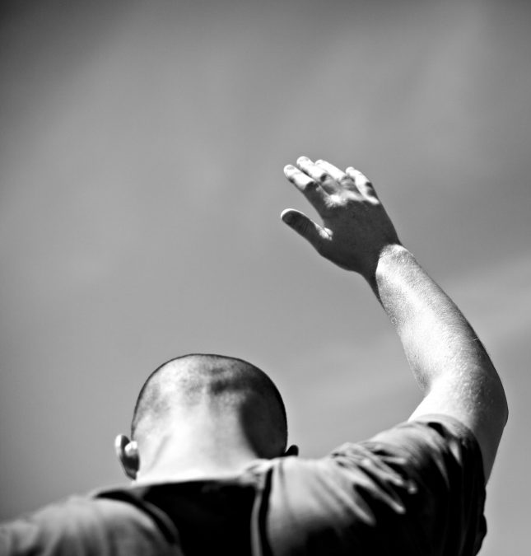
We are either whining or worshiping—
Yes, if things need to change…
We look to change with a spirit of WORSHIP

Slide 12

Worship Grows in Gratitude—
You just can’t hide it
Greetings
Prayer
Singing
Attentiveness to the Bible
Care for your brethren

Slide 13
Worship Grows in Gratitude—
You just can’t hide it
Greetings
Prayer
Singing
Attentiveness to the Bible
Care for your brethren

Slide 14
Worship Grows in Gratitude—
You just can’t hide it
Greetings
Prayer
Singing
Attentiveness to the Bible
Care for your brethren

Slide 15
Worship Grows in Gratitude—
You just can’t hide it
Greetings
Prayer
Singing
Attentiveness to the Bible
Care for your brethren

Slide 16
Worship Grows in Gratitude—
You just can’t hide it
Greetings
Prayer
Singing
Attentiveness to the Bible
Care for your brethren

Slide 17
Worship Grows in Gratitude—
You just can’t hide it
Greetings
Prayer
Singing
Attentiveness to the Bible
Care for your brethren

Slide 18
Worship Grows in Gratitude—
You just can’t hide it
Greetings
Prayer
Singing
Attentiveness to the Bible
Care for your brethren

Slide 19
Hebrews 12:28—
²⁸Therefore, since we receive a kingdom which cannot be shaken, let us ^{[a]}show gratitude, by which we may offer to God an acceptable service with reverence and awe;
(NASB95) [a] Lit have

Slide 20
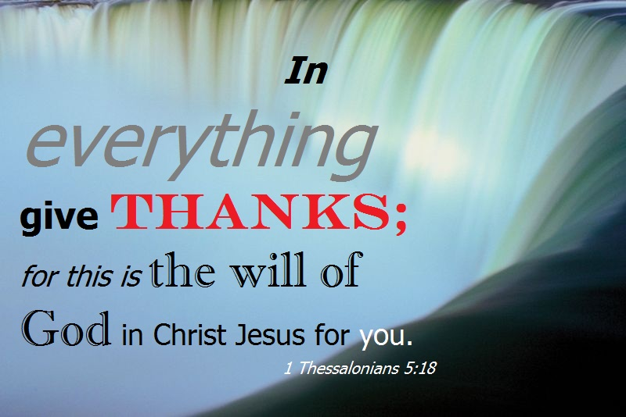
1. Fill your heart with the truths of God’s word.
Colossians 3:15-17
¹⁵Let the peace of Christ rule in your hearts, to which indeed you were called in one body; and be thankful.

Slide 21
1. Fill your heart with the truths of God’s word.
Colossians 3:15-17
¹⁶ Let the word of Christ richly dwell within you, with all wisdom teaching and admonishing one another with psalms and hymns and spiritual songs, singing with thankfulness in your hearts to God.

Slide 22
1. Fill your heart with the truths of God’s word.
Colossians 3:15-17
¹⁷Whatever you do in word or deed, do all in the name of the Lord Jesus, giving thanks through Him to God the Father. (NASB)

Slide 23
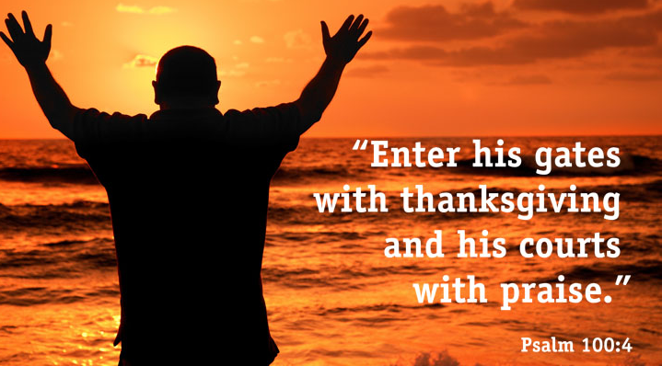
2. Constantly remind yourself and others of God’s goodness and faithfulness.

Slide 24
2. Constantly remind yourself and others of God’s goodness and faithfulness.
If complaining is your default response to everything: CHANGE IT!

Slide 25
2. Constantly remind yourself and others of God’s goodness and faithfulness.
Israel was prone to forgetting—God di not bless them for it.

Slide 26
2. Constantly remind yourself and others of God’s goodness and faithfulness.
The discipline of remembering
1. Write it down – 2. Retelling them to others – 3. Has a way of stirring up gratitude in our hearts

Slide 27
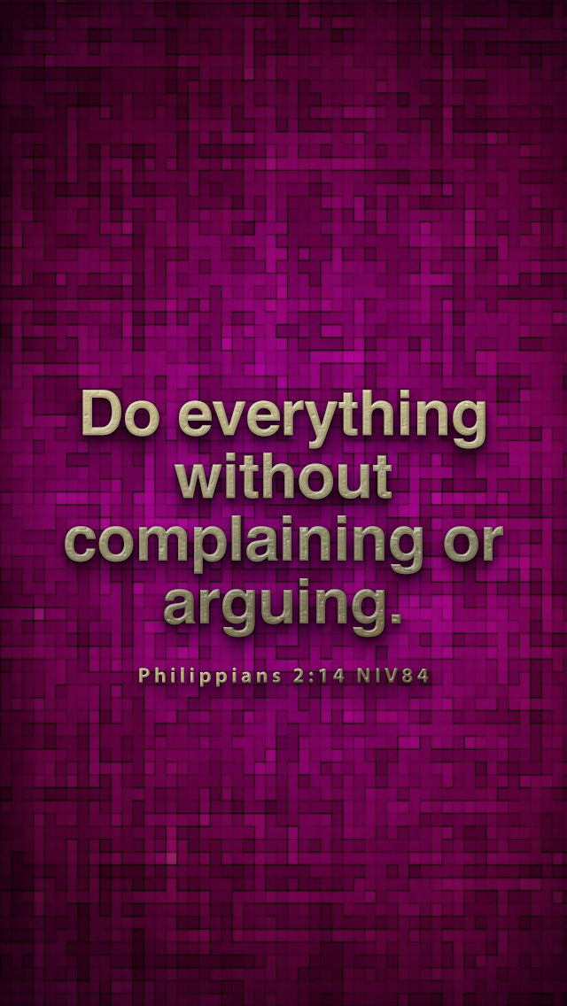
3. Ask God to put a guard over your mouth.

Slide 28
3. Ask God to put a guard over your mouth.
How do you feel when someone is venting frustrations?
  Look for reasons to rejoice.

Slide 29
3. Ask God to put a guard over your mouth.
An attitude of gratitude is just as easily spread as a spirit of complaint.

Slide 30
3. Ask God to put a guard over your mouth.
What are you known as…?
  Spirit-filled
  Joyful
  Whining
  Disgruntled

Slide 31
4. Practice—Make gratefulness your automatic reaction to any given circumstance.

Slide 32
4. Practice—Make gratefulness your automatic reaction to any given circumstance.
How do you react when you hear something negative for the first time?
Ask yourself:
  “What can I be grateful for in this circumstance?”

Slide 33
4. Practice—Make gratefulness your automatic reaction to any given circumstance.
How do you react when you hear something negative for the first time?
Ask yourself:
  “What can I be grateful for in this circumstance?”

Slide 34
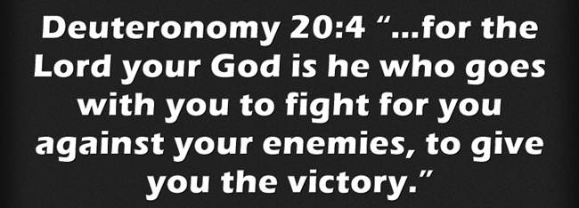
4. Practice—Make gratefulness your automatic reaction to any given circumstance.
How do you react when you hear something negative for the first time?
Ask yourself:
  “What can I be grateful for in this circumstance?”

Slide 35
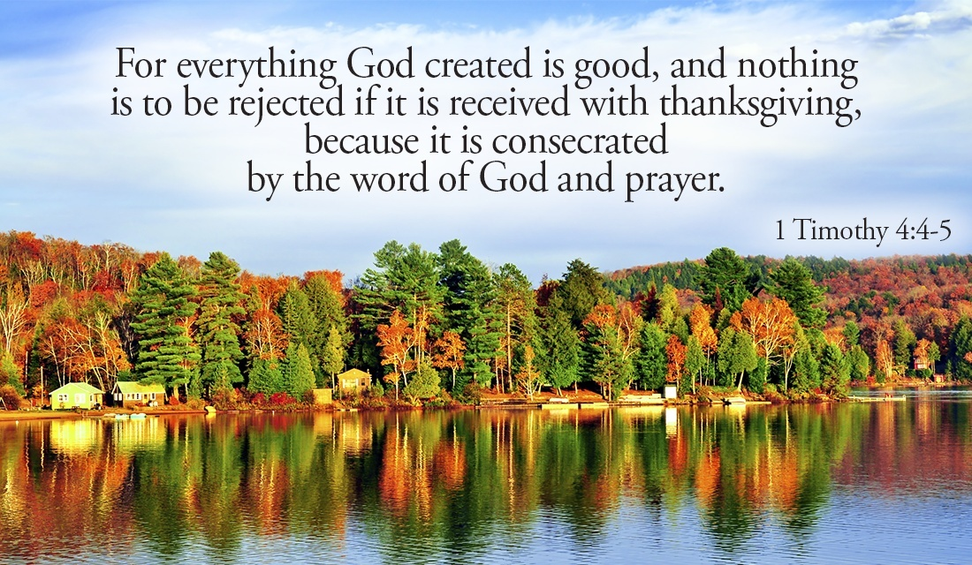

Slide 36
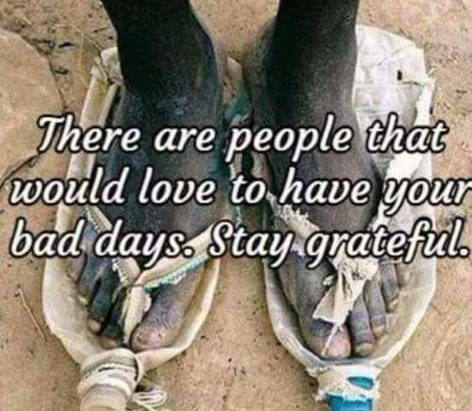
5. Put your thankfulness into words.
1. Write down five things to be grateful for as soon as you sense
yourself heading down the miry path of despair.
2. What are the simple things you take for granted?
3. Listing God’s daily
blessings may be one
of the most
transformative things
in your life.
4. By putting gratefulness
into words — whether
spoken or written —
an abstract idea like
thankfulness becomes
much more concrete.

Slide 37
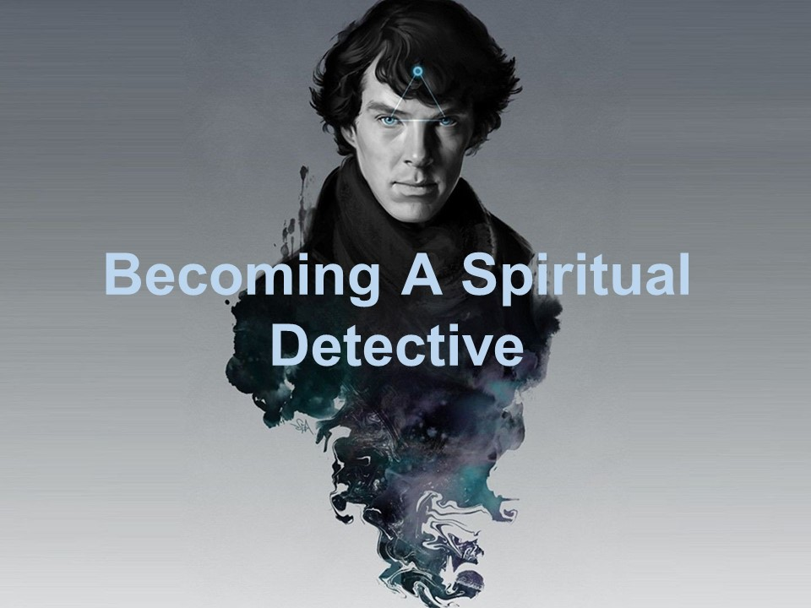
6. Spiritual Detective—Look for specific evidences of God’s goodness and grace.

Slide 38
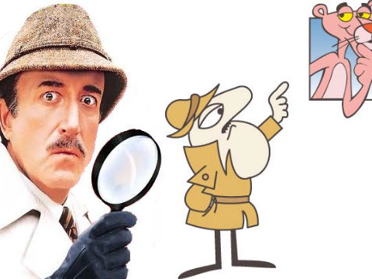
6. Spiritual Detective—Look for specific evidences of God’s goodness and grace.
Search your life
  Inventory
  Compare
  Ask others

Slide 39
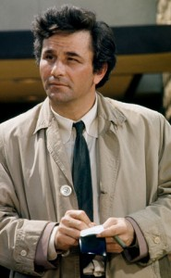
6. Spiritual Detective—Look for specific evidences of God’s goodness and grace.
Search your life
Search the lives of others
Your faith will be strengthened:
  When you see God answer a prayer
  When you notice the fruit of patience
  When you don’t ‘cry over spilt milk’
  Intentionally watching for God at work gives you much to be grateful for.

Slide 40
