Slide 1
“The Church and Truth.”
John Staiger
For Morningside Church of Christ
Sunday 30 August 2020
AM Sermon
Broadcast on Facebook Live from North Shore, AKL, NZ.

Slide 2
“The Church and Truth.”

Slide 3
Truth is to be Heard

Slide 4
Truth is to be Upheld
Ephesians 2:19-21—
¹⁹ So then you are no longer strangers and aliens, but you are fellow citizens with the ^{[a]}saints, and are of God’s household, ²⁰having been built on the foundation of the apostles and prophets, Christ Jesus Himself being the corner stone, ²¹ in whom the whole building, being fitted together, is growing into a holy ^{[b]}temple in the Lord, (NASB95) [a]Or holy ones [b]Or sanctuary

Slide 5

Truth is to be Upheld

Slide 6
Truth is to be Upheld
You are:
The people who help each other to—

Slide 7
Truth is to be Upheld
You are:
The people who help each other to—
Build on THE TRUTH

Slide 8
Truth is to be Upheld
You are:
The people who help each other to—
Build on THE TRUTH
Seeking Jesus
Obeying his will
Growing

Slide 9
Truth is to be Upheld
You are:
The people who help each other to—
To Uphold that truth

Slide 10
Truth is to be Upheld
You are:
The people who help each other to—
To Uphold that truth
Living it
Defending it
Spreading it

Slide 11
Truth is to be Lived
1 Timothy 3:14-15—
¹⁴I am writing these things to you, hoping to come to you before long; ¹⁵but ^{[a]}in case I am delayed, I write so that you will know how ^{[b]}one ought to conduct himself in the household of God, which is the church of the living God, the pillar and support of the truth. (NASB95) [a]Lit if I delay [b]Or you ought to conduct yourself

Slide 12

Truth is to be Lived
Every time we are together

Slide 13
Truth is to be Lived
Every time we are together
We are seeing truth being lived out

Slide 14
Truth is to be Lived
Every time we are together
We are seeing truth being lived out
A life changed because it is being built on truth

Slide 15
Truth is to be Lived
Every time we are together
We are seeing truth being lived out
A life that is changing this world because it is upholding the truth

Slide 16
Truth is to be Lived
Every time we are together
We are seeing truth being lived out
Doctrine being taught

Slide 17
Truth is to be Lived
Every time we are together
We are seeing truth being lived out
Doctrine being Lived out

Slide 18
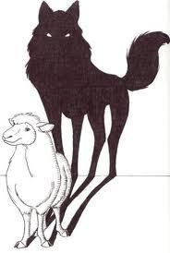
Truth is to be seen
Foundational problem

Slide 19
Truth is to be seen
Foundational problem
People build their lives on lies:

Slide 20
Truth is to be seen
Foundational problem
People build their lives on lies:
Religious—The traditions of men

Slide 21
Truth is to be seen
Foundational problem
People build their lives on lies:
Religious—The traditions of men
Atheistic—God does not exist

Slide 22
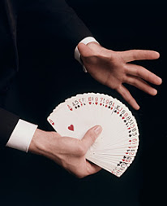
Truth is to be seen
Foundational Solution:

Slide 23
Truth is to be seen
Foundational Solution:
Watch for the ‘sleight-of-hand’

Slide 24
Truth is to be seen
Foundational Solution:
Watch for the ‘sleight-of-hand’
2 Timothy 3:13—¹³But evil men and impostors will proceed from bad to worse, deceiving and being deceived. (NASB95)

Slide 25
Truth is to be seen
Foundational Solution:
Watch for the ‘sleight-of-hand’
That is the foundation of a life beyond Christ

Slide 26
Truth is to be seen
Foundational Solution:
Watch for the ‘sleight-of-hand’
It’s fruit is deceptive—
  Sounds spiritual
  Until tested
  Momentary

Slide 27
Truth is to be seen
Foundational Solution:
Watch for the ‘sleight-of-hand’
It spreads—
  Destruction of others
  They teach others to teach others to deceive

Slide 28

Truth is to be seen
Foundational Solution:
We live it

Slide 29
Truth is to be seen
Foundational Solution:
We live it
Colossians 3:12—¹² So, as those who have been chosen of God, holy and beloved, put on a heart of compassion, kindness, humility, gentleness and patience; ¹³bearing with one another, and forgiving each other,… (NASB95)

Slide 30
Truth is to be seen
Foundational Solution:
We live it
People long for these Christlike virtues to be lived around them

Slide 31
Truth is to be seen
Foundational Solution:
We live it
People who are:
“Chosen of God”
“Holy and beloved”
“Compassion”
“Kindness”
“Humility”
“Gentleness”
“Patience”
“Bearing with one another
“Forgiving each other” (NASB95)

Slide 32
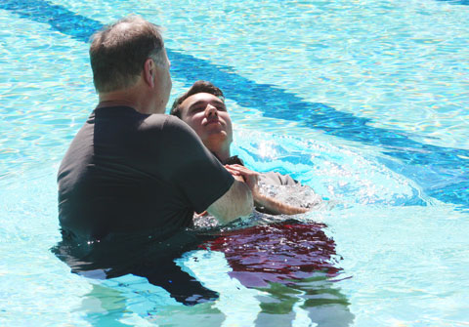
Acts 22:16—¹⁶ Now why do you delay? Get up and be baptized, and wash away your sins, calling on His name.’ (NASB)

