Slide 1


Slide 2
“Road to Progress.”
John Staiger
For Morningside Church of Christ
Sunday 23 August 2020
PM Sermon
Broadcast on Facebook Live from Massey, NZ.

Slide 3
“Road to Progress.”

Slide 4
The Way We Were

Slide 5
The Way We Were
James 1:22-24—²²But prove yourselves doers of the word, and not merely hearers who delude themselves. ²³ For if anyone is a hearer of the word and not a doer, he is like a man who looks at his natural face in a mirror; ²⁴for once he has looked at himself and gone away, he has immediately forgotten what kind of person he was. (NASB95)

Slide 6

The Way We Were
If you:
Listen to sermons just to affirm your present beliefs, you have come to the wrong place

Slide 7
The Way We Were
If you:
Read the Bible to support you present religious ideas and practices, you have come to the wrong book.

Slide 8
The Way We Were
If you:
Believe that listening is something that is best done by the other person, you have come to the wrong Jesus.

Slide 9
The Way We Were
If you:
Seek to insert Jesus’ teachings into the philosophies of this world, then you will never hear what Jesus is actually saying.

Slide 10

The Way We Were
If you:
Are willing to hold up the Word of God as the ‘mirror’ that it is, then you will Progress.

Slide 11
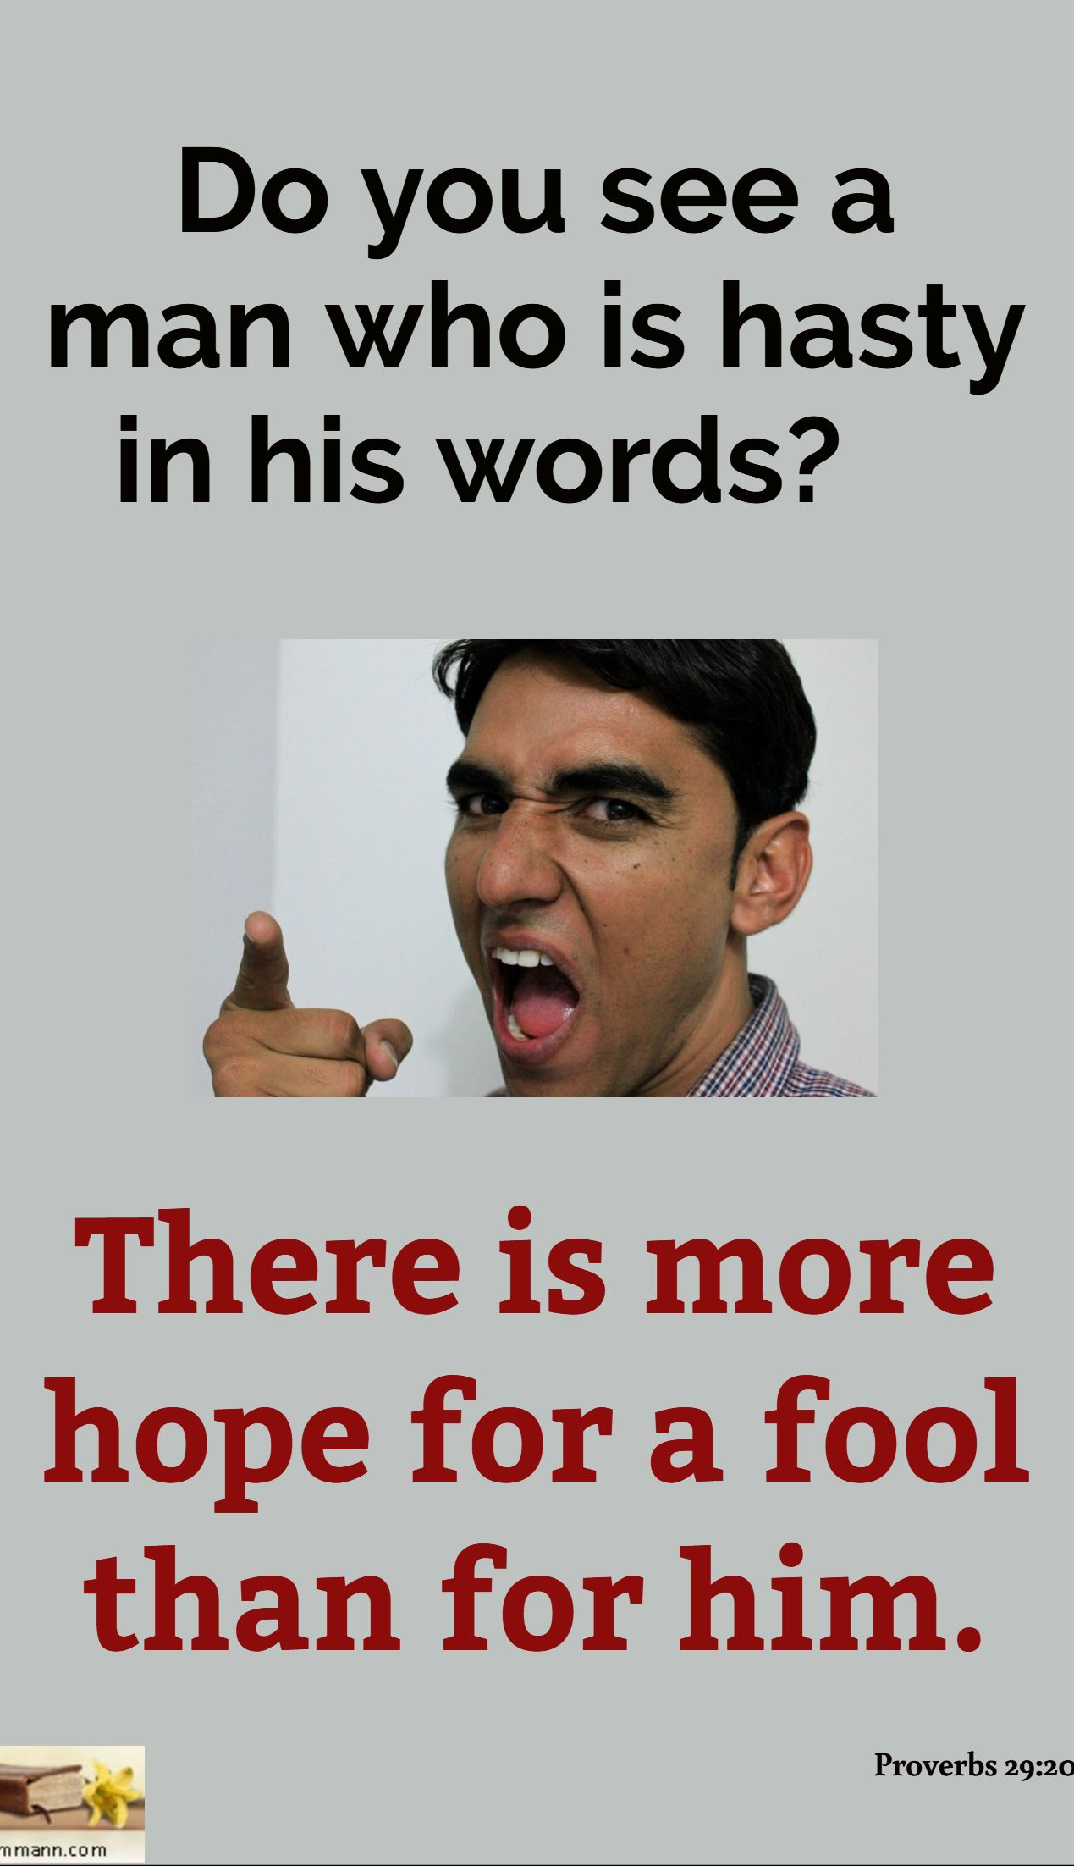
Hearing it Like it Is
Proverbs 29:20

Slide 12
Hearing it Like it Is
Learning when not to speak is something all must learn
Proverbs 29:20

Slide 13
Hearing it Like it Is
Shutting down that inner voice can be the hardest thing to do.
  Silence is not necessarily listening
Proverbs 29:20

Slide 14
Hearing it Like it Is
Social media didn’t invent ranting and angry outbursts, it just made them easier.
  Remember—Every word is under judgement. (Mt.12:37)
  Count them as God’s
Proverbs 29:20

Slide 15
Hearing it Like it Is
The hardest times to listen:
  When you are offended
  When the person doesn’t like you
  When you don’t like that person
Proverbs 29:20

Slide 16

Transformative Hearing
T
  W

Slide 17
Transformative Hearing
Why the stories?
  Powerful at every level
  Memorable
Matthew 13:10—¹⁰And the disciples came and said to Him, “Why do You speak to them in parables?” (NASB95)

Slide 18
Transformative Hearing
Jesus’ teaching had only two levels:
  You got it
  You didn’t get it
Matthew 13:13—¹³Therefore I speak to them in parables; because while seeing they do not see, and while hearing they do not hear, nor do they understand. (NASB95)

Slide 19
Transformative Hearing
Jesus’ teaching had ONE intended audience:
Matthew 13:11—¹¹Jesus answered them, “To you it has been granted to know the mysteries of the kingdom of heaven, but to them it has not been granted. (NASB95)

Slide 20
Transformative Hearing
You are it:
  If you get it
  You will have it
  Because you listened
Matthew 13:12—¹² For whoever has, to him more shall be given, and he will have an abundance; but whoever does not have, even what he has shall be taken away from him. (NASB95)

Slide 21
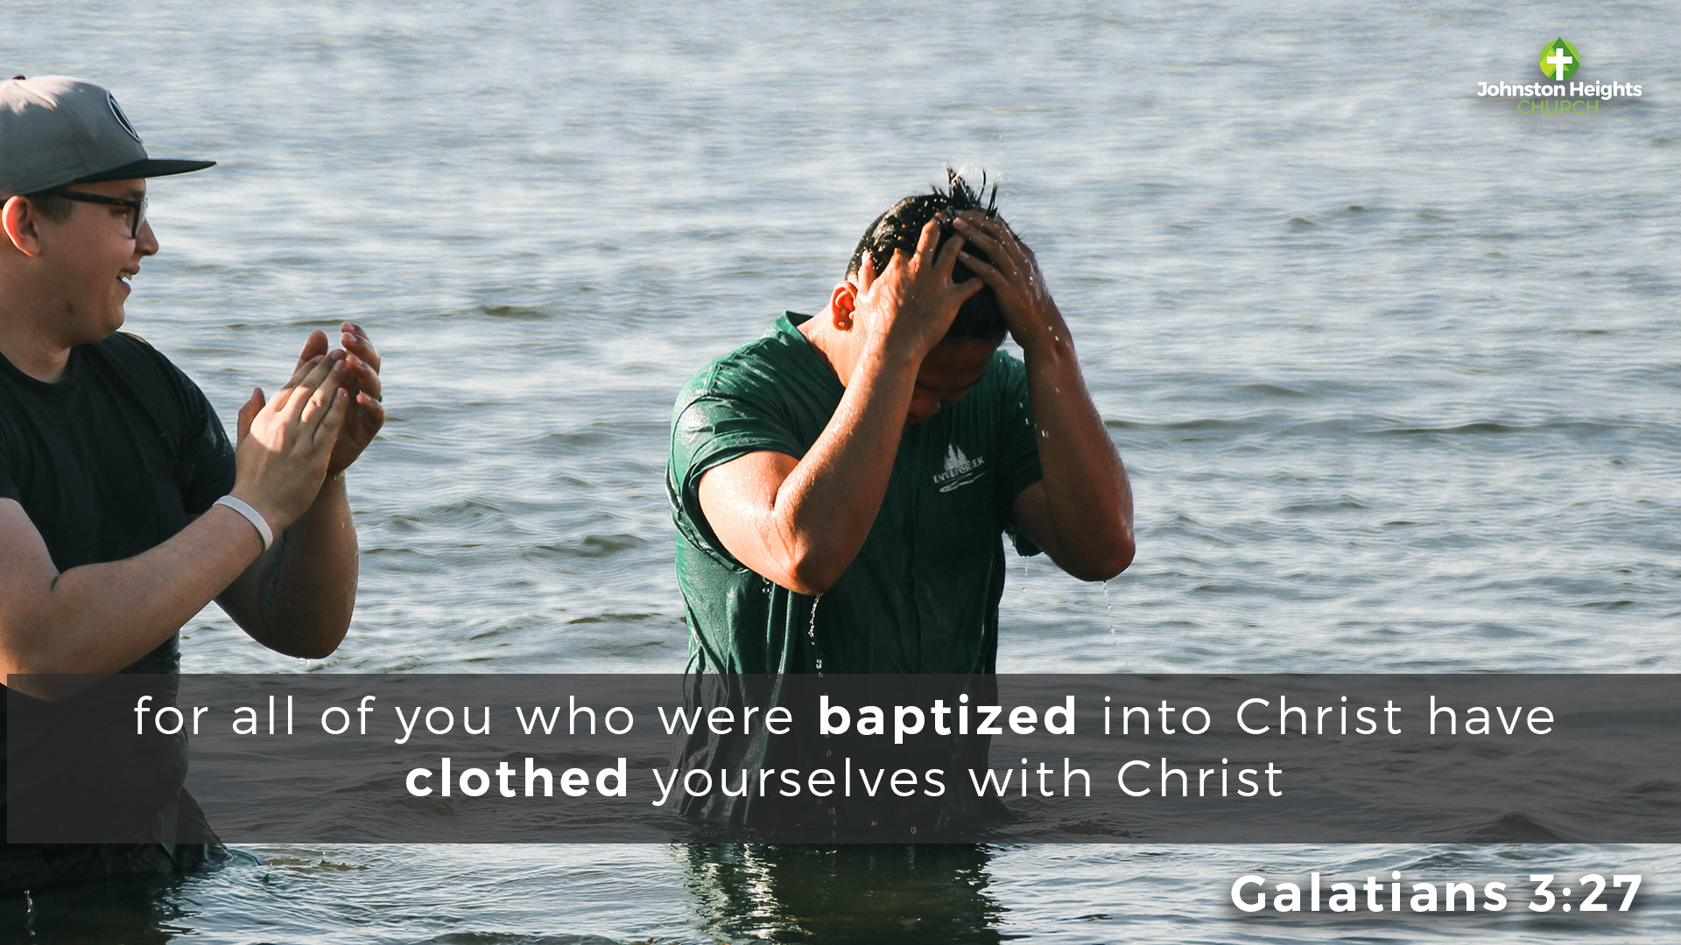
Acts 2:41—⁴¹So those who received his word were baptized, and there were added that day about three thousand souls. (ESV)

