Slide 1
“Be Humble.”
John Staiger
Morningside Church of Christ
Sunday 1 November 2020
AM Sermon
Broadcast on Facebook Live from
42 Leslie Ave, Sandringham.

Slide 2
Be
Humble

Slide 3
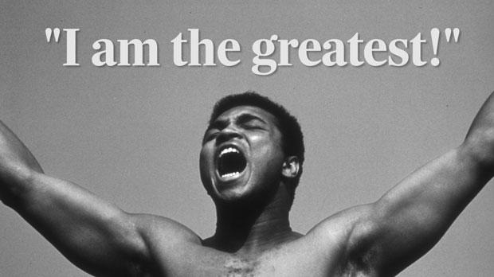

Slide 4
Mark 9:33-35—
³³They came to Capernaum; and when He was in the house, He began to question them: “What were you discussing on the way?” (NASB95)

Slide 5
Mark 9:33-35—
³⁴ But they kept silent, for on the way they had discussed with one another which of them was the greatest.

Slide 6
Mark 9:33-35— …³⁵And sitting down, He called the twelve and *said to them, “If anyone wants to be first, he shall be last of all and servant of all.” (NASB95)

Slide 7
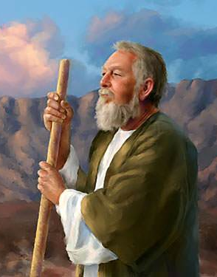
Moses—Man of God!

Slide 8
Moses—Man of God!
40 years a Prince of Egypt
40 years a fugitive and shepherd
40 years the leader of Israel

Slide 9
Moses—Man of God!
40 years a Prince of Egypt
40 years a fugitive and shepherd
40 years the leader of Israel

Slide 10
Moses—Man of God!
40 years a Prince of Egypt
40 years a fugitive and shepherd
40 years the leader of Israel

Slide 11
Moses—Man of God!
Numbers 12:3—
³Now the man Moses was very humble, more than any person who was on the face of the earth. (NASB95)

Slide 12

The fear of the Lord
is the instruction for wisdom,
And before honour comes humility.

Slide 13
1 Peter 5:4-6—
⁴ And when the Chief Shepherd appears,
you will receive the unfading ^{[a]}crown of glory.
⁵ You ^{[b]}younger men, likewise, be subject to your elders;
and all of you, clothe yourselves with humility toward one another,
because God is opposed to the proud, but He gives grace to the humble.
⁶ Therefore humble yourselves under the mighty hand of God,
so that He may exalt you at the proper time,
⁷ having cast all your anxiety on Him,
because He cares about you.
(NASB95) [a]Lit wreath [b]Or young people

Slide 14
1 Peter 5:4-6—
⁴ And when the Chief Shepherd appears,
you will receive the unfading ^{[a]}crown of glory.
⁵ You ^{[b]}younger men, likewise, be subject to your elders;
and all of you, clothe yourselves with humility toward one another,
because God is opposed to the proud, but He gives grace to the humble.
⁶ Therefore humble yourselves under the mighty hand of God,
so that He may exalt you at the proper time,
⁷ having cast all your anxiety on Him,
because He cares about you.
(NASB95) [a]Lit wreath [b]Or young people

Slide 15
1 Peter 5:4-6—
⁴ And when the Chief Shepherd appears,
you will receive the unfading ^{[a]}crown of glory.
⁵ You ^{[b]}younger men, likewise, be subject to your elders;
and all of you, clothe yourselves with humility toward one another,
because God is opposed to the proud, but He gives grace to the humble.
⁶ Therefore humble yourselves under the mighty hand of God,
so that He may exalt you at the proper time,
⁷ having cast all your anxiety on Him,
because He cares about you.
(NASB95) [a]Lit wreath [b]Or young people

Slide 16
1 Peter 5:4-6—
⁴ And when the Chief Shepherd appears,
you will receive the unfading ^{[a]}crown of glory.
⁵ You ^{[b]}younger men, likewise, be subject to your elders;
and all of you, clothe yourselves with humility toward one another,
because God is opposed to the proud, but He gives grace to the humble.
⁶ Therefore humble yourselves under the mighty hand of God,
so that He may exalt you at the proper time,
⁷ having cast all your anxiety on Him,
because He cares about you.
(NASB95) [a]Lit wreath [b]Or young people

Slide 17
1 Peter 5:4-6—
⁴ And when the Chief Shepherd appears,
you will receive the unfading ^{[a]}crown of glory.
⁵ You ^{[b]}younger men, likewise, be subject to your elders;
and all of you, clothe yourselves with humility toward one another,
because God is opposed to the proud, but He gives grace to the humble.
⁶ Therefore humble yourselves under the mighty hand of God,
so that He may exalt you at the proper time,
⁷ having cast all your anxiety on Him,
because He cares about you.
(NASB95) [a]Lit wreath [b]Or young people

Slide 18
1 Peter 5:4-6—
⁴ And when the Chief Shepherd appears,
you will receive the unfading ^{[a]}crown of glory.
⁵ You ^{[b]}younger men, likewise, be subject to your elders;
and all of you, clothe yourselves with humility toward one another,
because God is opposed to the proud, but He gives grace to the humble.
⁶ Therefore humble yourselves under the mighty hand of God,
so that He may exalt you at the proper time,
⁷ having cast all your anxiety on Him,
because He cares about you.
(NASB95) [a]Lit wreath [b]Or young people

Slide 19
1 Peter 5:4-6—
⁴ And when the Chief Shepherd appears,
you will receive the unfading ^{[a]}crown of glory.
⁵ You ^{[b]}younger men, likewise, be subject to your elders;
and all of you, clothe yourselves with humility toward one another,
because God is opposed to the proud, but He gives grace to the humble.
⁶ Therefore humble yourselves under the mighty hand of God,
so that He may exalt you at the proper time,
⁷ having cast all your anxiety on Him,
because He cares about you.
(NASB95) [a]Lit wreath [b]Or young people

Slide 20
1 Peter 5:4-6—
⁴ And when the Chief Shepherd appears,
you will receive the unfading ^{[a]}crown of glory.
⁵ You ^{[b]}younger men, likewise, be subject to your elders;
and all of you, clothe yourselves with humility toward one another,
because God is opposed to the proud, but He gives grace to the humble.
⁶ Therefore humble yourselves under the mighty hand of God,
so that He may exalt you at the proper time,
⁷ having cast all your anxiety on Him,
because He cares about you.
(NASB95) [a]Lit wreath [b]Or young people

Slide 21
1 Peter 5:4-6—
⁴ And when the Chief Shepherd appears,
you will receive the unfading ^{[a]}crown of glory.
⁵ You ^{[b]}younger men, likewise, be subject to your elders;
and all of you, clothe yourselves with humility toward one another,
because God is opposed to the proud, but He gives grace to the humble.
⁶ Therefore humble yourselves under the mighty hand of God,
so that He may exalt you at the proper time,
⁷ having cast all your anxiety on Him,
because He cares about you.
(NASB95) [a]Lit wreath [b]Or young people

Slide 22

Some things are not worth hanging on to…
Proverbs 18:12—
¹²Before destruction the heart of a person is haughty,
But humility goes before honour.

Slide 23
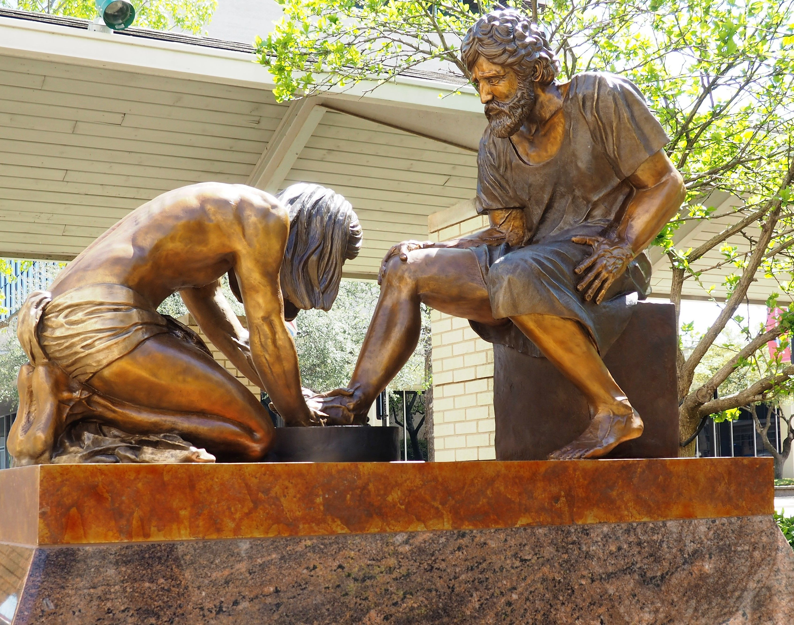
John 13:15—¹⁵For I gave you an example, so that you also would do just as I did for you. (NASB95)

Slide 24
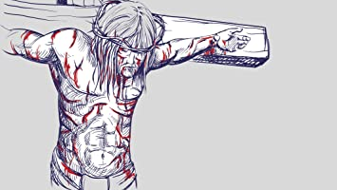
Philippians 2:8—⁸And being found in appearance as a man, He humbled Himself by becoming obedient to the point of death: death on a cross. (NASB95)

Slide 25
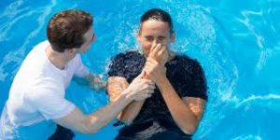
Acts 2:37-38—³⁷Now when they heard this, they were pierced to the heart, and said to Peter and the rest of the apostles, “Brothers, what are we to do?” ³⁸Peter said to them, “Repent, and each of you be baptized in the name of Jesus Christ for the forgiveness of your sins; and you will receive the gift of the Holy Spirit.

