Slide 1
“Be Courageous.”
John Staiger
Morningside Church of Christ
Sunday 25 October 2020
AM Sermon
Broadcast on Facebook Live from
42 Leslie Ave, Sandringham.

Slide 2
Be
Courageous

Slide 3
Courageous in Prayer

Slide 4
Courageous in Prayer
Jesus’ calls for
Mountain-moving-faith:

Slide 5
Courageous in Prayer
Jesus’ calls for
Mountain-moving-faith:
The Christian’s starting point in prayer.

Slide 6
Courageous in Prayer
Jesus’ calls for
Mountain-moving-faith:
The Christian’s starting point in prayer.
“Therefore, I tell you, whatever you ask for in prayer, believe that you have received it, and it will be yours” (Mk.11:24).

Slide 7
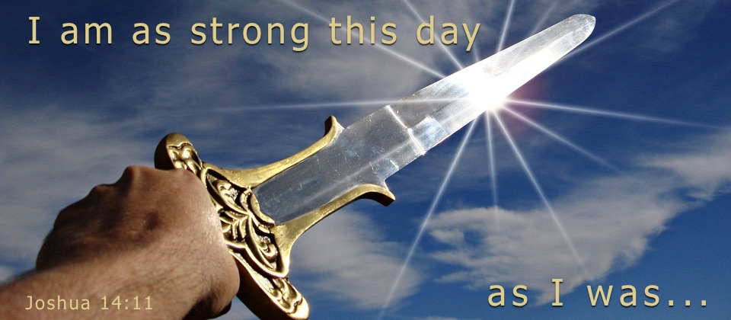
Be Courageous: Fearless

Slide 8
Be Courageous: Fearless
Caleb didn’t seem to have issues with fear

Slide 9
Be Courageous: Fearless
Joshua 14:10-11—¹⁰Now behold, the Lord has let me live, just as He spoke, these forty-five years, from the time that the Lord spoke this word to Moses, when Israel walked in the wilderness; and now behold, I am eighty-five years old today. ¹¹ I am still as strong today as I was in the day Moses sent me; as my strength was then, so my strength is now, for war and for going out and coming in. (NASB95)

Slide 10

Be Courageous: Live Free

Slide 11
Be Courageous: Live Free
Hebrews 2:14-15—¹⁴Therefore, since the children share in flesh and blood, He Himself likewise also partook of the same, that through death He might render powerless him who had the power of death, that is, the devil, ¹⁵ and might free those who through fear of death were subject to slavery all their lives. (NASB95)

Slide 12
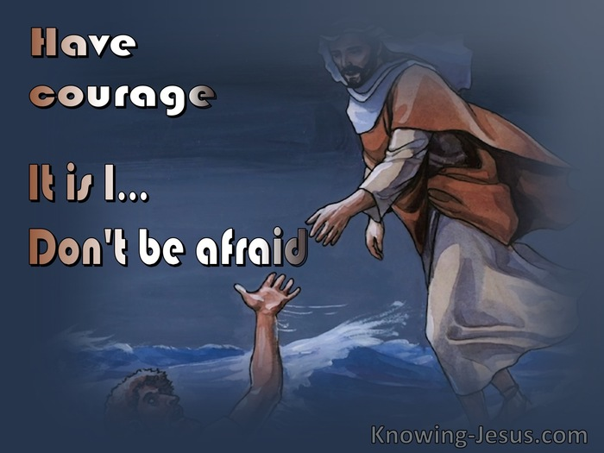
Be Courageous: Stay Focused

Slide 13
Be Courageous: Stay Focused
Peter honoured the storm.
“Fixing our eyes on Jesus” (Heb.12:2).
Set your mind on things above (Col.3:2).

Slide 14
Be Courageous: Stay Focused
Peter honoured the storm.
“Fixing our eyes on Jesus” (Heb.12:2).
Set your mind on things above (Col.3:2).

Slide 15
Be Courageous: Stay Focused
Peter honoured the storm.
“Fixing our eyes on Jesus” (Heb.12:2).
Set your mind on things above (Col.3:2).

Slide 16
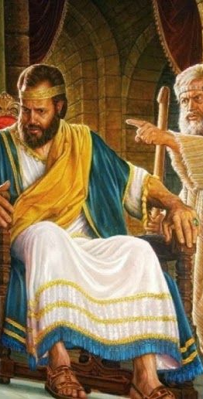
Be Courageous: Face Sin

Slide 17
Be Courageous: Face Sin
King David sat in a state of:
  Guilt
  Self-denial
  Self-righteousness over Bathsheba

Slide 18
Be Courageous: Face Sin
John 3:20—
²⁰ For everyone who does evil hates the Light, and does not come to the Light for fear that his deeds will be exposed. (NASB95)

Slide 19
Be Courageous: Face Sin
Then Nathan said to David,
“You are the man!” (2Sam.12:7)

Slide 20
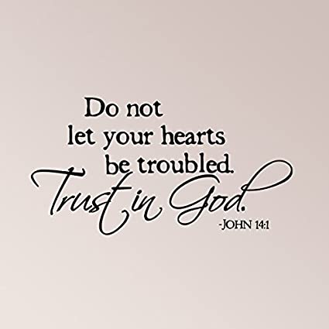
Be Courageous:
You’re going Home

Slide 21
Be Courageous:
You’re going Home
John 14:1-3—
¹“Do not let your heart be troubled; ^{[a]}believe in God, believe also in Me. ²In My Father’s house are many dwelling places; if it were not so, I would have told you; for I go to prepare a place for you. ³ If I go and prepare a place for you, I will come again and receive you to Myself, that where I am, there you may be also. (NASB95) [a]Or you believe in God

Slide 22

Be Courageous: Avoid this…!

Slide 23
Be Courageous: Avoid this…!
Matthew 10:28
²⁸Do not fear those who kill the body but are unable to kill the soul; but rather fear Him who is able to destroy both soul and body in hell. (NASB95)

Slide 24
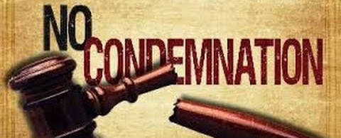
Be Courageous: The Cure

Slide 25
Be Courageous: The Cure
1 John 4:18—
¹⁸ There is no fear in love; but perfect love casts out fear, because fear involves punishment, and the one who fears is not perfected in love.

Slide 26
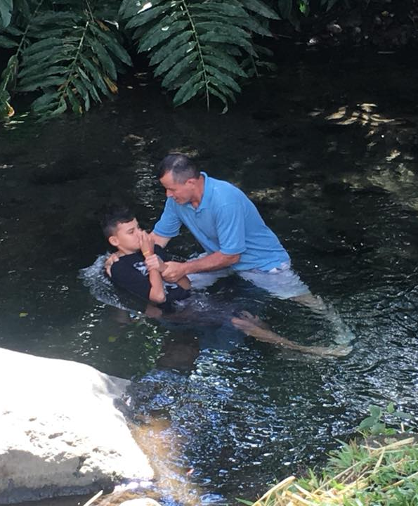
Acts 22:16—
¹⁶Now why do you delay? Get up and be baptized, and wash away your sins, calling on His name.’ (NASB95)

