Slide 1
“Be Merciful.”
John Staiger
Morningside Church of Christ
Sunday 8 November 2020
AM Sermon
Broadcast on Facebook Live from
42 Leslie Ave, Sandringham.

Slide 2
Be
Merciful

Slide 3
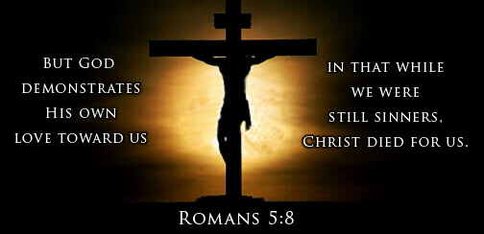

Slide 4
Mercy defined
.

Slide 5
Mercy defined
Mercy is the
demonstration of compassion

Slide 6
Mercy defined
Webster: “Kind or forgiving treatment of someone who could be treated harshly.”

Slide 7
Mercy defined
Easton’s Bible Dictionary:
“Compassion for the miserable.”

Slide 8
Mercy defined
Compassionate treatment or attitude to an offender or an enemy

Slide 9
Mercy defined
Vine’s Dictionary:
“The outward manifestation of pity”

Slide 10
Mercy defined
Helping the helpless,
forgiving the sinner

Slide 11
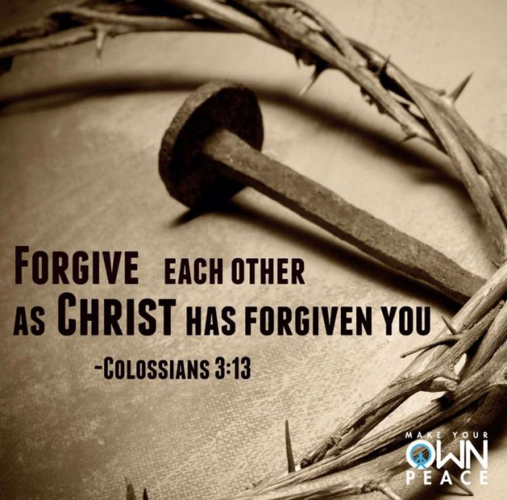
Mercy Lived

Slide 12
The Power of Mercy
The mercy of God is manifested by Jesus on the cross.

Slide 13
The Power of Mercy
The Cross
Heals…
The broken relationship between man and God. (Reconciliation)
The mercy of God is manifested by Jesus on the cross.

Slide 14
The Power of Mercy
The Cross
Heals…
The broken relationship between man and God. (Reconciliation)
The mercy of God is manifested by Jesus on the cross.

Slide 15
The Power of Mercy
The Cross
Breaks…
The devil’s power over sin and death
The mercy of God is manifested by Jesus on the cross.

Slide 16
The Power of Mercy
The Cross
Breaks…
The devil’s power over sin and death
The mercy of God is manifested by Jesus on the cross.

Slide 17
The Power of Mercy
The Cross
Brings…
Everlasting Life to those who seek it
The mercy of God is manifested by Jesus on the cross.

Slide 18
The Power of Mercy
The Cross
Brings…
Everlasting Life to those who seek it
The mercy of God is manifested by Jesus on the cross.

Slide 19
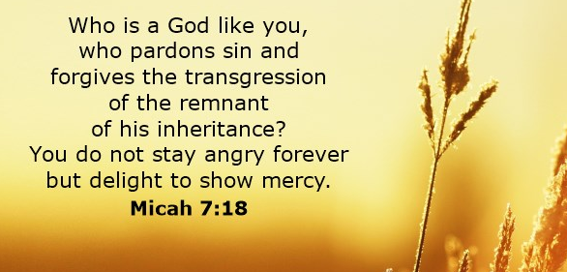

God delights to show mercy

Slide 20
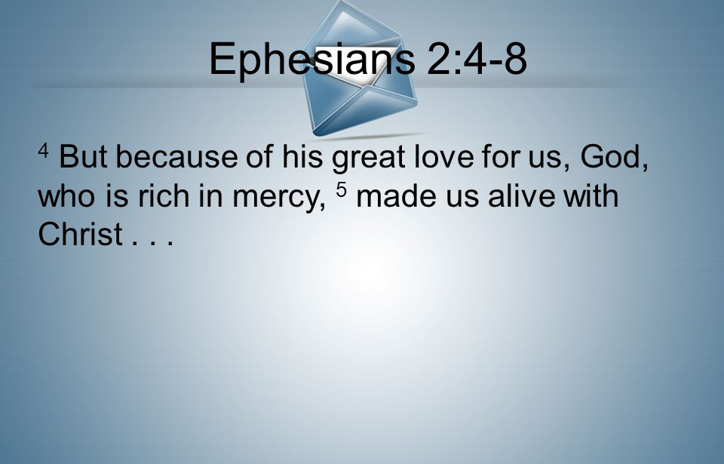
God delights to show mercy

Slide 21
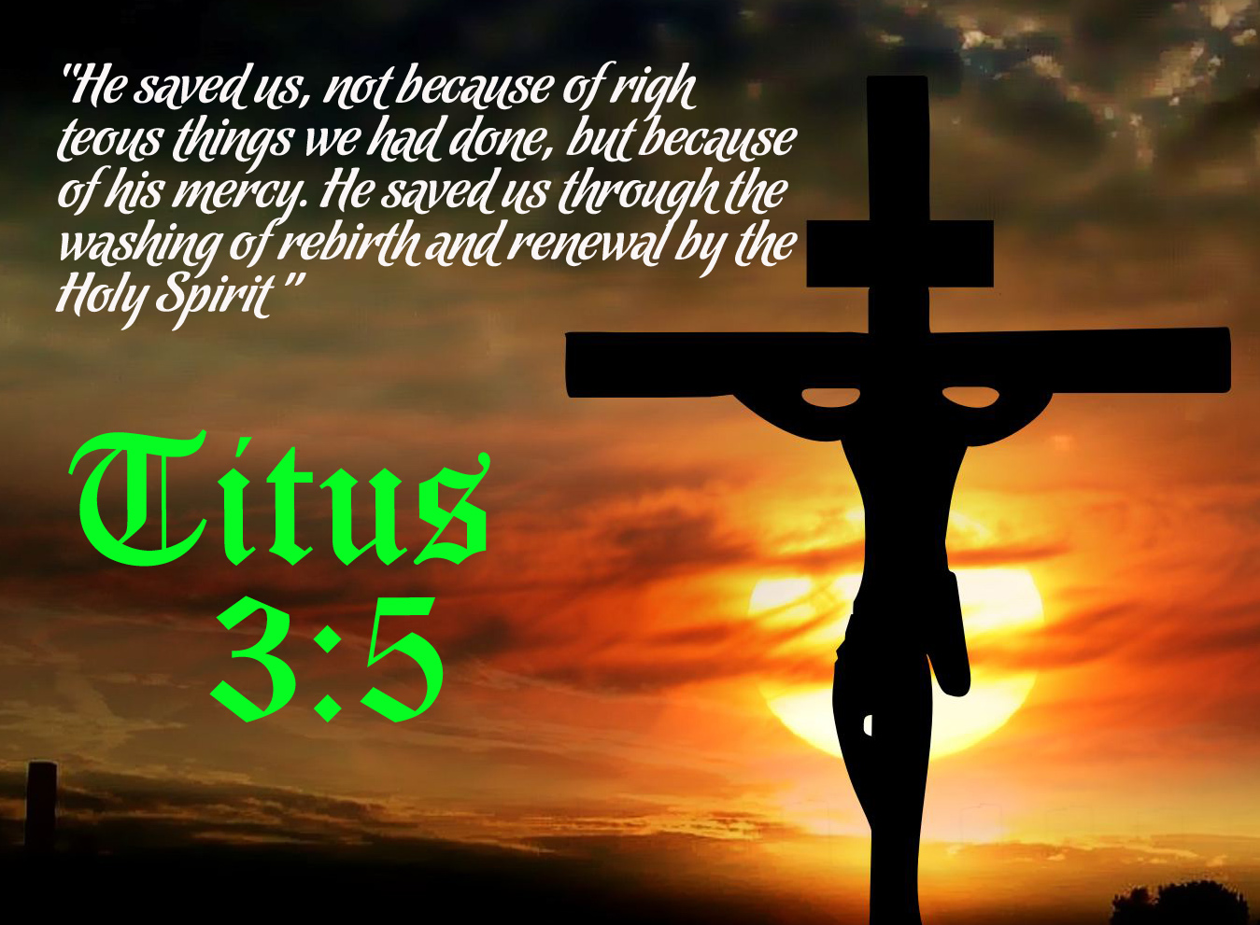
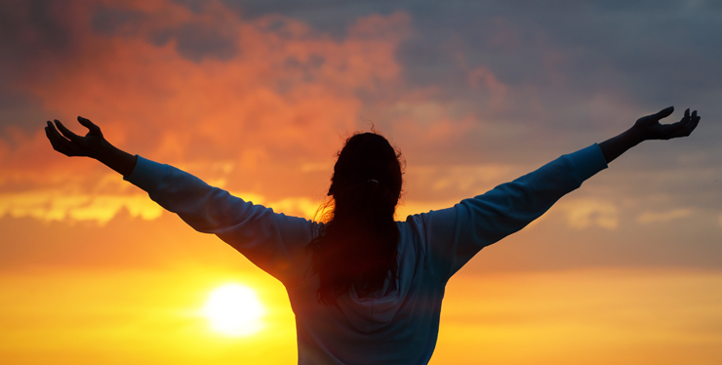
Titus 3:4-6—
⁴But when the kindness of God our Saviour and His love for mankind appeared,…
God saves us “according to His mercy”

Slide 22
Titus 3:4-6—
⁵He saved us, not on the basis of deeds which we did in righteousness,…
God saves us “according to His mercy”

Slide 23
Titus 3:4-6—
…but in accordance with His mercy, by the washing of regeneration and renewing by the Holy Spirit,…
God saves us “according to His mercy”

Slide 24
Titus 3:4-6—
⁶whom He richly poured out upon us through Jesus Christ our Saviour, (NASB95)
God saves us “according to His mercy”

Slide 25

Lamentations 3:22-24
²² The steadfast love of the Lord never ceases;
his mercies never come to an end;
²³ they are new every morning;
great is your faithfulness.
²⁴ “The Lord is my portion,” says my soul,
“therefore I will hope in him.” (ESV)

Slide 26
Lamentations 3:22-24
²² The steadfast love of the Lord never ceases;
his mercies never come to an end;
²³ they are new every morning;
great is your faithfulness.
²⁴ “The Lord is my portion,” says my soul,
“therefore I will hope in him.” (ESV)

Slide 27
Lamentations 3:22-24
²² The steadfast love of the Lord never ceases;
his mercies never come to an end;
²³ they are new every morning;
great is your faithfulness.
²⁴ “The Lord is my portion,” says my soul,
“therefore I will hope in him.” (ESV)

Slide 28
Lamentations 3:22-24
²² The steadfast love of the Lord never ceases;
his mercies never come to an end;
²³ they are new every morning;
great is your faithfulness.
²⁴ “The Lord is my portion,” says my soul,
“therefore I will hope in him.” (ESV)

Slide 29
Lamentations 3:22-24
²² The steadfast love of the Lord never ceases;
his mercies never come to an end;
²³ they are new every morning;
great is your faithfulness.
²⁴ “The Lord is my portion,” says my soul,
“therefore I will hope in him.” (ESV)

Slide 30
Lamentations 3:22-24
²² The steadfast love of the Lord never ceases;
his mercies never come to an end;
²³ they are new every morning;
great is your faithfulness.
²⁴ “The Lord is my portion,” says my soul,
“therefore I will hope in him.” (ESV)

Slide 31
Lamentations 3:22-24
²² The steadfast love of the Lord never ceases;
his mercies never come to an end;
²³ they are new every morning;
great is your faithfulness.
²⁴ “The Lord is my portion,” says my soul,
“therefore I will hope in him.” (ESV)

Slide 32
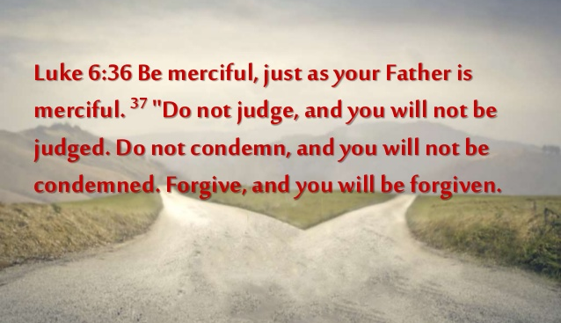
You were created to become like Christ
God has been extremely merciful to mankind

Slide 33


Slide 34
James 2:12-13—
¹²So speak, and so act,
as those who are to be judged by the law of freedom.
¹³For judgment will be merciless to one who has shown no mercy;
mercy triumphs over judgment.

Slide 35
James 2:12-13—
¹²So speak, and so act,
as those who are to be judged by the law of freedom.
¹³For judgment will be merciless to one who has shown no mercy;
mercy triumphs over judgment.

Slide 36
James 2:12-13—
¹²So speak, and so act,
as those who are to be judged
by the law of freedom.
¹³For judgment will be merciless to one who has shown no mercy;
mercy triumphs over judgment.

Slide 37
James 2:12-13—
¹²So speak, and so act,
as those who are to be judged
by the law of freedom.
¹³For judgment will be merciless to one who has shown no mercy;
mercy triumphs over judgment.

Slide 38
James 2:12-13—
¹²So speak, and so act,
as those who are to be judged
by the law of freedom.
¹³For judgment will be merciless
to one who has shown no mercy;
mercy triumphs over judgment.

Slide 39
James 2:12-13—
¹²So speak, and so act,
as those who are to be judged
by the law of freedom.
¹³For judgment will be merciless
to one who has shown no mercy;
mercy triumphs over judgment.

Slide 40
James 2:12-13—
¹²So speak, and so act,
as those who are to be judged
by the law of freedom.
¹³For judgment will be merciless
to one who has shown no mercy;
mercy triumphs over judgment.

Slide 41

“Blessed are the merciful, for they shall receive mercy.”
This is the “Out-Flowing Beatitude.”

Slide 42
“Blessed are the merciful, for they shall receive mercy.”
This is the “Out-Flowing Beatitude.”

Slide 43
Warning…

Slide 44
Warning
The cursed life:

Slide 45
Cursed are the merciless…
  Mt.18:33-34 – “punishment on the slave who did not mercifully forgive

Slide 46
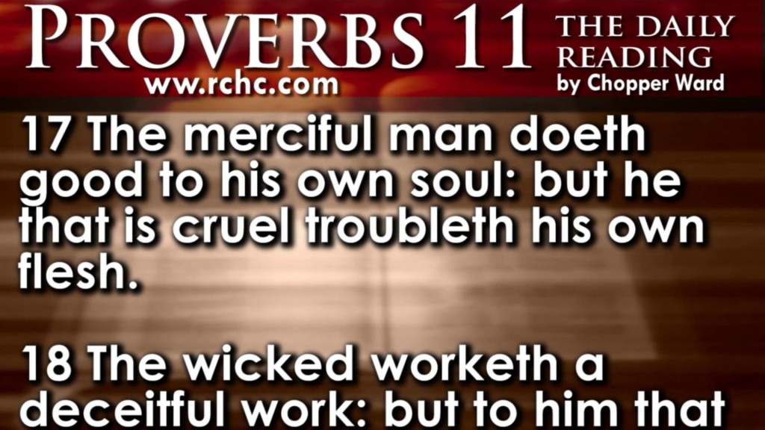
Do yourself and everyone else a favour!

Slide 47

Mercy = how God deals with us in our sin
Mercy = how you deal with others in their sin

Slide 48
Mercy = how God deals with us in our sin
Mercy is always greater than any sin
Mercy = how you deal with others in their sin

Slide 49
Mercy = how God deals with us in our sin
Show the way of mercy
Mercy = how you deal with others in their sin

Slide 50
Mercy = how God deals with us in our sin
Live the way of mercy
Mercy = how you deal with others in their sin

Slide 51
Mercy = how God deals with us in our sin
Pardon clearly expresses merciful love
Mercy = how you deal with others in their sin

Slide 52
Mercy = how God deals with us in our sin
Be an Oases of mercy in barren deserts
Mercy = how you deal with others in their sin

Slide 53
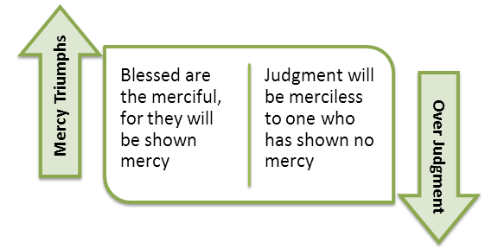

Slide 54
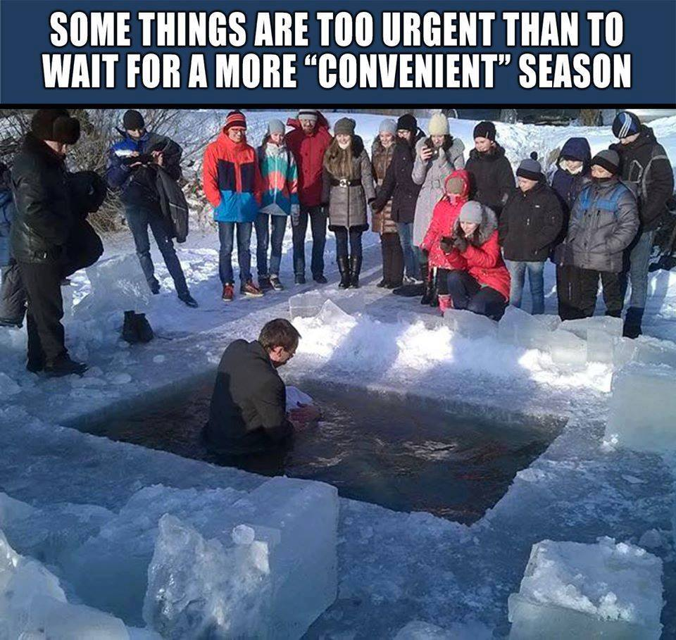
We receive the gift of mercy at baptism. God washes away our sins.

