Slide 1
Be
Patient

Slide 2
The Patience Test
Able to
Accept / Tolerate:
Delays
Problems
Suffering
Without becoming
Annoyed or Anxious.

Slide 3
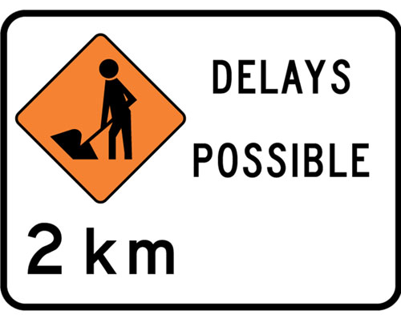


The Patience Test
Able to
Accept / Tolerate:
Delays
Problems
Suffering
Without becoming
Annoyed or Anxious.

Slide 4
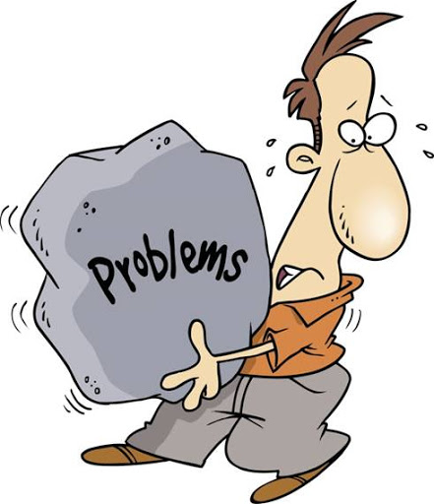
The Patience Test
Able to
Accept / Tolerate:
Delays
Problems
Suffering
Without becoming
Annoyed or Anxious.

Slide 5
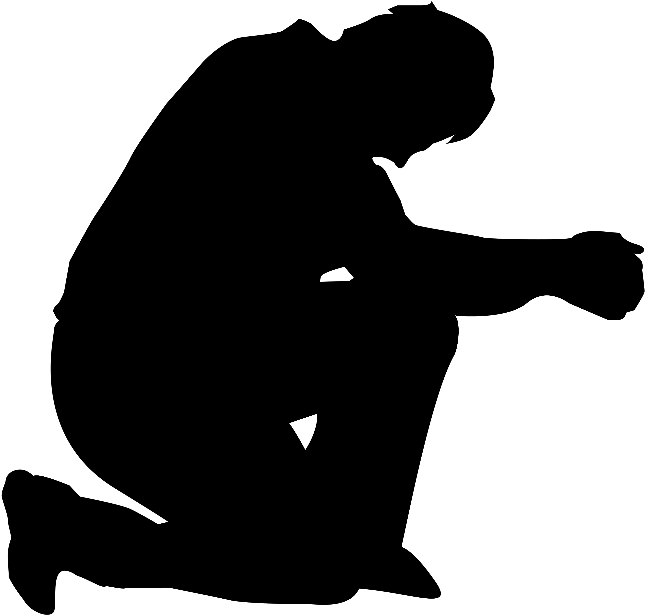
The Patience Test
Able to
Accept / Tolerate:
Delays
Problems
Suffering
Without becoming
Annoyed or Anxious.

Slide 6

The Patience Test
Able to
Accept / Tolerate:
Delays
Problems
Suffering
Without becoming
Annoyed or Anxious.

Slide 7
You can’t hide it!
Obvious to everyone:
Long-suffering
Forbearing
Accommodating
Calm
Content
Easy-going
Stoical

Slide 8
Three Reasons
Psalm 130:5—
I wait for the
Lord,
my soul waits,
and in his
word
I hope;
(ESV)
The
WHO
of my patience

Slide 9
Three Reasons
Psalm 130:5—
I wait for the
Lord,
my soul waits,
and in his
word
I hope;
(ESV)
The
CORE
of my patience

Slide 10

Three Reasons
Psalm 130:5—
I wait for the
Lord,
my soul waits,
and in
His word
I hope;
(ESV)
The
SOURCE
for my patience

Slide 11
Three Reasons
Hope is the key to Patience
And
God’s Word is the key to Hope

Slide 12

Patience includes planning
Proverbs 16:1—

Slide 13
Patience includes planning
Proverbs 16:1—
The plans of the heart
belong to man,
But the answer of the tongue
is from the Lord.

Slide 14
Patience includes planning
Proverbs 16:1—
The plans of the heart
belong to man,
But the answer of the tongue
is from the Lord.
Man is free to plan

Slide 15
Patience includes planning
Proverbs 16:1—
The plans of the heart
belong to man,
But the answer of the tongue
is from the Lord.
Man is free to plan
God will ultimately advance His own design

Slide 16
Motives open to testing
Proverbs 16:2—

Slide 17
Motives open to testing
Proverbs 16:2—
All the ways of a man are clean in his own sight,
But the Lord weighs the ^{[a]}motives. (NASB95) [a]Lit spirits

Slide 18
Motives open to testing
Proverbs 16:2—
All the ways of a man are clean in his own sight,
But the Lord weighs the ^{[a]}motives. (NASB95) [a]Lit spirits
1Cor.4:4—⁴For I am conscious of nothing against myself, yet I am not by this acquitted; but the one who examines me is the Lord. (NASB95)

Slide 19
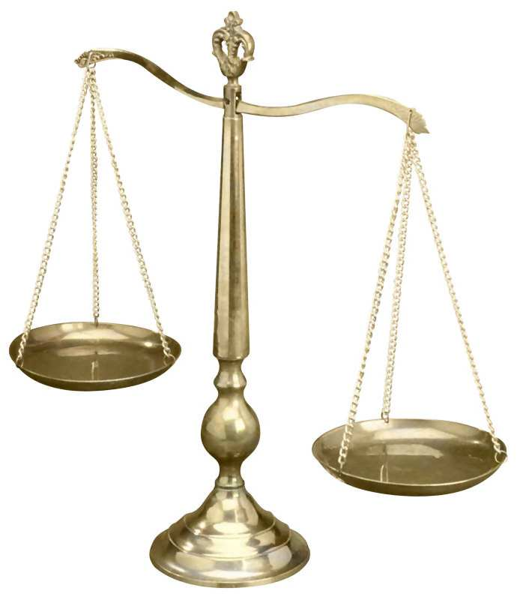
Motives open to testing
Proverbs 16:2—
All the ways of a man are clean in his own sight,
But the Lord weighs the ^{[a]}motives. (NASB95) [a]Lit spirits
Weighed in the balance

Slide 20

God’s safe hands
Proverbs 16:3
—

Slide 21
God’s safe hands
Proverbs 16:3
^{[a]}Commit your works to the Lord
And your plans will be established. (NASB95) [a]Lit Roll3—

Slide 22
God’s safe hands
Proverbs 16:3
^{[a]}Commit your works to the Lord
And your plans will be established. (NASB95) [a]Lit Roll3—
When your plans are God’s plans success is guaranteed.

Slide 23
God has no loose ends
Proverbs 16:4—
The Lord has made everything for ^{[a]}its own purpose,
Even the wicked for the day of evil. (NASB95) [a]Or His
Everything is put to its proper use
Everything matched to its proper end
God is not the author of evil
But he will honour man’s choices to that end

Slide 24
Watching others—Be Careful
Psalm 37:7—
^{7[a]}Rest in the Lord and wait ^{[b]}patiently for Him;
Do not fret because of him who prospers in his way,
Because of the man who carries out wicked schemes. (NASB95) [a]Or Be still [b]Or longingly
Prosperity must be spiritually defined

Slide 25
Romans 2:4—
⁴Or do you think lightly of the riches of His
kindness
and tolerance
and patience,
not knowing that the kindness of God leads you to repentance?
(NASB95)

Slide 26

Some things must not Wait

