Slide 1
“Be Sober-Minded.”
John Staiger
Morningside Church of Christ
Sunday 18 October 2020
AM Sermon
Broadcast on Facebook Live from
42 Leslie Ave, Sandringham.

Slide 2
Be
Sober-Minded

Slide 3
Be Sober—First thoughts…

Slide 4
Be Sober—First thoughts…
Not Drunk?

Slide 5
Be Sober—First thoughts…
Not Drunk?
Sombre?

Slide 6
Be Sober—First thoughts…
Not Drunk?
Sombre?
Serious?

Slide 7
Be Sober—First thoughts…
Not Drunk?
Sombre?
Serious?
Sensible?

Slide 8
What am I talking about?

Slide 9
What am I talking about?
The Sober-minded Christian

Slide 10
What am I talking about?
The Sober-minded Christian
  Self-controlled

Slide 11
What am I talking about?
The Sober-minded Christian
  Self-controlled
2 Timothy 1:7— For God has not given us a spirit of ^{[a]}timidity, but of power and love and ^{[b]}discipline. (NASB95) [a]Or cowardice [b]sound judgment

Slide 12
What am I talking about?
The Sober-minded Christian
  Self-controlled
  Clear-headed—
2 Corinthians 10:5—⁵We are destroying speculations and every lofty thing raised up against the knowledge of God, and we are taking every thought captive to the obedience of Christ, (NASB95)

Slide 13
What am I talking about?
The Sober-minded Christian
  Self-controlled
  Clear-headed—
2 Corinthians 10:5—⁵We are destroying speculations and every lofty thing raised up against the knowledge of God, and we are taking every thought captive to the obedience of Christ, (NASB95)

Slide 14
What am I talking about?
The Sober-minded Christian
  Self-controlled
  Clear-headed
  Watchful—
  God expects the Christian to know what is happening around them.

Slide 15
What am I talking about?
The Sober-minded Christian
  Self-controlled
  Clear-headed
  Watchful—
  God expects the Christian to know what is:
    Happening around them.
    Coming in the end.

Slide 16
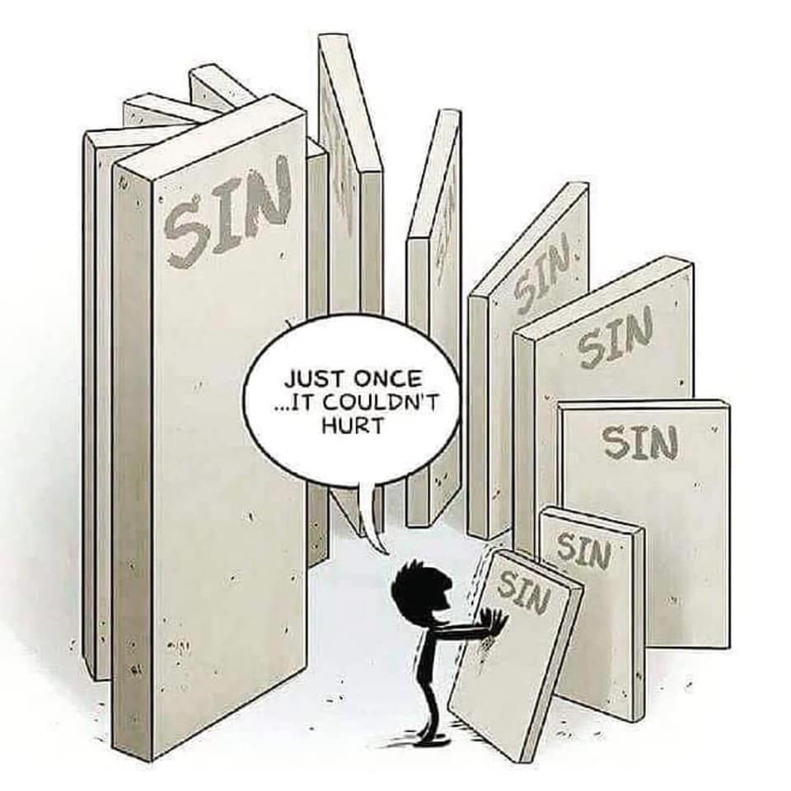
Paul, are you mad?
Acts 26:24—
²⁴While Paul was saying this in his defense, Festus *said in a loud voice, “Paul, you are out of your mind! ^{[a]}Your great learning is ^{[b]}driving you mad.” (NASB95) [a]Lit The many letters [b]Lit turning you to madness

Slide 17
Paul, are you mad?
Acts 26:25—
²⁵But Paul *said, “I am not out of my mind, most excellent Festus, but I utter words ^{[a]}of sober truth. (NASB95) [a]Lit of truth and rationality

Slide 18

1 Corinthians 15:34—³⁴Become sober-minded ^{[a]}as you ought, and stop sinning; for some have no knowledge of God. I speak this to your shame. (NASB95) [a] Lit righteously

Slide 19

1 Peter 1:13—
¹³Therefore, ^{[a]}prepare your minds for action, ^{[b]}keep sober in spirit, fix your hope completely on the grace ^{[c]}to be brought to you at the revelation of Jesus Christ. (NASB95) [a]Lit gird the loins of your mind [b]Lit be sober [c]Or which is announced

Slide 20
1 Peter 4:7—
⁷The end of all things ^{[a]}is near; therefore, be of sound judgment and sober spirit for the purpose of ^{[b]}prayer. (NASB95) [a]Lit has come near [b]Lit prayers

Slide 21
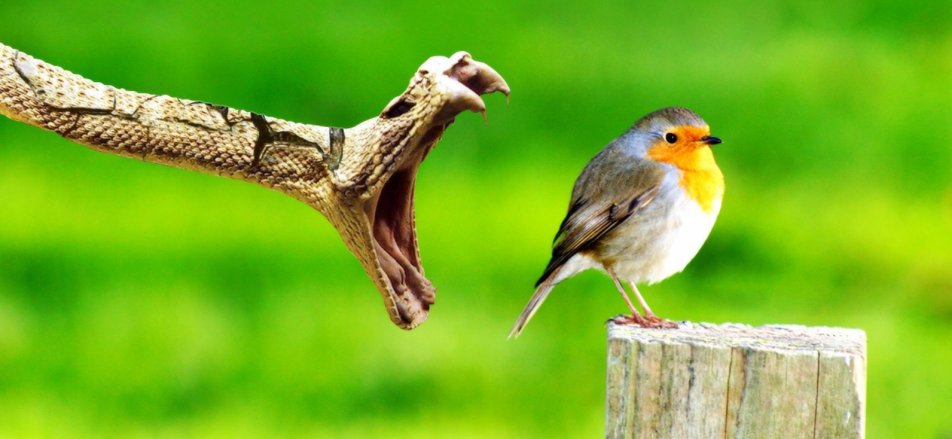
1 Peter 5:8—
⁸Be of sober spirit, be on the alert. Your adversary, the devil, prowls around like a roaring lion, seeking someone to devour. (NASB95)

Slide 22
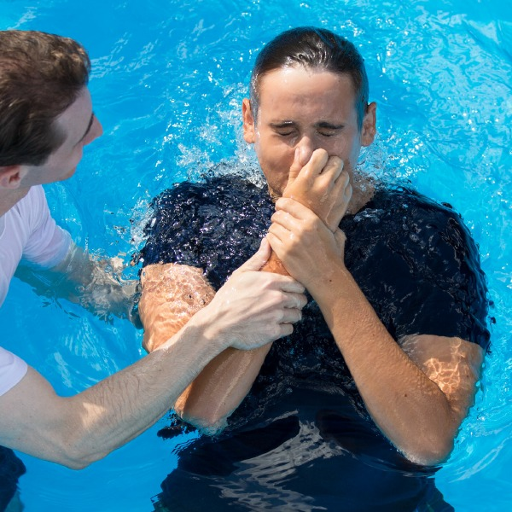
Get Ready!
.
Romans 6:4—⁴Therefore we have been buried with Him through baptism into death, so that as Christ was raised from the dead through the glory of the Father, so we too might walk in newness of life. (NASB95)

