Slide 1
Be
Truthful

Slide 2

What’s the Problem?

Slide 3


Slide 4
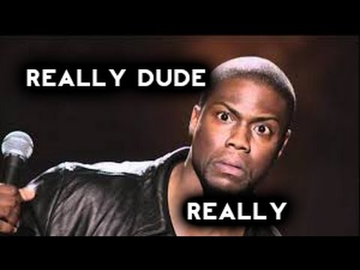

Slide 5
Truth

Slide 6
Let your ‘yes’
be
‘yes,’
and your ‘no’
be
‘no.’
Mt.5:37

Slide 7
…anything more than this comes from evil.
Mt.5:37

Slide 8

Truth
gets in the way of
“MY”
way
Lies…
Everywhere!
What’s wrong with the truth?

Slide 9
Truth
gets in the way of my Idols
Lies…
Everywhere!
What’s wrong with the truth?

Slide 10
For they exchanged the truth of God for a lie, and worshiped and served the creature rather than the Creator, who is blessed forever. Amen. (Rom.1:25)
Lies…
Everywhere!
What’s wrong with the truth?

Slide 11
Therefore consider the members of your earthly body as dead to immorality, impurity, passion, evil desire, and greed, which amounts to idolatry.
(Col.3:5)
Lies…
Everywhere!
What’s wrong with the truth?

Slide 12
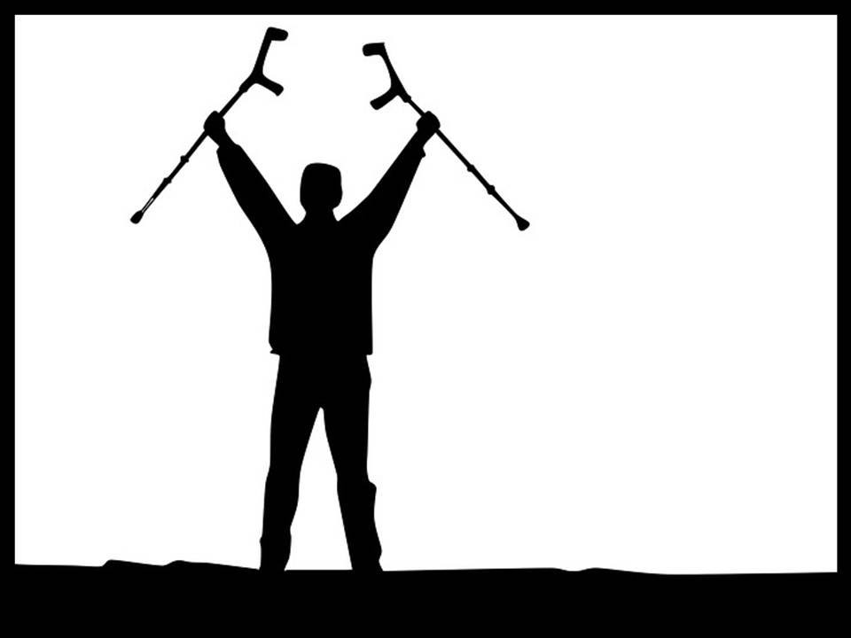
Truth Frees us from:
Leaning on Satan
Throw away the Crutches

Slide 13
Those
“White Lies”
to
Save Face
Throw away the Crutches

Slide 14
We have to pile on more lies to cover our tracks
Throw away the Crutches

Slide 15
Relationships are sustained through more lies and more deception
Throw away the Crutches

Slide 16
The Truth will set you free
Throw away the Crutches

Slide 17
Taking on the image of Christ is putting on
Truth Himself
Throw away the Crutches

Slide 18
Truth, the role of the Church.
1 Timothy 3:15
¹⁵but in case I am delayed, I write so that you will know how one ought to conduct himself in the household of God, which is the church of the living God, the pillar and support of the truth. (NASB)

Slide 19
Truth, the role of the Church.
The church
1 Timothy 3:15
¹⁵but in case I am delayed, I write so that you will know how one ought to conduct himself in the household of God, which is the church of the living God, the pillar and support of the truth. (NASB)

Slide 20
Truth, the role of the Church.
The church
The Pillar—Upholds the truth
1 Timothy 3:15
¹⁵but in case I am delayed, I write so that you will know how one ought to conduct himself in the household of God, which is the church of the living God, the pillar and support of the truth. (NASB)

Slide 21
Truth, the role of the Church.
The church
The Pillar—Upholds the truth
  Maintaining
1 Timothy 3:15
¹⁵but in case I am delayed, I write so that you will know how one ought to conduct himself in the household of God, which is the church of the living God, the pillar and support of the truth. (NASB)

Slide 22
Truth, the role of the Church.
The church
The Pillar—Upholds the truth
  Maintaining
  Defending
1 Timothy 3:15
¹⁵but in case I am delayed, I write so that you will know how one ought to conduct himself in the household of God, which is the church of the living God, the pillar and support of the truth. (NASB)

Slide 23
Truth, the role of the Church.
The church
The Pillar—Upholds the truth
  Maintaining
  Defending
  Transmitting
1 Timothy 3:15
¹⁵but in case I am delayed, I write so that you will know how one ought to conduct himself in the household of God, which is the church of the living God, the pillar and support of the truth. (NASB)

Slide 24
Truth, the role of the Church.
The church
The Pillar—Upholds the truth
  Maintaining
  Defending
  Transmitting
Support of the truth
1 Timothy 3:15
¹⁵but in case I am delayed, I write so that you will know how one ought to conduct himself in the household of God, which is the church of the living God, the pillar and support of the truth. (NASB)

Slide 25
Truth, the role of the Church.
The church
The Pillar—Upholds the truth
  Maintaining
  Defending
  Transmitting
Support of the truth
  It’s stability depends on the churchse the
1 Timothy 3:15
¹⁵but in case I am delayed, I write so that you will know how one ought to conduct himself in the household of God, which is the church of the living God, the pillar and support of the truth. (NASB)

Slide 26
Truth, the role of the Church.
The church
The Pillar—Upholds the truth
  Maintaining
  Defending
  Transmitting
Support of the truth
  It’s stability depends on the church
  Can do this because the church is founded (1Cor.3:11) on the Rock—Jesus Christ. (Mt.16:18)
1 Timothy 3:15
¹⁵but in case I am delayed, I write so that you will know how one ought to conduct himself in the household of God, which is the church of the living God, the pillar and support of the truth. (NASB)

Slide 27
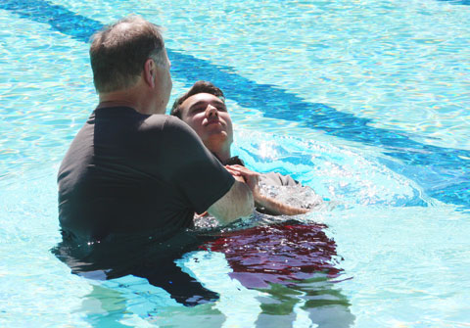
Acts 22:16—¹⁶ Now why do you delay? Get up and be baptized, and wash away your sins, calling on His name.’ (NASB)

