Slide 1
Be
Useful

Slide 2
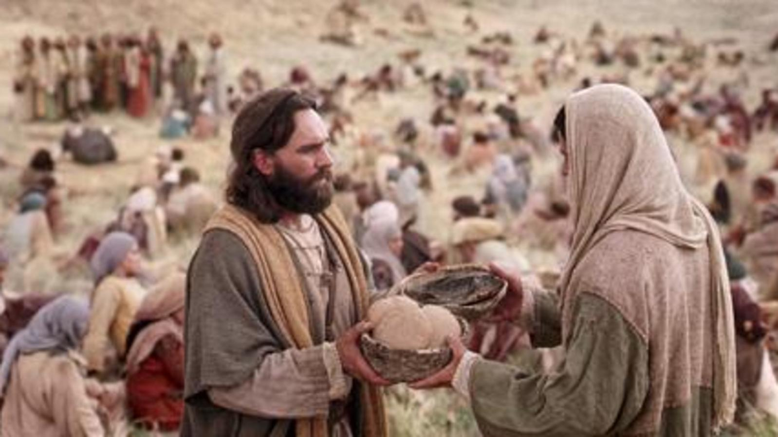
The gravy train stalled—John 6.
The crowds after the Feeding of the 5000 did not find Jesus’ invitation useful.

Slide 3
The gravy train stalled—John 6.
The food? “Yes.”

Slide 4
The gravy train stalled—John 6.
The food? “Yes.”
But, “Eat my flesh and drink my blood,” was madness to them.

Slide 5
Maturity brings greater Usefulness

Slide 6
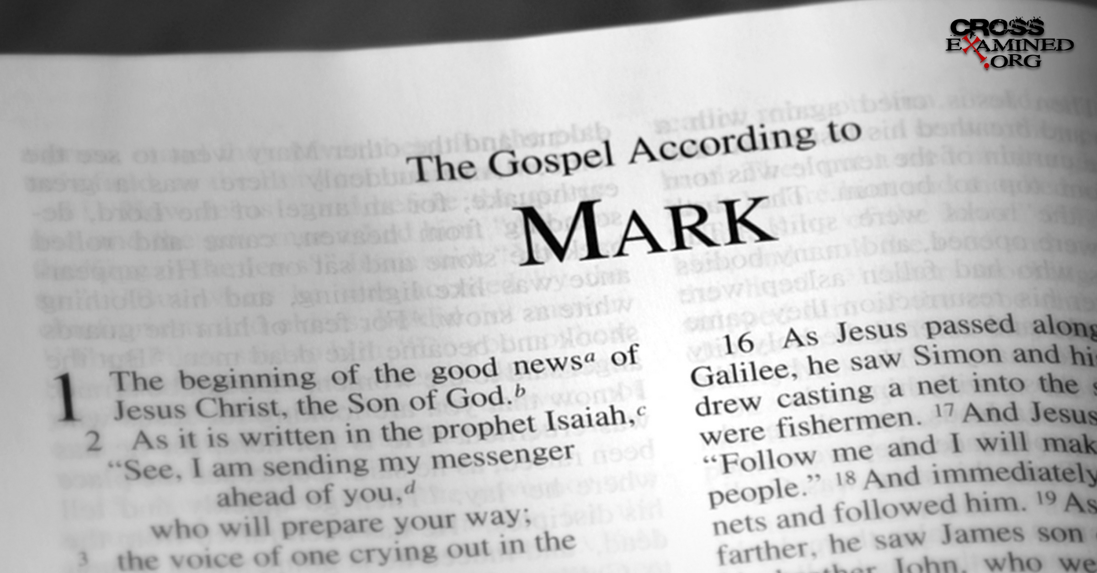
Maturity brings greater Usefulness
John Mark

Slide 7
Maturity brings greater Usefulness
John Mark abandoned the mission (Acts 13:13)
Paul said, “No!’ to taking him again (Acts 15:38)
(Col.4:10)
(2Tim.4:11)
Acts 13:13
¹³Now Paul and his companions put out to sea from Paphos and came to Perga in Pamphylia; but John left them and returned to Jerusalem.

Slide 8
Maturity brings greater Usefulness
John Mark abandoned the mission (Acts 13:13)
Paul said, “No!’ to taking him again (Acts 15:38)
(Col.4:10)
(2Tim.4:11)
Acts 15:38
³⁸ But Paul kept insisting that they should not take him along who had deserted them in Pamphylia and had not gone with them to the work.

Slide 9
Maturity brings greater Usefulness
John Mark abandoned the mission (Acts 13:13)
Paul said, “No!’ to taking him again (Acts 15:38)
(Col.4:10)
(2Tim.4:11)
Colossians 4:10-11
¹⁰Aristarchus, my fellow prisoner, sends you his greetings; and also Barnabas’s cousin Mark (about whom you received instructions; if he comes to you, welcome him);

Slide 10
Maturity brings greater Usefulness
John Mark abandoned the mission (Acts 13:13)
Paul said, “No!’ to taking him again (Acts 15:38)
(Col.4:10)
(2Tim.4:11)
2 Timothy 4:11
¹¹ Only Luke is with me. Pick up Mark and bring him with you, for he is useful to me for service.

Slide 11

Onesimus—Useful
Philemon 10-13—
¹⁰ I appeal to you for my child Onesimus, whom I have begotten in my imprisonment ¹¹who formerly was useless to you, but now is useful both to you and to me. ¹² I have sent him back to you in person, that is, sending my very heart, ¹³ whom I wished to keep with me, so that on your behalf he might minister to me in my imprisonment for the gospel;

Slide 12
Useful to the Master
2 Timothy 2:20-21
²⁰Now in a large house there are not only gold and silver vessels, but also vessels of wood and of earthenware, and some to honour and some to dishonour. ²¹Therefore, if anyone cleanses himself from these things, he will be a vessel for honour, sanctified, useful to the Master, prepared for every good work. (NASB95)

Slide 13
Useful—Ready
Matthew 24:44
For this reason you also must be ready; for the Son of Man is coming at an hour when you do not think He will. (NASB95)
If I am not ready
It is highly unlikely that I am useful in preparing others
I need help…

Slide 14
Useful—Ready
Matthew 24:44
For this reason you also must be ready; for the Son of Man is coming at an hour when you do not think He will. (NASB95)
If I am not ready
It is highly unlikely that I am useful in preparing others
I need help…

Slide 15
Useful—Ready
Matthew 24:44
For this reason you also must be ready; for the Son of Man is coming at an hour when you do not think He will. (NASB95)
If I am not ready
It is highly unlikely that I am useful in preparing others
I need help…

Slide 16
Useful—Ready
Matthew 24:44
For this reason you also must be ready; for the Son of Man is coming at an hour when you do not think He will. (NASB95)
If I am not ready
It is highly unlikely that I am useful in preparing others
I need help…

Slide 17
Useful—Ready to give account
1 Peter 3:15
but sanctify Christ as Lord in your hearts, always being ready to make a defense to everyone who asks you to give an account for the hope that is in you, yet with gentleness and reverence; (NASB95)

Slide 18
Useful—Ready to give account
1 Peter 3:15
but sanctify Christ as Lord in your hearts, always being ready to make a defense to everyone who asks you to give an account for the hope that is in you, yet with gentleness and reverence; (NASB95)

Slide 19
Useful—Ready to give account
1 Peter 3:15
but sanctify Christ as Lord in your hearts, always being ready to make a defense to everyone who asks you to give an account for the hope that is in you, yet with gentleness and reverence; (NASB95)
If Christ is not the “Holy Lord” in your heart you will be defending other things that make up your ‘Hope.’

Slide 20
Useful—Ready to give account
1 Peter 3:15
but sanctify Christ as Lord in your hearts, always being ready to make a defense to everyone who asks you to give an account for the hope that is in you, yet with gentleness and reverence; (NASB95)
If Christ is not the “Holy Lord” in your heart you will be defending other things that make up your ‘Hope.’
Always READY…

Slide 21
Useful—Ready to give account
1 Peter 3:15
but sanctify Christ as Lord in your hearts, always being ready to make a defense to everyone who asks you to give an account for the hope that is in you, yet with gentleness and reverence; (NASB95)
If Christ is not the “Holy Lord” in your heart you will be defending other things that make up your ‘Hope.’
Always READY…
Armour up!

Slide 22
Useful—Armour Up—Eph.6
¹³ Therefore put on the full armour of God,
so that when the day of evil comes, you may be able to stand your ground,…
¹⁴ …belt of truth buckled around your waist,
…breastplate of righteousness in place,
¹⁵…your feet fitted with the readiness that comes from the gospel of peace.
¹⁶…shield of faith, with which you can extinguish all the flaming arrows of the evil one.
¹⁷helmet of salvation
the sword of the Spirit, which is the word of God.

Slide 23
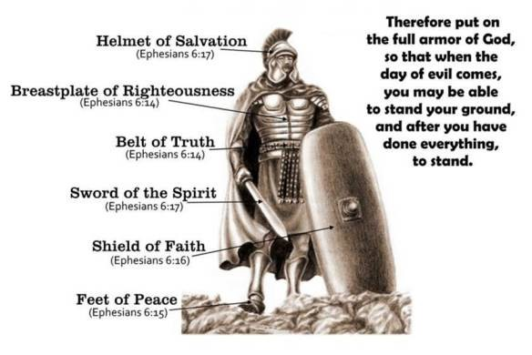
Useful—Armour Up—Eph.6

Slide 24
Useful—Armour Up—Eph.6
¹⁴ …Belt of truth buckled around your waist,

Slide 25
Useful—Armour Up—Eph.6
¹⁴ …Belt of truth buckled around your waist,
…Breastplate of righteousness in place,

Slide 26
Useful—Armour Up—Eph.6
¹⁴ …Belt of truth buckled around your waist,
…Breastplate of righteousness in place,
¹⁵…your feet fitted with the readiness that comes from the gospel of peace.

Slide 27
Useful—Armour Up—Eph.6
¹⁴ …Belt of truth buckled around your waist,
…Breastplate of righteousness in place,
¹⁵…your feet fitted with the readiness that comes from the gospel of peace.
¹⁶…Shield of faith, with which you can extinguish all the flaming arrows of the evil one.

Slide 28
Useful—Armour Up—Eph.6
¹⁴ …Belt of truth buckled around your waist,
…Breastplate of righteousness in place,
¹⁵…your feet fitted with the readiness that comes from the gospel of peace.
¹⁶…Shield of faith, with which you can extinguish all the flaming arrows of the evil one.
¹⁷Helmet of salvation

Slide 29
Useful—Armour Up—Eph.6
¹⁴ …Belt of truth buckled around your waist,
…Breastplate of righteousness in place,
¹⁵…your feet fitted with the readiness that comes from the gospel of peace.
¹⁶…Shield of faith, with which you can extinguish all the flaming arrows of the evil one.
¹⁷Helmet of salvation
Sword of the Spirit, which is the word of God.

Slide 30
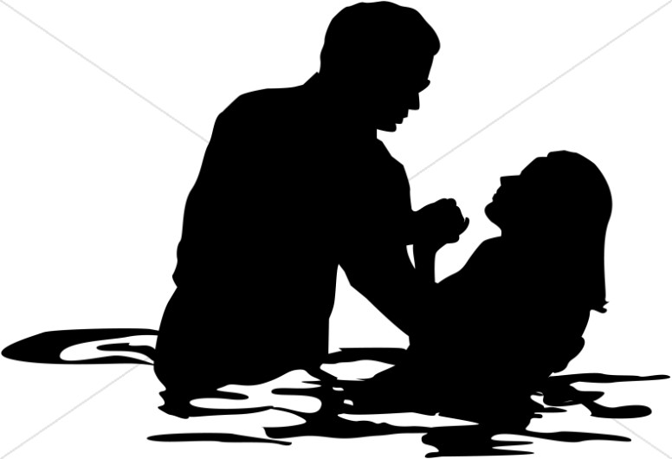
Acts 2:38—
³⁸Peter replied, “Repent and be baptized, every one of you, in the name of Jesus Christ for the forgiveness of your sins. And you will receive the gift of the Holy Spirit.

