Slide 1
Greatness Within

Slide 2
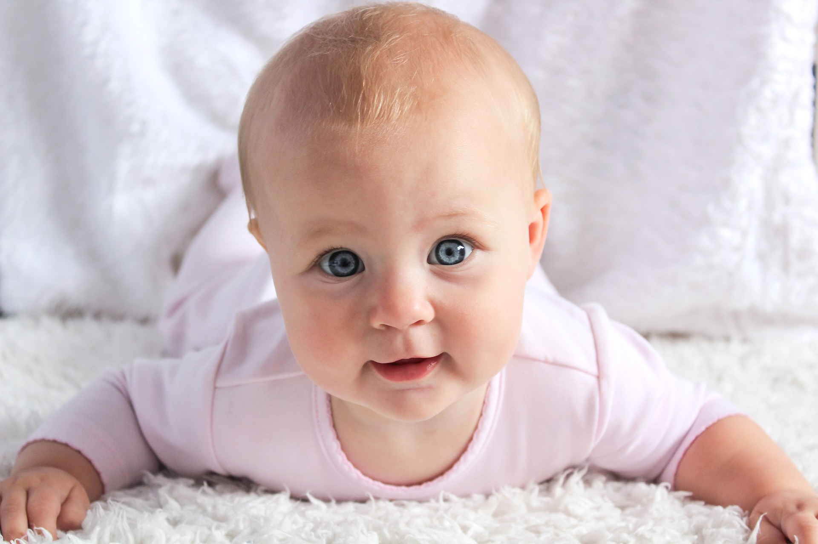
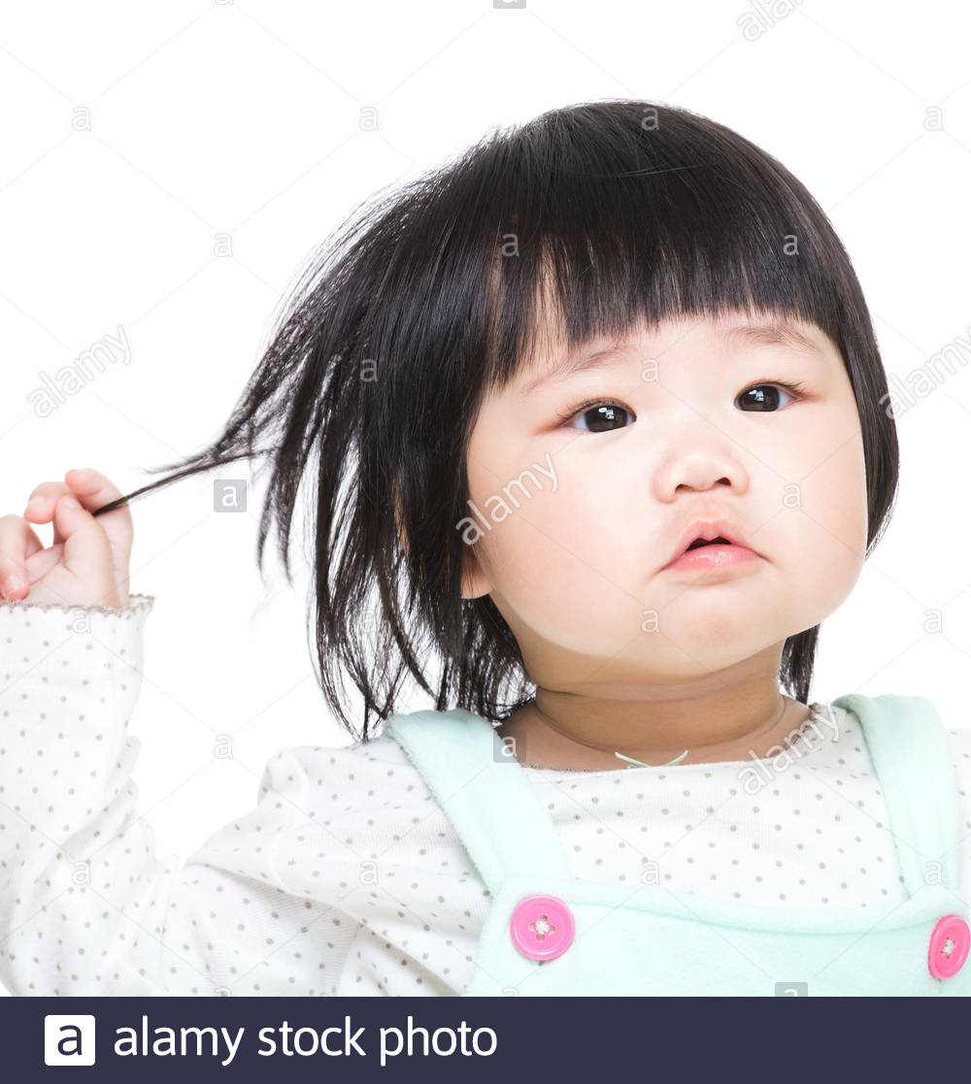
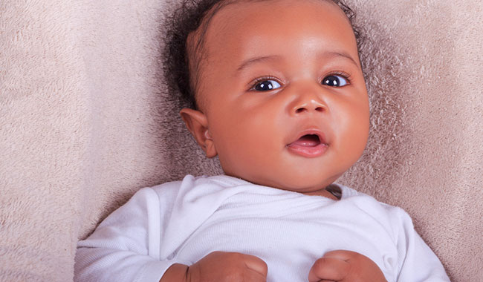
Every child born has the seeds of
Greatness within
in
God’s eyes

Slide 3
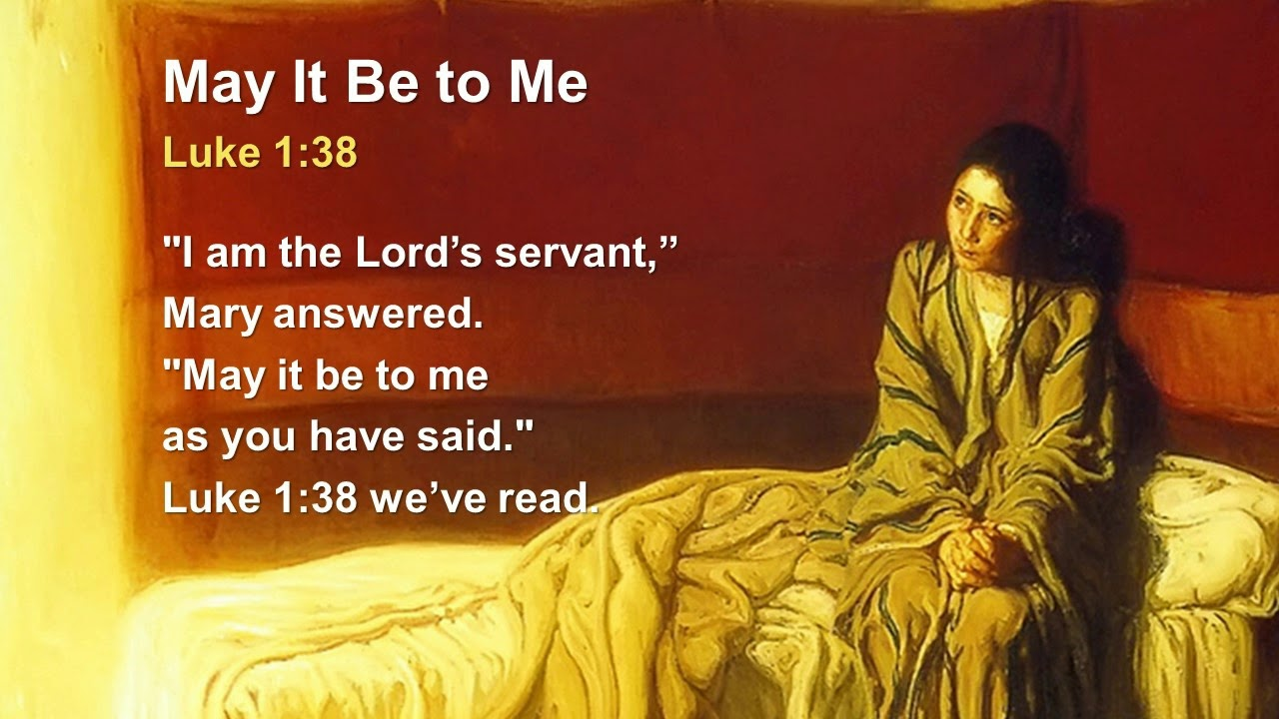
Mary

Slide 4
Mary
Selected by God to raise Jesus—Saviour of the world.

Slide 5
Mary
Selected by God to raise Jesus—Saviour of the world.
Her response to God’s call through Gabriel..?

Slide 6
Mary

Slide 7
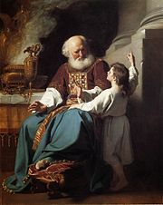
Samuel

Slide 8
Samuel
Gifted to Hannah

Slide 9
Samuel
Gifted to Hannah
Gifted to God

Slide 10
Samuel
Gifted to Hannah
Gifted to God
Faithful unto God

Slide 11
Samuel
Gifted to Hannah
Gifted to God
Faithful unto God
Great Priest, Prophet and (last) Judge of Israel

Slide 12
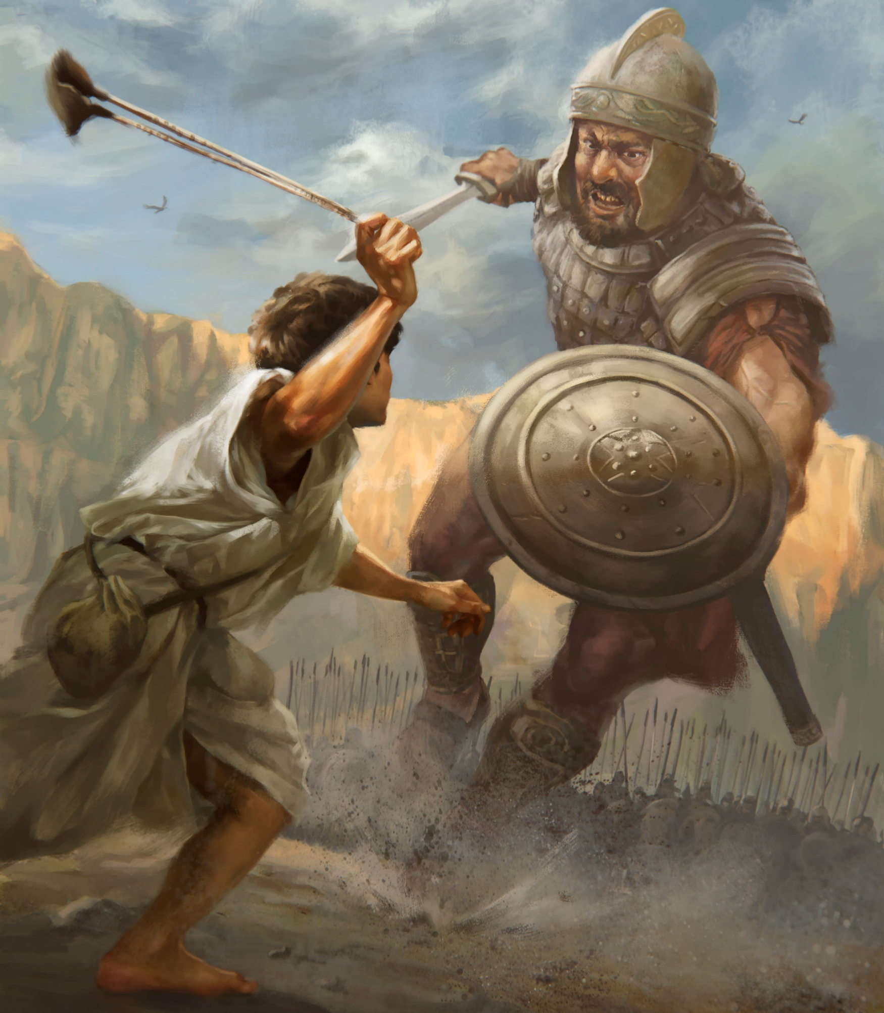
David

Slide 13
David
1Sam.17:37—³⁷And David said, “The Lord who delivered me from the paw of the lion and from the paw of the bear, He will deliver me from the hand of this Philistine.” (NASB95)

Slide 14

Preparation is Key

Slide 15
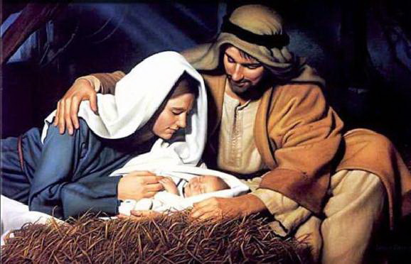
Preparation is Key
God put Jesus into the hands of Joseph and Mary

Slide 16
Preparation is Key
God put Samuel into the hands of Eli

Slide 17
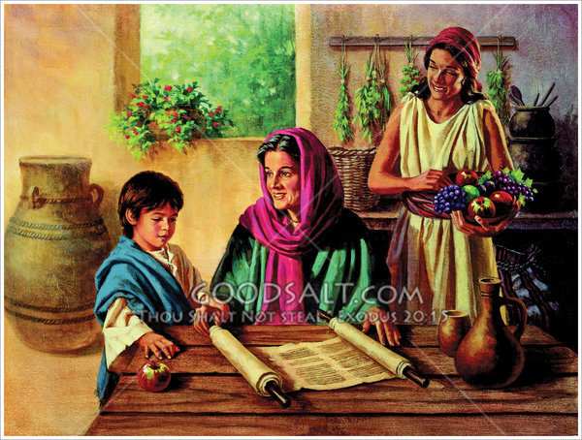
Preparation is Key
God put Timothy into the hands of Lois and Eunice

Slide 18

Don’t waste time

Slide 19

Don’t waste time
We get one go at this

Slide 20

Don’t waste time
Years flick by…

Slide 21
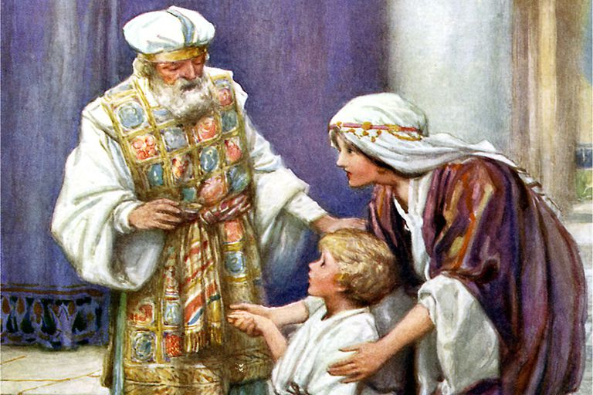
Don’t waste time
Future parents:
  Pray for the Heart of ‘Hannah’ or ‘Mary.’

Slide 22
Don’t waste time
Parents and Grandparents of little ones:
  Pray for the diligence of ‘Lois and Eunice’

Slide 23
Don’t waste time
  Pray for the skill and faithfulness of an Eli—
    He was not perfect
    He had issues with his own kids
    But he obviously did a lot of things right in Samuel’s case.

Slide 24
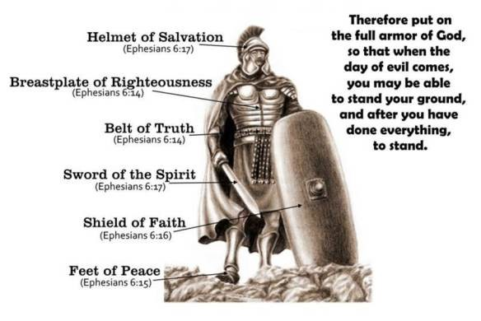
Armour Up—Ephesians 6

Slide 25

Acts 2:38—
³⁸Peter replied, “Repent and be baptized, every one of you, in the name of Jesus Christ for the forgiveness of your sins. And you will receive the gift of the Holy Spirit.

Slide 26
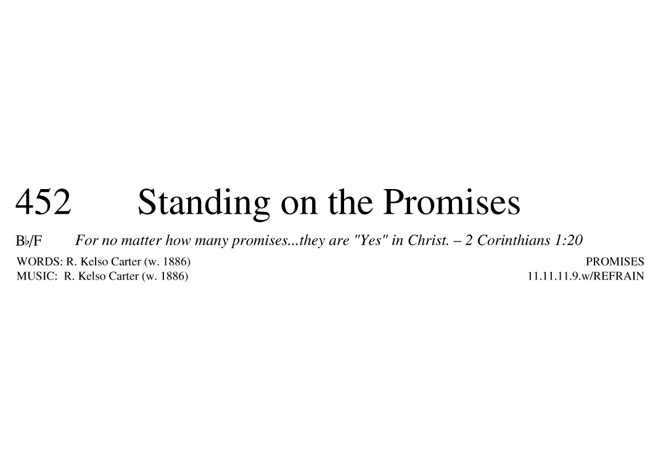
CCLI # 243919

Slide 27
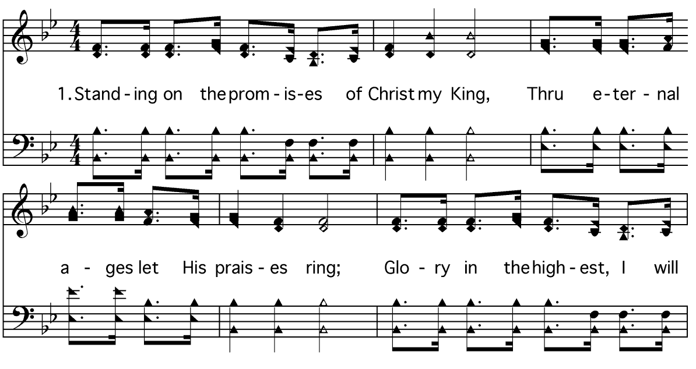
Slide 0452-01-01

Slide 28
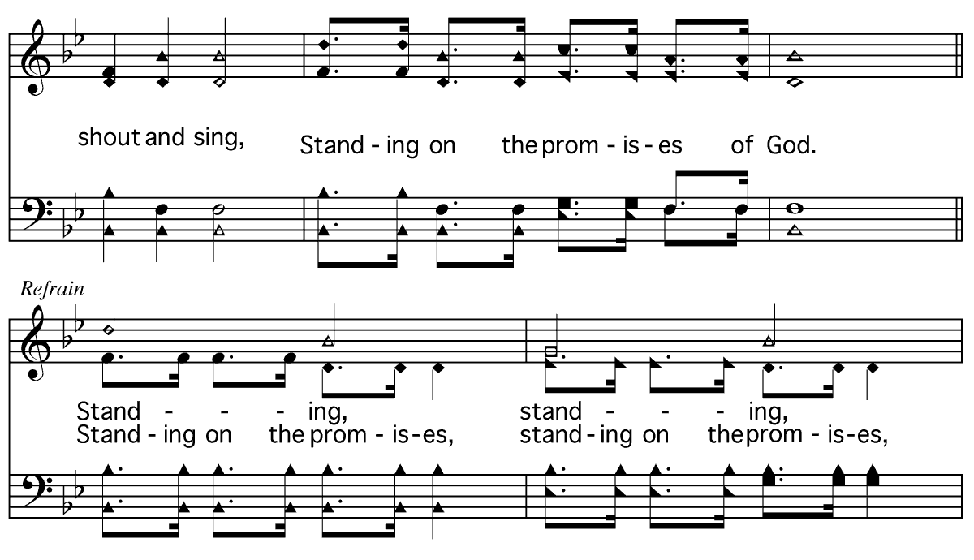
Slide 0452-01-02

Slide 29
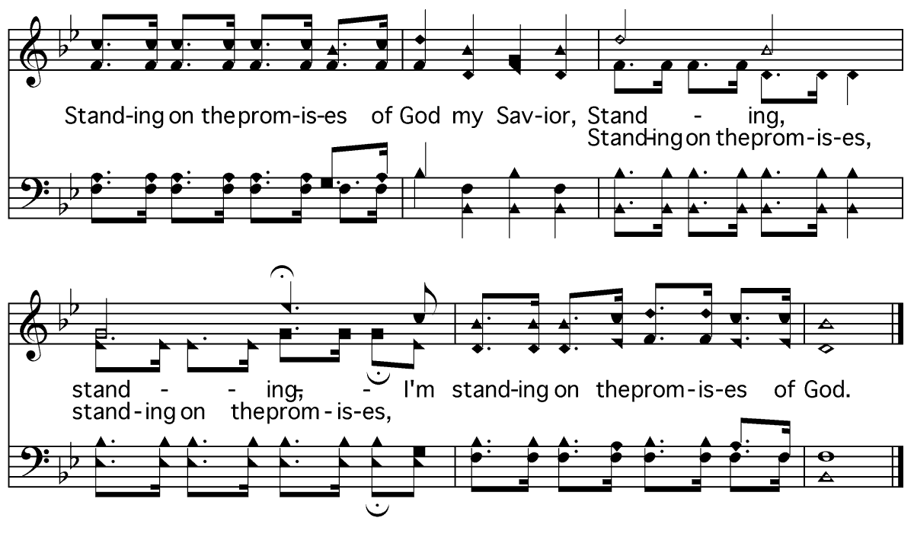
Slide 0452-01-03

Slide 30
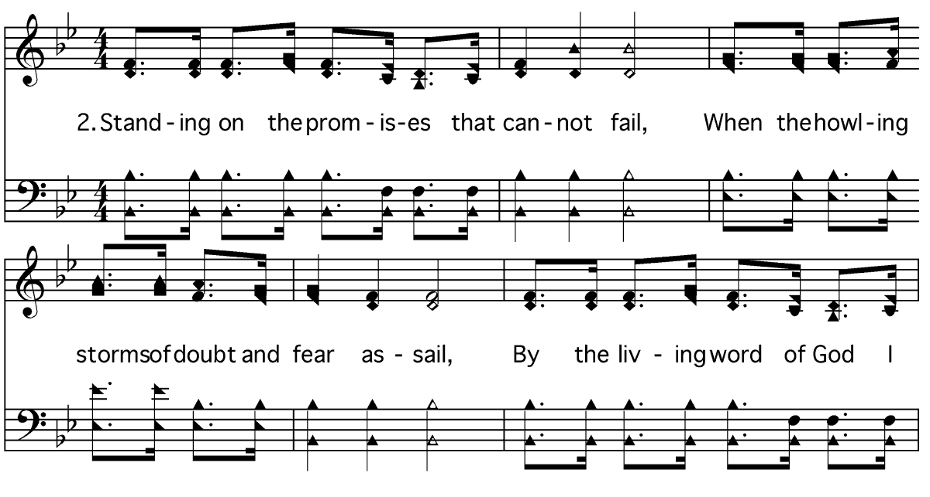
Slide 0452-02-01

Slide 31
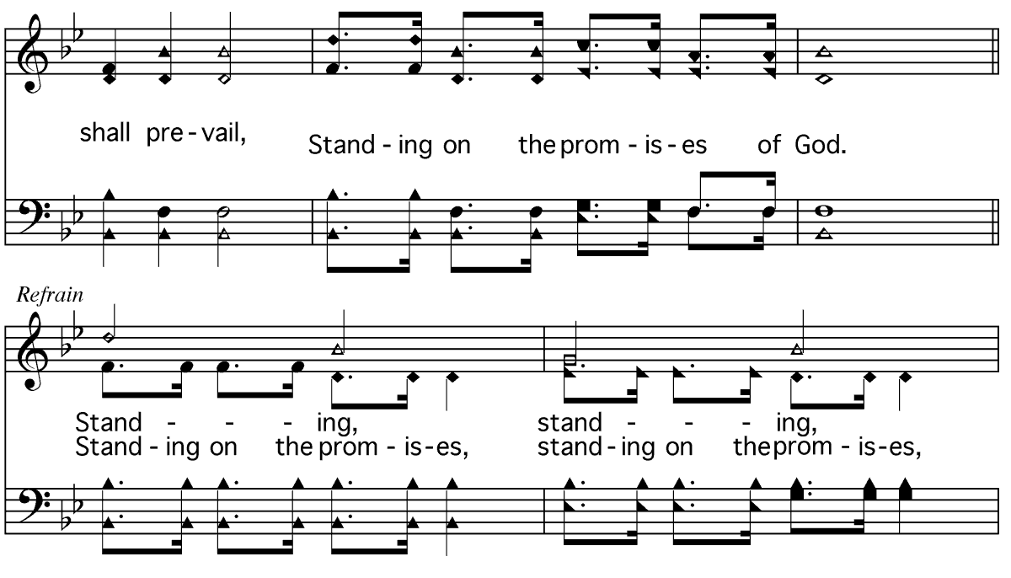
Slide 0452-02-02

Slide 32
Slide 0452-02-03

Slide 33
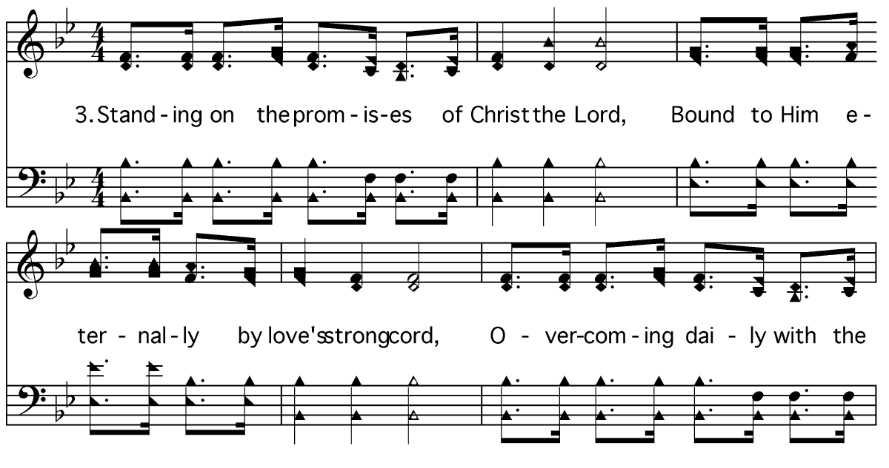
Slide 0452-03-01

Slide 34
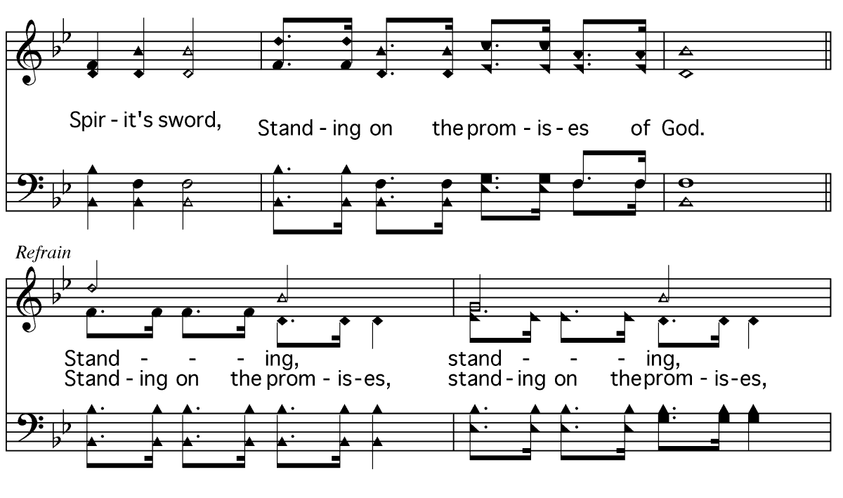
Slide 0452-03-02

Slide 35
Slide 0452-03-03

Slide 36
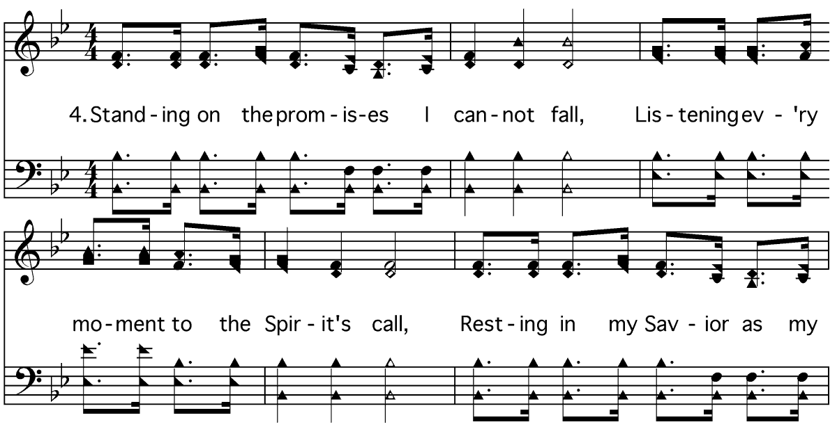
Slide 0452-04-01

Slide 37
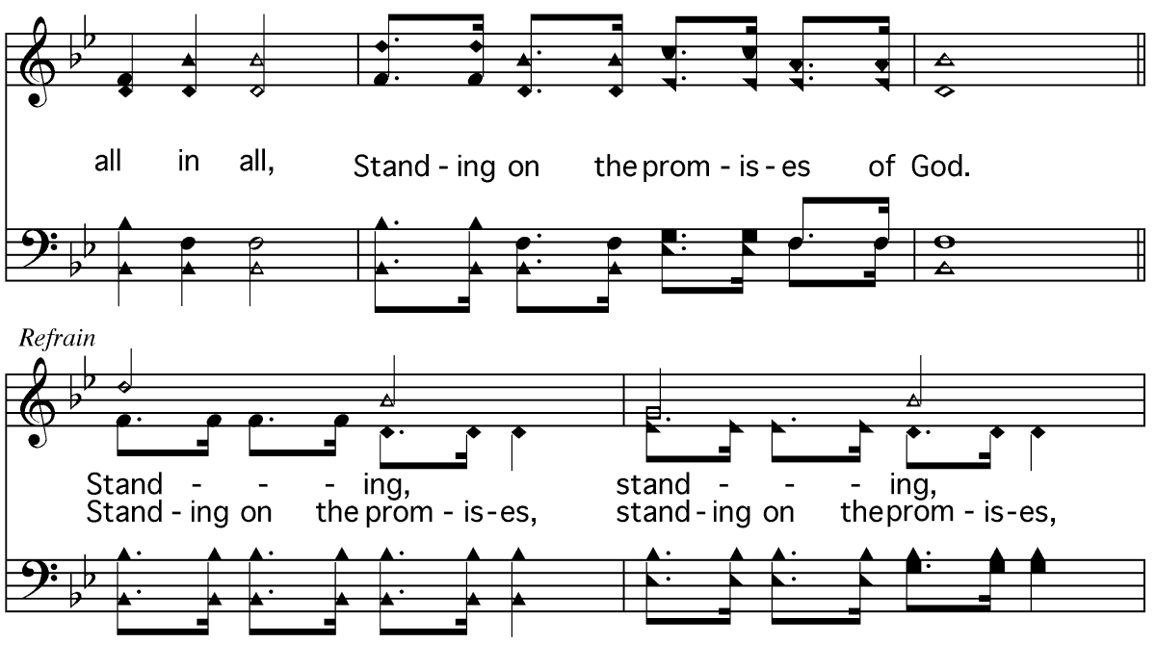
Slide 0452-04-02

Slide 38
Slide 0452-04-03

Slide 39
Closing Prayer
Louren

Slide 40
Announcements
Thank you for Visiting with us
16th Dec – Final mid-week class for year at the building
10th Jan – Combined Fellowship 6:00pm @ South Auckland

