Slide 1
“Invisible Good.”
John Staiger
Morningside Church of Christ
Sunday 22 November 2020
PM Sermon
Broadcast on Facebook Live from
42 Leslie Ave, Sandringham.

Slide 2
Invisible Good

Slide 3
Acts of Righteousness

Slide 4

Acts of Righteousness

Slide 5
Acts of Righteousness
Matthew 6:1—
“Beware of practicing your righteousness before men to be noticed by them; otherwise you have no reward with your Father who is in heaven. (NASB95)

Slide 6
Acts of Righteousness
Charitable acts—v.2-4.
Prayer—v.5-15.
Fasting—v.16-18
Solution—v,19-24

Slide 7

Acts of Righteousness
Charitable acts—v.2-4.
Prayer—v.5-15.
Fasting—v.16-18
Solution—v,19-24

Slide 8
Acts of Righteousness
Prayer—v.5-15.
Fasting—v.16-18
Solution—v,19-24

Slide 9
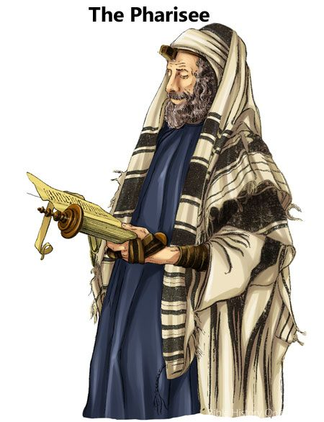
Acts of Righteousness
Prayer—v.5-15.
Fasting—v.16-18
Solution—v,19-24
Mt.6:5—⁵“And when you pray, do not be like the hypocrites, for they love to pray standing in the synagogues and on the street corners to be seen by others. Truly I tell you, they have received their reward in full. (NIV)

Slide 10

Acts of Righteousness
Prayer—v.5-15.
Fasting—v.16-18
Solution—v,19-24
Mt.6:6—⁶ But when you pray, go into your room, close the door and pray to your Father, who is unseen. Then your Father, who sees what is done in secret, will reward you. (NIV)

Slide 11
Acts of Righteousness
Fasting—v.16-18
Solution—v.19-24

Slide 12

Acts of Righteousness
Fasting—v.16-18
Solution—v.19-24

Slide 13
Acts of Righteousness
Solution—v,19-24

Slide 14
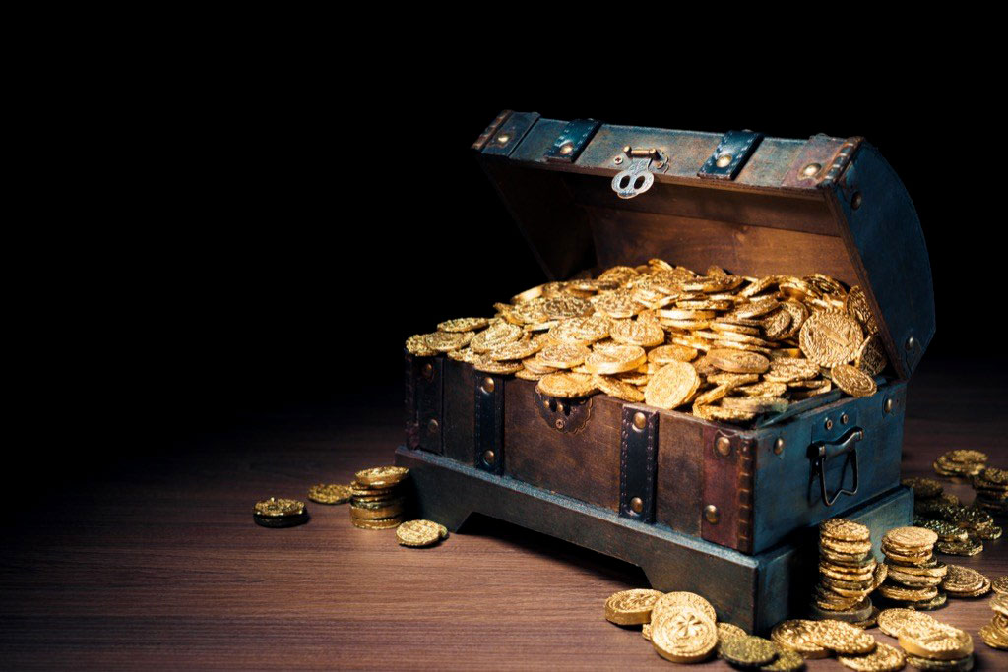

Acts of Righteousness
Solution—v,19-24

Slide 15
Acts of Righteousness
Solution—v,19-24
Matthew 6:20-21—²⁰But store up for yourselves treasures in heaven,…²¹For where your treasure is, there your heart will be also. (NIV)

Slide 16
As secret as possible

Slide 17
As secret as possible
1 Tim.5:24-25

Slide 18
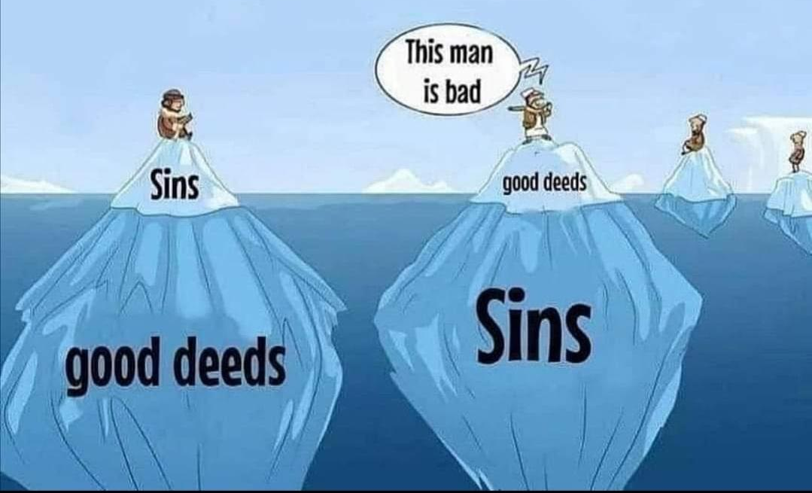
As secret as possible
1 Tim.5:24-25

Slide 19
As secret as possible
1 Tim.5:24-25
1 Timothy 5:24-25—²⁴The sins of some are obvious, reaching the place of judgment ahead of them; the sins of others trail behind them. ²⁵In the same way, good deeds are obvious, and even those that are not obvious cannot remain hidden forever. (NIV)

Slide 20
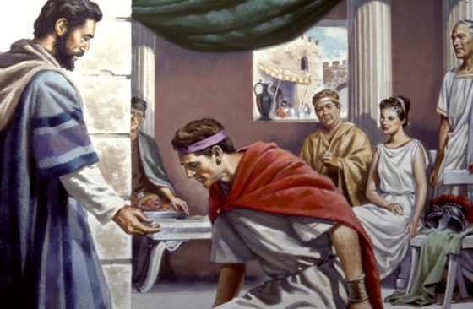
As secret as possible
Peter at CORNELIUS’ home
Acts 10:38

Slide 21
As secret as possible
Peter at CORNELIUS’ home
Acts 10:38 Jesus miracles were obvious
  Witnesses
  To bring glory to God
Acts 10:38—³⁸You know of Jesus of Nazareth, how God anointed Him with the Holy Spirit and with power, and how He went about doing good and healing all who were oppressed by the devil, (NASB95)

Slide 22
As secret as possible
Peter at CORNELIUS’ home
Acts 10:38 Jesus miracles were obvious
Acts 10:38—³⁸You know of Jesus of Nazareth, how God anointed Him with the Holy Spirit and with power, and how He went about doing good and healing all who were oppressed by the devil, (NASB95)

Slide 23
As secret as possible
Peter at CORNELIUS’ home
Acts 10:38 Jesus miracles were obvious
  Witnesses
  To bring glory to God
Acts 10:38—³⁸You know of Jesus of Nazareth, how God anointed Him with the Holy Spirit and with power, and how He went about doing good and healing all who were oppressed by the devil, (NASB95)

Slide 24
As secret as possible
Peter at CORNELIUS’ home
Acts 10:38 Jesus miracles were obvious
  Witnesses
  To bring glory to God
Acts 10:38—³⁸You know of Jesus of Nazareth, how God anointed Him with the Holy Spirit and with power, and how He went about doing good and healing all who were oppressed by the devil, (NASB95)

Slide 25
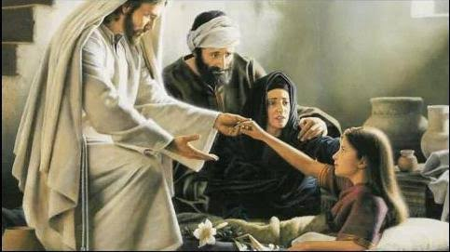
As secret as possible
Jesus at Jairus’ home
Luke 8:56 Jesus told some not to tell anyone
  Jairus’ daughter
  They did anyway
  Restricted his movements
  Always the message over the miracles

Slide 26
As secret as possible
Luke 8:56—⁵⁶Her parents were astonished, but he ordered them not to tell anyone what had happened. (NIV)
Luke 8:56 Jesus told some not to tell anyone
  Jairus’ daughter
  They did anyway
  Restricted his movements
  Always the message over the miracles

Slide 27
As secret as possible
Luke 8:56—⁵⁶Her parents were astonished, but he ordered them not to tell anyone what had happened. (NIV)
Luke 8:56 Jesus told some not to tell anyone
  Jairus’ daughter
  They did anyway
  Restricted his movements
  Always the message over the miracles

Slide 28
As secret as possible
Luke 8:56—⁵⁶Her parents were astonished, but he ordered them not to tell anyone what had happened. (NIV)
Luke 8:56 Jesus told some not to tell anyone
  Jairus’ daughter
  They did anyway
  Restricted his movements
  Always the message over the miracles

Slide 29
As secret as possible
Luke 8:56—⁵⁶Her parents were astonished, but he ordered them not to tell anyone what had happened. (NIV)
Luke 8:56 Jesus told some not to tell anyone
  Jairus’ daughter
  They did anyway
  Restricted his movements
  Always the message over the miracles

Slide 30
As secret as possible
Luke 8:56—⁵⁶Her parents were astonished, but he ordered them not to tell anyone what had happened. (NIV)
Luke 8:56 Jesus told some not to tell anyone
  Jairus’ daughter
  They did anyway
  Restricted his movements
  Always the message over the miracles

Slide 31
As secret as possible
Luke 8:56—⁵⁶Her parents were astonished, but he ordered them not to tell anyone what had happened. (NIV)
Luke 8:56 Jesus told some not to tell anyone
  Jairus’ daughter
  They did anyway
  Restricted his movements
  Always the message over the miracles

Slide 32
Checking my Motives

Slide 33
Checking my Motives
Who is this for?

Slide 34
Checking my Motives
If no one knew about this would I do it?

Slide 35
Checking my Motives
Is this for earthly credit or heavenly credit?

Slide 36

Checking my Motives
If I were to ask God for a sorting of my good deeds and which side of the balance would each land—how might I do?

