Slide 1
Welcome
To
Morningside
Church of Christ
10 December 2020

Slide 2
Wiser Builders

Slide 3
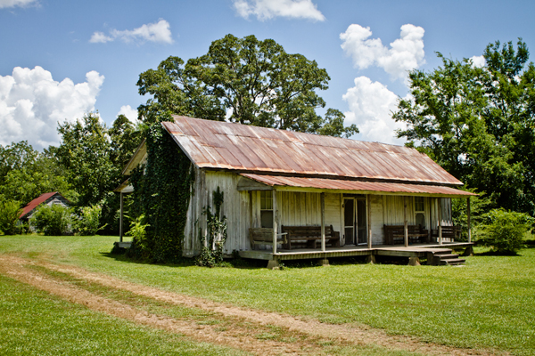
Where you live may be decided for you

Slide 4
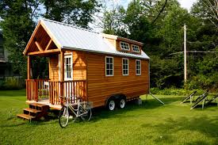
Do we envy those who find this more than enough?

Slide 5
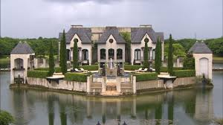
Do we envy those who find this more than enough?

Slide 6

Don’t forget the inside…

Slide 7

Who is your builder?

Slide 8
Who is your builder?
Psalm 127:1—
Unless the Lord builds the house,
They labour in vain who build it;

Slide 9
Who is your builder?
Psalm 127:1—
Unless the Lord builds the house,
They labour in vain who build it;
Unless the Lord guards the city,
The watchman keeps awake in vain.

Slide 10
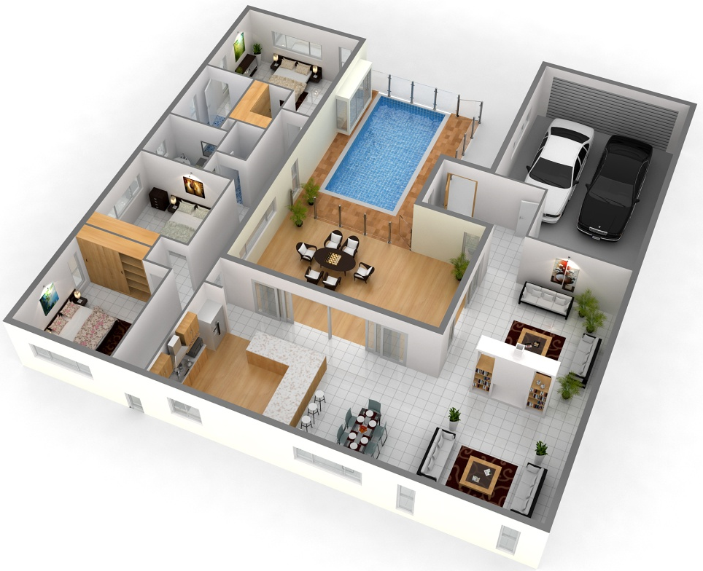
That which fills your home

Slide 11
Proverbs 24:3-4—³By wisdom a house is built, and through understanding it is established; ⁴through knowledge its rooms are filled with rare and beautiful treasures.

Slide 12
The physical contents of your house will say a lot about you

Slide 13
The physical contents of your house will say a lot about you
Ultimately, it is between you and God.

Slide 14
The physical contents of your house will say a lot about you
Ultimately, it is between you and God.
They are tools for your work in the church

Slide 15

The spiritual contents of your house will say a lot about you

Slide 16
The spiritual contents of your house will say a lot about you
What you put in is what will be available to use:

Slide 17
The spiritual contents of your house will say a lot about you
Family time
Hospitality
Outreach
Encouragement
Benevolence
Bible groups
Birthdays
Counselling

Slide 18

The spiritual contents of your house will say a lot about you
Love,
joy,
peace,
patience,
kindness,
Goodness,
Faithfulness,
Gentleness,
self-control;
Galatians 5:22-23

Slide 19
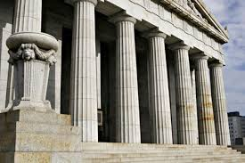
Proverbs 9:1—Wisdom has built her house; she has hewn out its seven pillars.

Slide 20

Proverbs 14:1—The wise woman builds her house,
But the foolish tears it down with her own hands. (NASB95)

Slide 21

Proverbs 14:1—The wise woman builds her house,
But the foolish tears it down with her own hands. (NASB95)

Slide 22
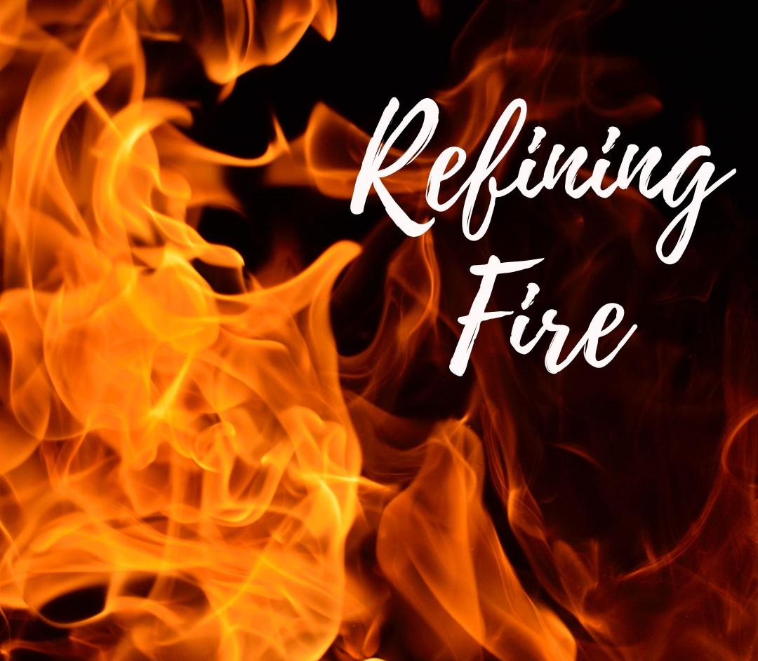

Slide 23
1 Corinthians 3:11-13
11 For no one can lay any foundation other than the one already laid, which is Jesus Christ.

Slide 24
1 Corinthians 3:11-13
11 For no one can lay any foundation other than the one already laid, which is Jesus Christ.
12 If any man builds on this foundation using gold, silver, costly stones, wood, hay or straw,

Slide 25
1 Corinthians 3:11-13
11 For no one can lay any foundation other than the one already laid, which is Jesus Christ.
12 If any man builds on this foundation using gold, silver, costly stones, wood, hay or straw,
13 his work will be shown for what it is, because the Day will bring it to light. It will be revealed with fire, and the fire will test the quality of each man's work.

Slide 26
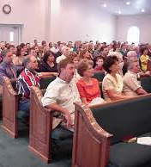
Ephesians 3:10
10 His intent was that now, through the church, the manifold wisdom of God should be made known to the rulers and authorities in the heavenly realms,

Slide 27
1 Corinthians 3:14-17
14 If what he has built survives, he will receive his reward.

Slide 28
1 Corinthians 3:14-17
14 If what he has built survives, he will receive his reward.
15 If it is burned up, he will suffer loss; he himself will be saved, but only as one escaping through the flames.

Slide 29
1 Corinthians 3:14-17
14 If what he has built survives, he will receive his reward.
15 If it is burned up, he will suffer loss; he himself will be saved, but only as one escaping through the flames.
16 Don't you know that you yourselves are God's temple and that God's Spirit lives in you?

Slide 30
1 Corinthians 3:14-17
14 If what he has built survives, he will receive his reward.
15 If it is burned up, he will suffer loss; he himself will be saved, but only as one escaping through the flames.
16 Don't you know that you yourselves are God's temple and that God's Spirit lives in you?
17 If anyone destroys God's temple, God will destroy him; for God's temple is sacred, and you are that temple.

Slide 31
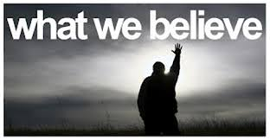
1 Timothy 3:15
15 if I am delayed, you will know how people ought to conduct themselves in God's household, which is the church of the living God, the pillar and foundation of the truth.

