Slide 1
“Worthy of the Calling of God Part 1.”
John Staiger
Morningside Church of Christ
Sunday 27 September 2020
AM Sermon
Broadcast on Facebook Live from
42 Leslie Ave, Sandringham.

Slide 2
Worthy of the
Calling of
God
Part 1.

Slide 3


Slide 4

Who…?
2 Thessalonians 1:11-12—¹¹To this end also we pray for you always, that our God will ^{[a]}count you worthy of your calling, and fulfill every desire for goodness and the work of faith with power, ¹²so that the name of our Lord Jesus will be glorified in you, and you in Him, according to the grace of our God and the Lord Jesus Christ. (NASB95) [a] Or make

Slide 5
Who…?
The Highest of Callings
A Calling to live and proclaim the message of rescue.
To Deliver the message of salvation
Only the Church is called to deliver this soul-saving message.

Slide 6
Who…?
The Highest of Callings
A Calling to live and proclaim the message of rescue.
To Deliver the message of salvation
Only the Church is called to deliver this soul-saving message.

Slide 7
Who…?
The Highest of Callings
A Calling to live and proclaim the message of rescue.
To Deliver the message of salvation
Only the Church is called to deliver this soul-saving message.

Slide 8
Who…?
The Highest of Callings
A Calling to live and proclaim the message of rescue.
To Deliver the message of salvation
Only the Church is called to deliver this soul-saving message.

Slide 9
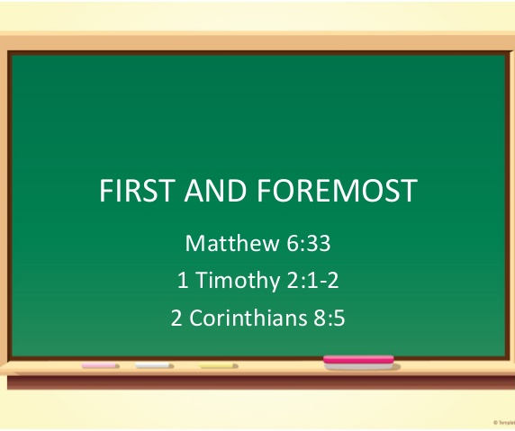

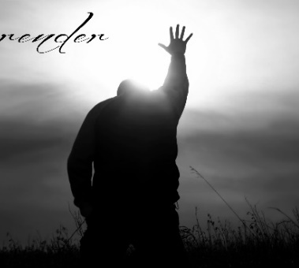
Matthew 10:37-39—
³⁷“He who loves father or mother more than Me is not worthy of Me; and he who loves son or daughter more than Me is not worthy of Me. ³⁸And he who does not take his cross and follow after Me is not worthy of Me. ³⁹He who has found his ^{[a]}life will lose it, and he who has lost his ^{[b]}life for My sake will find it. (NASB95) [a]Or soul [b]Or soul

Slide 10
A hard message from Jesus

Slide 11
In a day when
church
must fit
around
our schedules.

Slide 12
Our calling comes ahead of:
  Family relationships
  Your own life
  Ahead of all other values and loves
  Before every Person
  Dream
  Desire
  Urge
  Need…

Slide 13
Our calling comes ahead of:
  Family relationships
  Your own life
  Ahead of all other values and loves
  Before every Person
  Dream
  Desire
  Urge
  Need…

Slide 14
Our calling comes ahead of:
  Family relationships
  Your own life
  Ahead of all other values and loves
  Before every Person
  Dream
  Desire
  Urge
  Need…
Galatians 2:20—
²⁰I have been crucified with Christ; and it is no longer I who live, but Christ lives in me; and the life which I now live in the flesh I live by faith in the Son of God, who loved me and gave Himself up for me. (NASB95)

Slide 15
Our calling comes ahead of:
  Family relationships
  Your own life
  Ahead of all other values and loves
  Before every Person
  Dream
  Desire
  Urge
  Need…
Galatians 2:20—
²⁰I have been crucified with Christ; and it is no longer I who live, but Christ lives in me; and the life which I now live in the flesh I live by faith in the Son of God, who loved me and gave Himself up for me. (NASB95)

Slide 16
Our calling comes ahead of:
  Family relationships
  Your own life
  Ahead of all other values and loves
  Before every Person
  Dream
  Desire
  Urge
  Need…

Slide 17
Our calling comes ahead of:
  Family relationships
  Your own life
  Ahead of all other values and loves
  Before every Person
  Dream
  Desire
  Urge
  Need…

Slide 18
Our calling comes ahead of:
  Family relationships
  Your own life
  Ahead of all other values and loves
  Before every Person
  Dream
  Desire
  Urge
  Need…

Slide 19
Our calling comes ahead of:
  Family relationships
  Your own life
  Ahead of all other values and loves
  Before every Person
  Dream
  Desire
  Urge
  Need…

Slide 20
Our calling comes ahead of:
  Family relationships
  Your own life
  Ahead of all other values and loves
  Before every Person
  Dream
  Desire
  Urge
  Need…

Slide 21
Our calling comes ahead of:
  Family relationships
  Your own life
  Ahead of all other values and loves
  Before every Person
  Dream
  Desire
  Urge
  Need…

Slide 22
Our calling comes ahead of:
  Family relationships
  Your own life
  Ahead of all other values and loves
  Before every Person
  Dream
  Desire
  Urge
  Need…

Slide 23
Until it is, we cannot say, by Jesus’ definition, that we are worthy of His calling.
When that happens:
All the tiny questions that plague us and stall us go away.
If Jesus’ calling is first solutions appear to:
Time wasting
Spending
Relationships that pull you away
Because Jesus get’s first call – you will protect it.

Slide 24
Until it is, we cannot say, by Jesus’ definition, that we are worthy of His calling.
When that happens:
All the tiny questions that plague us and stall us go away.
If Jesus’ calling is first solutions appear to:
Time wasting
Spending
Relationships that pull you away
Because Jesus get’s first call – you will protect it.

Slide 25
Until it is, we cannot say, by Jesus’ definition, that we are worthy of His calling.
When that happens:
All the tiny questions that plague us and stall us go away.
If Jesus’ calling is first solutions appear to:
Time wasting
Spending
Relationships that pull you away
Because Jesus get’s first call – you will protect it.

Slide 26
Until it is, we cannot say, by Jesus’ definition, that we are worthy of His calling.
When that happens:
All the tiny questions that plague us and stall us go away.
If Jesus’ calling is first solutions appear to:
Time wasting
Spending
Relationships that pull you away
Because Jesus get’s first call – you will protect it.

Slide 27
Because in the great paradox of grace:
We only find true life when we lose that which is of ourselves.
If you live the life of your own choosing-that’s all you will ever have.
But if you live the life of God’s choosing-you will live that life that is worthy of it’s calling.
It’s a calling and a high task and you must decide everyday what comes first.

Slide 28
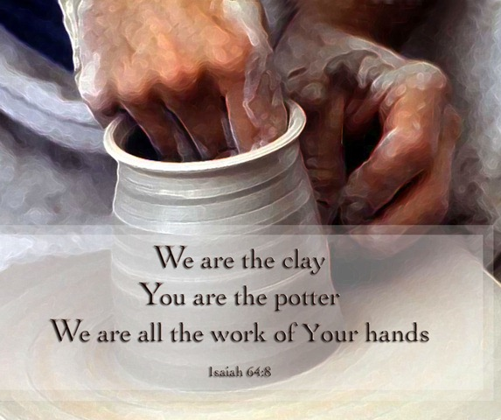

By His Power
2 Thessalonians 1:11-12—
¹¹To this end also we pray for you always, that our God will ^{[a]}count you worthy of your calling, and fulfill every desire for goodness and the work of faith with power, (NASB95)

Slide 29
By His Power
The purpose of our lives become that which God has designed us to do.

Slide 30
By His Power
Ephesians 2:10—
¹⁰For we are God’s handiwork, created in Christ Jesus to do good works, which God prepared in advance for us to do.

Slide 31
By His Power
He is the one who made us

Slide 32
By His Power
He retains ownership of our lives

Slide 33
By His Power
“Every deed prompted by faith”

Slide 34
By His Power
Things that we will only do because we have faith:

Slide 35
By His Power
He gives us power to ‘turn the other cheek’-
We are delivered from taking revenge by realizing that returning evil for evil will only perpetuate evil.

Slide 36


Jesus’ prescriptions
Are always extreme…

Slide 37
Jesus’ prescriptions
Because he wants us to be completely healed.

Slide 38
Jesus’ prescriptions
When we step out in faith we pray:

Slide 39
Jesus’ prescriptions
“God, I will do this, but you will have to provide the strength and the wisdom.”

Slide 40
Jesus’ prescriptions
When all you have is willingness, He will complete your work of faith with power.

Slide 41
Jesus’ prescriptions
When you submit to God, He provides the strength.

Slide 42
Jesus’ prescriptions
Philippians 4:13—
¹³I can do all this through him who gives me strength.

Slide 43
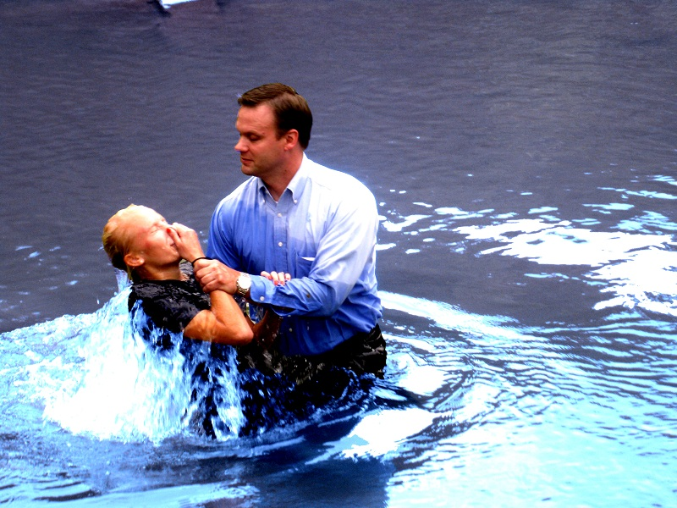
Romans 6:4—⁴ We were therefore buried with him through baptism into death in order that, just as Christ was raised from the dead through the glory of the Father, we too may live a new life.

