Slide 1
“Worthy of the Calling of God Part 2.”
John Staiger
Morningside Church of Christ
Sunday 4 October 2020
AM Sermon
Broadcast on Facebook Live from
42 Leslie Ave, Sandringham.

Slide 2
Worthy of the
Calling of
God
Part 2.

Slide 3


Slide 4
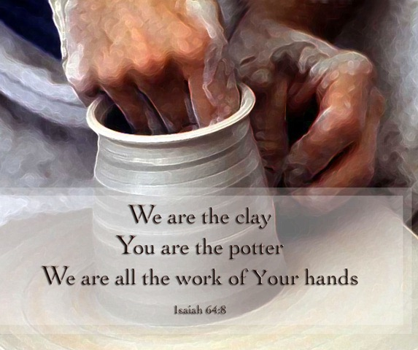

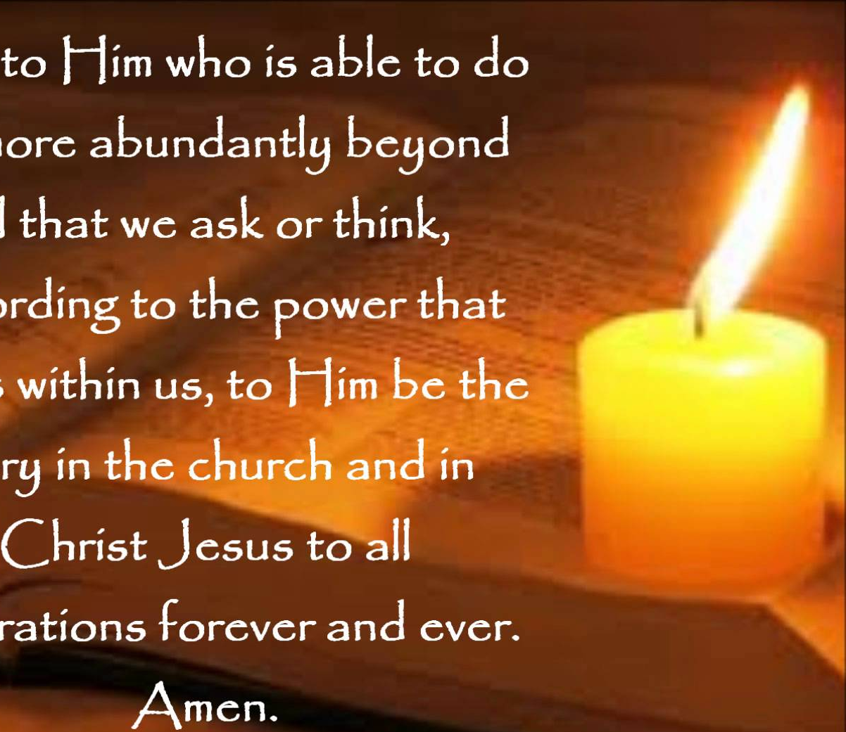
By His Power
How to NEVER be Worthy of the Calling of God:
Operate on:
Own knowledge
Own wisdom
Own power

Slide 5
By His Power
How to NEVER be Worthy of the Calling of God:
Operate on your:
Own knowledge
Own wisdom
Own power

Slide 6
By His Power
How to NEVER be Worthy of the Calling of God:
Operate on your:
Own knowledge
Own wisdom
Own power

Slide 7
By His Power
How to NEVER be Worthy of the Calling of God:
Operate on your:
Own knowledge
Own wisdom
Own power

Slide 8
By His Power
How to NEVER be Worthy of the Calling of God:
Operate on your:
Own knowledge
Own wisdom
Own power
2 Thessalonians 1:11…

Slide 9
By His Power
2 Thessalonians 1:11-
¹¹To this end also we pray for you always, that our God will ^{[a]}count you worthy of your calling, and fulfill every desire for goodness and the work of faith with power, (NASB95) [a]Or make

Slide 10
By His Power
Who’s power?
God’s power is infinite
Ours exists only by Him
He gifts us free will
He gifts us resources
He gifts us salvation
He gifts us purpose
Living a ‘Worthy life’
Starts with accepting them.

Slide 11
By His Power
Who’s power?
God’s power is infinite.
Ours exists only by Him
He gifts us free will
He gifts us resources
He gifts us salvation
He gifts us purpose
Living a ‘Worthy life’
Starts with accepting them.

Slide 12
By His Power
Who’s power?
God’s power is infinite
Ours exists only by Him
He gifts us free will
He gifts us resources
He gifts us salvation
He gifts us purpose
Living a ‘Worthy life’
Starts with accepting these.

Slide 13
By His Power
Who’s power?
God’s power is infinite
Ours exists only by Him
He gifts us free will
He gifts us resources
He gifts us salvation
He gifts us purpose
Living a ‘Worthy life’
Starts with accepting these.

Slide 14
By His Power
Who’s power?
God’s power is infinite
Ours exists only by Him
He gifts us free will
He gifts us resources
He gifts us salvation
He gifts us purpose
Living a ‘Worthy life’
Starts with accepting these.

Slide 15
By His Power
Who’s power?
God’s power is infinite
Ours exists only by Him
He gifts us free will
He gifts us resources
He gifts us salvation
He gifts us purpose
Living a ‘Worthy life’
Starts with accepting these.

Slide 16
By His Power
Who’s power?
God’s power is infinite
Ours exists only by Him
He gifts us free will
He gifts us resources
He gifts us salvation
He gifts us purpose
Living a ‘Worthy life’
Starts with accepting these.

Slide 17
By His Power
God strengthens us for His purposes
The purpose of our lives Becomes:
  That which God has designed us to do.
  Ephesians 2:10…

Slide 18

By His Power
God strengthens us for His purposes
The purpose of our lives Becomes…
  That which God has designed us to do.
  Ephesians 2:10…

Slide 19
By His Power
God strengthens us for His purposes
The purpose of our lives Becomes:
  That which God has designed us to do.
  Ephesians 2:10…

Slide 20
By His Power
Ephesians 2:10—
¹⁰For we are God’s handiwork, created in Christ Jesus to do good works, which God prepared in advance for us to do.

Slide 21
By His Power
He is the one who made us
Isaiah 64:8—
⁸ But now, O Lord, You are our Father,
We are the clay, and You our potter;
And all of us are the work of Your hand. (NASB95)

Slide 22
By His Power
He is the one who made us
Isaiah 64:8—
⁸ But now, O Lord, You are our Father,
We are the clay, and You our potter;
And all of us are the work of Your hand. (NASB95)

Slide 23
By His Power
He retains ownership of our lives.
Acts 17:28—
²⁸for in Him we live and move and have our being, as also some of your own poets have said, ‘For we are also His offspring.’ (NKJV)

Slide 24
By His Power
He retains ownership of our lives.
Acts 17:28—
²⁸for in Him we live and move and have our being, as also some of your own poets have said, ‘For we are also His offspring.’ (NKJV)

Slide 25
By His Power
“Every deed prompted by faith”
1 Thessalonians 1:3—
³constantly bearing in mind your work of faith and labour of love and ^{[a]}steadfastness of hope ^{[b]}in our Lord Jesus Christ in the presence of our God and Father, (NASB95) [a]Or perseverance [b]Lit of

Slide 26
By His Power
“Every deed prompted by faith”
1 Thessalonians 1:3—
³constantly bearing in mind your work of faith and labour of love and ^{[a]}steadfastness of hope ^{[b]}in our Lord Jesus Christ in the presence of our God and Father, (NASB95) [a]Or perseverance [b]Lit of

Slide 27
By His Power
Things only done because we have faith:
  He gives us power to ‘turn the other cheek’-
  We are delivered from taking revenge by realizing that returning evil for evil will only perpetuate evil.

Slide 28
By His Power
Things only done because we have faith:
  He gives us power to ‘turn the other cheek’-
  We are delivered from taking revenge by realizing that returning evil for evil will only perpetuate evil.

Slide 29
By His Power
Things only done because we have faith:
  He gives us power to ‘turn the other cheek’-
  We are delivered from taking revenge:
  Knowing ‘returning evil for evil’ only perpetuates evil.

Slide 30
By His Power
Things only done because we have faith:
  He gives us power to ‘turn the other cheek’-
  We are delivered from taking revenge:
  Knowing ‘returning evil for evil’ only perpetuates evil.

Slide 31


Jesus’ prescriptions
Are always extreme…

Slide 32
Jesus’ prescriptions
Are always extreme…

Slide 33
Jesus’ prescriptions
Because he wants us to be completely healed.

Slide 34
Jesus’ prescriptions
When we step out in faith we pray:
“God, I will do this, but you will have to provide the strength and the wisdom.”

Slide 35
Jesus’ prescriptions
When we step out in faith we pray:
“God, I will do this, but you will have to provide the strength and the wisdom.”

Slide 36
Jesus’ prescriptions
When all you have is willingness…
God will complete your work of faith with power.

Slide 37
Jesus’ prescriptions
When all you have is willingness…
God will complete your work of faith with power.

Slide 38
Jesus’ prescriptions
When you submit to God, He provides the strength.
Phil.4:13…

Slide 39
Jesus’ prescriptions
Philippians 4:13—
¹³I can do all this through him who gives me strength.

Slide 40
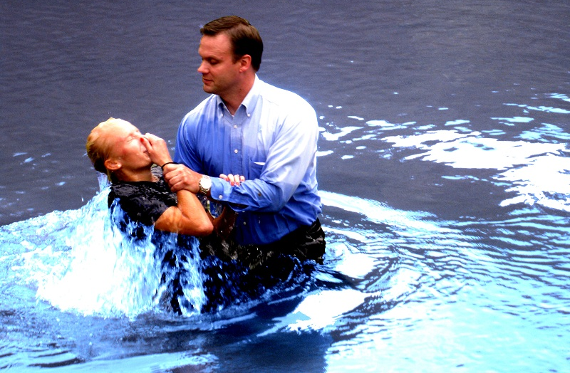
Romans 6:4—⁴ We were therefore buried with him through baptism into death in order that, just as Christ was raised from the dead through the glory of the Father, we too may live a new life.

